Slide 1


Computer Networks
INTELLIGENT NETWORK HEALTH ANALYZER
Group Members:
  Muhammad Ali - 241499
  Muhammad Talha - 241547
  Haseeb Ahsan - 241577
Instructor: Ma’am Laraib Javed

Slide 2











) INTRODUCTION
Modern applications require stable and fast networks
Poor networks cause:
O
High Latency & Jitter
O
Packet Delays in Gaming
O
DNS Resolution Errors
✅ Our project automates the measurement of these variables into a single health score.

Slide 3
) CORE OBJECTIVES
Latency
Precise measurement of Round Trip Time(RTT) for data packets across TCP.
Jitter
Analysis of delay variation to determine connection stability over time.
DNS Health
Validation of hostname resolution to ensure address translation is optimal.
Scoring
Generating a weighted 0- 100 health index for simplified analysis.

Slide 4
) TECHNICAL STACK
Category | Technology | Role in Project
Language | Python 3.x | Core logic and backend processing
Networking | Socket Library | TCP connection testing & timing
UI Framework | Tkinter | Graphical User Interface implementation
Analytics | Statistics/Time | Mathematical calculations for Jitter & Latency

Slide 5

) SYSTEM ARCHITECTURE
User Input
DNS Resolution
TCP Testing
Health Score

Slide 6
) BACKEND MECHANICS
Step 1: The domain (e.g., googIe.com) is converted to an IP via socket . gethostbyname().
Step 2: A TCP socket attempts a connection to measure RTT.
Step 3: Multiple samples are collected to calculate the average and deviation.
Step 4: Jitter is derived from the variance in these samples.
Step 5: A normalization algorithm generates the final Health Score.

Slide 7



) PRIMARY METRICS
Defining Network Quality
Latency: Measured in milliseconds (ms), representing the round-trip delay.
Jitter: The variation in latency; high jitter indicates congestion or interference.
Max Health Score
DNS Status: A binarycheck for domain accessibility.

Slide 8
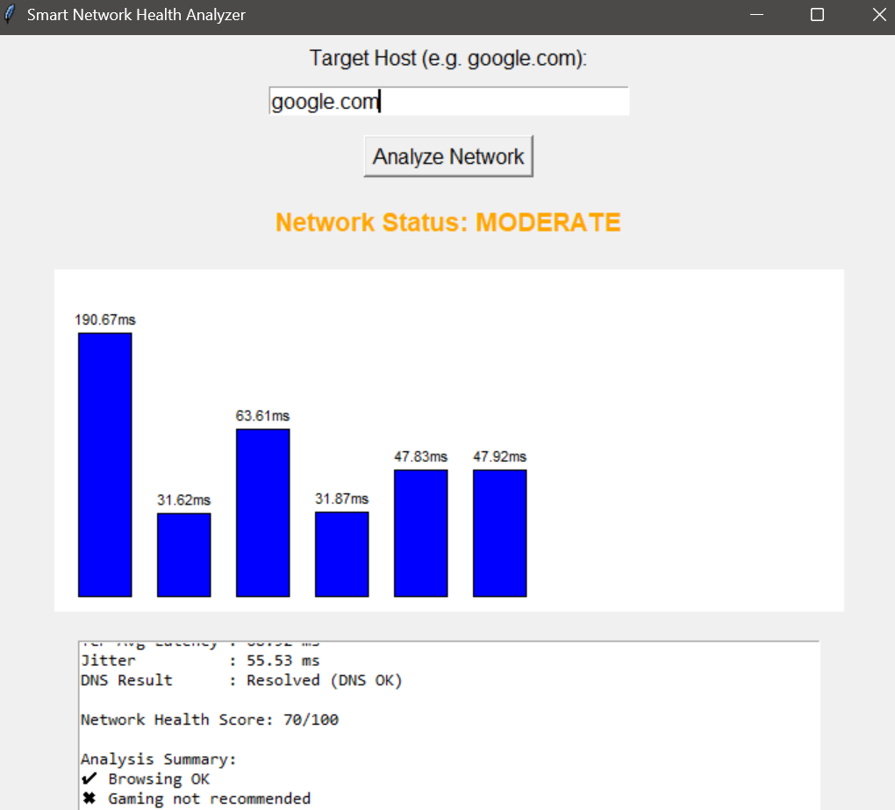
) VISUAL RESULTS
User Dashboard
The analyzer provides a clean GUI showing live metrics. It intelligently classifies the network for specific use cases:
Gaming Recommendations
Streaming Performance
General Browsing

Slide 9
) SAMPLE COMPARISONS
Poor Network Example
High latency and jitter
Health Score below 40
✖ Poor network quality
Good Network Example
TCP Avg Latency: ~58 ms
Jitter: ~21 ms
DNS: OK
Health Score: 85/100
✔ Gaming, Streaming, Browsing OK

Slide 10






) PROJECT APPLICATIONS
IT Support
Remote Work
E-Sports
Network troubleshooting
Internet performance analysis
Ensuring connectivity for video calls.
Pre-match latency and jitter checks.

Slide 11
) PROS & CONS
Advantages
Simple and user-friendly GUI allows non-technical users to analyze their connection.
Provides real-time metrics with zero setup time.
Limitations
Does not perform deep packet inspection or traffic capture.
Results are dependent on existing internet stability during probe time.

Slide 12

) FUTURE ENHANCEMENTS
Version 2.0 Goals
••}- Packet Loss Measurement
••}- Traceroute Visualization
-{- PDF Report Exporting
••}- Cross-platform Support

Slide 13
Project Conclusion
We have successfully bridged the gap between technical networking metrics and actionable user feedback, providing a robust platform for real-time connectivity analysis.

Slide 14
Questions?
Thank you for your time and attention.

