Slide 1
Chapter 2: Statistical Learning
Presented by:
Talha
Areeba
Zaupash
Notes:
AOA my name is Talha Mahmood today i am going to present you ch2 statistical learning of the given book introduction to statistical learning with application in R. My group members are areeba and zaupash.

Slide 2
Statistical Learning: An Introduction
What is statistical learning?
Goal of statistical learning
Modeling relationships
Predicting outputs
Notes:
To begin with i give you the introduction of statistical learning. So what is statistical learning? statistical learning is a set of tools for modeling and understanding complex datasets.
What is it’s goal? its goal is to model the relationship between input variables (predictors) and an output variable (response) and to predict the output variable based on the input variables.
For better understanding i give you an example

Slide 3
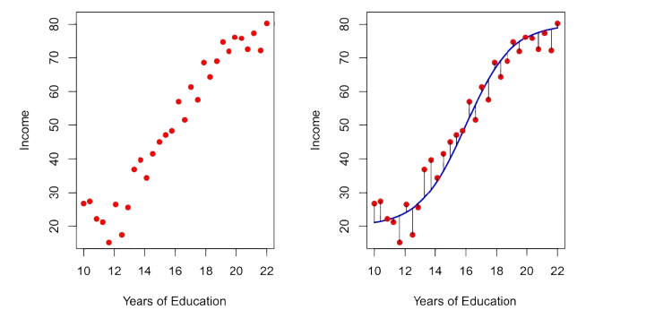
Example: Income Data
Observations
True Relationship
Error
Figure 1: The Income data set
Notes:
Consider an income data where we have years of education of person as an input variable and income as an output variable. so here statistical learning will help us to understand the true relationship b/w years of education and income and can also predict the income based on provided years of education.
here as you cans see the blue curve represents relationship between income and years of education and it also predict income using years of education.
The black lines represent the error associated with each observation.
For drawing the blue curve we have to estimate f so what are the reasons behind estimating f i answer in next slide.

Slide 4
Why Estimate f?
Reasons
Prediction
Inference
Example
Income data
Customer purchase data
Notes:
there are two primary reasons why we estimate f, first one is prediction
We estimate f when we have to make predictions for y(the output) here we are not interested in the implementation of f which is unknown and referred as black box
Second main reason behind estimating f is inference we estimate f when we need to understand the relationship b/w X and Y here we need to know the exact form of f, not just a black box prediction.
Now i give you an example of each one of them . Consider the income data in previous slide in it out goal is to predict the income based on the provided years of education we are not interested in the association years of education with income. it is an example of prediction.
Consider another example of customer purchase data which involves modeling the brand of a product that a customer might purchase based on the variables such as price, store location, discoupurchase of product. It is an nt levels, competition price, here we are interested in answering questions such as which predictor variables contribute to purchase or what effect price has on example of inference.
So we answered why we estimate f but the next question comes in mind how to do it i discuss that in next slide

Slide 5
How Do We Estimate f?
Using statistical learning method
Parametric or non parametric
Pros and Cons
Notes:
we estimate f using a statistical learning method. There are two such methods one is parametric and other is non parametric.
In parametric methods we assume a specific form for f (for example we choose a linear model). It is easier to estimate but might not capture complex relationships.
In non-Parametric methods we don't make assumptions about functional form of f instead we seek an estimate of f that gets as close to the data points as possible without being too rough. it is more flexible but require more data and can overfit
I give the example of the two methods in next slide

Slide 6
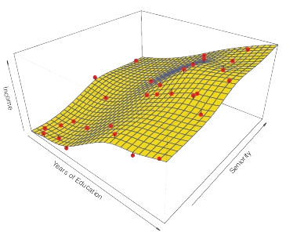
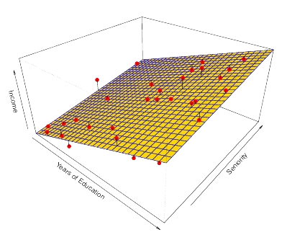
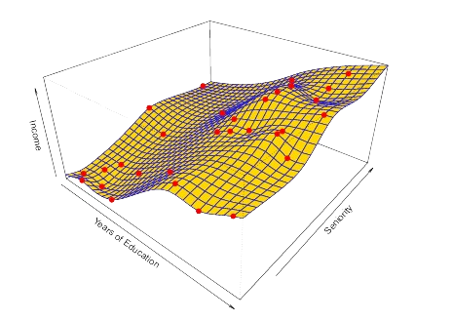
Parametric and Non-Parametric Examples
Observations
True Relationship
Observations
Smooth thin-plate spline fit
Figure 3: A smooth thin-plate that represents true relationship in Income data
Observations
Least squares
fit
Figure 2: A linear model fit by least squares to the Income data
Figure 4: A smooth thin-plate spline fit to the Income data
Notes:
Here is the example graphs of the methods
Middle graph is showing true fit ot true f
first graph is an example of parametric method in graph we can see that the linear fit is not quite right: the true f has some curvature that is not captured in the linear fit. However, the linear fit still appears to do a reasonable job of capturing the positive relationship between years of education and income,as well as the slightly less positive relationship between seniority and income
Second graph is the example of non parametric method second graph shows the thin-plate spline fit using a lower level of smoothness, allowing for a rougher fit. The resulting estimate fits the observed data perfectly! However, the spline fit is far more variable than the true function f. This is an example of overfitting the data

Slide 7
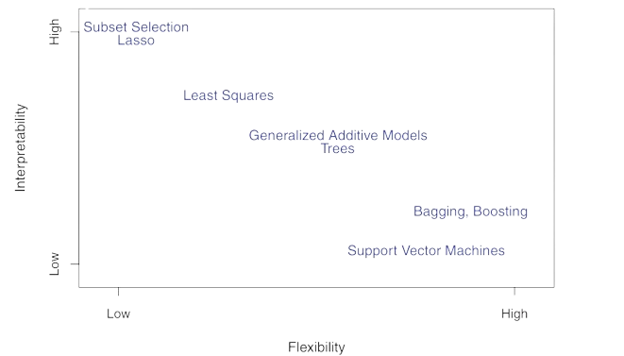
Trade-off Between Flexibility and Interpretability
Figure 5: A representation of the tradeoff between flexibility and interpretability, using different statistical learning methods
Notes:
The choice of model depends on the specific goals of the analysis. If understanding the relationship between predictors is important, a simpler model might be better. If prediction accuracy is the primary goal, a more flexible model might be considered, but overfitting should be carefully managed.

Slide 8
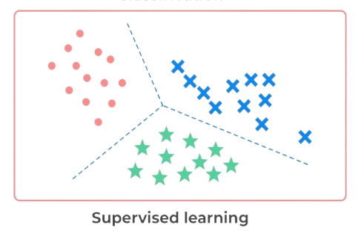
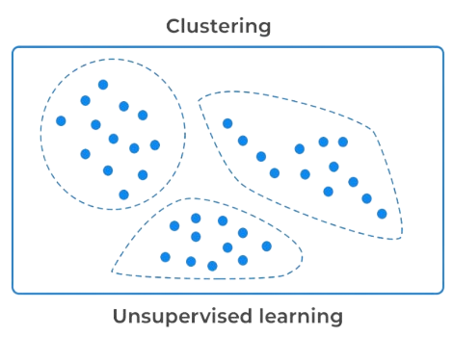
Supervised VS Unsupervised Learning
Supervised Learning
Unsupervised Learning
Predicts outputs from labeled inputs
Identifies hidden structures without labeled outputs
Figure 6: Supervised learning
Figure 7: Unsupervised learning
Notes:
Supervised learning aims to predict an outcome based on known data, such as using past trends to forecast future stock prices. In contrast, unsupervised learning looks for hidden structures or patterns when we don't have labeled responses, like identifying customer segments from their shopping habits."

Slide 9
Regression VS Classification
Regression
Classification
Quantitative response (e.g., age, income)
Example: Linear Regression
Categorical response (e.g., gender, diagnosis)
Example: Logistic Regression

Slide 10
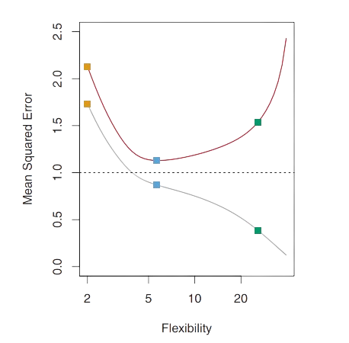
Measuring the Quality of Fit
Training MSE
MSE
Testing curve
Training curve
Linear regression
Smoothing splines
Smoothing splines
Testing MSE
Figure 8: MSE vs Flexibility graph
Notes:
"We assess model performance using metrics like MSE. While training MSE shows how well the model fits existing data, we care more about the test MSE, which tells us how well the model performs on unseen data. Overfitting is a risk when a model is too complex and captures random noise rather than true patterns."

Slide 11
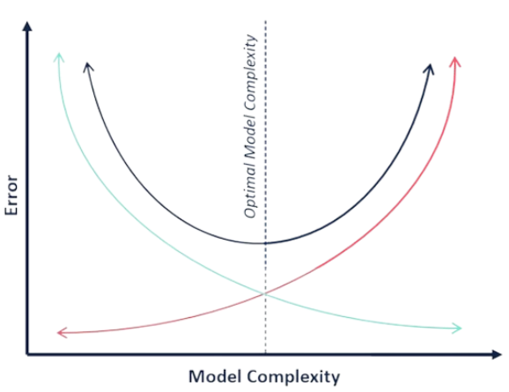
Bias-Variance Trade Off
Total Error
Bias
Variance
Optimal Model Complexity
Bias
Variance
Figure 9: Bias-Variance Trade Off graph
Notes:
One of the most important concepts in statistical learning is the bias-variance trade-off. Think of it like this: a model with high bias makes strong assumptions about the data. It tries to simplify things too much, which can cause it to miss important patterns. This leads to underfitting—where the model doesn’t capture the complexity of the data.
On the other hand, a model with high variance focuses too much on the details in the training data, even picking up on random noise or minor fluctuations. This causes overfitting—where the model performs well on the training data but struggles to generalize to new data.
The goal is to find the spot where bias and variance are balanced, so the model performs well not only on the training data but also on new, unseen data.

Slide 12
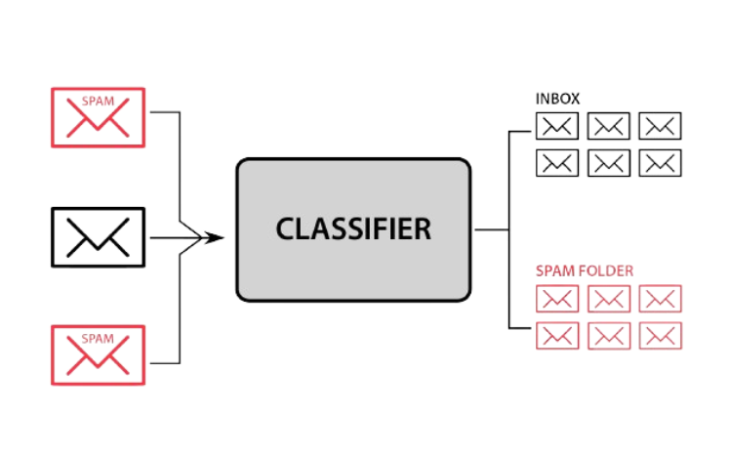
Classification Setting
Classification: predicting categories
Figure 10: Spam mail classification
Notes:
In classification, we aim to predict a category or class for each data point. For example, determining whether an email is spam or not is a classification problem. The model is trained on existing data, and we assess its accuracy by checking how often it correctly predicts the class, both on training data and, more importantly, on new data.

Slide 13
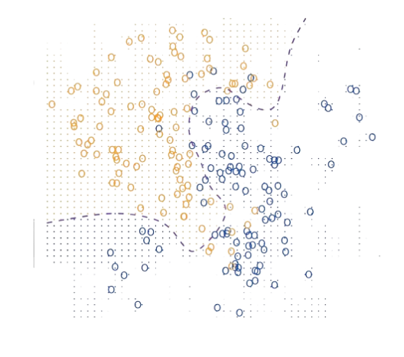
Bayes Classifier
It uses probabilistic approach
Class A
Class B
Figure 11: Bayes classification of Class A and B
Notes:
The Bayes classifier uses probabilities to make the best possible prediction for a new data point.
Let’s picture a dataset with two categories—class A and class B. The Bayes classifier would draw an ideal decision boundary between them. On one side of the boundary, the points are classified as orange, and on the other side, they’re classified as blue. This decision boundary is based on which class is more likely.

Slide 14
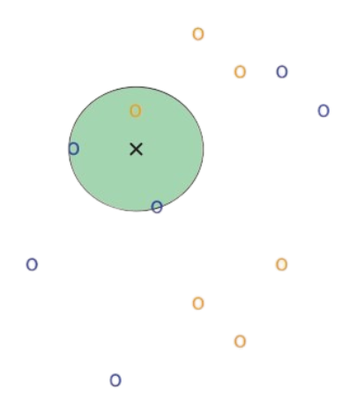
K-Nearest Neighbors (KNN)
Classifies new points by finding their K nearest neighbors
Class A
Class B
x New point
K = 3
Figure 12: KNN approach for new data point with K=3
Notes:
The new point is assigned to the most common class among its neighbors.
It classifies a new point by looking at its K nearest neighbors in the training data.
The new point is assigned to the class that most of its neighbors belong to.
Here’s how it works: when you get a new data point, KNN looks at the closest points in the training data, called its 'neighbors.' It then classifies the new point based on what most of its neighbors are—whether they are class A or class B.

Slide 15
Conclusion
Statistical learning helps with prediction and inference
It balances accuracy and interpretability
Key concepts: bias-variance trade-off, model assessment
Notes:
In conclusion, statistical learning is a powerful tool for making predictions and gaining insights from data. It’s all about balancing accuracy and interpretability and understanding key concepts like the bias-variance trade-off. In future chapters, we’ll explore specific models and techniques in more depth. Thank you for your attention, we can move to questions now.

