Slide 1
Chapter # 03: Linear Regression
Mausab Bin Umair
Talha Mahmood
Muhammad Tahir

Slide 2
Table of Contents
Simple Linear Regression
Multiple Linear Regression
Considerations in Regression Model
The Marketing Plan
Linear regression vs KNN

Slide 3
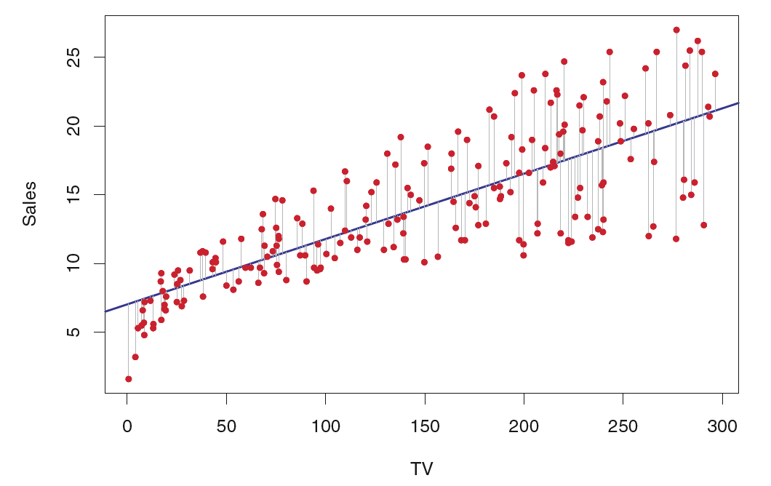
Simple Linear Regression
Predict y based on x
Linear equation y = β0 + β1(x) + ϵ

Slide 4
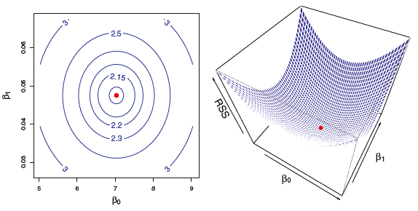
Estimating the Coefficients
Coefficients β0​ and β1
Ordinary Least Squares
Minimizes sum of squared differences
Best fitting line to predict y based on x

Slide 5
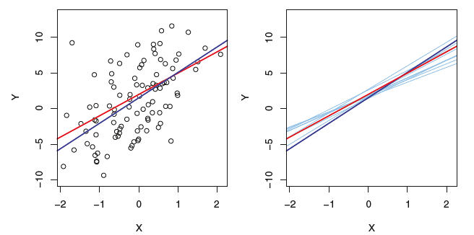
Assessing the Accuracy of Coefficients
Calculate standard error
SE < Confident estimate
SE > Less confident
T-statistic
Large value x significant effect
Small value x not significant effect
P-value
Low p-value < 0.05
Reject null hypothesis
Vice versa

Slide 6
Assessing the Model Accuracy
R-squared
Proportion of variance explained by the model
Residual Standard Error
Average deviation of observed values
High R-squared and low RSE
Better model fit

Slide 7
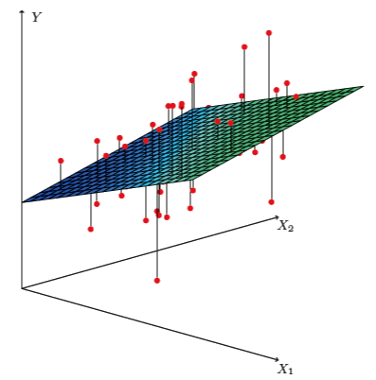
Multiple Linear Regression
Involve multiple predictors
Equation
Y = β0​ + β1(​x1​) + β2​(x2​) + ⋯ + βp(​xp) ​+ ϵ

Slide 8
Estimating Coefficients in Multiple Regression
Ordinary least squares
T-test & p-value
Test significance of each predictor
​Measures each predictor effect

Slide 9
Some Important Questions
Is there a relationship between the response and predictors?
Which predictors are important?
How well does the model fit the data?
How to make predictions and assess their accuracy?
Notes:
Question 1: Relationship Between Response and Predictors
Explain the null and alternative hypotheses.
Introduce the F-statistic and its interpretation.
Discuss the p-value and its role in decision-making.
Mention the limitations of the F-statistic for large p.
Question 2: Deciding on Important Variables
Introduce variable selection techniques.
Explain forward selection, backward selection, and mixed selection.
Discuss the challenges of variable selection for large p.
Mention alternative model selection criteria (Mallow's Cp, AIC, BIC, adjusted R2).
Question 3: Model Fit
Introduce RSE and R2 as measures of model fit.
Explain the interpretation of R2 and its limitations.
Discuss the importance of graphical analysis (e.g., residual plots).
Question 4: Predictions
Explain how to make predictions using the fitted model.
Discuss the types of uncertainty associated with predictions:
Coefficient estimates
Model bias
Random error
Introduce confidence intervals and prediction intervals

Slide 10
Other Considerations in the Regression Model
How to incorporate qualitative predictors into regression models.
Dummy variables and their coding.
Examples with two and more levels of qualitative predictors.
Notes:
Challenge: Representing categorical data in a numerical format suitable for linear regression
Solution: Dummy variables

Slide 11


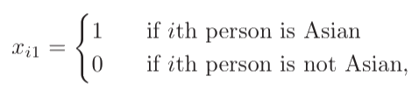
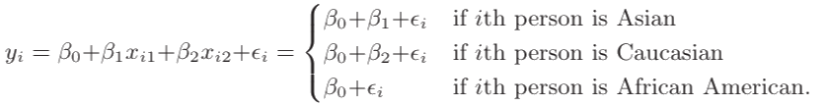

Example

Slide 12
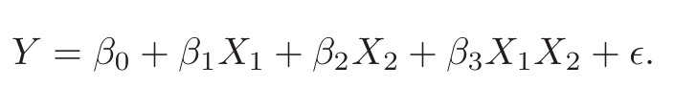
Extensions of the Linear Model
Limitations of the standard linear model (additive and linear assumptions).
Removing the Additive Assumption
Removing the linear assumption
Notes:
imitations of the standard linear model: Assumes an additive and linear relationship between predictors and response
The additive assumption means that the effect of changes in a predictor Xj on the response Y is independent of the values of the other predictors
Need for extensions: To handle more complex relationships in real-world data
Removing the Additive Assumptions: introduce an interaction term that captures the effect of one predictor on the value of another predictor
Removing linear assumption: we include polynomial terms

Slide 13
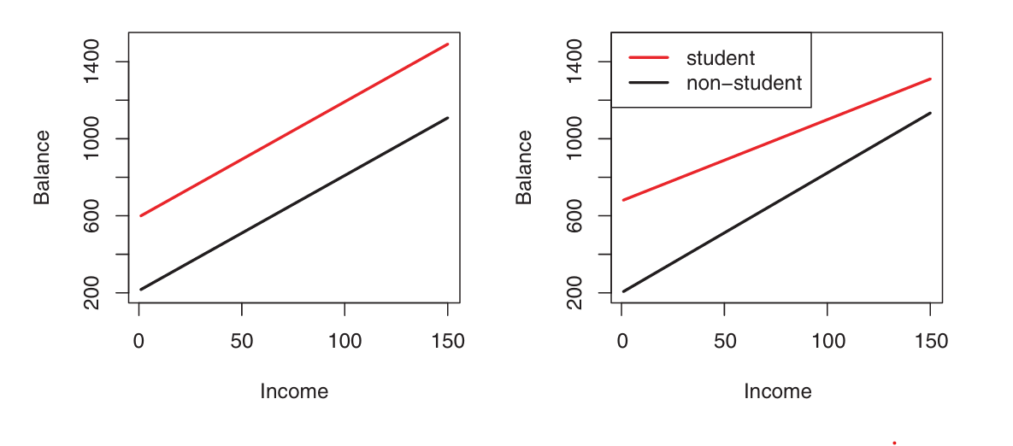
Example of Removing Additive Assumption
Figure 1: Graphs showing effect of additive assumption on prediction

Slide 14
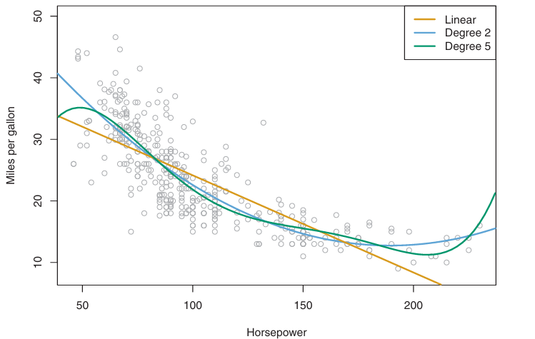
Example of Removing Linear Assumption
Figure 1: Graph showing effect of linear model and non-linear model on prediction

Slide 15
Potential Problems
Data Non-Linearity
Correlated Error Terms
Non-Constant Error Variance
Outliers and High Leverage

Slide 16
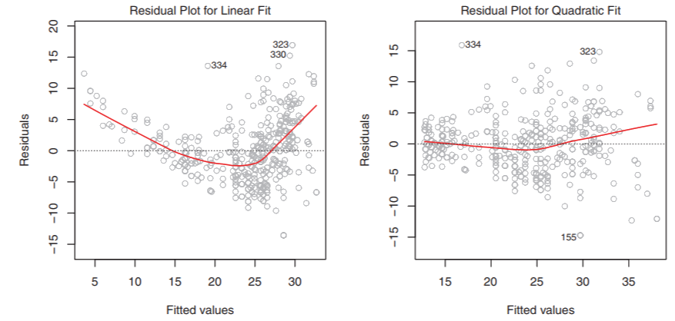
Detecting and Fixing Issues
Check Residual Plots
Handle Non-Linearity
Fix Correlated Errors
Collinearity

Slide 17
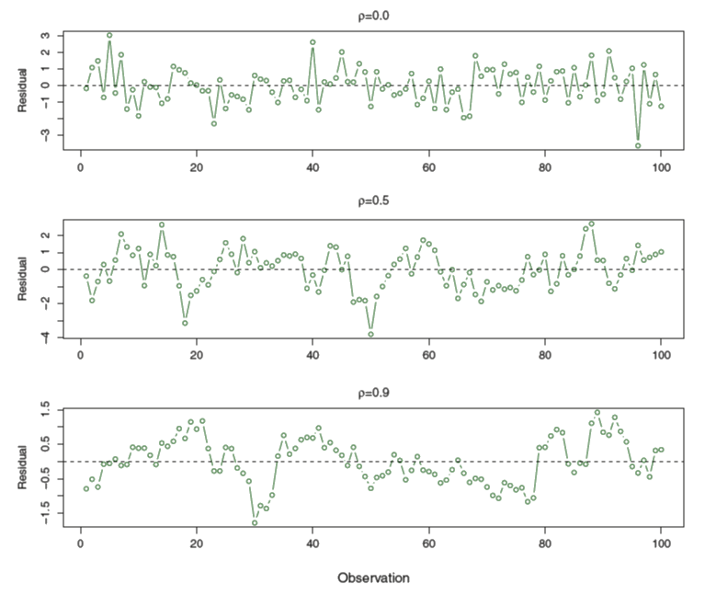
Correlated Error Terms

Slide 18
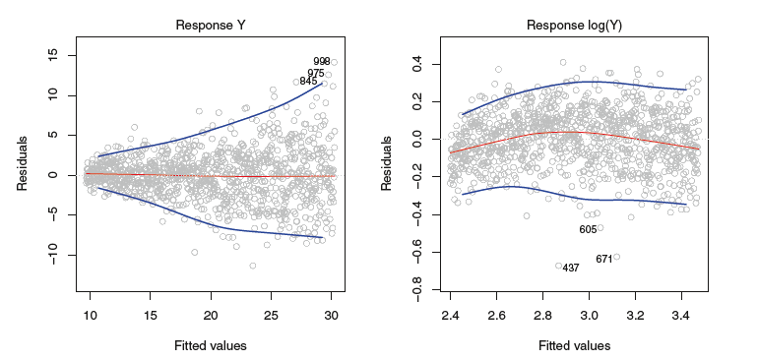
Non-Constant Error Variance

Slide 19
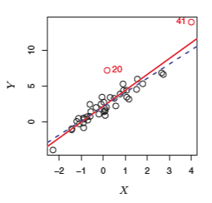
Outliers and High Leverage

Slide 20
Marketing Plan Insights
Ads Spend and Sales
Key Contributing Media
TV and Radio Impact
Interaction Effect Exists

Slide 21
Comparison
Linear Regression
KNN
Parametric
Linear Data
High Bias, Low Variance
High Dimensionality
Non-Parametric
Non-Linear
Low Bias, High Variance
Complex Patterns

Slide 22
Conclusion
Relationship Understanding
Expands Analysis Scope
Practical Tool

