Slide 1
Classification
Presented By:
Muhammad Tahir
Talha Mahmood
Areeba Sultan

Slide 2
Contents
Introduction to Classification
Logistic Regression
Multiple Logistic Regression
Bayes Classifier
LDA, QDA and KNN

Slide 3
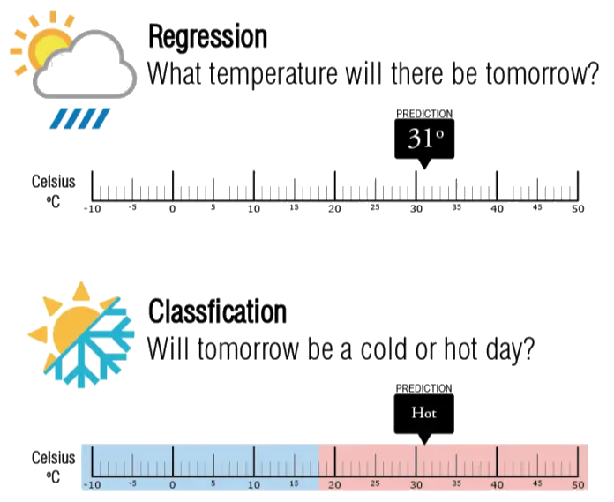
Introduction to Classification
Background
Comparison
Generally Binary Outcomes
For Example: Weather, Default
Figure 1: Regression vs Classification
Notes:
Background: In our previous discussions, we explored how linear regression predicts numerical values, like sales figures or salaries. However, for situations where we need to predict categories—such as whether someone will default on a loan or what the weather will be like—we turn to classification models.
Key Difference: Linear regression is suited for continuous outcomes, while classification predicts categorical responses. Linear regression estimates a function for a straight line, while classification calculates the probability of an observation falling into different classes.
Binary Outcomes: Many classification problems involve binary responses, such as a yes/no outcome or determining whether an image is a dog or a cat. For instance, when predicting weather conditions, we often convert the continuous variable of temperature into categories like "hot" or "cold.“
Transition: Since linear regression isn't always a good fit for categorical predictions, we use models like logistic regression, which is designed to handle binary outcomes more effectively. Let's now explore logistic regression in detail.
Background: As we have discussed in our previous presentations that linear regression model is used to predict the quantitative or numerical values. For example, the sales of product, salary of an employee and etc, but what if we have to predict whether a person would default or not, OR what will be the weather conditions for today? So, in these type of scenarios classification model helps us in prediction.
Comparison: Linear regression is for quantitative response, whereas classification is used to predict the qualitative or categorical response.
In linear regression We tend to estimate a function that defines an equation of straight line on other side in classification we estimate the probability of each data point or observation with given classes.
Generally Binary Outcomes: In most of the classification model we generally predict the binary response i.e, in the favor of YES or NO, or on the basis of images to predict whether it’s a Dog or a Cat.
For Example: As in the case of predicting weather conditions we can clearly see that we have transformed the temperature a quantitative value into categorical to predict the hotness or coldness of the weather.
Transition: So, in most cases linear regression doesn’t fit well, Classification is also indeed is required in such tasks.

Slide 4
Why Not Linear Regression?
Ordering Issue
Encoding Issue
Natural Ordering Scenario
Binary Response Scenario
Multiple Categories Issue
Notes:
"Linear regression is a powerful tool, but it’s not suitable for classification tasks—especially when dealing with qualitative responses. Here’s why:
First, linear regression implies an ordering on the outcomes. For example, if we’re trying to classify medical conditions like stroke, drug overdose, and epileptic seizure, linear regression assumes there’s a natural order among them, which isn’t true. It also assumes that the difference between stroke and drug overdose is the same as between drug overdose and seizure, which doesn't reflect reality.
Second, the encoding you choose—whether it’s 1 for stroke, 2 for overdose, or 3 for seizure—can affect the model’s predictions. If we change the coding, we get completely different models, meaning the results are arbitrary and unreliable.
However, linear regression can work when there’s a natural ordering between outcomes, such as classifying conditions as mild, moderate, or severe. In these cases, assigning values like 1, 2, and 3 might make sense.
For binary responses—like predicting stroke or drug overdose—we can use dummy coding, where stroke is 0 and overdose is 1. Linear regression will work, but it may sometimes produce predictions outside the [0, 1] range, which makes interpreting them as probabilities problematic.
Finally, when dealing with more than two categories, dummy coding doesn’t extend well, making it even less suitable for multi-class problems.
For these reasons, classification methods, are more appropriate for qualitative responses with multiple categories."

Slide 5
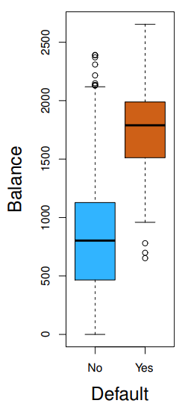
Logistic Regression
Binary Decisions
Probabilities
Likelihood of an Event
Uses Log-Odds
Non-Default
Default
Figure 2: Box Plot of Balance of Default and Non Default Groups
Notes:
Binary Decisions: Logistic regression predicts binary outcomes like "yes" or "no. It assigns probabilities to each category, determining which one is more likely. This is useful when decisions need to be made between two options, such as whether a loan will be approved or not.
Probabilities: Logistic regression outputs probabilities instead of exact values. It calculates the likelihood that an observation belongs to a particular category. This helps in cases where uncertainty must be managed, giving clear, interpretable results.
Likelihood Of An Event: The model predicts how likely an event is to occur. For this purpose it uses log-odds to express probabilities. This ensures predictions are based on the strength of each variable, improving decision-making.
Image Explanation: In the image we can clearly see that the person having credit card balance in between 1500 to 2000 are likely to default and the Bank can make decision to whom they can approve the loan.
Transition: Now that we understand how logistic regression works with binary decisions, let's expand it to understand in predicting outcome.

Slide 6
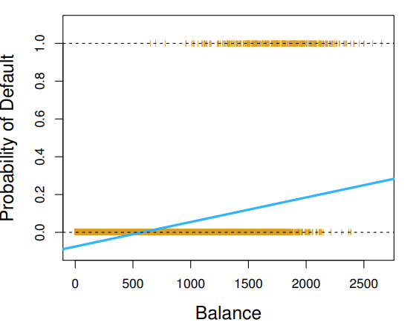
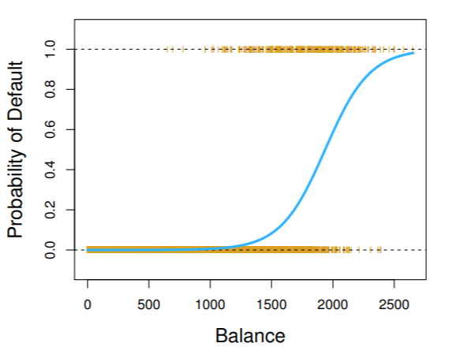
Predicting Outcomes
Estimates via Maximum Likelihood
Simple Interpretation
Clear Decision-Making
Estimated Probability of Default
0/1 Values Coded for Default
Figure 3: Estimated Probabilities of Default Using Linear Regression and Logistic Regression
Notes:
Estimates via Maximum Likelihood: Logistic regression estimates its parameters using maximum likelihood. This method finds the parameters that maximize the probability of observing the given data. It ensures that the model fits the data as accurately as possible, leading to reliable predictions.
Simple interpretation: Likelihood of event: The model is easy to interpret because it outputs probabilities. By translating data into probabilities, the results are straightforward to understand. This simplicity makes logistic regression a go-to method for practical decision-making.
Clear decision-making based on probabilities: Logistic regression provides a clear path for decision-making based on the probabilities. It classifies outcomes based on which probability is higher. This helps in scenarios where clear and binary decisions need to be made.
Transition: Let's take this further by adding more predictors to make our predictions even more realistic.

Slide 7
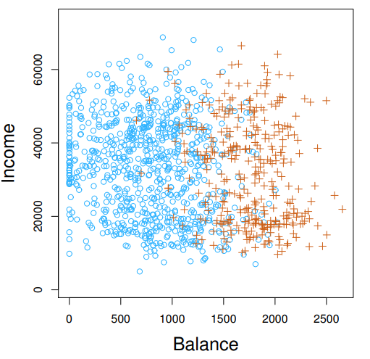
Multiple Logistic Regression
Adds Multiple Factors
Confounding Effect
Example
Non-Default
Default
Figure 4: Annual Income vs Monthly Credit Balances Graph
Notes:
Adds multiple factors into the model: Multiple logistic regression incorporates more variables into the model. It allows for more complex relationships by considering additional factors. This leads to more accurate and comprehensive predictions, better reflecting real-world complexity.
Image Explanation: In the given image now, we are classifying the person that would likely to default on the basis of two predictors; one is income and the other credit card balance.
More accurate, realistic predictions: This model improves accuracy by considering multiple predictors. It uses all relevant factors to predict the outcome more precisely. Real-life problems often involve multiple variables, and this model can handle that complexity.
Correlated variables handled effectively: Another benefit in using Multiple Logistic Regression is that this model effectively manages correlated variables. By accounting for the relationships between predictors, it improves the accuracy of predictions. In many practical scenarios, predictors are interrelated, and handling them properly is essential.
Transition: Now that we have seen how logistic regression manages multiple factors, let’s discuss some of its classifier.
Confounding effect: when another factor effects the predictor and response
For example: when we’re predicting the probability of defaulting , only using student status result shows student are more likely to default but when we use both student status and balance result shows students are less likely to default here balance is the confounding factor

Slide 8
Logistic Regression for >2 Response Classes
Extension of Regular Logistic Regression
Example
Notes:
Pitch: Thanks tahir so as tahir explained logistic regression is a well-known method for binary classification, but what if we have more than two classes? For example, in a medical scenario, we may need to classify patients into multiple categories like stroke, drug overdose, or seizure. Logistic regression can be extended to handle more than two response classes by finding probability of each class and then assign the observation to the class with the highest probability
Discriminant analysis is a popular alternative for multiple-class classification
In multiclass problem LR becomes complex because it requires estimating separate parameters for each class which can be computationally extensive
LDA is more interpretable because it is based on the assumption of normality and shared variance , its linear decision boundaries are easy to understand logistic regression while flexible produces decision boundaries based on log odds which can be harder to interpret when extended to multi class.
.
When the classes are well-separated, the parameter estimates for the logistic regression model are surprisingly unstable. Linear discriminant analysis does not suffer from this problem.
If n is small and the distribution of the predictors X is approximately normal in each of the classes, the linear discriminant model is again more stable than the logistic regression model
When the sample size is small and the predictor variables are approximately normally distributed, LDA tends to be more reliable than logistic regression. This is because LDA’s assumptions allow it to generalize better from limited data, as it estimates class boundaries based on the means and shared variance across the classes.
On the other hand logistic regression attempts to fit the data more precisely, even when the sample size is insufficient to reliably estimate the parameters.
Yes, logistic regression becomes unstable when classes are well-separated because it produces extreme parameter estimates to fit the data perfectly. This can lead to overfitting, where the model captures the random variations of the training data but may perform poorly on unseen data
LDA remains stable in this situation because it makes strong distributional assumptions—that the data for each class is normally distributed and that all classes share the same variance. LDA uses these assumptions to calculate the coefficients based on estimated means and shared variance from the normally distributed data.
Logistic regression equation for binary classification : P(Y=1∣X)=1 /1 + e−(β0​+β1​X1​+β2​X2​+⋯+βp​Xp​)
Logistic regression equation for multiple class classification :P(Y=k∣X)= ​eβ0k​+β1k​X1​+β2k​X2​+⋯+βpk​Xp​​ / ∑j=1 K ​eβ0j​+β1j​X1​+β2j​X2​+⋯+βpj​Xp

Slide 9
Using Bayes’ Theorem for Classification
Problem
Goal
Key Concepts:
Prior Probability
Class-Conditional Density
Posterior Probability
Notes:
Now lets discuss bayes theorem for classification
Problem: Classifying observations into K distinct classes.
Goal: Use Bayes' theorem to calculate the posterior probability of an observation belonging to a specific class.
Key Concepts:
Prior probability (πk): Proportion of observations that belong to k class in the training dataset
Class-conditional density (fk(x)): Probability that an observation belonging to class k has feature x.
Posterior probability (pk(x)): Probability that an observation with feature x belongs to class k
p k​ (x)= ∑ l=1K​ π l​ f l​ (x)π k​ f k​ (x)​
So posterior probability is calculated using prior probability and class conditional density so the class which has highest posterior probability value observation is assigned to that class

Slide 10
Linear Discriminant Analysis for p =1
Goal
Assumptions
Steps
Estimate Means and Common Variance
Calculate Discriminant Function
Assign to Highest Discriminant Class
Notes:
Next we discuss Linear discriminant analysis for classification with one predictor
Goal:
Classify observations into K classes using a single predictor.
Assumptions:
Observations within each class follow a normal distribution.
All classes have a common variance.
Steps:
Estimate class-specific means (μk) and common variance (σ^2).
Calculate discriminant functions for each class : δk(x) = x * μk / σ^2 - μk^2 / (2σ^2) + log(πk).
Assign an observation to the class with the highest discriminant function value

Slide 11
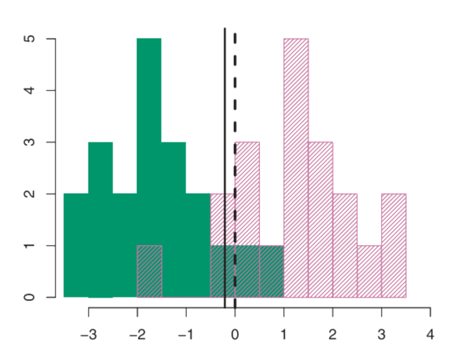
Estimated LDA Decision Boundary
Class 1
Class 2
– LDA Decision Boundary
- - Bayes Decision Boundary
Figure 5: Bayes Decision Boundary vs LDA Decision Boundary
Notes:
Now lets see estimated LDA decision boundary
There are 20 observations in each class and there is 50 percent prior probability that observation belong to class 1 and 50 percent prior probability that observation belong to class 2, as you can see that LDA decision boundary is slightly to the left of the optimal Bayes decision boundary. This indicates that LDA is performing pretty well on this data set
Since this is simulated data, we can generate a large number of test observations in order to compute the Bayes error rate and the LDA test error rate. These are 10.6%and11.1%, respectively. In other words, the LDA classifier’s error rate is only 0.5% above the smallest possible error rate

Slide 12
Linear Discriminant Analysis for Multiple Predictors
Multivariant Gaussian Distribution
Confusion Matrices
Performance Matrices
Sensitivity
Specificity
True Positive Rate
False Positive Rate
Notes:
The multivariate Gaussian distribution (also called multivariate normal distribution) is a generalization of the normal (bell-shaped) distribution to multiple variables. It’s used when you’re analyzing more than one predictor at the same time, like income and balance together.
A confusion matrix is a table that shows how well a classification model performed. It compares the predicted labels (outputs from the model) with the actual labels (what actually happened).
It contains
True Positive (TP): positive case correctly identified as positive
True Negative (TN): negative case correctly identified as negative
False Positive (FP): negative case incorrectly identified as positive
False Negative (FN): positive case incorrectly identified as negative
Performance metrics are used to measure how well your classification model works (Sensitivity): The percentage of positive cases correctly identified as positive Specificity: the percentage of negative cases correctly identified as negative
TPR: The rate at which the positive cases are correctly identified
FPR: The rate at which the negative cases are incorrectly identified

Slide 13
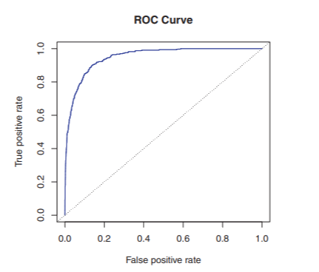
ROC Curve
Threshold
-- TPR = FPR
Notes:
Thresholds: In a binary classification model, you often predict a probability (like 0.7 or 0.3). You need a threshold to decide which class to assign (e.g., above 0.5 = positive, below 0.5 = negative). Different thresholds will lead to different combinations of TPR and FPR.
The ROC curve shows the performance of the model across all possible thresholds. This way, you can choose the best threshold depending on your needs (e.g., whether you want to minimize false positives or maximize true positives).
How to Read the ROC Curve:
Y-axis: True Positive Rate (TPR) — the higher the better.
X-axis: False Positive Rate (FPR) — the lower the better.
A perfect model: The curve will go straight up to the top left corner (TPR = 1, FPR = 0). This means the model correctly identifies all positives and doesn’t make any mistakes with the negatives.
A random model: The curve will be a diagonal line (TPR = FPR) because it's guessing randomly, so its performance is no better than chance.

Slide 14
Quadratic Discriminant Analysis (QDA)
What is QDA?
Bias-Variance Trade-off
Comparison with LDA
Notes:
QDA is a classification technique that assumes each class has its own covariance matrix, allowing for flexible decision boundaries.
Bias-Variance Trade-off:
High Flexibility: QDA can model complex boundaries, but may overfit with small datasets.
Use Cases: Prefer QDA with large datasets or when the assumption of a common covariance matrix is not valid.
Comparison with LDA:
LDA assumes a shared covariance matrix across classes, leading to simpler (linear) decision boundaries.

Slide 15
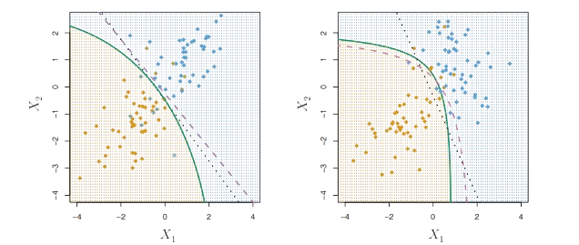
Comparison between LDA and QDA
Class 1 (points)
Class 2 (points)
Bayes (dotted line)
LDA ( dotted line)
QDA (solid line)
Figure 6: A Graph Illustrating Decision Boundaries: Linear (Bayes, LDA) on the Left and Non-Linear (QDA) on the Right.

Slide 16
Comparison of Classification Methods
Logistic Regression & LDA
K-Nearest Neighbors(KNN)
Quadratic Discriminant Analysis(QDA)
Notes:
When selecting a classification method, it's important to know the strengths of each one. Logistic Regression and Linear Discriminant Analysis (LDA) both create linear decision boundaries. LDA assumes the data follows a Gaussian distribution, which can be helpful in some cases, while Logistic Regression is more flexible and works better with non-Gaussian data. K-Nearest Neighbors (KNN) is a non-parametric method that makes no assumptions about the data's shape, making it great for non-linear boundaries, but it doesn’t provide insights into which predictors are important. Quadratic Discriminant Analysis (QDA) assumes a quadratic boundary, making it suitable for moderate non-linearity and effective with limited data. In summary, LDA and Logistic Regression are ideal for linear data, QDA works well for moderate non-linearity, and KNN is best for complex boundaries, but requires careful choice of smoothness. Choosing the right method based on your data is key to achieving the best results.

Slide 17
Conclusion
Importance of Logistic Regression
Binary Classification Problems
Bays Classifier & LDA
QDA & KNN
Notes:
Logistic Regression: Logistic regression is a key method for binary classification problems. It uses probabilities to provide clear, interpretable results. This makes it a versatile tool for many decision-making scenarios.
Predictive Accuracy: It calculates the likelihood of each outcome, enabling precise decisions. Accurate predictions are critical in making informed decisions in business, healthcare, and other fields.
Multiple Predictors: Logistic regression handles multiple predictors effectively. It models complex relationships between variables for better insights. Incorporating multiple factors leads to richer and more reliable predictions.

