Slide 1
Resampling Methods
Presented by:
Zaupash Tariq
Laraib Nadeem
Talha Mehmood

Slide 2
Table Of Contents
Cross-validation
Validation set approach
Leave-one-out method
K-fold method
Bias-variance trade-off
Classification tasks
Bootstrap

Slide 3
Resampling Methods
What is resampling methods?
Types
Cross-validation, bootstrap
Notes:
resampling methods are crucial for gaining deeper insights into our models beyond a single training fit. These techniques, like cross-validation and the bootstrap, allow us to repeatedly sample and refit models, revealing variability and performance metrics that strengthen our understanding and decision-making. Despite the potential computational demands, advances in technology have made resampling widely applicable. Cross-validation helps with model assessment and selection, while the bootstrap provides accuracy estimates for parameters. Together, these tools are invaluable for refining and evaluating statistical learning methods in real-world applications.

Slide 4
Cross-Validation
Test vs training error
Test error estimation
Hold-out methods
Notes:
Cross-validation is a key approach for evaluating model performance when a designated test set isn’t available. Our goal is to estimate the test error—the error from using a model on new, unseen data—because test error provides a real measure of model accuracy. Although we can easily calculate training error from the data we used to build the model, it often underestimates true test error.
To bridge this gap, cross-validation holds out a subset of data from training, allowing us to use part of our data to estimate test error directly. Whether we're working with regression or classification, these methods offer flexible and practical options for real-world testing.

Slide 5
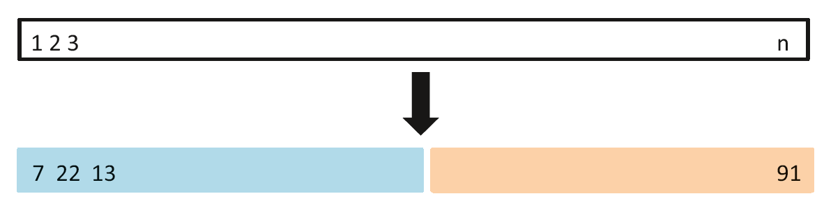
Validation Set Approach
Training and validation split
Calculate MSE
Drawbacks
Training set
Validation set
Figure 1: A schematic display of the validation set approach
Notes:
The validation set approach is a straightforward method to estimate test error by splitting data into training and validation sets. After fitting a model on the training data, we calculate the mean squared error (MSE) on the validation set as a test error estimate.
Although straightforward, the validation set approach has limitations. Since only a portion of the data is used for training, this method can overestimate the test error and results may vary depending on which data is in each set. To address these issues, upcoming sections explore cross-validation for more consistent and reliable test error estimates.

Slide 6
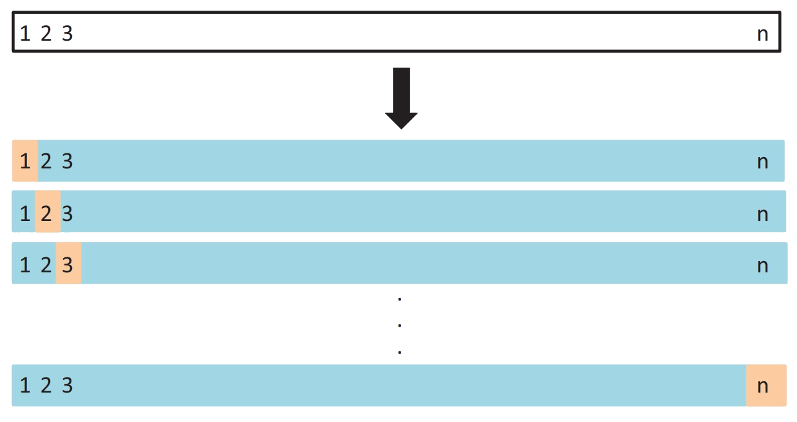
Leave-One-Out Cross-Validation
Training set
Validation set
1 observation: validation
Remaining data: training
Drawbacks
Figure 2: A schematic display of LOOCV
Notes:
Leave-One-Out Cross-Validation (LOOCV) enhances the validation approach by addressing its limitations. In LOOCV, each observation is individually used as a validation set, while the rest serve as the training set. This method offers lower bias, as nearly the entire dataset is used for each model fit, providing consistent results without the variability seen in random splits. However, LOOCV has some notable drawbacks. It is computationally intensive for large datasets, as the model needs to be fit for each observation. Additionally, LOOCV can lead to high variance in error estimates, as each test error is based on a single point rather than an average, making it sensitive to outliers and noisy data. Finally, LOOCV does not directly help manage the bias-variance trade-off, potentially favoring models that overfit.
Leave-One-Out Cross-Validation (LOOCV) enhances the validation approach by addressing its limitations. Here, each observation is individually used as a validation set while the rest serve as the training set. This method offers lower bias as nearly the entire dataset is used in each model fit, producing consistent results without the variability seen in random splits. However, LOOCV can be computationally intensive if the dataset is large, as the model needs to be fit for each observation.
LOOCV’s unbiased approach allows us to test multiple models while maintaining consistency across iterations, helping confirm the optimal model complexity for the data.

Slide 7
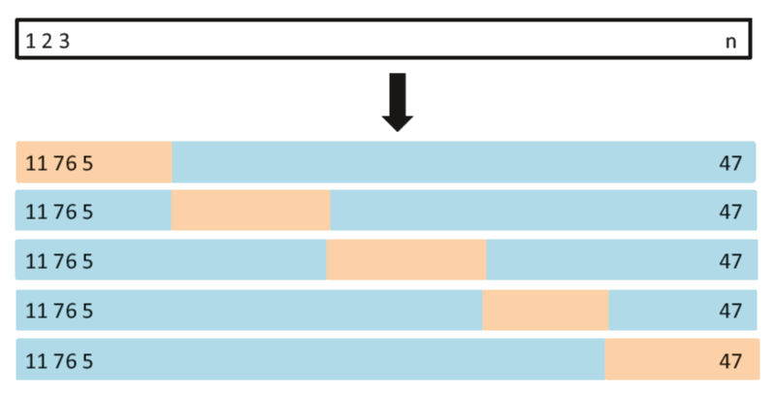
K-Fold Validation
Training set
Validation set
Better approach
Divide data into k-folds
Figure 3: A schematic display of 5-fold CV.
Notes:
So we have talked about leave one out CV method which is a special case of another better resampling method called K-fold validation. In this
Instead of leaving out one observation we divide the whole dataset in k subsets. In this diagram as you can see have divided the dataset with n
Observations into k folds.
Now lets talk about about the procedure behind it

Slide 8
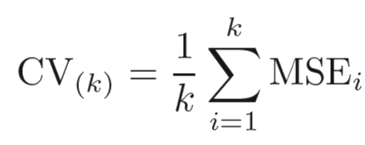
Procedure
Training and validation sets
MSE for each set
Notes:
After dividing the whole data into k subsets we use one fold as validation set and rest of the data for training set.
We train the data then test using validation set and get an MSE. If there are k fold there will be k MSE and then average them out to get the CV error

Slide 9
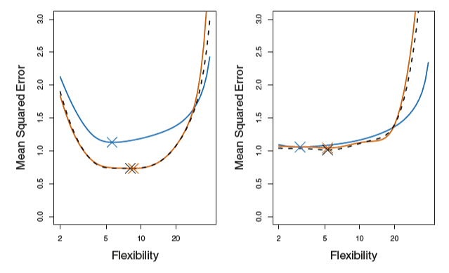
Comparing K-Fold MSE
K-fold error
Test error
LOOCV error
Close estimation
Right minimum point
Figure 4: True and estimated test MSE for the simulated data sets
Notes:
In this diagram we have calculated the K-fold CV and LOOCV error for a simulated data and then comparing it to the true MSE. As you can see in the first panel
The True MSE depicted by blue line is more than the two estimated errors.

Slide 10
Bias Variance Trade-Off
Low Bias
LOOCV
K= 10
High Bias
Validation set approach
K=5
Figure 5: Bias variance trade-off for validation methods

Slide 11
Cross-Validation On Classification Problems
Qualitative variables
Error metric: misclassified observations
Notes:
so far, we have discussed the use of cross-validation in the regression setting where the outcome Y is quantitative, and so have used MSE to quantify test error. But cross-validation can also be a very useful approach in the classification setting when Y is qualitative. In this setting, cross-validation works just as described earlier except that rather than using MSE to quantify test error, we instead use the number of misclassified observations
In next slide I give you an example of logistic regression fits

Slide 12
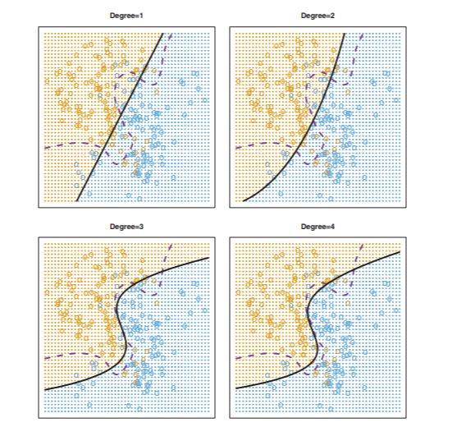
Logistic Regression For Classification
Bayes boundary (dotted)
Logistic boundary (solid)
Class 1
Class 2
Figure 6: Logistic regression fits on the two-dimensional classification data
Notes:
In the example you can see Logistic regression fits on the two-dimensional classification data. The Bayes decision boundary is represented using a purple dashed line. Estimated decision boundaries from linear, quadratic, cubic and 4th degree logistic regressions are displayed in black. As data is simulated so we know the test error rates and bayes decision boundary, the cubic logistic regression model is giving us lowest test error rate which is also visible in the figure that cubic model fit is the best fit and most close to optimal bayes decision boundary but In practice, for real data, the Bayes decision boundary and the test error rates are unknown. So how might we decide between the four logistic regression models displayed in Figure ? We can use cross-validation in order to make this decision which is shown in next slide

Slide 13
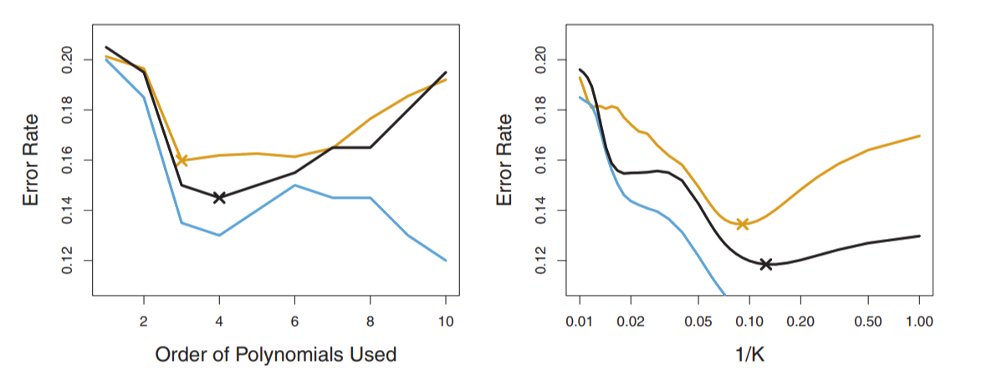
Model Selection With Cross-Validation
Test error
10-fold CV error
Training error
X Minimum error rate
Figure 7: Test, training, and 10-fold CV error of logistic regression and KNN
Notes:
In this figure we have calculated test, training, and 10-fold CV error of logistic regression and KNN in left panel as we have seen previously, the training error tends to decrease as the flexibility of the fit increases. (The figure indicates that though the training error rate doesn’t quite decrease monotonically, it tends to decrease on the whole as the model complexity increases.) In contrast, the test error displays a characteristic U-shape. The 10-fold CV error rate provides a pretty good approximation to the test error rate.
The right-hand panel of Figure displays the same three curves using the KNN approach, as a function of K again the training error rate declines as the method becomes more flexible, and so we see that the training error rate cannot be used to select the optimal value for K. Though the cross-validation error curve slightly underestimates the test error rate, it takes on a minimum very close to the best value for K
(K=10 for test and k=8 for CV)

Slide 14
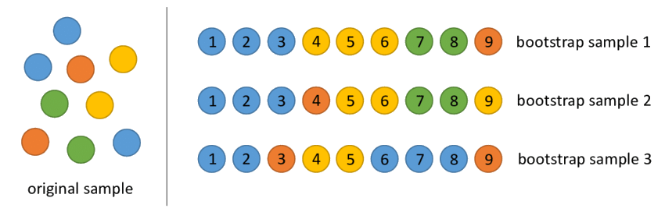
The Bootstrap
Estimate parameter uncertainty
Working
Figure 8: Bootstrap working
Notes:
Definition: A method to estimate the uncertainty of an estimator or statistical learning model.
Purpose: Helps measure the variability in sample estimates,
Working
Start with an original dataset consisting of n observations
Create multiple bootstrap samples from the original dataset. Each bootstrap sample is created by randomly selecting observations with replacement from the original dataset. This means that some observations may appear multiple times in a bootstrap sample, while others may not be included at all.

Slide 15
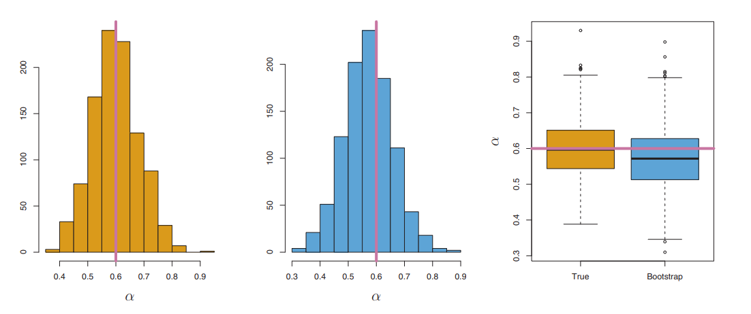
Bootstrap Results And Accuracy
True samples α
Bootstrap samples α
True value of α
Figure 9: Bootstrap samples vs true population samples
Notes:
In reality we cannot get random samples from true population so we have to use bootstrapping technique to generate samples
The example graph shows the results and accuracy of bootstrapping
In the example graph α represents the fraction of money that is allocated to the financial assets and goal is to minimizes the total risk (variance) of investments, as data is simulated we know that true value of alpha is 0.6
In the figure Left panel shows A histogram of the estimates of α obtained by generating 1,000 simulated data sets from the true population, Center panel shows A histogram of the estimates of α obtained from 1,000 bootstrap samples from a single data set and Right panel show boxplot of The estimates of α displayed in the left and center panels. In each panel, the pink line indicates the true value of α
As we can see bootstrap samples alpha estimates are close to random samples from true population alpha estimates and bootstrap average alpha estmate is close to true estimate

Slide 16
Conclusion
Different resampling methods
Validation and its types
Bias variance trade-off
Bootstrap

