Slide 1
Chapter8: Tree-Based Methods
Presented By:
Talha Mahmood
Muhammad Bilal
Areeba Sultan
Notes:
Assalam Alaikum Everyone! Today we are supposed to present Chapter 8 called Tree based methods

Slide 2
Table of Contents
Polynomial Regression
Regression Trees and Classification Trees
Trees vs Linear Models
Advantages and Disadvantages of Trees
Bagging, Random Forests and Boosting
Notes:
These are the table of contents that we will be covering in this presentation

Slide 3
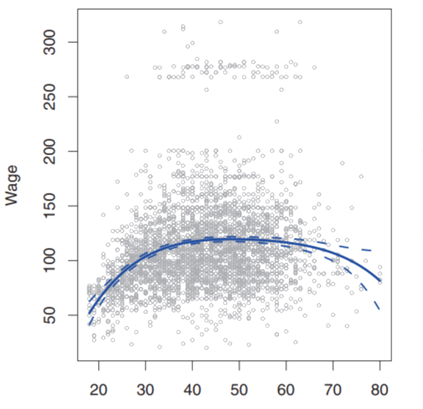
Polynomial Regression
Background
Definition
Flexibility
Bias-Variance Tradeoff
Polynomial Regression (degree 4) Graph
Notes:
Firstly I explain a additional toppic polynomial regression then I move towards main chapter
Background: Linear Regression assumes a linear relationship between the predictor and response it may not capture complex patterns in real-world data for that we use Polynomial regression
Definition:
Polynomial regression is a linear regression model with polynomial terms of the predictor variable.
Flexibility:
By increasing the degree of polynomial terms, we can fit increasingly complex curves
Bias –Variance Tradeoff:
We have to choose an appropriate degree for the polynomial terms lower degrees will lead towards high bias and higher degrees will lead towards high variance
In the example we have used a degree-4 polynomial to capture the nonlinear trend.
Nowe we move towards main chapter

Slide 4
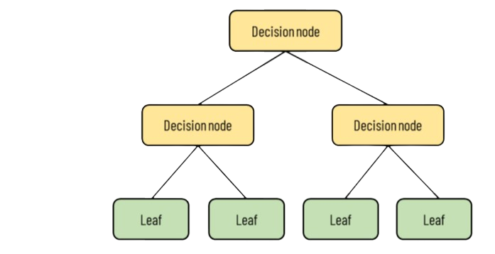
Decision Trees
Make decision
Manageable Sections
Figure 1: Decision Tree Graph
Notes:
Strating with decision trees so what are decision trees? Decision trees are a way to make decisions or predictions based on data by breaking it down into smaller, more manageable sections using a tree as show in figure
Decision trees can be applied to both regression and classification problems. We first consider regression problems

Slide 5
Regression Trees
Definition
Non Overlapping Regions
Mean Response Value
Notes:
Definition: A decision tree used for predicting a numerical response. Here Splits the predictor space into non-overlapping regions.
Makes predictions based on the mean response value within each region
Key Advantages:
Easy to interpret and visualize.
Can handle both numerical and categorical predictors.
Can capture complex nonlinear relationships.
Now I give you an example of regression tree

Slide 6
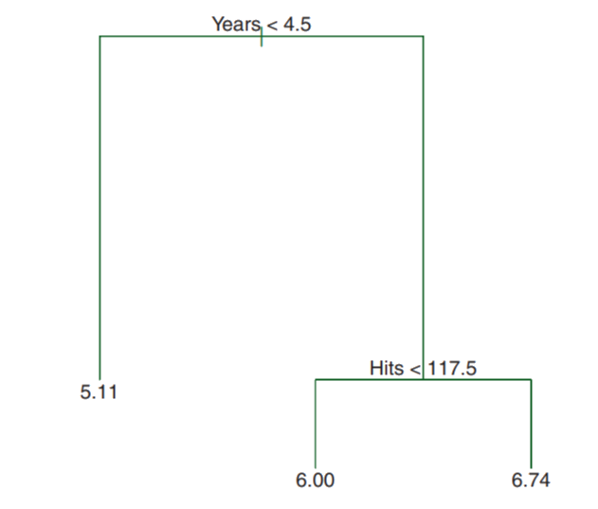
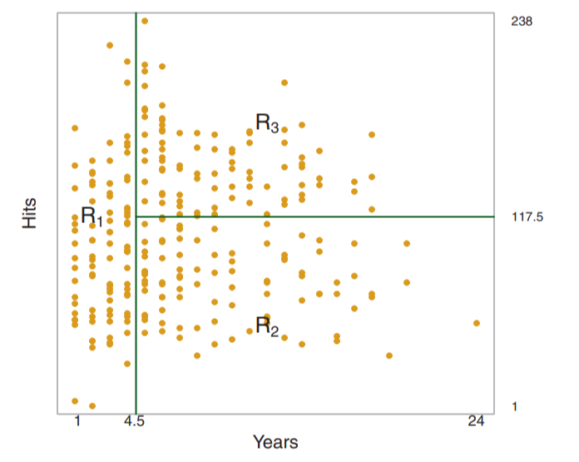
Regression Tree Example
Figure 3: Decision tree graph of predicting log salary of a basketball player in hitters dataset
Figure 4: Three region partition for hitters dataset from regression tree in figure 3
Notes:
two diagrams are related to predicting baseball player salaries using a regression tree based on the Hitters dataset.
In left diagram the decision tree is used to predict the log salary of a baseball player.
And in the right diagram the plot visualizes the data partitioned into three regions based on the splits in the tree.
We get following information from the two diagrams
Years is the most important predictor.
Players with fewer years tend to have lower salaries.
Among experienced players, players with more hits have greater salaries
Now we discuss rediction via Stratification(grouping) of Predictor Space

Slide 7
Prediction via Stratification of Predictor Space
Goal
Process:
Select a Predictor
Choose a Split Point
Split Data
Repeat
Notes:
Goal: Minimize the Residual Sum of Squares (RSS).
Process:
Select a Predictor: Choose the predictor that leads to the largest reduction in RSS.
Choose a Split Point: Determine the best cut-point for the selected predictor.
Split the Data: Divide the data into two subsets based on the split point.
Repeat: Recursively apply the splitting process to each subset until a stopping criterion is met.
Now we disuss tree prunnig concept
Stopping criteria: until no region contains more than five observations.
RSS value improvement to a certain threshold

Slide 8
Tree Pruning
Definition
Pruning Process:
Grow a Large Tree
Prune the Tree using α
Cost Complexity Criterion
Optimal Value of α
Notes:
Definition: Tree Pruning simplifies decision trees by removing branches that add little predictive value
Pruning Process
Start with a large tree and gradually prune it by introducing a tuning parameter, α.
For each value of α, remove branches in a way that minimizes the cost complexity criterion, which balances the tree’s complexity and fit to the data
Use cross-validation to choose the optimal value of α.
Now I would like to invite areeba to present next part which is classification trees
Cost Complexity Criterion is a measure used in tree pruning to balance the complexity of a decision tree with its fit to the training data. It's a trade-off between underfitting and overfitting.
Alpha is a tuning parameter its large value penalizes tree complexity, leading to a smaller, simpler tree.

Slide 9
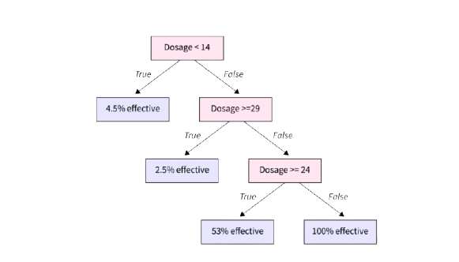
Classification Trees
Node Proportions
Purity Measures
Classification Error Method
Gini Index
Cross-Entropy
Figure 6: Classification tree
Notes:
Definition: Used for predicting categories instead of numerical values.
Prediction Method: Assigns the most common class in each terminal node.
Node Proportions: Shows confidence level in predictions.
Growing Trees: Utilizes recursive binary splitting, focusing on class separation.
Purity Measures:
Classification Error Rate: Simple but less sensitive.
Gini Index: Measures node purity; lower values indicate better classification.
Cross-Entropy: Similar to Gini, also indicates node purity.

Slide 10
Trees vs Linear Models
Different Approaches
Choosing the Right Model
Model Performance
Notes:
Different Approaches:
Linear Models: Assume a straight-line relationship.
Decision Trees: Partition data into segments, allowing for complex relationships.
Choosing the Right Model:
Use Linear Models for linear relationships.
Use Decision Trees for non-linear, complex data.
Model Performance: Assess using test error and cross-validation.

Slide 11
Advantages and Disadvantages of Trees
Advantages
Interpretability and Simplicity
Visualizable and Flexibility
Disadvantages
Overfitting and Instability
Accuracy

Slide 12
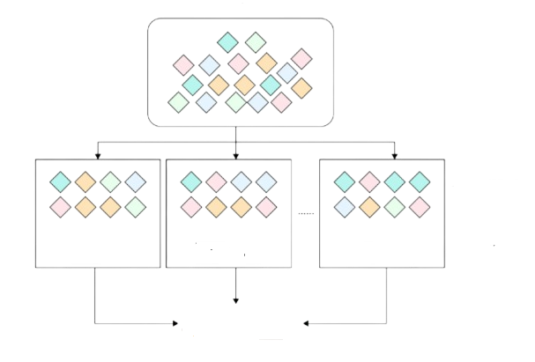
Bagging
Original Dataset
Multiple Bootstrapped Datasets
Averages Predictions For Stability
Low Variance, High Accuracy
Prediction
Figure 7: Bagging Process
Notes:
In the previous slides we understood how tree based methods suffer from low accuracy and overfitting. To address these limitation, we can use bagging. Bagging, is a technique that involves generating multiple bootstrapped datasets from the original training set. We use each of these datasets to train separate models, and then we average their predictions. This helps improve model performance by reducing variance, leading to high accuracy.

Slide 13
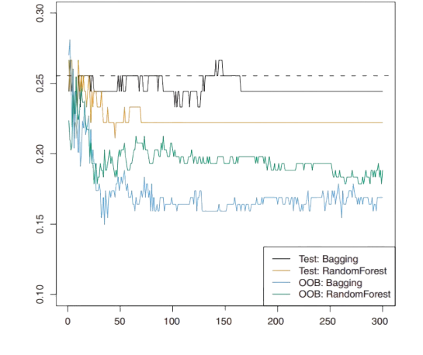
Out of Bag Error
Unused Sample Observation
Estimates Test Error
Variable Importance Measure
Importance Of Predictors
Error
Number of Trees
Figure 8: Graph showing different errors
Notes:
Bagging introduces a helpful evaluation metric known as Out-of-Bag Error. This error estimation method involves samples that were not used during the bootstrapping process. We use these observations to estimate the test error directly, without needing an additional test set. Bagging also provides insights into variable importance, which tells us how each predictor contributes to the model’s performance."

Slide 14
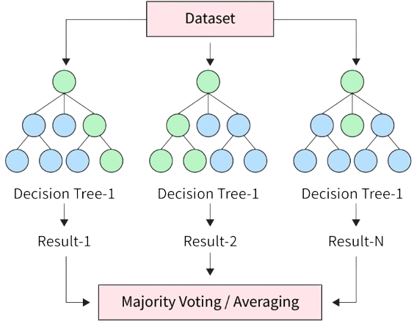
Random Forests
Random Predictor Subsets
Less Correlation Among Trees
Reduces Model Variability
Figure 9: Random Forest illustration
Notes:
Random Forests improve Bagging by introducing random predictor subsets. Rather than considering all predictors at each split, a random subset of predictors is chosen. This reduces correlation among trees, resulting in more accuracy for the model. Random Forests further reduce model variance, making them more robust and accurate.

Slide 15
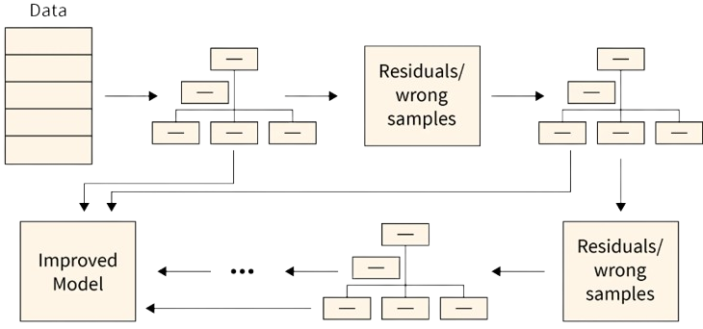
Boosting
Sequentially Grown Trees
Slow Learning Rate
Gradually Reduces Error
Figure 10: Boosting Process
Notes:
Now, let’s discuss Boosting. Boosting is different from Bagging and Random Forests. Instead of building trees independently, Boosting builds trees sequentially. Each new tree aims to correct errors made by the previous ones. The process uses a slow learning rate, meaning each tree contributes only a small amount to the overall model. This gradual, step-by-step improvement helps Boosting to minimize errors more effectively, especially in complex datasets.

Slide 16
Conclusion
Polynomial Regression
Regression Tree
Classification Tree
Comparing Tree-based Methods
Bagging And Random Forests
Boosting
Notes:
In conclusion, we’ve looked at several powerful tree-based methods. Polynomial Regression, Regression Trees, and Classification Trees each have their specific applications and advantages. methods like Bagging, Random Forests, and Boosting can enhance model stability, accuracy, and predictive power. Bagging and Random Forests work well to reduce variance. Together, these methods expand our toolkit for creating more accurate, reliable models."

