Slide 1
Project Scheduling
Network Optimization can be used as an aid in the scheduling of large complex projects that consist of many activities
A project is divided into a collection of work activities (for planning and control purposes) that must all be completed to accomplish the project

Slide 2
Project Scheduling
Identifying precedence relationships
Sequencing activities
Determining activity times & costs
Estimating material and worker requirements
Determining critical activities

Slide 3
Purposes of Project Scheduling
Shows the relationship of each activity to others and to the whole project
Identifies the precedence relationships among activities
Encourages the setting of realistic time and cost estimates for each activity
Helps make better use of people, money, and material resources by identifying critical bottlenecks in the project

Slide 4

Project Management Techniques
Gantt chart
Critical Path Method (CPM)
Program Evaluation and Review Technique (PERT)

Slide 5
Service For A Delta Jet
Passengers
Baggage
Fueling
Cargo and mail
Galley servicing
Lavatory servicing
Drinking water
Cabin cleaning
Cargo and mail
Flight services
Operating crew
Baggage
Passengers
Deplaning
Baggage claim
Container offload
Pumping
Engine injection water
Container offload
Main cabin door
Aft cabin door
Aft, center, forward
Loading
First-class section
Economy section
Container/bulk loading
Galley/cabin check
Receive passengers
Aircraft check
Loading
Boarding
0 15 30 45 60
Minutes

Slide 6
CPM & PERT
Network techniques
Developed in 1950’s
Consider precedence relationships and interdependencies
Each uses a different estimate of activity times
CPM: activity durations are known with certainty
PERT: not known with certainty

Slide 7
Steps CPM & PERT
Define the project and prepare the work breakdown structure
Develop relationships among the activities - decide which activities must precede and which must follow others
Draw the network connecting all of the activities

Slide 8
Six Steps CPM & PERT
Assign time and/or cost estimates to each activity
Compute the longest time path through the network – this is called the critical path
Use the network to help plan, schedule, monitor, and control the project

Slide 9
Questions CPM & PERT
Can Answer
When will the entire project be completed?
What are the critical activities or tasks in the project?
Which are the noncritical activities?
Is the project on schedule, behind schedule, or ahead of schedule? (due date!)

Slide 10
Questions CPM & PERT
Can Answer
Is the money spent equal to, less than, or greater than the budget?
Are there enough resources available to finish the project on time?
If the project must be finished in a shorter time, what is the way to accomplish this at least cost (crashing)?

Slide 11
Precedence Relationships and Networks
Activity j is a predecessor of activity k if activity j must be completed before activity k can begin
Project networks represent the precedence relationships between activities

Slide 12
A Comparison of AON and AOA Network Conventions
Activity on Activity Activity on
Node (AON) Meaning Arrow (AOA)
A comes before B, which comes before C
(a)
A
B
C
A
B
C
A
A
A and B must both be completed before C can start
(b)
C
C
B
B
B
B and C cannot begin until A is completed
B
(c)
A
A
C
C

Slide 13
A Comparison of AON and AOA Network Conventions
Activity on Activity Activity on
Node (AON) Meaning Arrow (AOA)
A
C
C and D cannot begin until A and B have both been completed
A
C
(d)
B
D
B
D
C cannot begin until both A and B are completed; D cannot begin until B is completed. A dummy activity is introduced in AOA
A
C
A
C
(e)
Dummy activity
B
D
B
D

Slide 14
A Comparison of AON and AOA Network Conventions
Activity on Activity Activity on
Node (AON) Meaning Arrow (AOA)
B and C cannot begin until A is completed. D cannot begin until both B and C are completed. A dummy activity is again introduced in AOA.
A
B
D
A
B
D
(f)
Dummy activity
C
C

Slide 15
AON Example
Milwaukee Paper Manufacturing's
Activities and Predecessors
Activity | Description | Immediate Predecessors
A | Build internal components | —
B | Modify roof and floor | —
C | Construct collection stack | A
D | Pour concrete and install frame | A, B
E | Build high-temperature burner | C
F | Install pollution control system | C
G | Install air pollution device | D, E
H | Inspect and test | F, G

Slide 16
AON Network for Milwaukee Paper
Activity | Immediate Predecessors
A | —
B | —
C | A
D | A, B
E | C
F | C
G | D, E
H | F, G
Activity A
(Build Internal Components)
A
Start
Activity B
(Modify Roof and Floor)
Start Activity
B

Slide 17
AON Network for Milwaukee Paper
Activity | Immediate Predecessors
A | —
B | —
C | A
D | A, B
E | C
F | C
G | D, E
H | F, G
Activity A Precedes Activity C
A
C
Start
B
D
Activities A and B Precede Activity D

Slide 18
AON Network for Milwaukee Paper
Activity | Immediate Predecessors
A | —
B | —
C | A
D | A, B
E | C
F | C
G | D, E
H | F, G
F
A
C
E
Start
H
B
D
G
Finish
Arrows Show Precedence Relationships

Slide 19
Determining the Project Schedule
Perform a Critical Path Analysis
The critical path is the longest path through the network
The critical path is the shortest time in which the project can be completed
Any delay in critical path activities delays the project
Critical path activities have no slack time

Slide 20
Determining the Project Schedule
Perform a Critical Path Analysis
Activity Description Time (weeks)
A Build internal components 2
B Modify roof and floor 3
C Construct collection stack 2
D Pour concrete and install frame 4
E Build high-temperature burner 4
F Install pollution control system 3
G Install air pollution device 5
H Inspect and test 2
Total Time (weeks) 25

Slide 21
AON Network for Milwaukee Paper
2
2
F
A
C
3
2
0
2
E
Start
H
4
0
5
3
4
2
B
D
G
Finish
Numbers show activity durations

Slide 22
Longest Paths
Given G=(N,A) with nonnegative lengths associated on arcs, special source node s, find the longest path from s to every other node in N.
Principle of optimality applies if no directed cycle of positive length
Project networks are acyclic!
Functional Equations
v[s]=0
v[k]=max {v[i]+c_{ik}} ∀k ∈N\{s}
i:(i,k)∈A
If there is no neighbor i leading to k, then the maximum is -∞
d[k]=preceeding node on the longest path from s to k

Slide 23
Determining the Project Schedule
Perform a Critical Path Analysis
Earliest start (ES) = earliest time at which an activity can start, assuming all predecessors have been completed
Earliest finish (EF) = earliest time at which an activity can be finished
Latest start (LS) = latest time at which an activity can start so as to not delay the completion time of the entire project
Latest finish (LF) = latest time by which an activity has to be finished so as to not delay the completion time of the entire project
Activity Description Time (weeks)
A Build internal components 2
B Modify roof and floor 3
C Construct collection stack 2
D Pour concrete and install frame 4
E Build high-temperature burner 4
F Install pollution control system 3
G Install air pollution device 5
H Inspect and test 2
Total Time (weeks) 25
Table 3.2

Slide 24
Forward Pass
Begin at starting event and work forward
Earliest Start Time Rule:
If an activity has only one immediate predecessor, its ES equals the EF of the predecessor
If an activity has multiple immediate predecessors, its ES is the maximum of all the EF values of its predecessors
ES = Max (EF of all immediate predecessors)

Slide 25
Forward Pass
Begin at starting event and work forward
Earliest Finish Time Rule:
The earliest finish time (EF) of an activity is the sum of its earliest start time (ES) and its activity time
EF = ES + Activity time

Slide 26
Early Schedules
ES[k]=length of the longest path from start to node k in
the AON project network
Project completion time
= minimum time to complete a project
= length of the longest path from start to end on AON

Slide 27
Computing an Early Schedule
(Forward Pass)
Step 1: Order the nodes lexicographically.
ES [start] = EF [start]= 0
Step 2: Terminate if the early start time of the end node has been fixed.
Otherwise, let p be the lowest number of an unprocessed node.
Step 3: Compute:
ES [p]= max{EF[i]: i is an immediate predecessor of p}
EF [p]= ES [p] + activity time (p)
d[p]= argmax of the maximum above
Return to Step 2

Slide 28
Early Schedule Computation
2
2
F
A
C
3
2
0
2
E
Start
H
4
0
5
3
4
2
B
D
G
Finish

Slide 29
Late Schedules
Assume there is a due date for the project
LS[k]=due date – length of longest path from node k to
node finish

Slide 30
Backward Pass
Begin with the last event and work backwards
Latest Finish Time Rule:
If an activity is an immediate predecessor for just a single activity, its LF equals the LS of the activity that immediately follows it
If an activity is an immediate predecessor to more than one activity, its LF is the minimum of all LS values of all activities that immediately follow it
LF = Min (LS of all immediate following activities)

Slide 31
Backward Pass
Begin with the last event and work backwards
Latest Start Time Rule:
The latest start time (LS) of an activity is the difference of its latest finish time (LF) and its activity time
LS = LF – Activity time

Slide 32
Computing a Late Schedule
(Backward Pass)
Step 1: Order the nodes lexicographically.
LF [finish] = LS [finish]= due date
Step 2: Terminate if the late start time of the start node has been fixed.
Otherwise, let p be the highest number of an unprocessed node.
Step 3: Compute:
LF [p]= min{LS[i]: i is an immediate successor of p}
LS [p]= LF [p] - activity time (p)
d[p]= argmin of the minimum above
Return to Step 2

Slide 33
Late Schedule Computation
Due Date=15
2
2
F
A
C
3
2
0
2
E
Start
H
4
0
5
3
4
2
B
D
G
Finish

Slide 34
Computing Slack Time
After computing the ES, EF, LS, and LF times for all activities, compute the slack or free time for each activity
Slack is the length of time an activity can be delayed without delaying the entire project
Slack = LS – ES or Slack = LF – EF
Critical Activities: Activities with Zero Slack

Slide 35
Computing Slack Time
Earliest Earliest Latest Latest On
Start Finish Start Finish Slack Critical
Activity ES EF LS LF LS – ES Path
A 0 2 0 2 0 Yes
B 0 3 1 4 1 No
C 2 4 2 4 0 Yes
D 3 7 4 8 1 No
E 4 8 4 8 0 Yes
F 4 7 10 13 6 No
G 8 13 8 13 0 Yes
H 13 15 13 15 0 Yes

Slide 36
ES – EF Gantt Chart for Milwaukee Paper
1 2 3 4 5 6 7 8 9 10 11 12 13 14 15 16
A Build internal components
B Modify roof and floor
C Construct collection stack
D Pour concrete and install frame
E Build high-temperature burner
F Install pollution control system
G Install air pollution device
H Inspect and test

Slide 37
LS – LF Gantt Chart for Milwaukee Paper
1 2 3 4 5 6 7 8 9 10 11 12 13 14 15 16
A Build internal components
B Modify roof and floor
C Construct collection stack
D Pour concrete and install frame
E Build high-temperature burner
F Install pollution control system
G Install air pollution device
H Inspect and test

Slide 38
Example:
Activities | Duration | Immediate Predecessor
A: Purchase Raw Material | 9 | -
B: Train workers | 6 | -
C: Produce part 1 | 8 | A,B
D: Produce Part 2 | 7 | A, B
E: Test part 2 | 10 | D
F: Assemble parts 1 and 2 | 12 | C,E

Slide 40
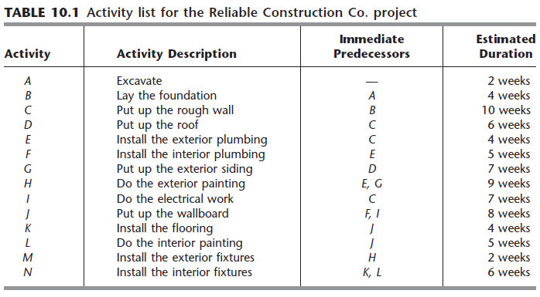
CPM-Example

Slide 41
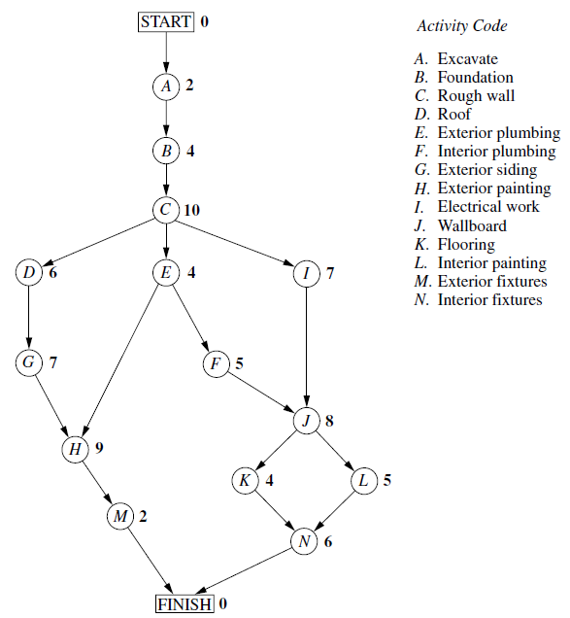
CPM-Example

Slide 42
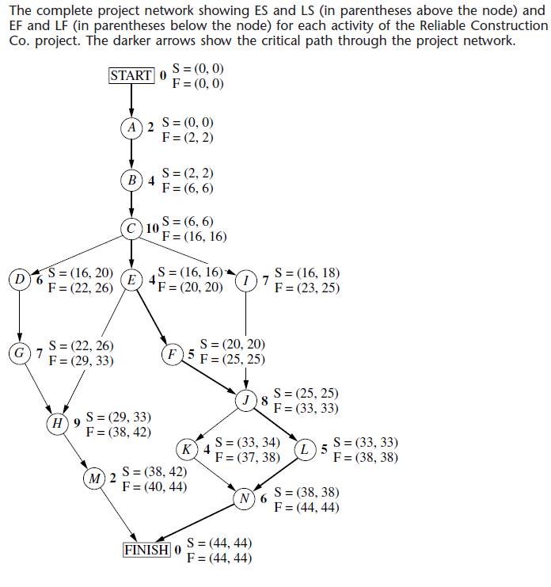
CPM-Example

Slide 43
PERT: Variability in Activity Times
CPM assumes we know a fixed time estimate for each activity and there is no variability in activity times
PERT uses a probability distribution for activity times to allow for variability

Slide 44
PERT: Variability in Activity Times
Three time estimates are required
  Optimistic time (a) – if everything goes according to plan
  Pessimistic time (b) – assuming very
  unfavorable conditions
  Most likely time (m) – most realistic estimate

Slide 45
PERT: Variability in Activity Times
Estimate follows beta distribution
Expected time:
Variance of times:
t = (a + 4m + b)/6
v = [(b – a)/6]²

Slide 46
Variability in Activity Times
Estimate follows beta distribution
Expected time:
Variance of times:
t = (a + 4m + b)/6
v = [(b − a)/6]2
Figure 3.12
Probability of 1 in 100 of
< a occurring
Probability of 1 in 100 of > b occurring
Probability
Activity Time
Optimistic Time (a)
Most Likely Time (m)
Pessimistic Time (b)

Slide 47
Computing Variance
Most Expected
Optimistic Likely Pessimistic Time Variance
Activity a m b t = (a + 4m + b)/6 [(b – a)/6]²
A 1 2 3 2 .11
B 2 3 4 3 .11
C 1 2 3 2 .11
D 2 4 6 4 .44
E 1 4 7 4 1.00
F 1 2 9 3 1.78
G 3 4 11 5 1.78
H 1 2 3 2 .11

Slide 48
Probability of Project Completion
Project variance is computed by summing the variances of critical activities
σ² = Project variance
= ∑(variances of activities
on critical path)
p

Slide 49
Probability of Project Completion
Project variance is computed by summing the variances of critical activities
Project variance
σ² = .11 + .11 + 1.00 + 1.78 + .11 = 3.11
Project standard deviation
σ_{p} = Project variance
= 3.11 = 1.76 weeks
p

Slide 50
Probability of Project Completion
PERT makes two more assumptions:
Total project completion times follow a normal probability distribution
Activity times are statistically independent

Slide 51
Probability of Project Completion
Standard deviation = 1.76 weeks
15 Weeks
(Expected Completion Time)

Slide 52
Probability of Project Completion
What is the probability this project can be completed on or before the 16 week deadline?
P(T ≤ 16 )=P(Z ≤ 0.57) where
Z = – /σ_{p}
= (16 wks – 15 wks)/1.76
= 0.57
due expected date
date of completion

Slide 53
LP to find the project completion time
G=(N,A): AON project network
Parameters:
Decision Variables:
Model:

Slide 54
Crashing a Project
What if
due date < project completion time?
Crashing the project:
Reducing the project duration below its normal value by accomplishing some activities in a shorter time at a larger cost

Slide 55
Factors to Consider When Crashing A Project
The amount by which an activity is crashed is, in fact, permissible
Taken together, the shortened activity durations will enable us to finish the project by the due date
The total cost of crashing is as small as possible

Slide 56
Crashing a Project
Let:
Cost[i]=cost of reducing the duration of activity i by one unit
u[i]=maximum possible reduction in the duration of activity i

Slide 57
LP to find the min cost crashing
Decision Variables:
Model:

Slide 58
Least possible project duration with a budget of K units?
Decision Variables:
Model:

Slide 59
Advantages of PERT/CPM
Especially useful when scheduling and controlling large projects
Straightforward concept and not mathematically complex
Network depiction help highlight relationships among project activities
Critical path and slack time analyses help pinpoint activities that need to be closely watched

Slide 60
Advantages of PERT/CPM
Project documentation and graphics point out who is responsible for various activities
Applicable to a wide variety of projects
Useful in monitoring not only schedules but costs as well

Slide 61
Limitations of PERT/CPM
Project activities have to be clearly defined, independent, and stable in their relationships
Precedence relationships must be specified and networked together
Time estimates tend to be subjective and are subject to fudging by managers
There is an inherent danger of too much emphasis being placed on the longest, or critical, path

