Slide 1
Project 200
Software Lab Website

Slide 2
Supervisors
Sheikh Nabil Mohammad
Lecturer,
Department of Computer Science and Engineering,
Shahjalal University of Science and Technology, Sylhet.
Chakrabarty Biswa
Lecturer,
Department of Computer Science and Engineering,
Shahjalal University of Science and Technology, Sylhet.

Slide 3
Students/Developers
Md. Abu Talha
Reg: 2012331008
Farzad Bin Fazle
Reg: 2012331005

Slide 4
Features
User Panel
Upcoming Events
Latest News
Research/ software Area
Current Research
Competition/Award
Projects
Research Paper
Blog
Research Students
Research Supervisors
Apply System
Others lab site link
Contest System

Slide 5
User Panel
User login panel.
User Profile.
User projects.
User Research area.
User Current Projects.

Slide 6
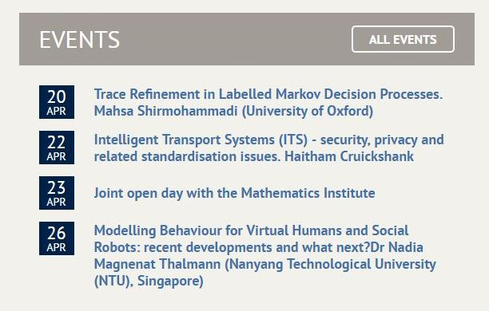
Upcoming Events

Slide 7
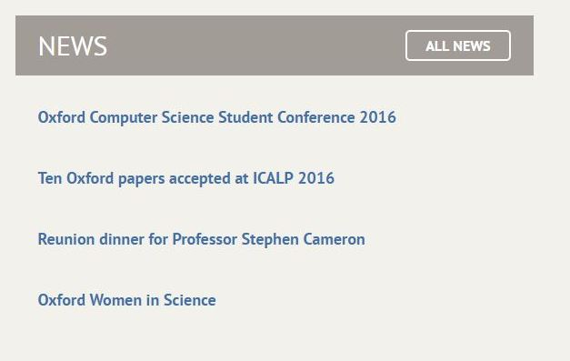
News

Slide 8
Lab Members
Member List
Clickable Profile
Membership Duration
Contribute

Slide 9
Lab Supervisors(Teachers)
Supervisor List/Teachers List
Profile
Work
Current project

Slide 10
Competition and Awards
Competition Name
Awards
Member associate with awards

Slide 11
Online Contest
Lab Contest
Contest Status
Awards
Previous contest
Previous contest status

Slide 12
Projects & Papers
All Project List
Current project List
Research Papers

Slide 13
Blog
Students and teachers Blog
Comment System
Like System
Share System

Slide 14
Apply for Membership
Apply from
Waiting Student
Viva Date

Slide 15
Teachers Course Projects
Suggested Project List
Assign project To Student
Student Projects Details
Viva Date
Submission Date
Projects Grade

Slide 16
Others Lab Website List And Contact
Others Lab Website List
Lab Description
Contact From
Email Sending System

Slide 17
Thank You

