Slide 1
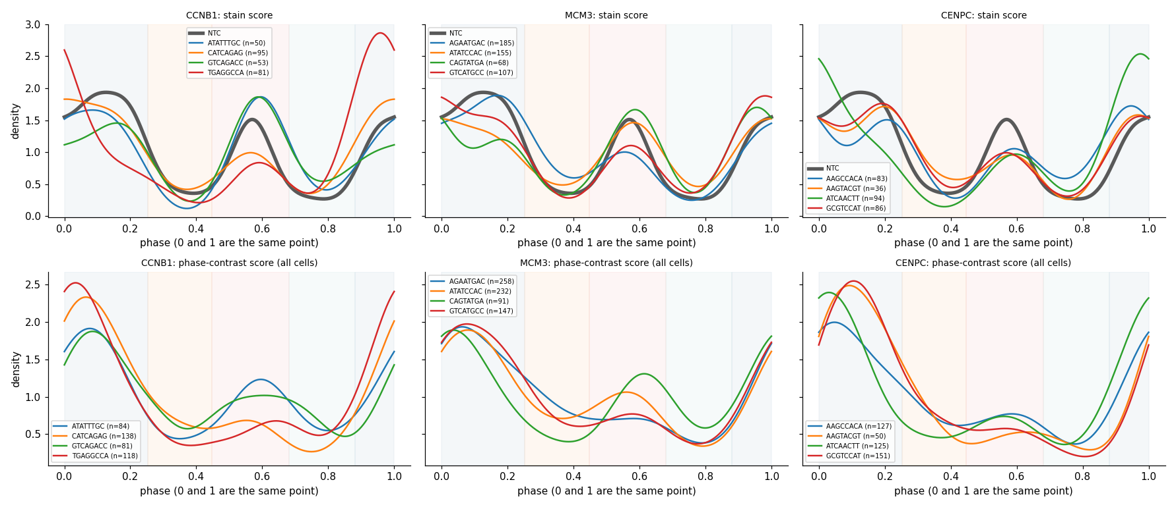
Measured DNA reproduces CCNB1 guide split
gene | p, shuffled cells | p, vs control guides
CCNB1 | 0.227 | 0.352
MCM3 | 0.033 | 0.131
CENPC | 0.783 | 0.869
AURKB | 0.001 | 0.004
POLA1 | 0.477 | 0.626
POLA2 | 0.001 | 0.002
BUB1B | 0.141 | 0.216
CDK7 | 0.817 | 0.882
Louise: cells of each guide along the clock (grey: controls). Top: stain score; bottom: phase contrast.
Do a gene's 4 guides differ in measured DNA? (all cells)
CCNB1 guides, measured change in % 4N cells: ATATTTGC +14, GTCAGACC +11, CATCAGAG +1, TGAGGCCA -2.
The usual shuffled-cell test calls 12% of control-guide sets different (5% expected); compare guides with control guides instead.
Notes:
Louise found that the four guides of CCNB1, MCM3 and CENPC behave differently on the clock (her plot, left). We measured DNA in every cell of these knockouts. Her per-guide clock shifts agree with measured DNA across her 12 guides (G1 against 2N, rank correlation 0.9; G2/M against 4N, 0.7; her score uses DNA, so this is consistency rather than independent proof). For CCNB1, the two guides that add G2/M cells on her clock also gain 4N cells in DNA: ATATTTGC +14 points and GTCAGACC +11, while TGAGGCCA gains 2N cells instead (+7). So CCNB1 likely does have the classic G2/M phenotype, diluted in the gene average by guides that work less well. We also checked the guide test. The usual test shuffles cells among a gene's guides; applied to sets of four non-targeting control guides it calls a difference in 12% of sets instead of 5%, because control guides differ from each other too, for example when cells grow in patches. Against control guides of the same size, the guides clearly differ only in AURKB and POLA2, two genes with a real phenotype that some guides show strongly and others not at all, as uneven knockout efficiency would. Take-home: where an expected arrest is weak, look at the guides one by one, and compare them with control guides, not with shuffled cells.

Slide 2
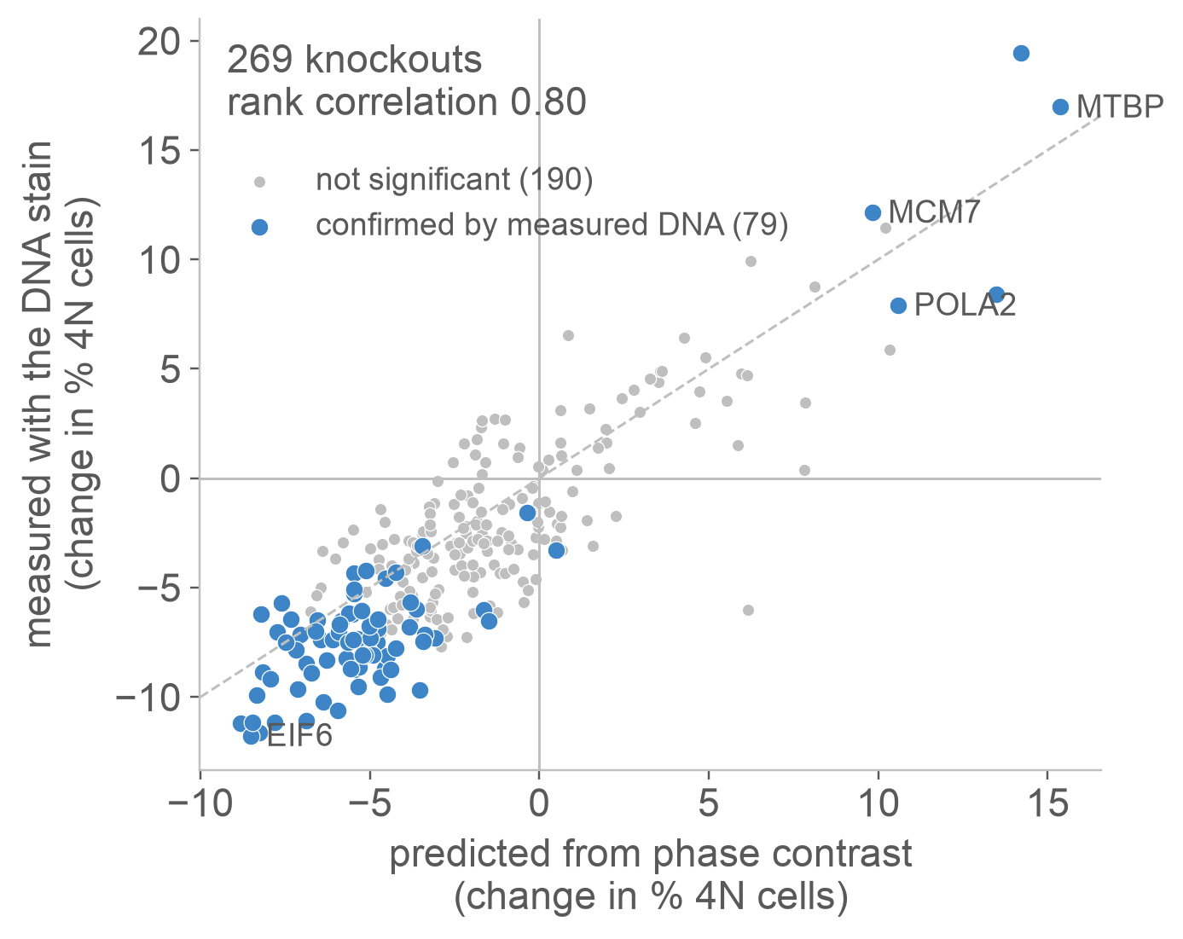
Predicted shifts hold up against measured DNA
FDR 5% against control groups of the same size.
Notes:
We then predicted the cycle distribution of all 1,000 knockouts from phase contrast, flagged those that differ from controls, and measured DNA directly in 269 knockouts: every flagged one, a random set, and the team's list of expected arrests. Left: predicted against measured change in the share of 4N cells. They agree with a rank correlation of 0.80. Replication genes such as MTBP, MCM7 and POLA2 gain 4N cells; ribosome and translation genes such as EIF6 lose them, as expected for cells that stall before copying DNA. Right: how often a flagged knockout is confirmed by measured DNA at 5% false discovery rate. Flagged by both models: 41 of 73. Only by gradient boosting: 33 of 121, weaker but well above the 5 of 67 knockouts flagged by neither. Only by the linear model: 0 of 8. The extra measurements for 111 knockouts were made this week on a laptop from the public OPS0077 images, with the same rules as the original measurement.

Slide 3
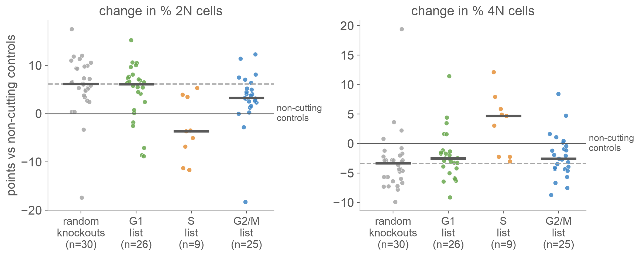
Judge expected arrests against random knockouts
Dashed line: median of 30 random knockouts. S-phase list passes; G1 and G2/M lists look like random knockouts.
Notes:
The team listed 60 genes expected to stop cells in G1, S or G2/M. Here each dot is one knockout with measured DNA, as change against non-cutting control guides. Grey on the left: 30 knockouts picked at random. They shift too: median +6.1 points of 2N cells and -3.3 points of 4N cells. Cutting DNA alone seems to hold some cells back; A549 cells have working p53, and p21 RNA rises in 636 of 1,000 knockouts in the CROP-seq data. So the dashed line, not zero, is the fair reference. Against it, the S-phase list stands out (about 8 points more 4N cells than random knockouts). The G1 list gains 2N cells exactly as much as random knockouts, and the G2/M list does not gain 4N cells at all. Literature expectations do not always hold in one cell line and about 89 hours of Cas9, and a direct readout is needed to tell.

Slide 4
Brian's updated panels against measured DNA
knockout | Brian's expectation | clock shift (panel) | measured DNA vs controls | vs random knockouts
AURKB | cytokinesis failure: G2 | G2/M +7.1 (Z 3.2) | 4N +3.6 (n=335) | 4N +7.0
POLA1 | fork stalling: S or G2/M | G2/M +10.4 (Z 5.4) | 4N +6.9 (n=457) | 4N +10.2
POLA2 | fork stalling: S or G2/M | G2/M +14.7 (Z 6.0) | 4N +8.2 (n=261) | 4N +11.6
CDK7 | G1 restriction point: G1 | early G1 +8.5 (Z 2.9) | 2N +10.0 (n=399) | 2N +3.9
BUB1B | checkpoint loss: G1 (slippage) | early G1 +6.3 (Z 2.1) | 2N +2.6 (n=267) | 2N -3.5
CCNB1 | G2 block, back to G1 | no clear change | 4N +4.4 (n=349) | 4N +7.8
Clock shifts read from Brian's panels (against matched control groups). DNA: change in % of cells, all cells of each knockout; random knockouts: median of 30 (+6.1 2N, -3.3 4N).
Notes:
Brian redrew his knockout panels on the corrected clock. For each gene we measured DNA in every cell of that knockout, not a sample, and compared it with non-cutting controls and with random knockouts. AURKB, POLA1 and POLA2 gain 4N cells, as their panels show, well above random knockouts. CDK7 gains 2N cells, again above random knockouts, so the G1 restriction-point expectation holds for it. BUB1B gains early-G1 cells on the clock, but its DNA does not move beyond what cutting alone does; slippage out of mitosis would leave G1 cells with doubled DNA, so a shorter mitosis is the more likely reading. On Brian's literature note for POLA1 and POLA2 (S-phase build-up, survivors in G2/M): measured DNA shows mostly 4N cells and little extra S (+1 and +3 points), so in this window the survivors dominate. CCNB1 shows no clear shift on the clock, but against random knockouts it does gain 4N cells, and two of its guides gain 11 to 14 points (next slide). There is no RNA sign of CCNB2 compensation in CROP-seq (rank 387 of 997 knockouts), though compensation could still act on protein.

Slide 5
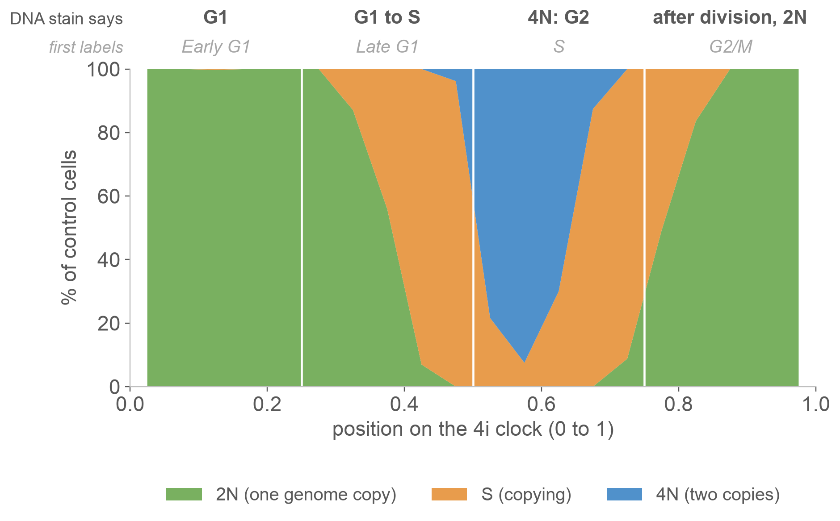
What each part of the 4i clock contains
76%
of cells at 0.5 to 0.75 have doubled DNA (4N)
0.75 to 1
is cells just after division, back to 2N
So the first labels were a quarter turn off.
Notes:
Before we used the 4i clock, we checked it against something measured directly: the DNA stain. For about 35,600 control cells we measured DNA content from DAPI in three imaging rounds and called each cell 2N, S or 4N. The plot shows the share of each DNA state along the clock. Cells with doubled DNA sit between 0.5 and 0.75, and the last quarter, 0.75 to 1, is almost entirely cells that have just divided and are back to one genome copy. The first quarter labels (early G1, late G1, S, G2/M) were therefore shifted by about a quarter turn. That explained a first-day puzzle: knockouts expected to stop cells in G1, such as CDK7, seemed to pile up in G2/M. Those were G1 cells just after division. Note that the clock itself uses DNA as an input, so this checks the labels, not the clock.

Slide 6
Phase contrast reads DNA state like the antibody panel
AUC: the chance that a random 4N cell scores higher than a random 2N cell (0.5 is chance, 1 is perfect).
Any brightfield or phase-contrast screen can get a cell-cycle readout without spending a fluorescence channel.
Notes:
Next question: can label-free phase contrast read the cycle? We trained models on control cells to predict each cell's DNA state from phase-contrast features, and scored them on image tiles they never saw. Phase contrast separates 4N from 2N cells with an AUC of 0.92; the 4i antibody panel (pRb, Rb and p21) reaches 0.89, and chance is 0.5. Gradient-boosted trees on the raw features beat a linear model on principal components. On the right: a model trained only on control cells reads knockout cells as well as control cells (CCNB1, MCM3 and CENPC, 1,353 cells with measured DNA; 0.963 against 0.968), so it does not break on perturbed cells. These transfer numbers come from a lighter laptop run (10,000 control cells, 1,740 features), so they sit a little below the full model.

