Slide 1
TDD (04-04-2026)
Functional programming (08-04-2026)
Kafka, Spring kafka, Kafka Stream, Kafka connect (11-04-2026)
Spring Cloud Function, Spring Cloud Stream.(15-04-2026)
Event, Event Stream, Event Streaming Patterns(18-04-2026)
Microservice core components.(20-04-2026)
Security(22-04-2026)

Slide 2
Test Driven Development(TDD)

Slide 3
Scenario:1
User:I am going to click the button. Should I? Are you sure?
Dev: ah, yeeees ,click
User: Oooooh it’s not working . Please check
Dev: Ok I am checking…..

Slide 4
Scenario:2
Support: Feature x is not working properly
Dev: What? I do this feature and it was workable for last 1 year.
J.Dev Did you make any changes here a few days ago?
J.Dev: Yes, I improved its performance.

Slide 5
Scenario:3
“I said I fixed the spelling error and he said well don't ever do that”

Slide 6
What?
Why?
When?

Slide 7
Testing is an integral part of enterprise software development.

Slide 8
Catch Bug Early
Fearless Refactoring
Documentation That Doesn’t lie
Better Design
Faster Development

Slide 9
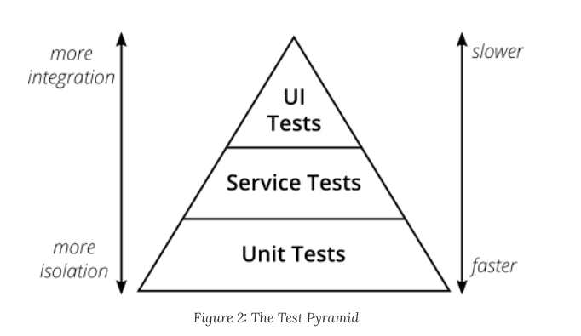

Slide 10
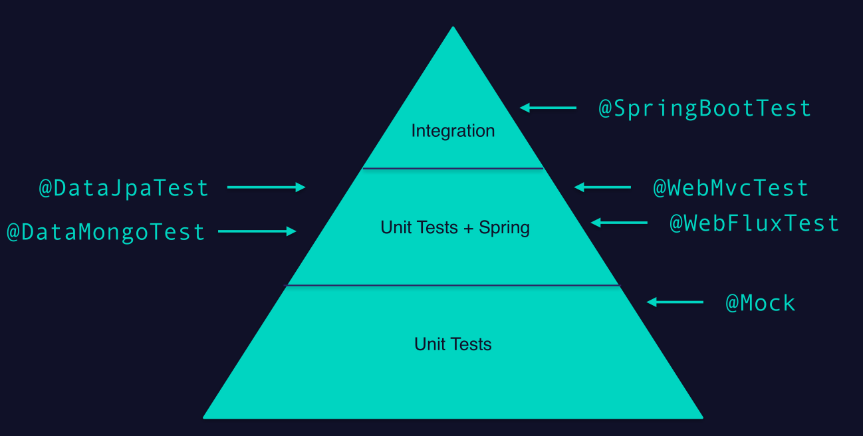

Slide 11
The Three Laws of TDD
First Law You may not write production code until you have written a failing unit test.
Second Law You may not write more of a unit test than is sufficient to fail, and not compiling is failing.
Third Law You may not write more production code than is sufficient to pass the currently failing test.

Slide 12
F.I.R.S.T.
Fast Tests should be fast. They should run quickly.
Independent Tests should not depend on each other.
Repeatable Tests should be repeatable in any environment.
Self-Validating The tests should have a boolean output. Either they pass or fail.

Slide 13
Timely The tests need to be written in a timely fashion.
Unit tests should be written just before the production code that makes them pass.
If you write tests after the production code, then you may ﬁnd the production code to be hard to test.
You may decide that some production code is too hard to test. You may not design the production code to be testable.

Slide 14
Demo

