Slide 1
Kafka

Slide 2
What is kafka?
Distributed event streaming platform designed to handle high-volume, real-time data feeds

Slide 3
Topic
Partitions
Brokers
Replication
Producers
Consumers
Kafka Connect
Stream Processing

Slide 4
https://developer.confluent.io/courses/apache-kafka/events/

Slide 5
Kafka Streams
Client-side Java library for building real-time stream processing applications and microservices.
https://developer.confluent.io/courses/kafka-streams/get-started/

Slide 6
Spring Cloud Streams

Slide 7
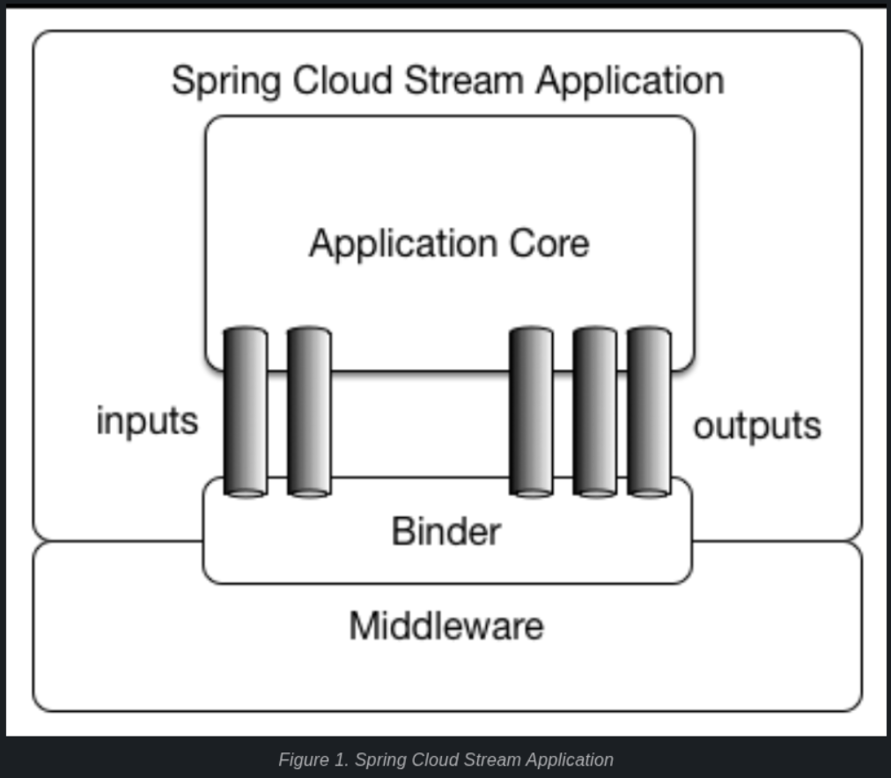
Application Model

Slide 8
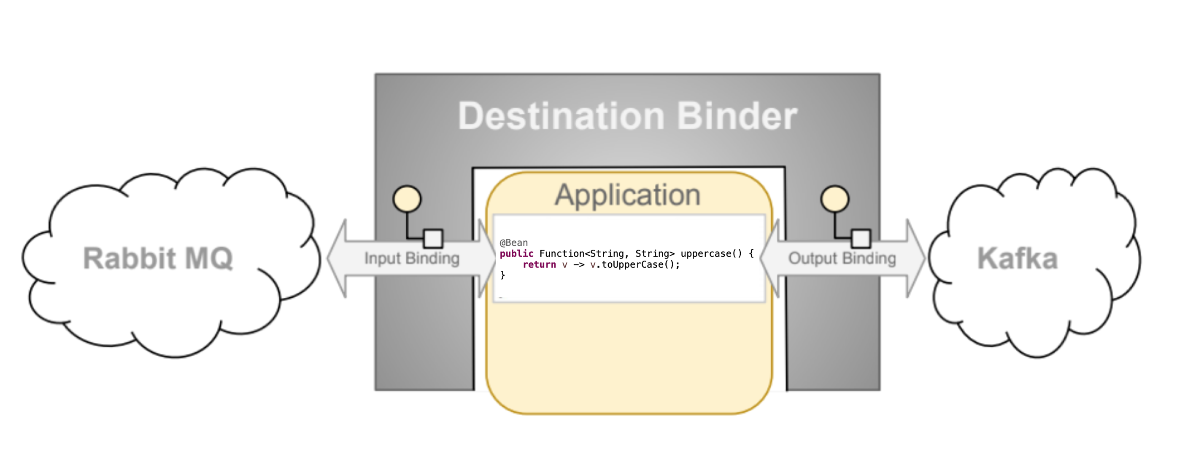
Programming Model

Slide 9
Binders
Bindings

Slide 10
@Bean
public Supplier<String> supply() {
return () -> dataService.getLatestData();
}
Producer/Publisher
/Source App
Output

Slide 11
@Bean
public Consumer<String> consume() {
return data -> service.sendToMySink(data);
}
Consumer/Sink
Input

Slide 12
@Bean
public Function<String, String> process() {
return input -> service.doSomethingWithTheData(input);
}
Processor
Input
Output

Slide 13
Demo

Slide 14
https://developer.confluent.io/patterns/

