Slide 1


DATA WAREHOUSE
Applying in business practice, benefits and structure.
Data Warehouse is centralised data storage system that allows your business to consolidate data from multiple applications and sources into one location.
July 9, 2020

Slide 2
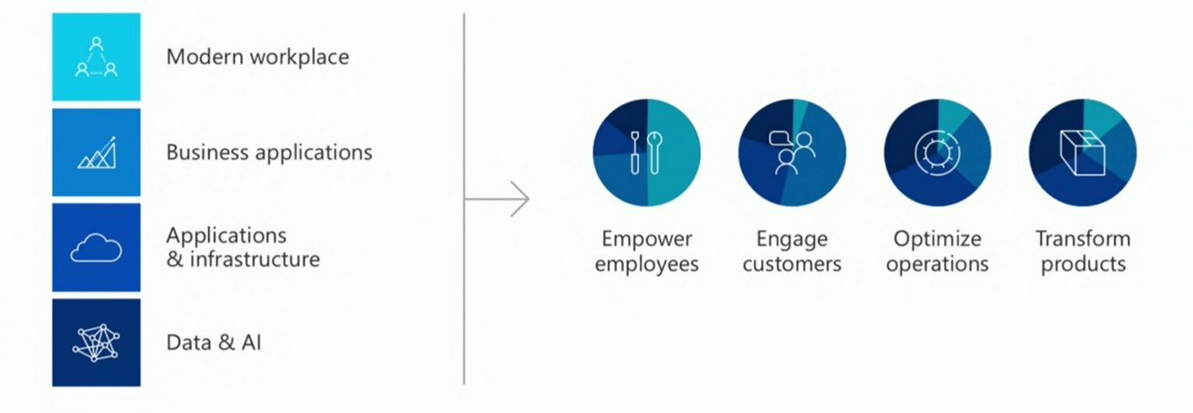

Digital Transformation - 4 Areas & Pillars
Data Warehouse| Novum
Digital transformation is about reimagining how you bring together people, data, and processes to create value for your customers and maintain a competitive advantage in a digital-first world
Notes:
Microsoft drives digital transformation for its customers across these four pillars:
Empower Employees, Engage Customers, Optimize Operations, Transform Products
Data from the Microsoft Solution areas feeds the intelligent cloud and intelligent edge to fuel digital
transformation and business innovation. Digital Transformation in form of AI Enabled CRM, modern
desktop and cloud services enable you to build cutting-edge, individualized solutions.

Slide 3






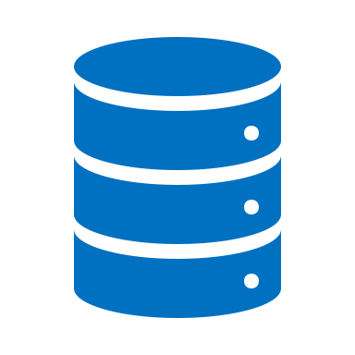




What is Data Warehouse?
Data Warehouse| Novum
In computing, a data warehouse (DW or DWH), is a system used for reporting and data analysis, and
is considered a core component of business intelligence. DWs are central repositories of integrated
data from one or more disparate sources. They store current and historical data in one single place
that are used for creating analytical reports for workers throughout the enterprise.
Reporting
DATAWAREHOUSE
Analytics
Sales
Core Operations
Finance
KPIs
Logistics & Distribution
Warehouse
Marketing

Slide 4

Why we need DWH?
Data Warehouse| Novum
Copy Transactional Database
Deploy Analytics across all organization
KPIs in order to measure performance
Increase Bottom Line (Income)
Create solid reporting structure for management and C level
Create ground for Advanced Analytics and Machine Learning models
Business intelligence refers to the collective term for the IT-supported preparation and analysis of companies’ raw data. BI should generate knowledge that serves as a decision maker for the strategic direction and orientation of a company.

Slide 5
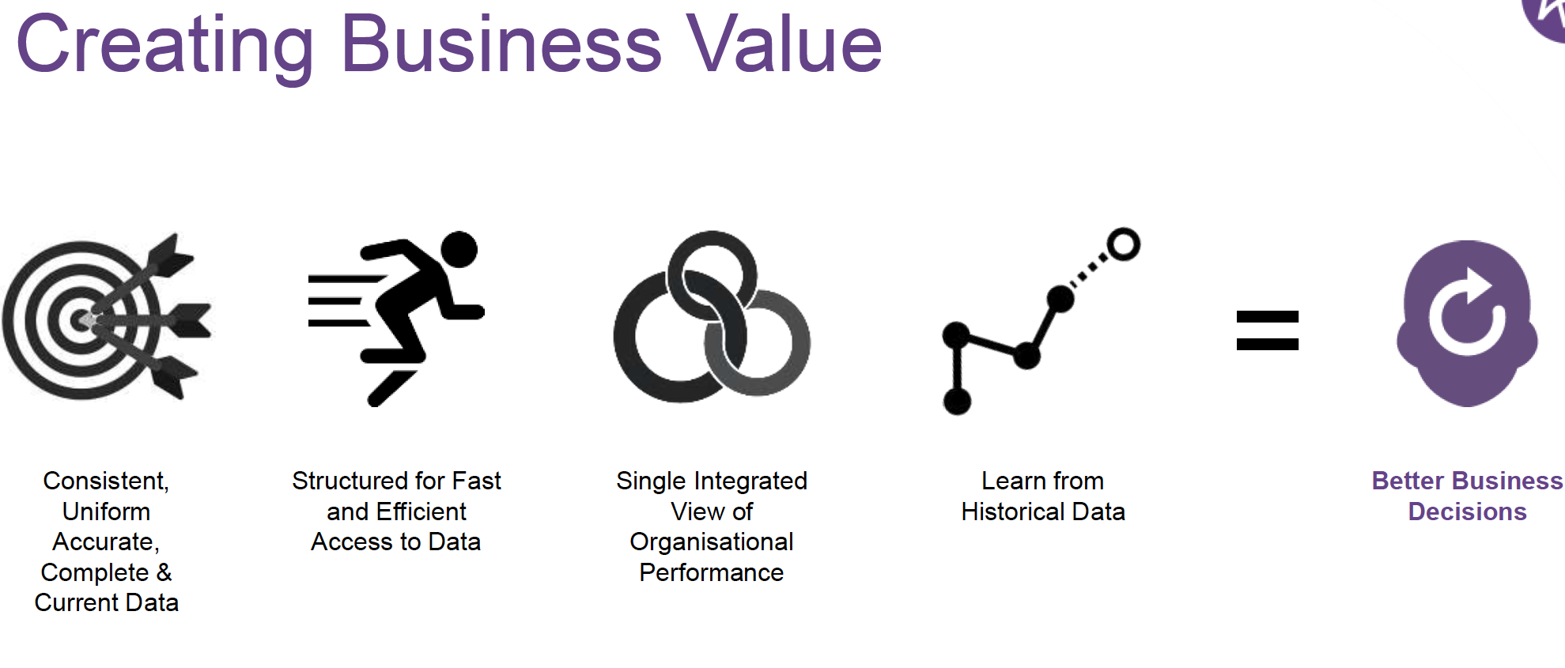
How it delivers business value?
Data Warehouse| Novum
Sample Reports

Slide 6
Benefits of Data Warehouse
Data Warehouse| Novum
Data-Driven Decision Making - Corporate decision makers will no longer have to make important business decisions based on limited data and hunches.
Quick and easy access to do - Speed is an important factor that sets you above your competitors.
Data quality and consistency - Since data warehouses gather information from different sources and convert it into a single and widely used format, departments will produce results that are in line and consistent with each other

Slide 7
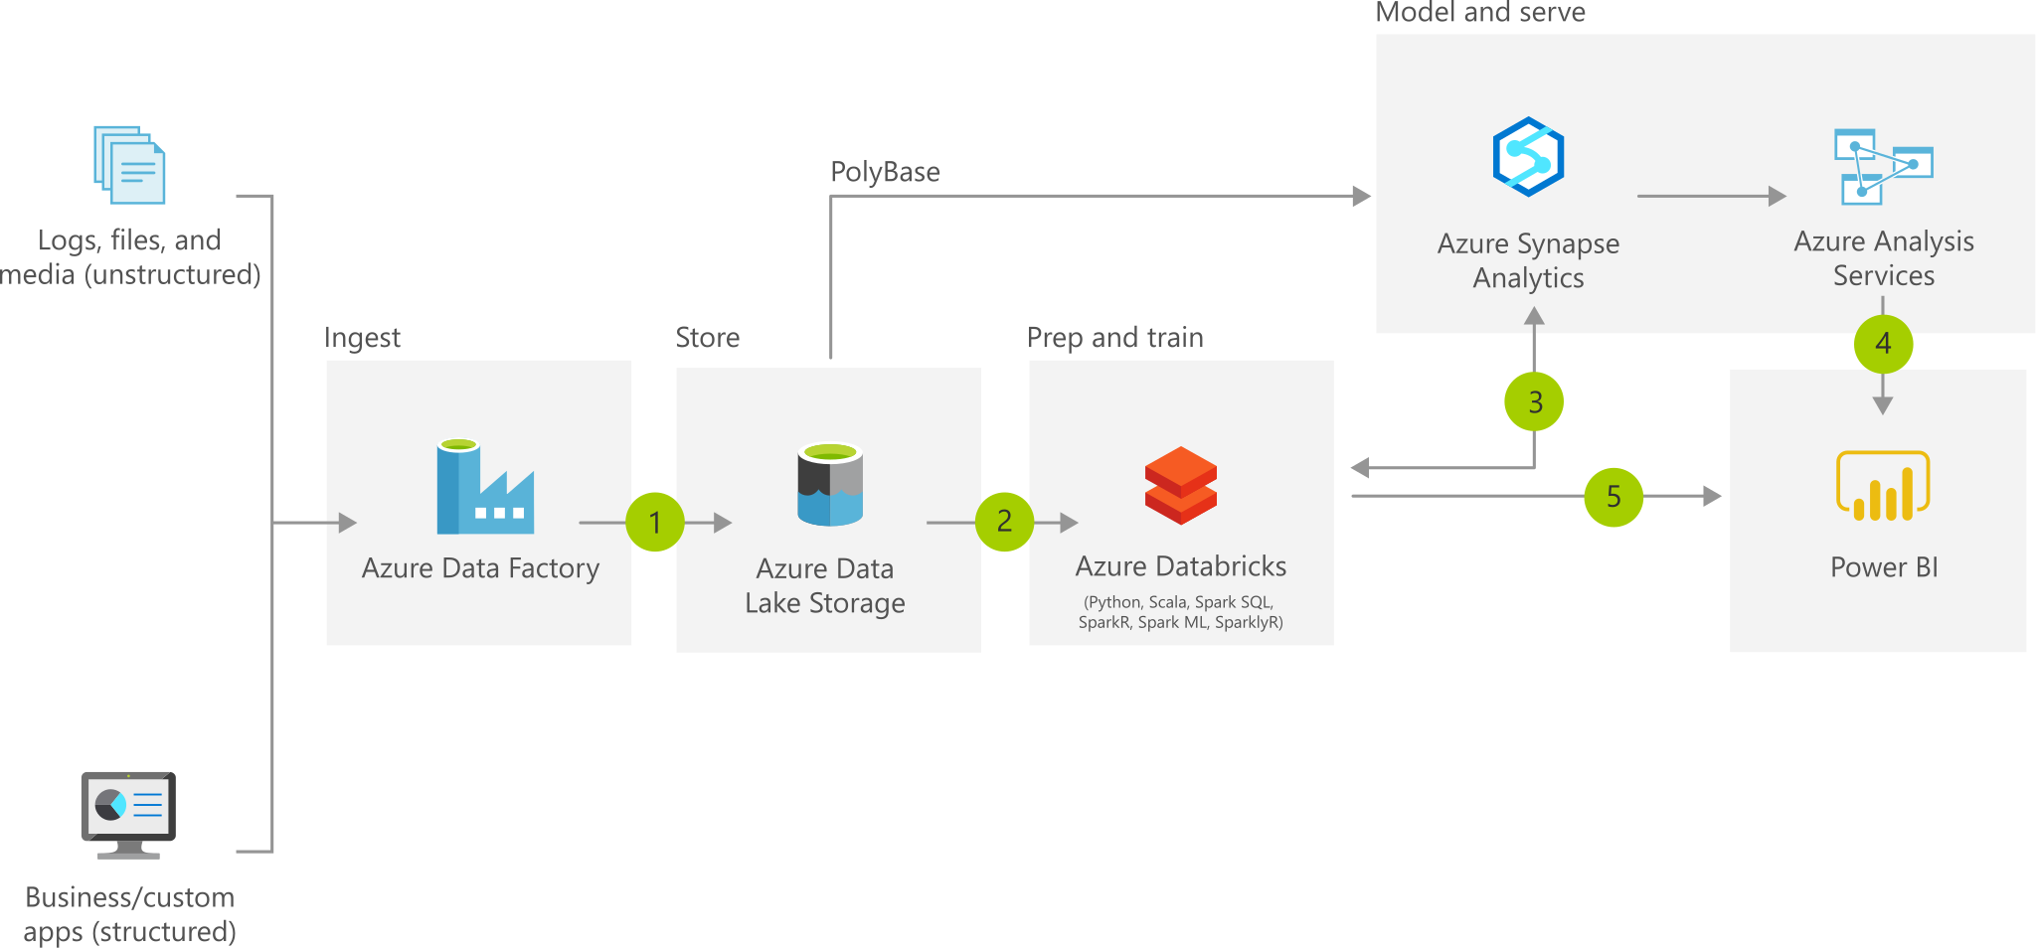
Microsoft Azure based DWH
Data Warehouse| Novum

