Slide 1
Optimizing nanochat down to the assembly level
NVPTX and AMDGCN: rewriting the hot GPU kernels of an LLM trainer, then reading their machine code
Talha Mahmood and Hamza Mahmood
CISC662 | Presentation 1 | November 2026
Notes:
HAMZA (30 s). Hello. Our project takes a small program that trains a language model, finds the slowest pieces that run on the GPU, rewrites them by hand, and then reads the machine code the compiler produces, for NVIDIA and for AMD GPUs. This is the first of two presentations: today is what we are doing and the first results; the second one (December 17) is the final results.

Slide 2
What we are doing and why
1
Pick the hot spots
Profile one training step of nanochat and find which GPU operations cost the most time.
2
Rewrite them by hand
Fused Triton kernels first, then CUDA and HIP versions of the three most important ones.
3
Read the machine code
Compile for NVIDIA (PTX, SASS) and AMD (AMDGCN); explain every speedup or slowdown by the instructions.
Baselines to beat: eager PyTorch and torch.compile (Inductor), measured on the same GPU in the same job.
CISC662 | Optimizing nanochat down to the assembly level
2
Notes:
HAMZA (1 min). nanochat is a small, complete program that trains a GPT-style language model on one GPU. Almost all of its time goes into a few kinds of GPU operations. Today PyTorch runs these either one at a time (eager) or fused automatically by torch.compile. Our question: can hand-written kernels beat both, and what does the machine code tell us about why? We go all the way down: PyTorch, Triton, CUDA, HIP, and finally the instructions: PTX and SASS for NVIDIA, and AMDGCN for AMD.

Slide 3
Proposal versus reality: what changed and why
 | Proposal | What we do now | Status
Main GPU | DARWIN V100 | DeltaAI GH200 (H100-class) | Measured
AMD GPUs | MI100 / MI250X | AMDGCN compiled for gfx908, gfx90a, gfx942 | Static done
AMD measured | same | NCSA Delta MI100 / MI210 (access confirmed) | Node in maintenance
CPU reference | x86 EPYC | Grace (aarch64) CPU, reported raw and normalised | Script written
V100 / A100 | primary / extra | Static comparison of sm_70, sm_80, sm_90a SASS | Planned
CISC662 | Optimizing nanochat down to the assembly level
3
Notes:
HAMZA (1 min). Honest status of the plan. The proposal named a V100 cluster as the main GPU. We cannot reach it from our allocation, so we use DeltaAI at NCSA: one GH200, an H100-class GPU. For AMD, DeltaAI has no AMD GPUs, so we already compile our kernels for three AMD chips and analyse the instructions without running them (static). Last week we confirmed access to NCSA Delta, which has MI100 and MI210 GPUs, so we can also measure on real AMD hardware. That node is in maintenance right now, so the measured AMD numbers are for the second presentation. Question you may get: why not DARWIN? Answer: we dropped it; everything is on NCSA systems now.

Slide 4
Method: a ladder from PyTorch down to instructions
L0
L1
L2
L3
L4
L5
Eager
PyTorch
torch.compile
Triton
(ours)
CUDA
(ours)
HIP for AMD
(ours)
PTX / SASS /
AMDGCN
Filled = done for our three kernels. We already read the NVIDIA and static AMD instructions for them (L5); CUDA and HIP versions (L3, L4) start next.
Correctness gate
Timing rules
Fair comparison
value and gradient checked against a 64-bit reference, and no worse than PyTorch's own error
GPU events, L2 cache flushed, 3 separate processes, bootstrap confidence intervals
baselines run in the same job on the same GPU; only gated rows are plotted
CISC662 | Optimizing nanochat down to the assembly level
4
Notes:
TALHA or HAMZA (1 min). The method is a ladder. L0 is plain eager PyTorch. L1 is torch.compile. L2 is our Triton kernel. L3 is CUDA. L4 is HIP, the AMD version of CUDA. L5 is reading the instructions the compiler produced. Every kernel has to pass a correctness gate against a 64-bit reference before we are allowed to time it, and every timing uses GPU events, flushes the cache, and repeats in three separate processes with confidence intervals. That is how we make sure a speedup is real. Three kernels are on this ladder already: RMSNorm, QK-norm with RoPE, and softcap with cross-entropy.

Slide 5
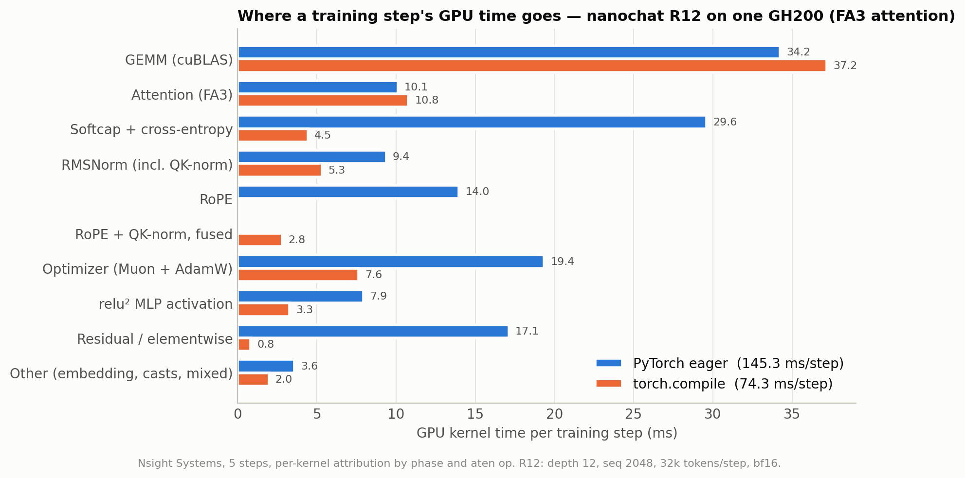
Baseline: compile already halves the step; the loss and norms are what remains
8.05 s
per 100 steps, torch.compile + FA3 (stock)
15.08 s
per 100 steps, eager PyTorch + FA3
37%
model FLOP utilisation of the compiled baseline
CISC662 | Optimizing nanochat down to the assembly level
5
Notes:
TALHA or HAMZA (1.3 min). This is the baseline we have to beat. We train a 12-layer model, one GPU, bf16. Stock nanochat with torch.compile and FlashAttention-3 takes 8.05 seconds per 100 steps; eager PyTorch takes 15.08 seconds. So compile already gives about 1.9 times. The chart shows where one step's GPU time goes: matrix multiplications and attention dominate and are already near the hardware limit; those use vendor libraries and we do not try to beat them. What is left is the memory-bound operations: normalization, RoPE, the loss. The loss (softcap plus cross-entropy) is the largest one in eager at 29.6 milliseconds, and compile cuts it to 4.5. Those are our targets.

Slide 6
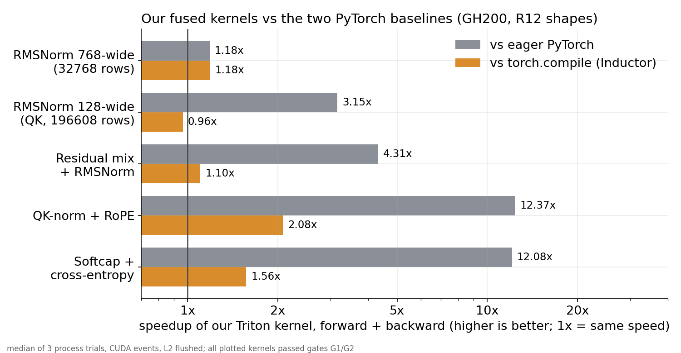
First results: up to 2x over torch.compile and 12x over eager, with an honest tie
Loss kernel: 1.56x vs compile, 12.1x vs eager, 8x less memory (2.15 vs 17.2 GB)
QK-norm + RoPE: 2.08x vs compile
RMSNorm: 1.18x at 768 wide; a tie (0.96x) at 128 wide
All kernels passed correctness gates.
CISC662 | Optimizing nanochat down to the assembly level
6
Notes:
TALHA or HAMZA (1.7 min). First results, all measured on the GH200, forward plus backward. Grey is speedup over eager PyTorch, orange is speedup over torch.compile, which is the harder baseline. Reading the chart from the bottom: the loss kernel, softcap plus cross-entropy, is 12 times faster than eager and 1.56 times faster than compile, and it uses 8 times less memory. QK-norm plus RoPE is 12 times over eager and 2 times over compile. The residual-mix plus norm kernel is 4.3 over eager and 1.1 over compile. Two honest points: for plain RMSNorm compile is already good, so we get only 1.18 times at 768 wide, and at 128 wide we tie compile (0.96, which is within noise). We report that because a result that is not better is still a result. All plotted kernels passed the correctness gates.

Slide 7
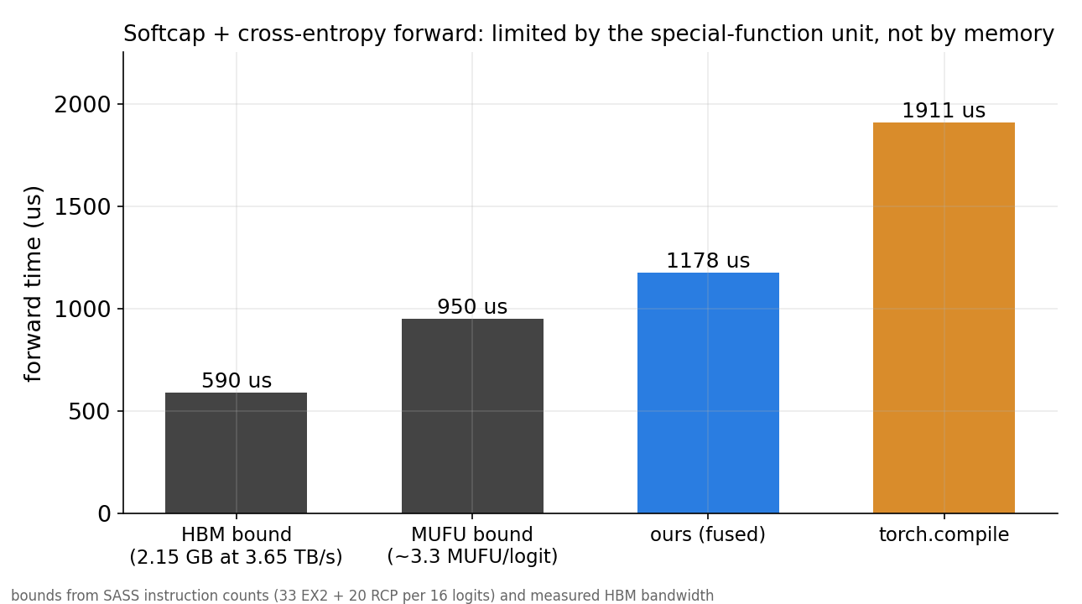
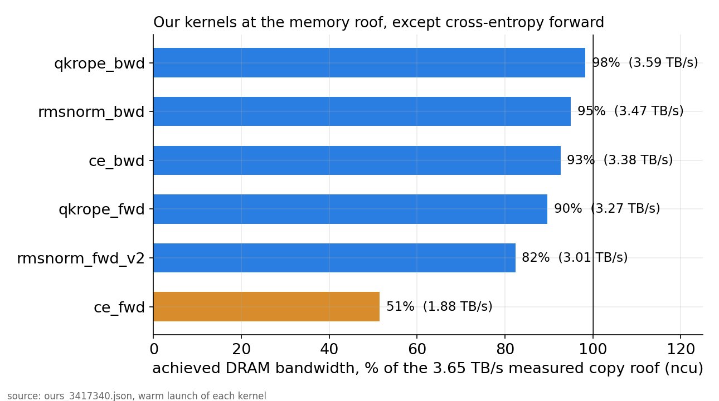
The machine code explains it: the loss kernel is limited by exp units, not memory
Evidence: SASS has 33 EX2 + 20 RCP per 16 logits (about 3.3 special-function ops per logit). Compute floor 0.95 ms > memory floor 0.59 ms; measured 1.18 ms. Other kernels sit at 82-98% of the 3.65 TB/s measured bandwidth (Nsight Compute).
CISC662 | Optimizing nanochat down to the assembly level
7
Notes:
TALHA (1.5 min). This is the kind of result the project is about: using the machine code to explain a number. Our loss kernel moves little data, so we expected it to be limited by memory. The instruction analysis says otherwise: each logit needs about 3.3 operations on the GPU's special-function unit, the hardware that computes exp and reciprocal, and those units are only a fraction of the arithmetic units. That gives a floor of about 0.95 milliseconds, higher than the 0.59 ms the memory floor allows. We measure 1.18 ms, close to that floor. So the next improvement is not about memory: it is about using fewer or cheaper exp instructions. As a check, a variant using the hardware's approximate tanh instruction is about 2.5 times faster than compile on the forward pass with a small error, but it is only an experiment; we have not adopted it. The profiler also shows our other kernels run at 82 to 98 percent of the GPU's measured memory bandwidth, so they are at the roof.

Slide 8
Plan to December 17, and the one real risk
Now to Nov 20
Chunked loss + output layer, Triton GEMM and attention study, CUDA RMSNorm / RoPE
Budget
About 0.85 of 25 planned
service units (SU) used
Nov 20 to Dec 8
HIP ports, AMD tables, measured MI100/MI210 runs, plug into training and check the loss curve
Dec 8
Code freeze, then final measurements
Main risk
AMD node in maintenance. Fallback: static AMDGCN analysis, already built.
Dec 17
Presentation 2: results
CISC662 | Optimizing nanochat down to the assembly level
8
Notes:
HAMZA (1.3 min). What comes next. Over the next month: the fused loss with the output layer so the huge logits tensor is never stored, a study of Triton matrix multiplication, an attention kernel, and CUDA and HIP versions of the three main kernels. In parallel the AMD side: static tables for all kernels, and measured runs on Delta as soon as the node is back. Then plug the kernels into nanochat training and check that the loss curve is the same, which is the gate that matters. The code freeze is December 8 and the second presentation is December 17. Budget: we have used about 0.85 service units (SU) of the 25 we planned, so cost is not the constraint. The main risk is AMD hardware availability; the fallback is the static analysis, which is already built.

Slide 9
Backup: terms and numbers
MUFU
special-function unit: exp, reciprocal, tanh hardware
ISA / SASS / PTX
machine code; SASS is NVIDIA's real code, PTX the portable layer
AMDGCN
AMD's machine code; 64-thread wavefronts, MFMA matrix instructions
Roofline
chart of achieved speed against the memory and compute limits
Gates G1 / G2
value and gradient correctness against a 64-bit reference
R12
the test setup: 12 layers, sequence 2048, 32k tokens per step, bf16
CISC662 | Optimizing nanochat down to the assembly level
9
Notes:
BACKUP. Use only for questions. MUFU = multi-function unit (exp, reciprocal, tanh hardware). ISA = instruction set architecture. SASS = the real NVIDIA machine code; PTX is the portable layer above it. AMDGCN = AMD's machine code. Roofline = a chart of how close a kernel is to the hardware's memory or compute limit. Wavefront = AMD's 64-thread group, a warp is NVIDIA's 32. G1/G2 are our correctness gates: G1 for values, G2 for gradients.

