Slide 1
Applied data science course final Project – The Battle of Neighbourhoods
Finding a Better Place in Scarborough, Toronto

Slide 2
INTRODUCTION
The primary purpose of this study is to facilitate people to explore better facilities around their neighborhood.
This will provide people with an opportunity to make a smart and effective decision for selecting a neighborhood among various others in Scarborough, Toronto region.
The core concept behind this study is to analyze some key features from the data for the people who are moving to Scarborough to find out the best neighborhood and compare it with the neighboring suburbs.
Some of the features that are highlighted are median housing price and better school according to ratings, crime rates of that particular area, road connectivity, weather conditions, good management for an emergency, water resources both fresh and wastewater, and excrement conveyed in sewers and recreational facilities.

Slide 3
TARGET GROUPS
New immigrants to Canada.
People migrating from different other states of Canada.
People not familiar with their surroundings

Slide 4
DATA Selection
The Data Link: https://en.wikipedia.org/wiki/List_of_postal_codes_of_Canada:_M
Scarborough dataset is used, that is scrapped from Wikipedia.
Dataset consisting of latitude and longitude, zip codes.
Foursquare API data.

Slide 5
FOURSQUARE API
Foursquare is a platform that provides information about several venues and events within the area of interest.
Such information includes venue names, locations, menus, and even photos.
As such, the foursquare location platform will be used as the sole data source since all the stated required information can be obtained through the API.

Slide 6
FOURSQUARE API DATA
The data retrieved from Foursquare contained information of venues within a specified distance of the longitude and latitude of the postcodes. The information obtained per venue as follows:
Neighbourhood
Neighbourhood Latitude
Neighbourhood Longitude
Venue
Name of the venue e.g. the name of a store or restaurant
Venue Latitude
Venue Longitude
Venue Category

Slide 7
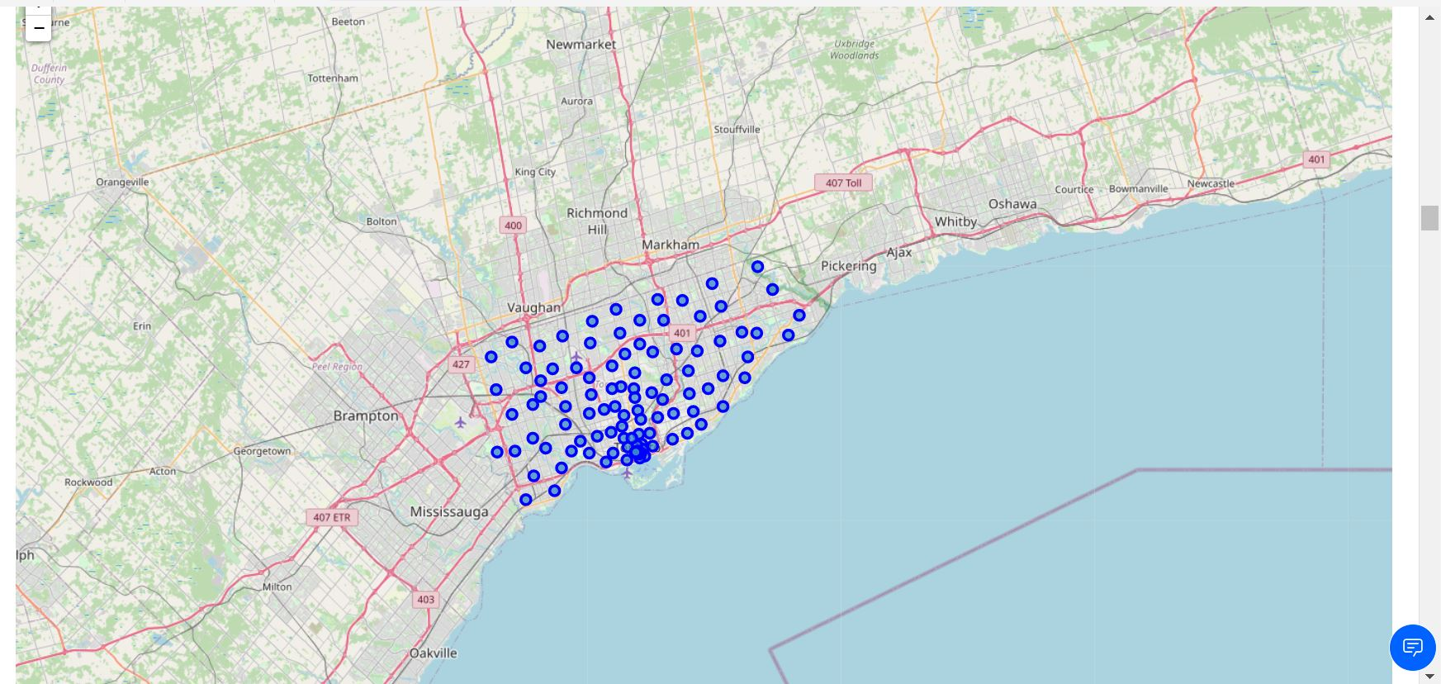
Map of Scarborough

Slide 8
METHODOLOGY
Clustering Method:
In order to compare the resemblance between the two cities, the key approach is to explore the neighborhoods, segment them, and group them into clusters to find similar suburbs in metropolitans like New York and Toronto.
K-means clustering technique is used to cluster the data .

Slide 9
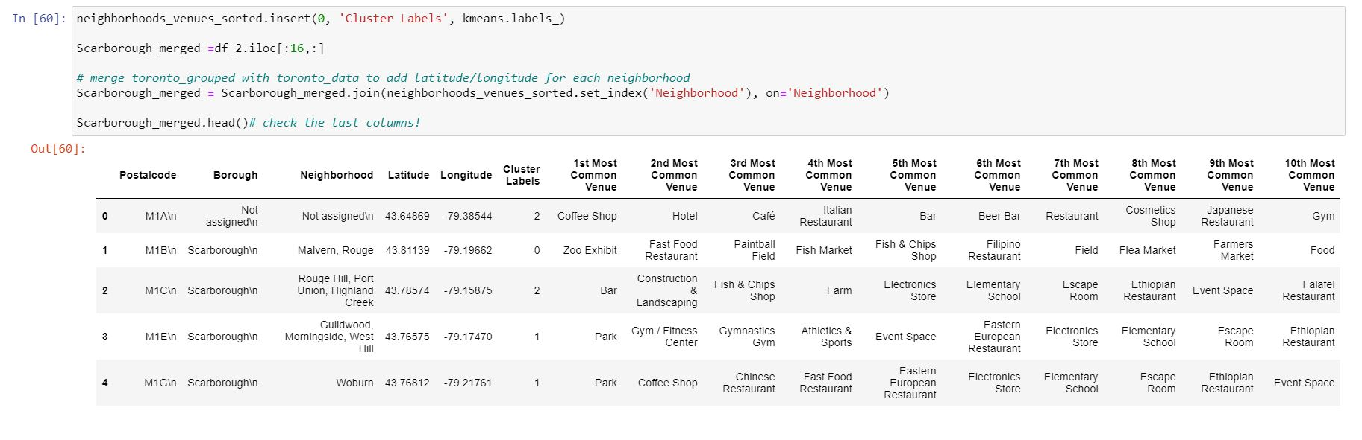
K-MEANS CLUSTERING

Slide 10
WORKFLOW
Using credentials of Foursquare API features of near-by places of the neighbourhoods would be mined.
Due to http request limitations the number of places per neighbourhood parameter would reasonably be set to 100 and the radius parameter would be set to 500.

Slide 11
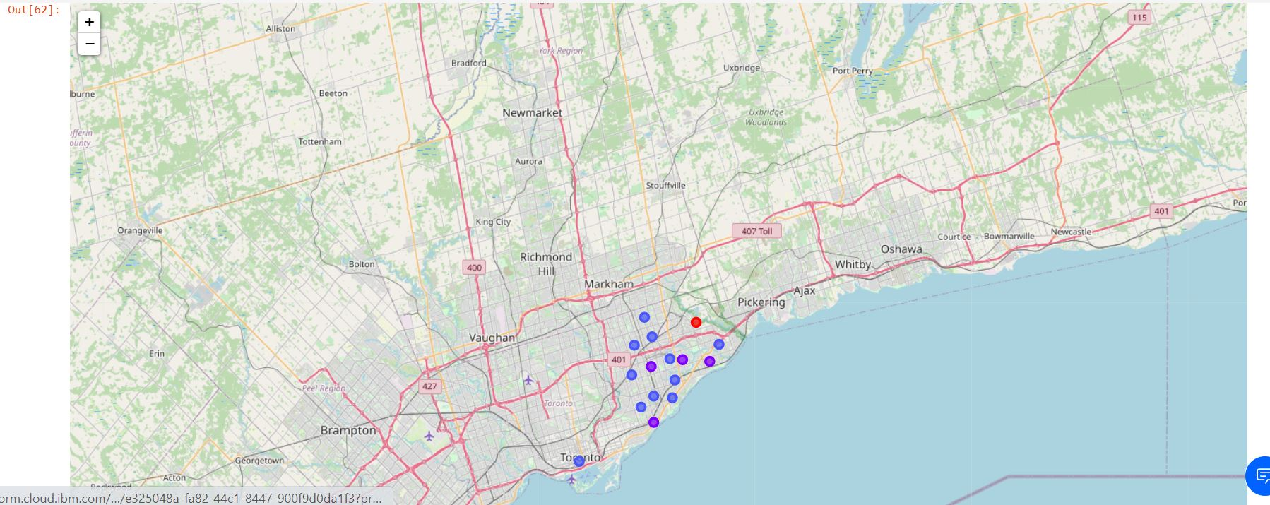
RESULTS-Map of clusters in Scarborough

Slide 12
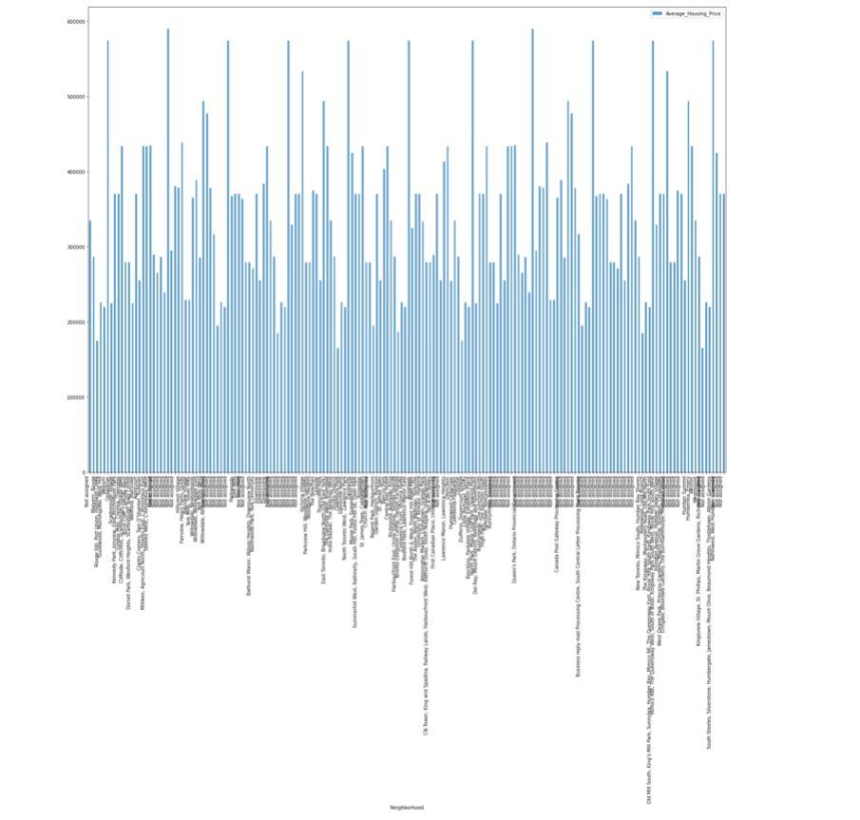
RESULTS- Average Housing Price by Clusters in Scarborough

Slide 13
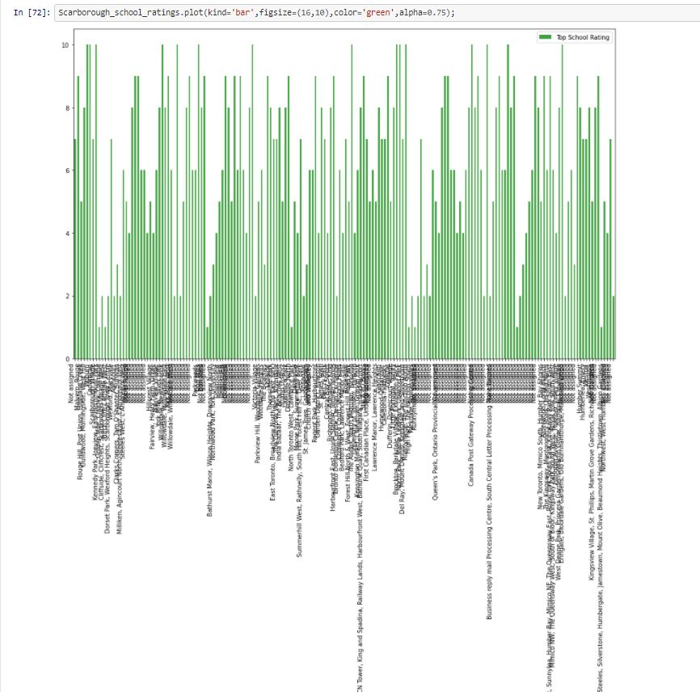
RESULTS- School Ratings by Clusters in Scarborough

Slide 14
DISCUSSION
The primary purpose of this project, is to suggest a better neighbourhood in a new city for the people who are shifting there. Connectivity to the airport, bus stand, city centre markets and other daily needs nearby.
Sorted list of house in terms of housing prices in a ascending or descending order
Sorted list of schools in terms of location, fees, rating and review

Slide 15
CONCLUSIONs
In this study, k-means cluster approach is used. The neighbourhood is separated into ten different clusters and for 103 different latitude and longitude from dataset that have very-similar suburbs around them.
Using the histograms results for a particular neighbourhood based on average house prices and school rating have been made.

Slide 16
LIBRARIES USED in this project
Pandas: For creating and manipulating dataframes.
Folium: Python visualization library would be used to visualize the neighbourhoods cluster distribution of using interactive leaflet map.
Scikit Learn: For importing k-means clustering.
JSON: Library to handle JSON files.
XML: To separate data from presentation and XML stores data in plain text format.
Geocoder: To retrieve Location Data.
Beautiful Soup and Requests: To scrap and library to handle http requests.
Matplotlib: Python Plotting Module

