Slide 1



SMART INDIA HACKATHON 2024
Problem Statement ID : 1711
Problem Statement Title : Enhancing Rail Madad
with Al-powered Complaint Management
Theme - Smart Automation
PS Category- Software
Team ID : 48148 Team Name : Neuratech

Slide 2


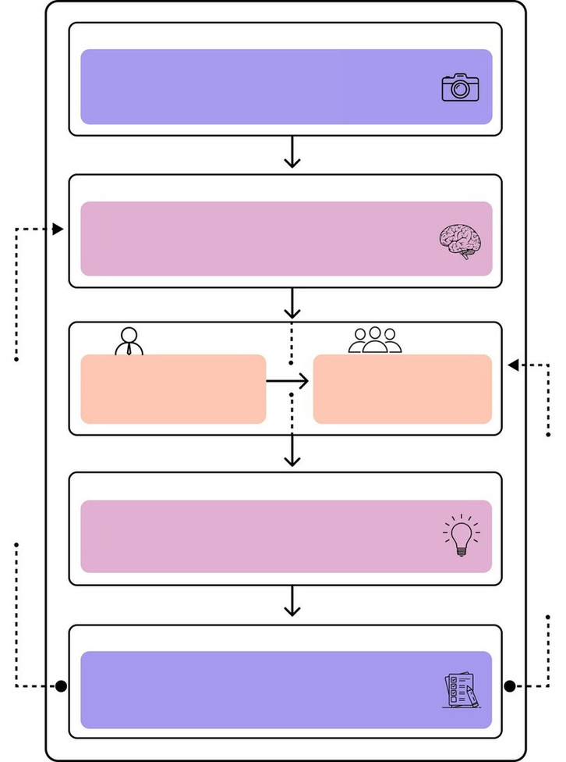
Neuratech
Transforming Rail Madad: AI-Powered Smart Complaint Management
Proposed Solution (Describe your Idea/Solution/Prototype)
Solution
Uniqueness
User Complaint
The user will upload an image or video of the issue along with a description of the complaint.
Complaint Source Integration
Automated Categorization, Prioritization &
Smart Routing
A CNN model processes complaint text and images, extracting features to classify, prioritize, and route complaints.
Aggregates complaints from diverse sources like
social media and news into one system,
automatically categorizing and routing them for
AI Models & ML Algo
efficient handling.
Apply artificial intelligence and machine learning algorithms to analyze user complaints and provide insights.
Predicting Recurring Issue
Cross-Department Collaboration
An LSTM model analyzes historical complaint data to detect patterns, predicting recurring issues and allowing proactive maintenance. Helps in preventing problems before they become widespread
Facilitates collaboration by allowing shared access to complaints, creating a dedicated space for departments to work together on multi-category issues.
Admin
Staff
Manage and oversee the operations and system configurations.
Support and assist in handling user issues and system operations
API - Integration with Rail Madad
Realtime Training
Complaint Recommendation
Creating APIs to connect the AI system with Rail Madad, enabling seamless data exchange. This ensures real-time updates and automated workflows across the complaint management system.
When users submit a complaint, the system shows similar past complaints and their resolutions. This helps users see how similar issues were handled
Output
Assign staff for solving complaint and helping with proper required service, making sure Passenger is Satisfied.
Staff Training
and potentially resolve their concerns faster
Sentiment Analysis - Feedback Management
Emergency Live Video Complaint/SOS
Sentiment analysis uses NLP models to assess emotional tone of complaints, urgent responses to negative feedback. Improves customer satisfaction by addressing critical issues faster.
User Feedback
Introduces real-time video-based complaint reporting for emergencies, enabling instant verification and prioritization. Adds a new level of immediacy to critical situations.
Gather feedback from users after they receive solutions, using it to refine the system and improve future responses.
@SIH Idea submission- Template
2

Slide 3

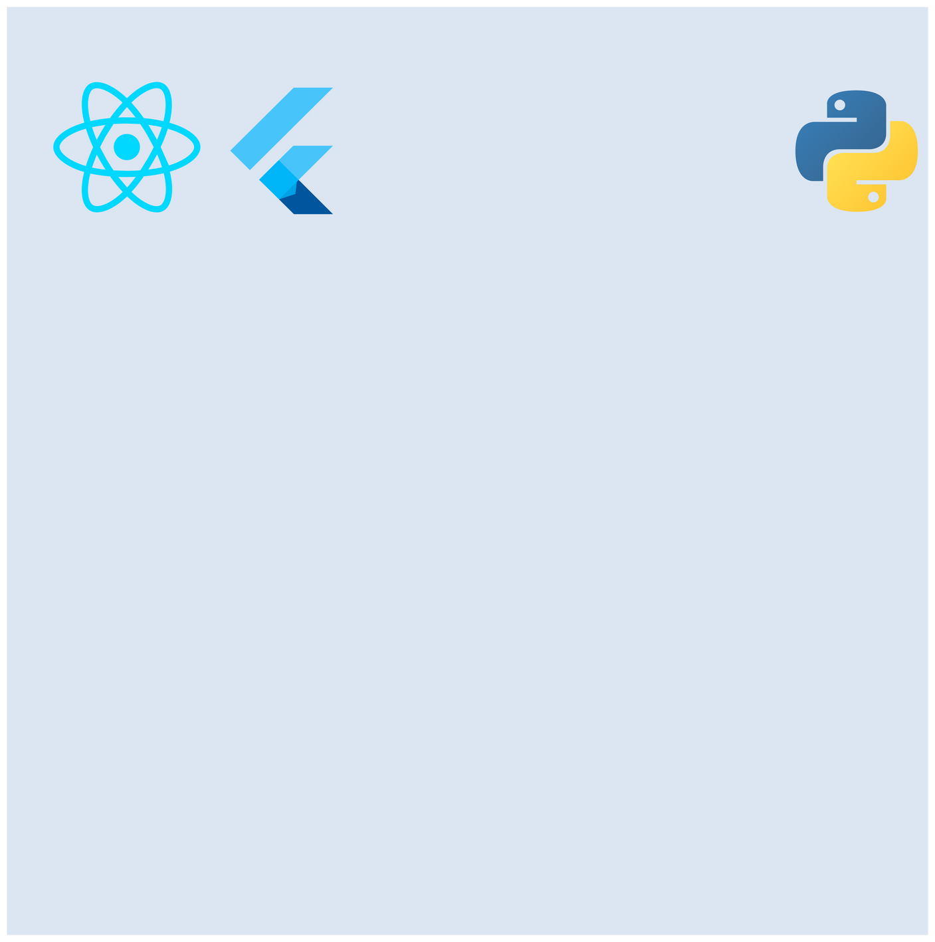
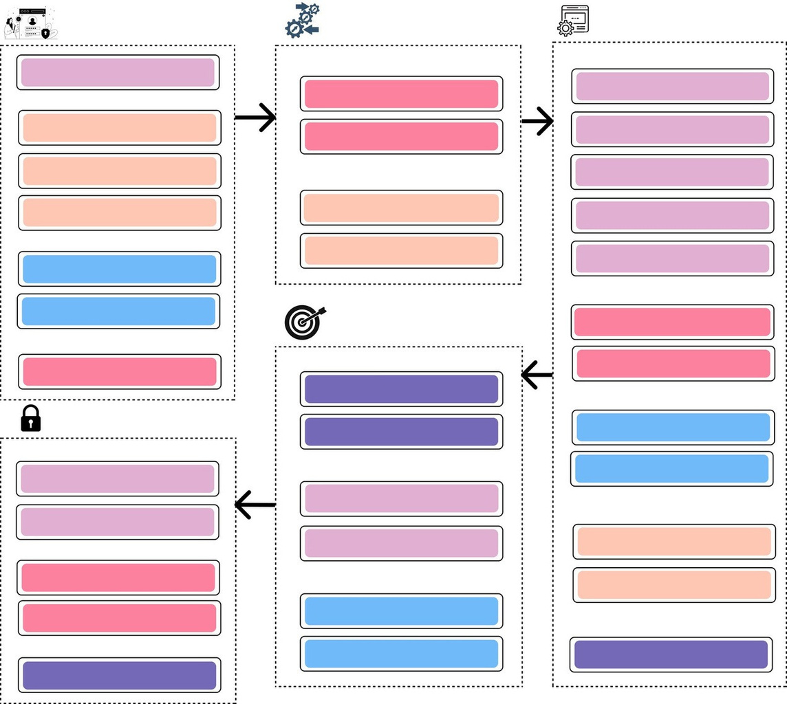






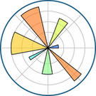

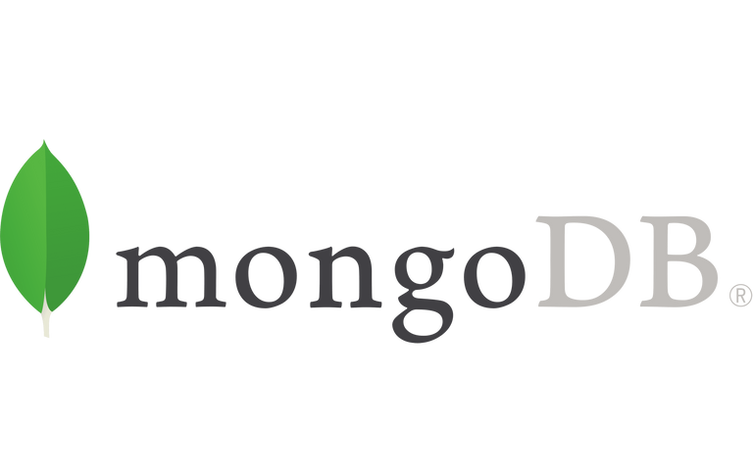
Neuratech
TECHNICAL APPROACH
Frontend
Backend
Presentation Layer
Integration Layer
Application Layer
Registration and Login
API Integration
ML Algorithms & Models
Flask APIS’s accessing ML models
Automated Categorization &
User
Prioritization
Complaint Submission
Integration With Rail Madad
Enhanced Data Extraction(OCR)
Real-Time Updates
Middleware Component
Automated Response and Routing
React for admin website and Flutter for user and staff applications
Flask for building APIs and handling logic and Python for the server side solutions
Machine Learning
Feedback Collection
Data Transformation Preprocessing
LLM Based Chatbot
Staff
Complaint Management
Complaint Queues
Sentiment Analysis
Preprocessing
Training Portal
Complaint Management
Persistence Layer
Complaint Registration and Tracking
Admin
Admin Dashboard
Complaint Database
Departmental Management
Structured Storage
Real Time Training Module
scikit-learn for machine learning tasks and TensorFlow for convolutional neural networks
Security Layer
Data Accessibility
Performance Monitoring
NLTK for text preprocessing & OpenCV for image & video preprocessing
User Authentication
Secure Login Protocols
AI Model Storage
User Feedback
Model Repository
Text Extraction
Visualization
Database
Multi-Factor Authentication (MFA)
Media Handling
Version Control
NLP Based Feature Extraction
Data Encryption
Encryption at Rest
Additional Data Stores
Multilingual Support
Encryption in Transit
Caching Systems
Emergency
Access Control
Logging and Auditing
SOS Live with help of Sockets
Optical Character Recognition Matplotlib for Model Visualization Realtime updates,
Role-Based Access Control (RBAC)
for Text Extraction
& Chartjs for Analytics
Auth & Storage
@SIH Idea submission- Template
3

Slide 4
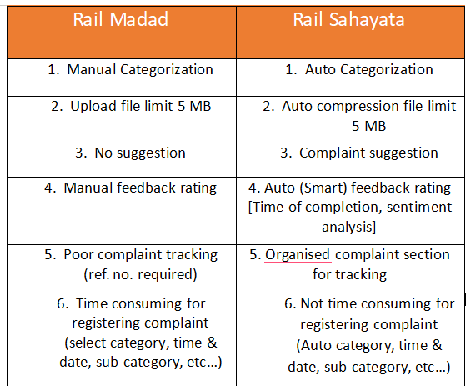
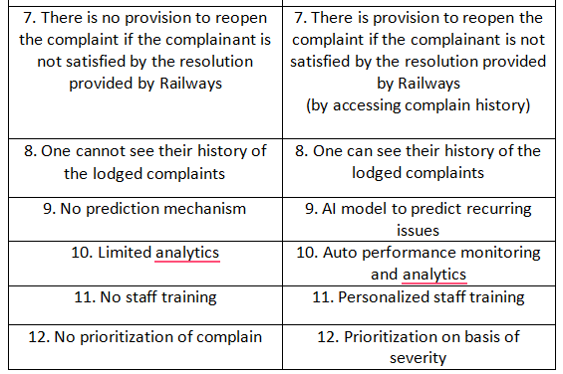
Neuratech
Rail Madad VS Rail Sahayta
@SIH Idea submission- Template
3

Slide 5

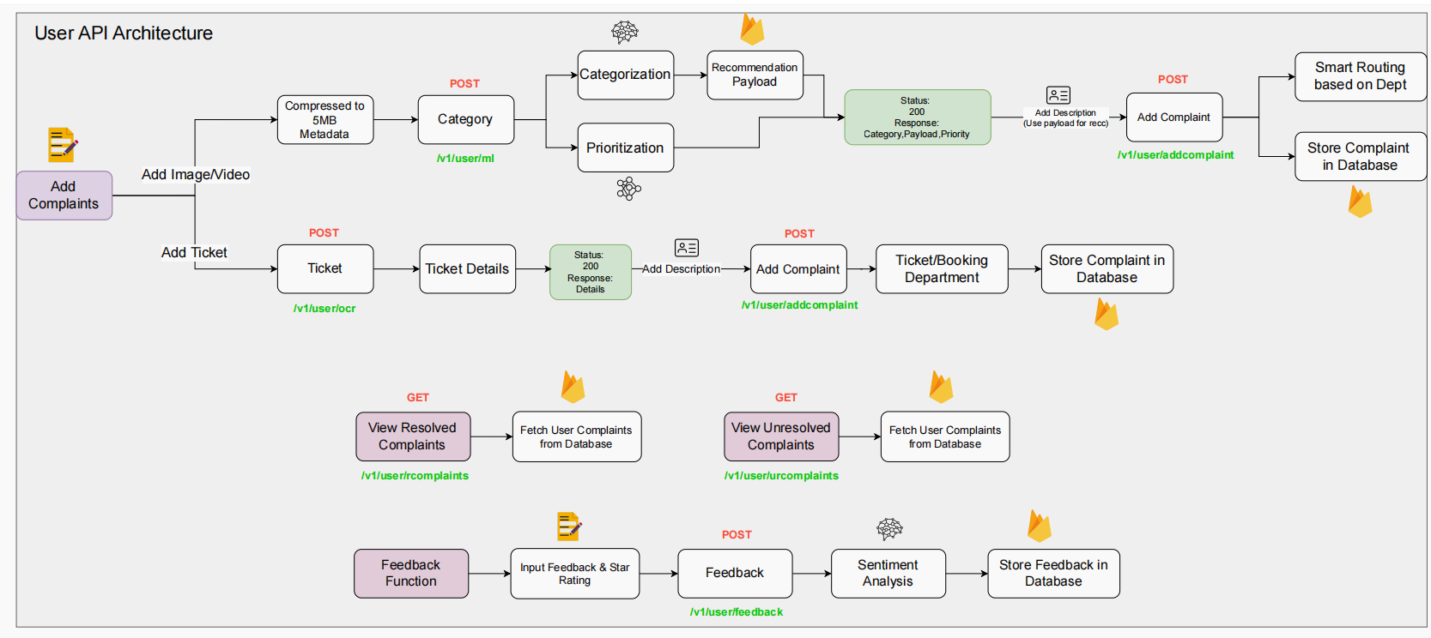
Neuratech
API Architecture
@SIH Idea submission- Template
5
5

Slide 6
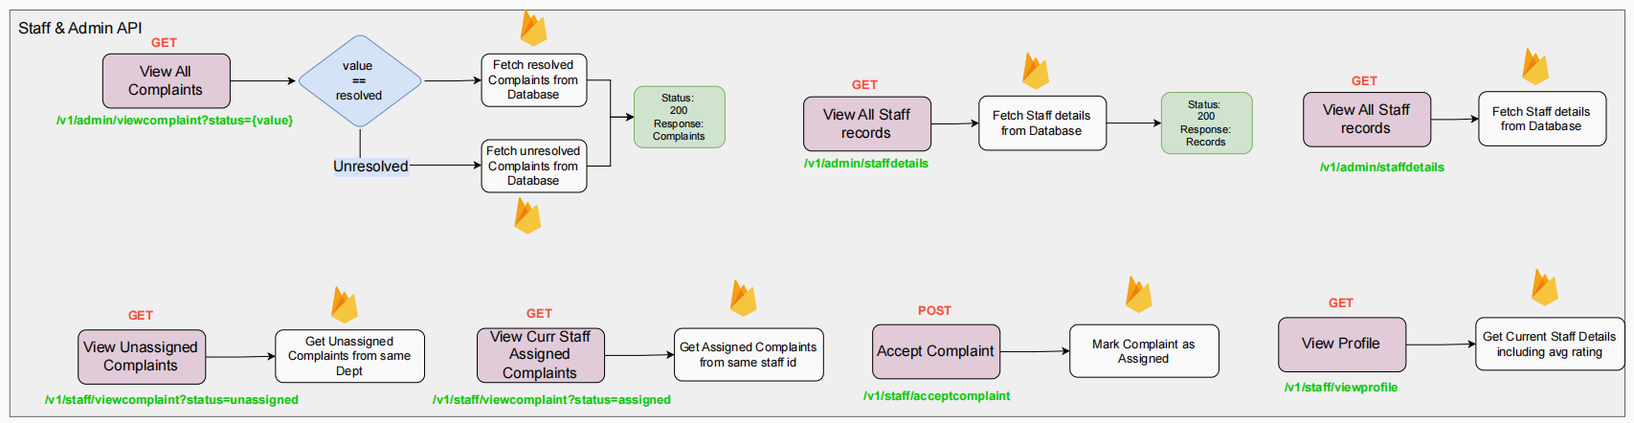
Neuratech
API Architecture
@SIH Idea submission- Template
5
5

Slide 7
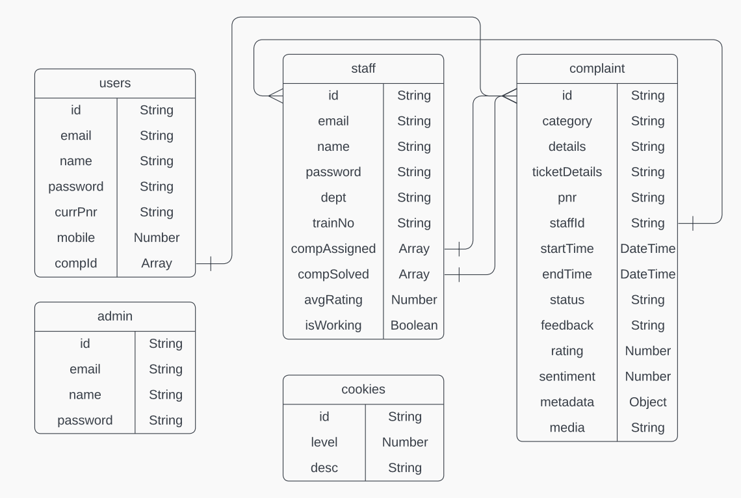
Neuratech
Database Model
@SIH Idea submission- Template
5
5

Slide 8
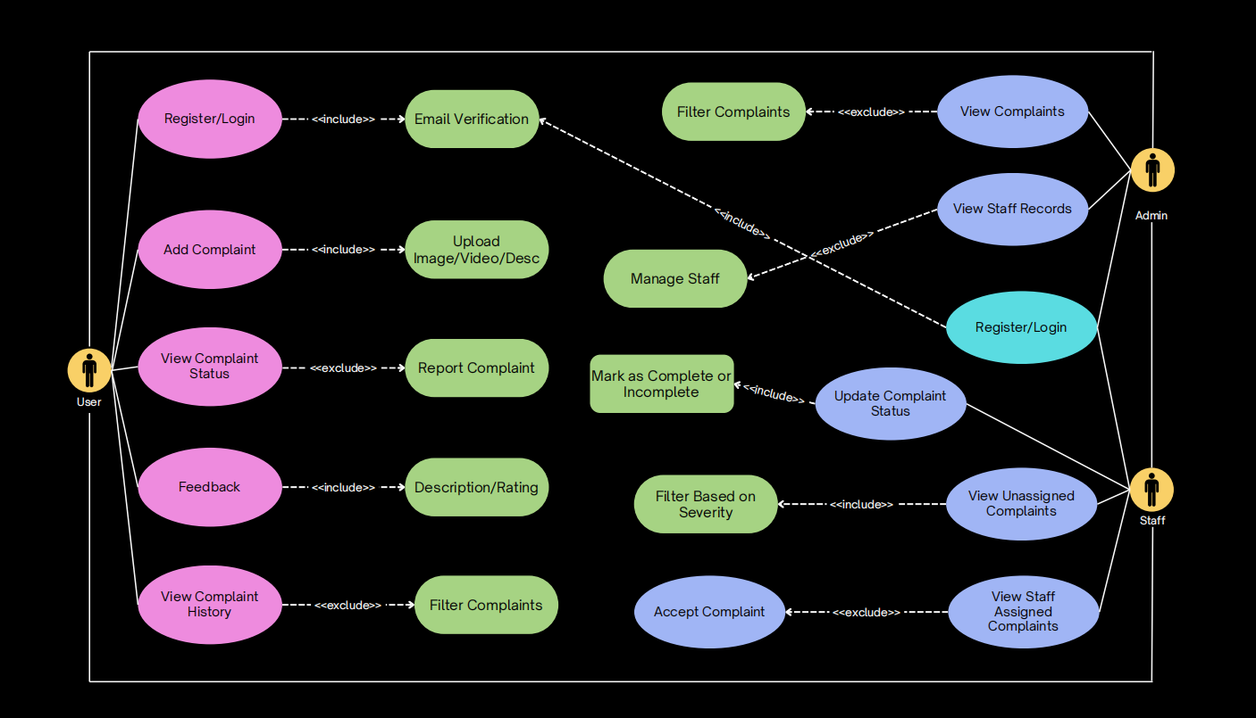
Neuratech
Use Case Diagram
@SIH Idea submission- Template
5
5

Slide 9
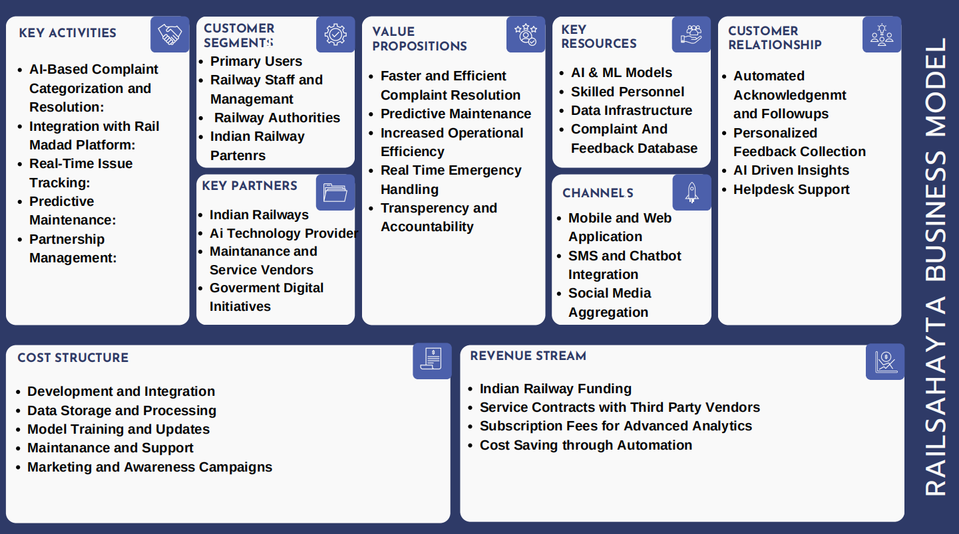
Neuratech
Business Model
@SIH Idea submission- Template
5
5

Slide 10



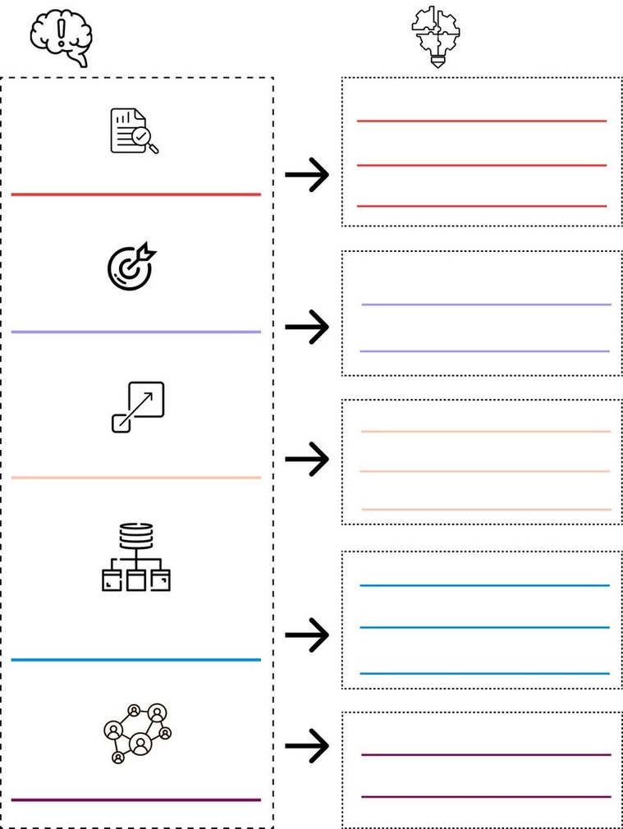













Neuratech
FEASIBILITY AND VIABILITY
Operational Feasibility
Problems
Solution
Automated Categorization and Prioritization: Implementing CNNs for image and video analysis enhances complaint classification, boosting processing efficiency.
Enhanced Data Extraction: Utilizing OCR and metadata extraction provides additional context,
leading to more precise and informed resolutions.
Data Preprocessing & Cleaning
Manual Labelling & Annotation
Automated Response & Routing: AI chatbots and smart routing algorithms streamline complaint
handling and ensure timely resolution by directing complaints to the correct departments.
Predictive Maintenance: Machine learning models for predictive analytics forecast recurring issues,
enabling proactive maintenance and reducing future complaints.
Feedback and Continuous Improvement: Sentiment analysis and performance monitoring drive
ongoing improvements in the complaint resolution process.
Data Quality & Availability
Data Augmentation
Continuous Model Training & Validation
Model Accuracy
Human-In-Loop Approach
Cloud Based Solutions
Technical Feasibility
Economic Feasibility
Scalibility Issues
Distributed Systems
Data Prioritization
Integration with Existing Systems: Requires complex API development and data synchronization for seamless functionality.
Cost of AI Integration: High initial investment in AI technologies and system integration but offers long-term efficiency gains.
Hybrid AI Models
Real-Time Processing: Needs efficient
processing pipelines and low-latency
infrastructure for timely analysis.
Resource Allocation: AI-driven optimization
can lead to cost savings by dynamically
adjusting staffing and resources.
Data Fusion
Handling Multimodal Data
Multimodal Frameworks
(Text, Image & Videos)
Scalability and Performance: Must optimize
algorithms and use cloud solutions to handle
large data volumes and varying loads.
Maintenance and Updates: Ongoing costs for
system maintenance & updates are balanced
by improved resolution speed and accuracy.
Provide Training & Support
Cultural Resistance (staff)
Rewarding & Rankings
@SIH Idea submission- Template
4
4

Slide 11


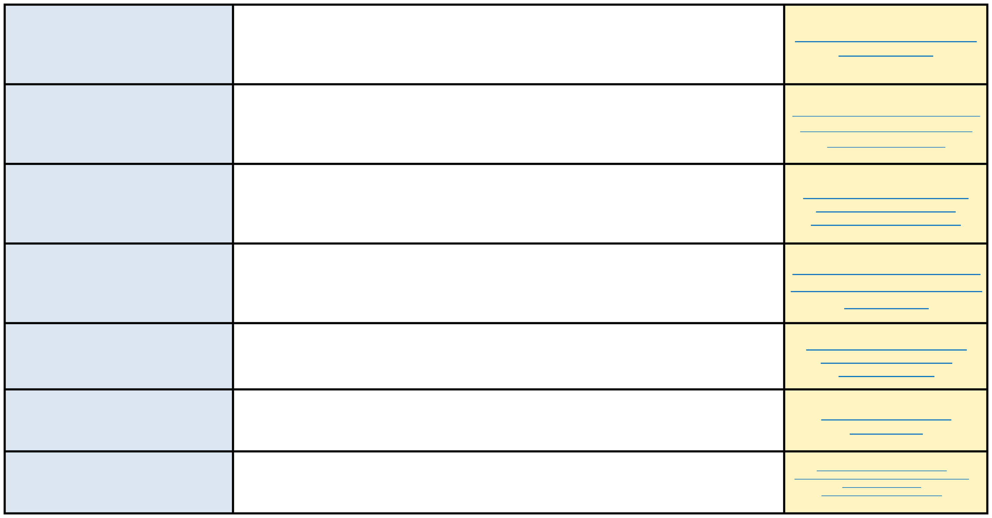
Neuratech
RESEARCH AND REFERENCES
CNN for image categorization & prioritization
CNNs excel at image categorization by learning hierarchical features from raw data, while the final softmax layer provides confidence scores that can prioritize complaints based on classification certainty.
https://www.tensorflow.org/tuto rials/images/cnn
LSTM Model for Predicting Recurring Issue
LSTM models effectively capture temporal dependencies and long-term patterns in time-series data, making them ideal for predicting recurring issues by learning from historical trends and mitigating the vanishing gradient problem.
https://github.com/jaungiers/LSTM- Neural-Network-for-Time-Series- Prediction/tree/master
Sentiment Analysis using NLTK for User Feedback
NLTK (Natural Language Toolkit) effectively classifies sentiment in user feedback by analyzing text data and extracting sentiment scores, providing insights into user opinions and satisfaction levels.
https://www.kaggle.com/code/ jonathanoheix/sentiment- analysis-with-hotel-reviews
OpenCV for Image Preprocessing
OpenCV provides robust tools for image preprocessing, including techniques like filtering, resizing, and normalization, which enhance and prepare images for further analysis.
https://docs.opencv.org/4.x/d2/d 96/tutorial_py_table_of_contents _imgproc.html
Flask API for Integration
Flask enables the creation of RESTful APIs for integrating various components by providing tools for routing, request handling, and CRUD operations.
https://medium.com/@dennisi vy/flask-restful-crud-api- c13c7d82c6e5text
Tesseract for OCR Text Extraction
Tesseract, accessed via the pytesseract library, provides powerful Optical Character Recognition (OCR) capabilities for extracting text from images.
https://pypi.org/project /pytesseract/
LLM Fine Tuning for Chatbot
Fine-tuning large language models (LLMs) allows for advanced chatbot development by adapting the model to specific conversational contexts and user interactions.
https://wandb.ai/mostafaibrahim17/ml- articles/reports/Fine-Tuning-Llama-2-for-Advanced- Chatbot-Development-- Vmlldzo2NTY3ODUwparagraph text
@SIH Idea submission- Template
6

