Slide 1
Citrus Plant Disease Identification using Deep Learning with Multiple Transfer Learning Approaches
Talha Anwar

Slide 2
Introduction
Agricultural sector holds a vital role in the Pakistan economy by contributing 19.8% in Pakistan’s total GDP. [1]
Citrus plants covers 33% total fruit production of Pakistan.
These production can be affected by different diseases.
Misidentification of leaf disease in the agricultural crop can lead to improper or misuse of insecticides and pesticides , causing loss of the crop, increase in pathogen resistance and environmental effect.
Machine learning technique has been used to tackle this problem.
[1] Memon NA, KASBIT D. Citrus fruit (Kino): Punjab produced 98% of production. Exclusive on Kino. 2017:29 - 31

Slide 3
Literature Review
Author | No of Classes | Classifier | Accuracy
Deng, 2016 | 2 | SVM | 91.93%
Sharif, 2018 | 5 | SVM | 90.4 %
Vladimir, 2019 | 3 | Voting | 93.33%
Doh, 2019 | 5 | SVM | 93.12 %
Singh, 2020 | 4 | LDA | 84.3 %
Process followed in above literature papers.
pre-processing,
segmentation,
feature extraction such as color histogram, texture, geometric, statistical features
feature selection
and then classification

Slide 4
Motivation
The previous studies use machine learning which require manual feature extraction and selection to achieve better result.
Machine learning require less data as compared to deep learning.
The proposed approach used deep learning convolution neural network for classification of diseases in citrus leaves.

Slide 5
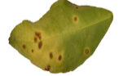
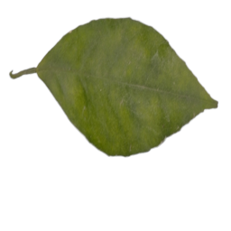
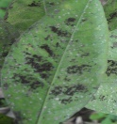
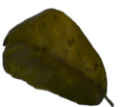
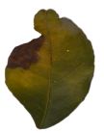
Methodology
Dataset
External Dataset
Different images of pepper, potato , tomato leaves diseases
Canker
Disease | Number of images
Black Spot | 171
Canker | 163
Greening | 204
Melanose | 13
Healthy | 58
Total Images | 609
Healthy
Melanose
Greening
Black Spot

Slide 6
Methodology
Architecture : DenseNet 121
Image size: 224x224
Augmentation:
Flipping Images are flipped vertically and horizontally.
Rotation Images are rotated randomly from 0 to 360 degree.
Shifting Image pixels are shifted 20% width wise and height wise.
Brightness Images are brightened 50% and darkened 50%.
Zoom Images are zoomed 10%.

Slide 7
Methodology
Models
Randomly initialized weights base model (BM)
ImageNet pretrained weights (IMP)
External data pretrained weights model (EPM)
ImageNet + external data pretrained weights (IEPM)

Slide 8
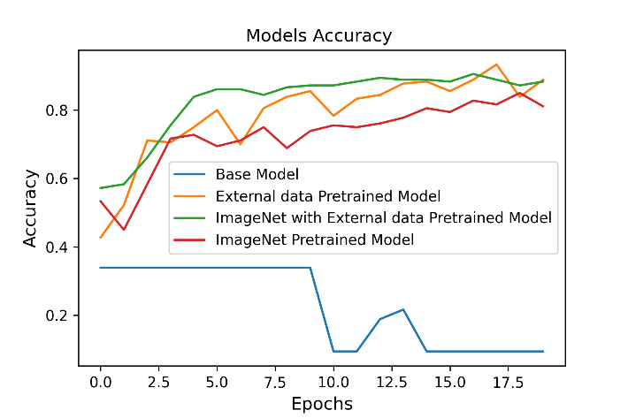
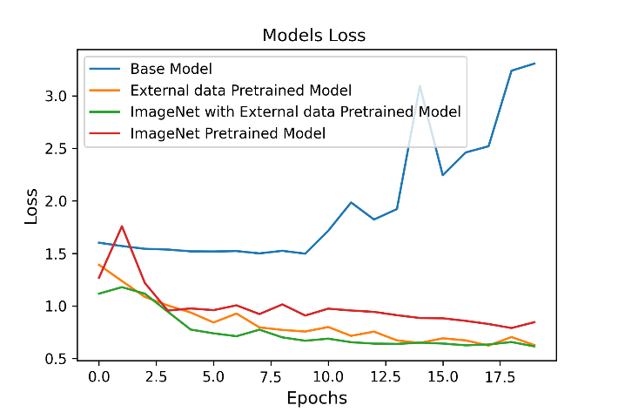
Results
Model Performance
Models | Precision | Recall | F1-score | Accuracy
BM | 0.02 | 0.20 | 0.03 | 0.09
EPM | 0.94 | 0.95 | 0.95 | 0.92
IEPM | 0.92 | 0.85 | 0.88 | 0.88
IPM | 0.89 | 0.86 | 0.87 | 0.82

Slide 9
Conclusion
Using pretrained weights, better result can be achieved. Though the pretrained models are not exactly trained on same classes dataset under study.

Slide 10
Thank You

Slide 11
Reference
X. Deng, Y. Lan, T. Hong, J. Chen (2016). Citrus greening detection using visible spectrum imaging and C-SVC. Computers and Electronics in Agriculture, 130, 177-183.
M. Sharif, MA Khan, Z. Iqbal, M.I. Lali, M.Y. Javed Detection and classification of citrus diseases in agriculture based on optimized weighted segmentation and feature selection, (2018). Computers and electronics in agriculture
P. Vladimir, M.A. Khan, H. Luo Automatic Orange Fruit Disease Identification Using Visible Range Images (2019). International Symposium on Intelligence Computation and Applications. Springer, Singapore
B. Doh, D. Zhang, Y. Shen, F. Hussain, R.F. Doh,, & K. Ayepah. (2019). Automatic Citrus Fruit Disease Detection by Phenotyping Using Machine Learning. 2019 25th International Conference on Automation and Computing (ICAC).
H. Singh, R. Rani, S. Mahajan (2020). "Detection and Classification of Citrus Leaf Disease Using Hybrid Features." Soft Computing: Theories and Applications. Springer, Singapore

