Slide 1
Introduction
Who Should watch this course
  Familiarity with python
  Familiarity with CNN
  Want to
    learn a new framework
    win deep learning competitions
    Build portfolio in medical imaging

Slide 2
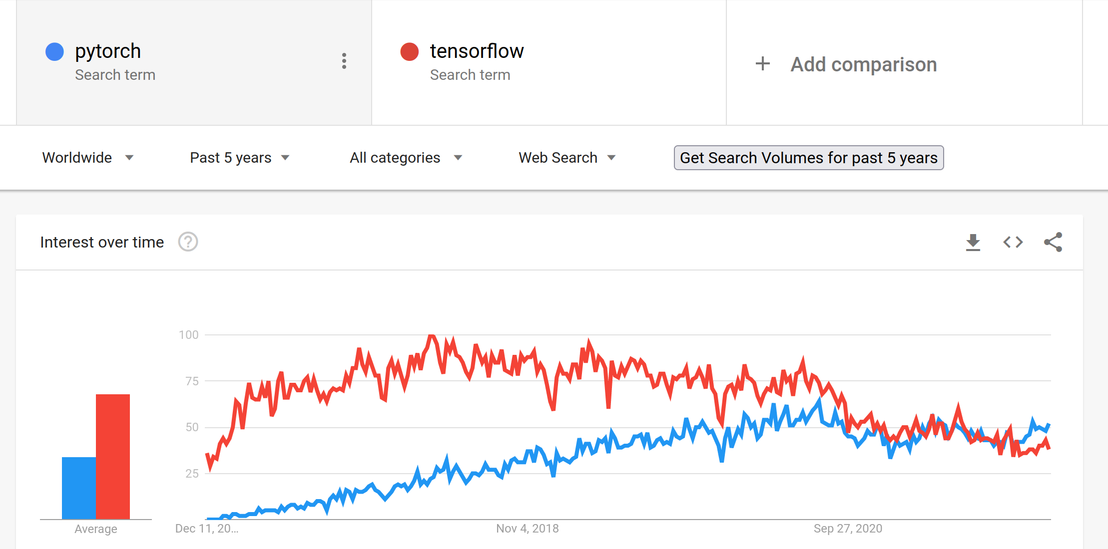
Introduction
Why this course use PyTorch
  PyTorch community is more responsive
  Easy to convert to ONNX for inference
  PyTorch is Flexible
  Easy to Debug
  More conceptual
  Easy to Install

Slide 3
Introduction
Why this course is not using PyTorch
  Unorganized code (hard to read)
  Difficult to add state of art functionality
    Mix Precision
    Stochastic weighting average
    Gradient Accumulation
  A lot of code writing

Slide 4
Introduction
Pytorch Lightning
  Increase Readability
  Easy to reproduce result by deterministic behavior
  Check code error before training
  Display bar to track progress
  Provide a structured way to write code

Slide 5
Introduction
Why this course used Linux
Linux
Finish with:89.55 second, num_workers=2
Finish with:32.36 second, num_workers=4
Finish with:26.83 second, num_workers=6
Finish with:26.47 second, num_workers=8
Finish with:26.32 second, num_workers=10
Finish with:25.773 second, num_workers=12
Finish with:25.34 second, num_workers=14
Finish with:25.43 second, num_workers=16
Finish with:25.52 second, num_workers=18
Finish with:26.797 second, num_workers=20
Finish with:24.81 second, num_workers=22
Windows
Finish with:80.83 second, num_workers=2
Finish with:78.34 second, num_workers=4
Finish with:90.41 second, num_workers=6
Finish with:108.79 second, num_workers=8
Finish with:131.13 second, num_workers=10
Finish with:152.95 second, num_workers=12
Finish with:177.897 second, num_workers=14
error

Slide 6
Sections I
Binary Image Classification
  How to load data from image folder
  How data flow from folders to model training
  How to apply augmentation from Pytorch
  How to train a model
  How to evaluate on validation data
  How to get predictions
  Data Source : github.com/UCSD-AI4H/COVID-CT

Slide 7
Sections II
Multi class Image Classification
  How to apply augmentation from albumentation
  How to set loss function
  How to set scheduler
  How to load and save model
  Competition Source : cxr-covid19.grand-challenge.org
  Position on leader-board: 18th

Slide 8
Sections III
Multi label Image Classification
  How to load data from dataframe
  How to take two input at a time
  How to make parallel deep learning model
  How to use callbacks
  How to use test function in PyTorch lightning
  Competition Link: odir2019.grand-challenge.org
  Position on leader-board: 100th

Slide 9
Sections IV
Medical image regression
  How to find percentage of area infected by disease
  How to ensemble model
  Loss function
  How to resume training

Slide 10
Section V
Model ensemble (bonus)
  The secret sauce to win the competition

