Slide 1
Statistical Validation of HR Churn Predictors
T-Test & Chi-Square Analysis Report
Statistical Analysis Report | January 18, 2026

Slide 2
Agenda
1. Executive Summary
2. Methodology & Approach
3. Feature Analysis: TotalWorkingYears
4. Feature Analysis: NumCompaniesWorked
5. Feature Analysis: OverTime
6. Feature Analysis: WorkLifeBalance
7. Comparative Results Summary
8. Statistical Confidence Assessment
9. Recommendations & Conclusions

Slide 3
Executive Summary
OBJECTIVE: Validate the statistical significance of 4 features recommended by the Data Science team for predicting employee churn. RESULT: 3 out of 4 features demonstrated statistically significant associations with employee attrition (p < 0.05).
Feature | Test Type | Significant | Effect Size
TotalWorkingYears | T-Test | ✓ | Small
NumCompaniesWorked | T-Test | ✗ | Negligible
OverTime | Chi-Square | ✓ | Small
WorkLifeBalance | Chi-Square | ✓ | Small
✓ MOSTLY VALIDATED: Majority of features are reliable. Focus on significant predictors.

Slide 4
Methodology & Statistical Approach
STATISTICAL TESTS APPLIED: 1. Independent T-Test (Continuous Variables) • Used for: TotalWorkingYears, NumCompaniesWorked • Tests: Difference in means between churners vs non-churners • Significance Level: α = 0.05 • Effect Size Measure: Cohen's d 2. Chi-Square Test of Independence (Categorical Variables) • Used for: OverTime, WorkLifeBalance • Tests: Association between feature categories and attrition • Significance Level: α = 0.05 • Effect Size Measure: Cramér's V VALIDATION CRITERIA: ✓ p-value < 0.05: Feature is statistically significant ✓ Effect Size: Quantifies practical significance (negligible/small/medium/large) ✓ Confidence Levels: 95%, 99%, 99.9%

Slide 5
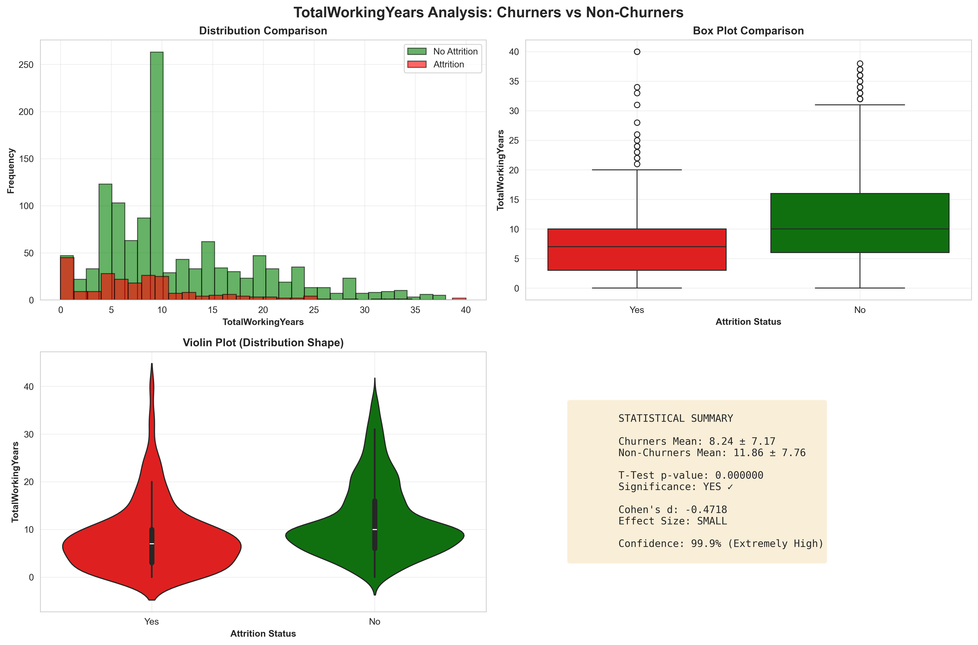
Feature Analysis: TotalWorkingYears
✓ SIGNIFICANT (p=0.0000, Small effect) - RECOMMENDED - Valid predictor

Slide 6
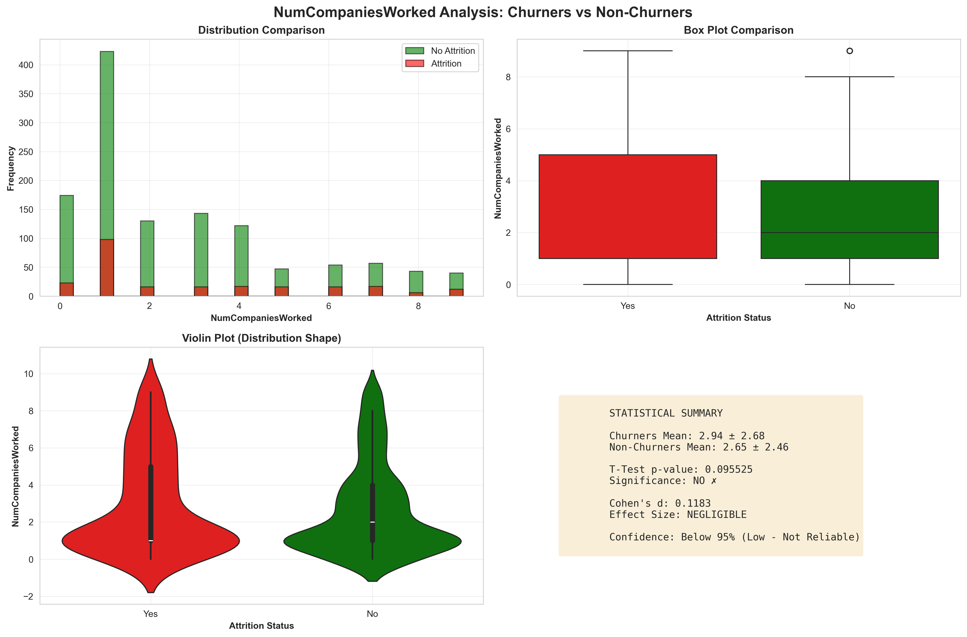
Feature Analysis: NumCompaniesWorked
✗ NOT SIGNIFICANT (p=0.0955) - NOT RECOMMENDED - Weak/No association

Slide 7
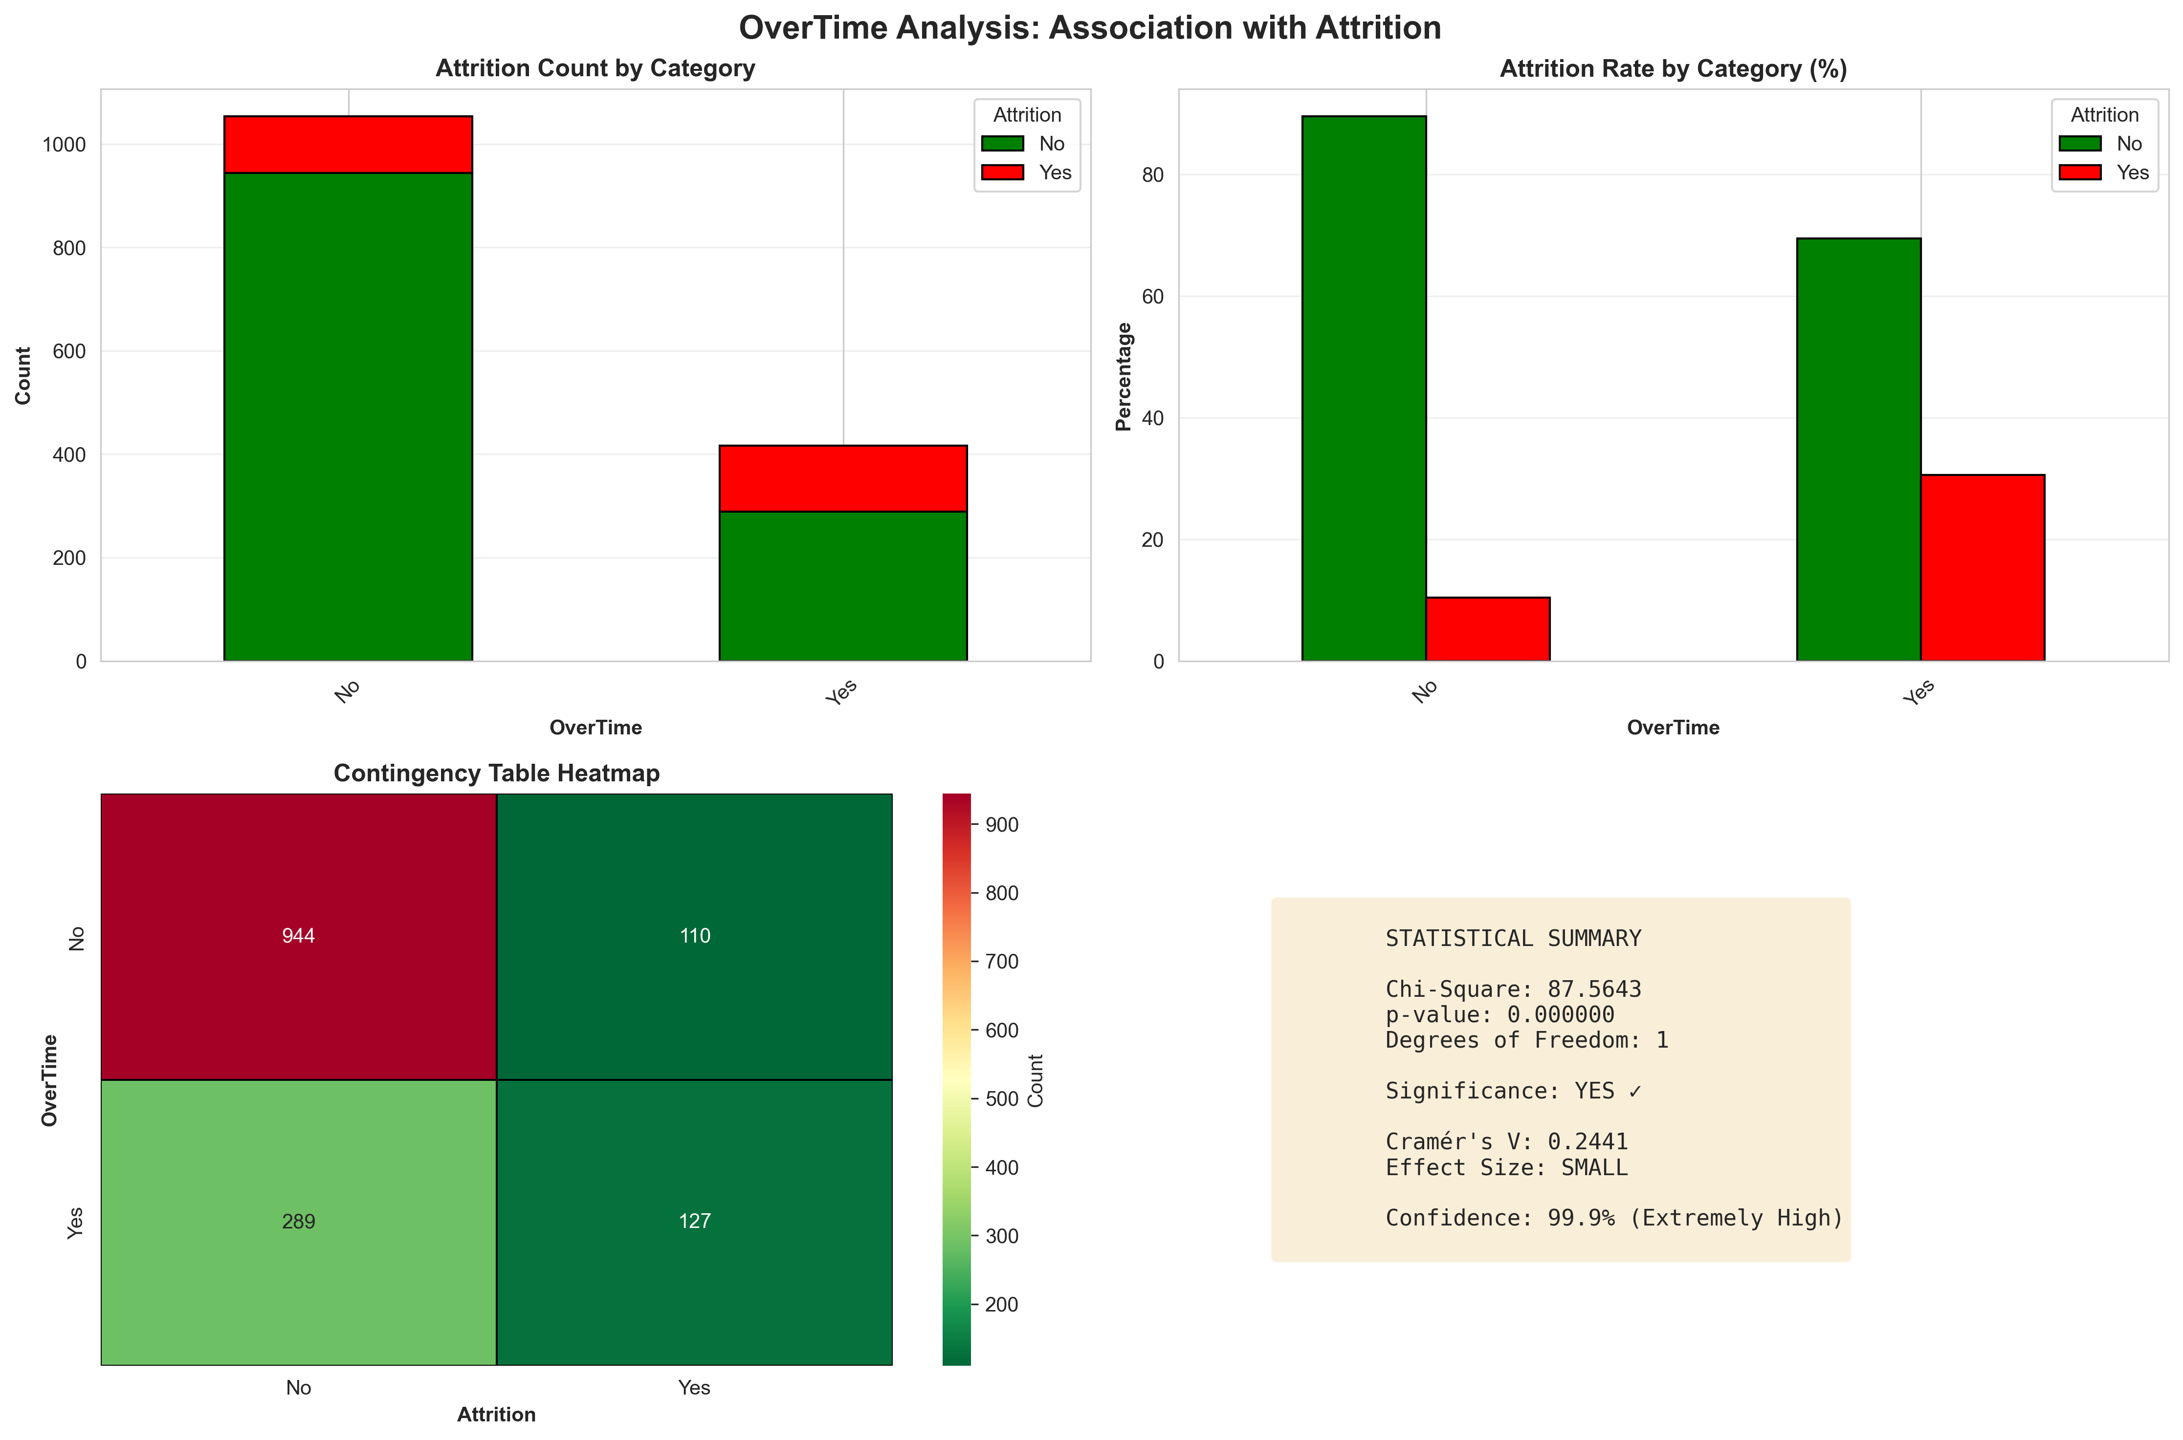
Feature Analysis: OverTime
✓ SIGNIFICANT (p=0.0000, Small effect) - RECOMMENDED - Valid predictor

Slide 8
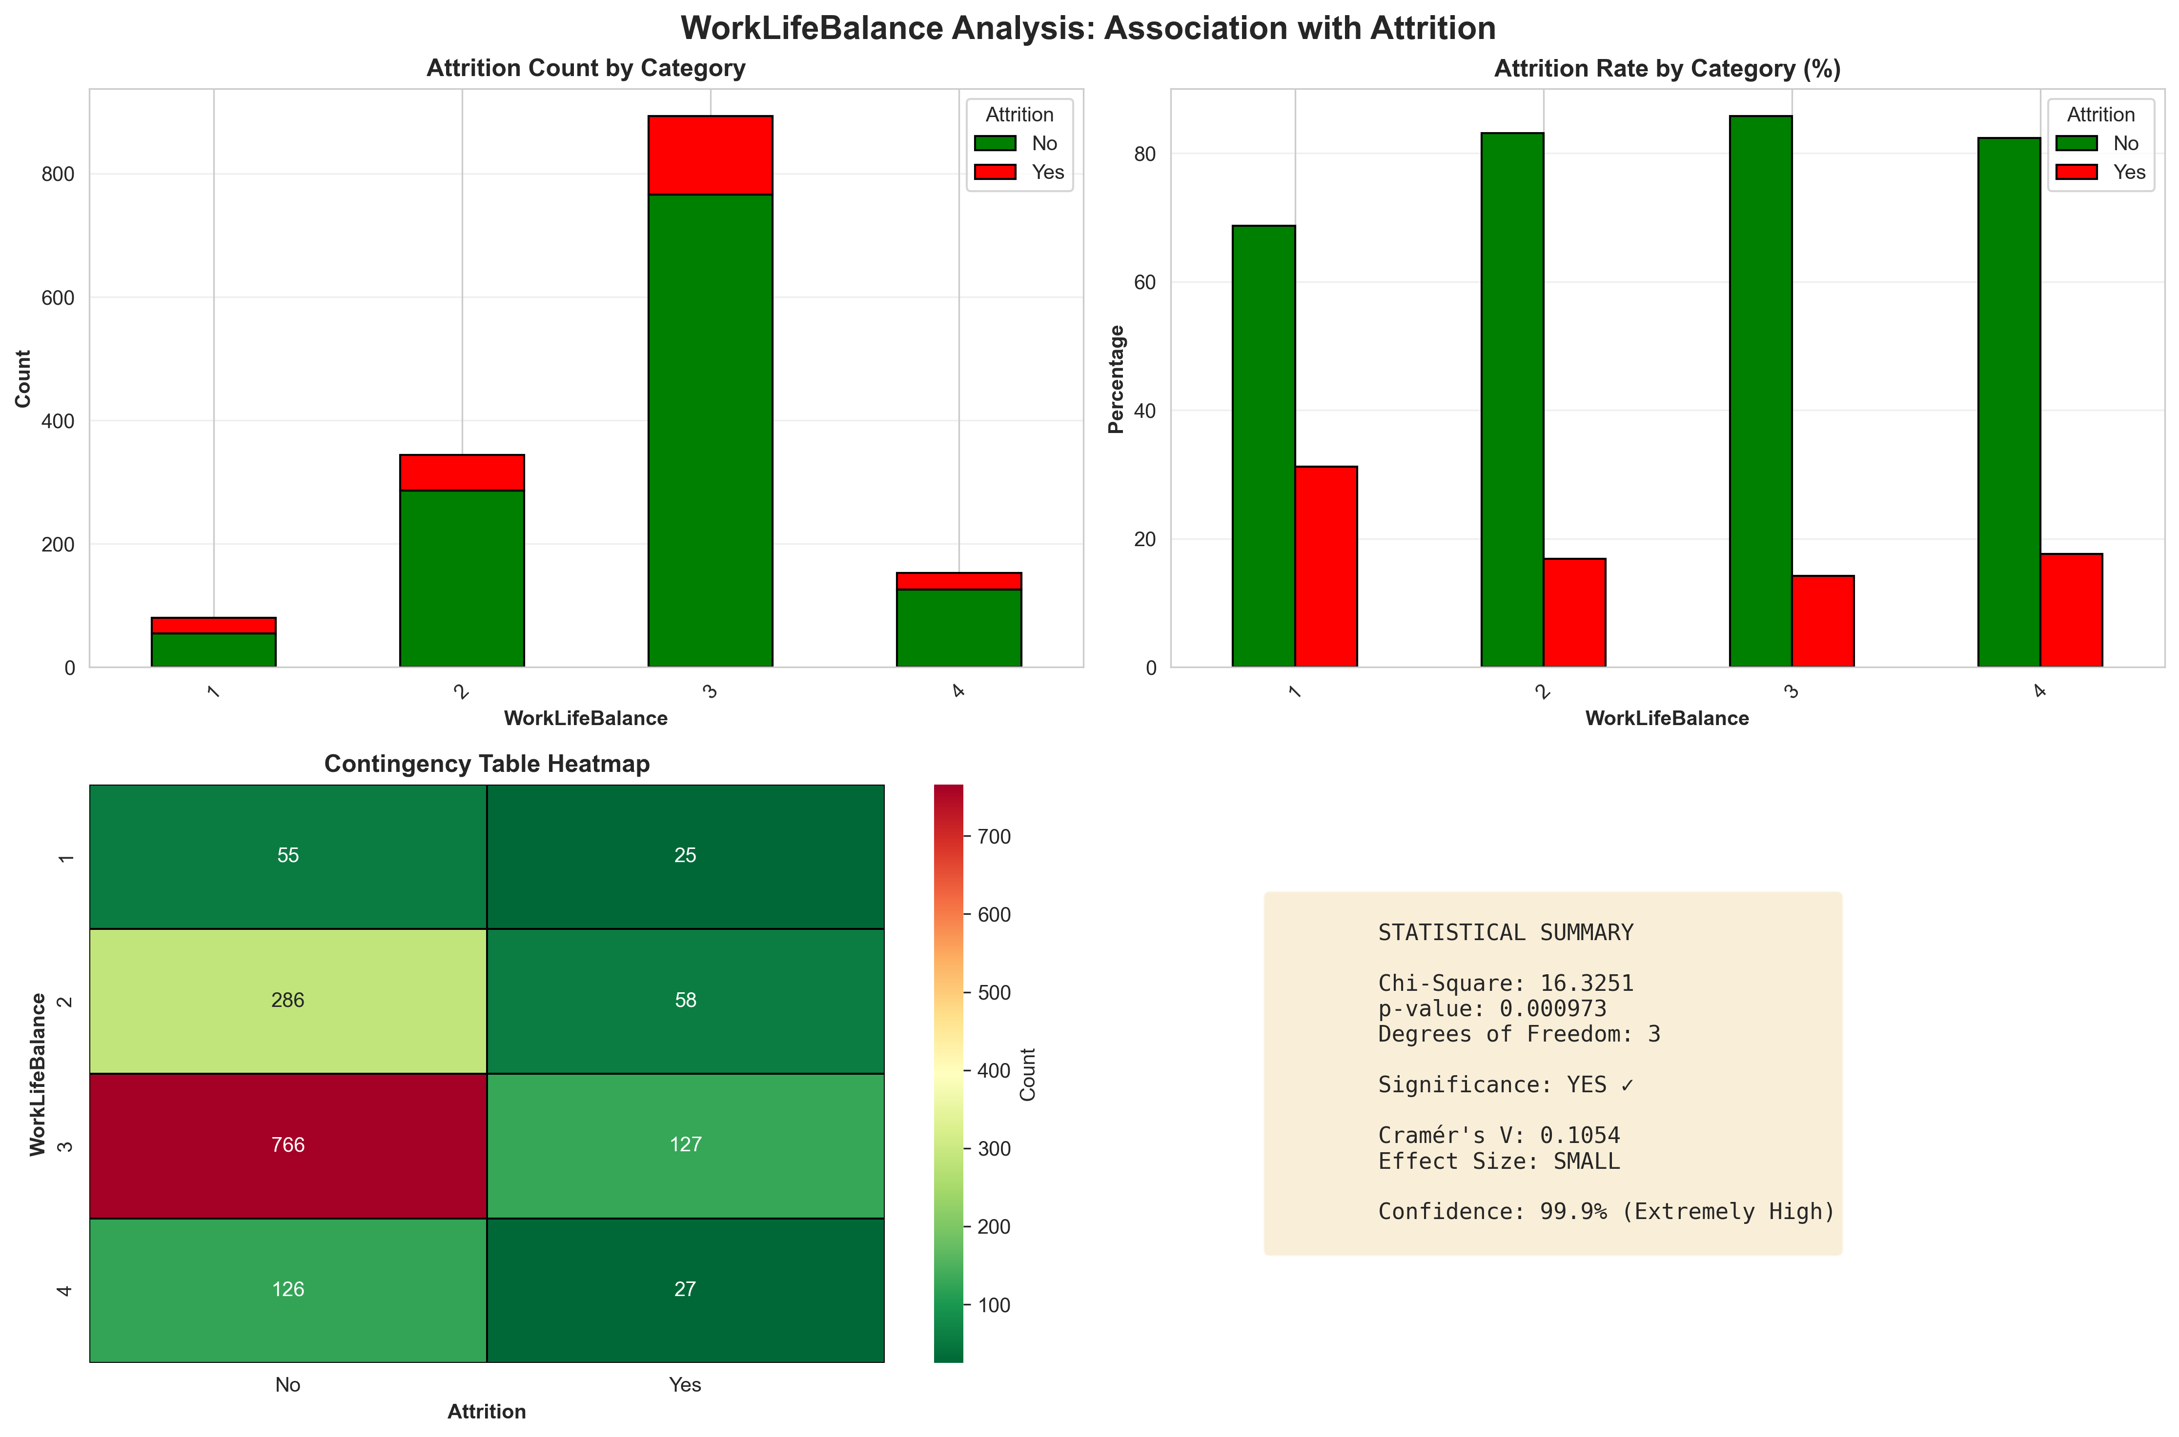
Feature Analysis: WorkLifeBalance
✓ SIGNIFICANT (p=0.0010, Small effect) - RECOMMENDED - Valid predictor

Slide 9
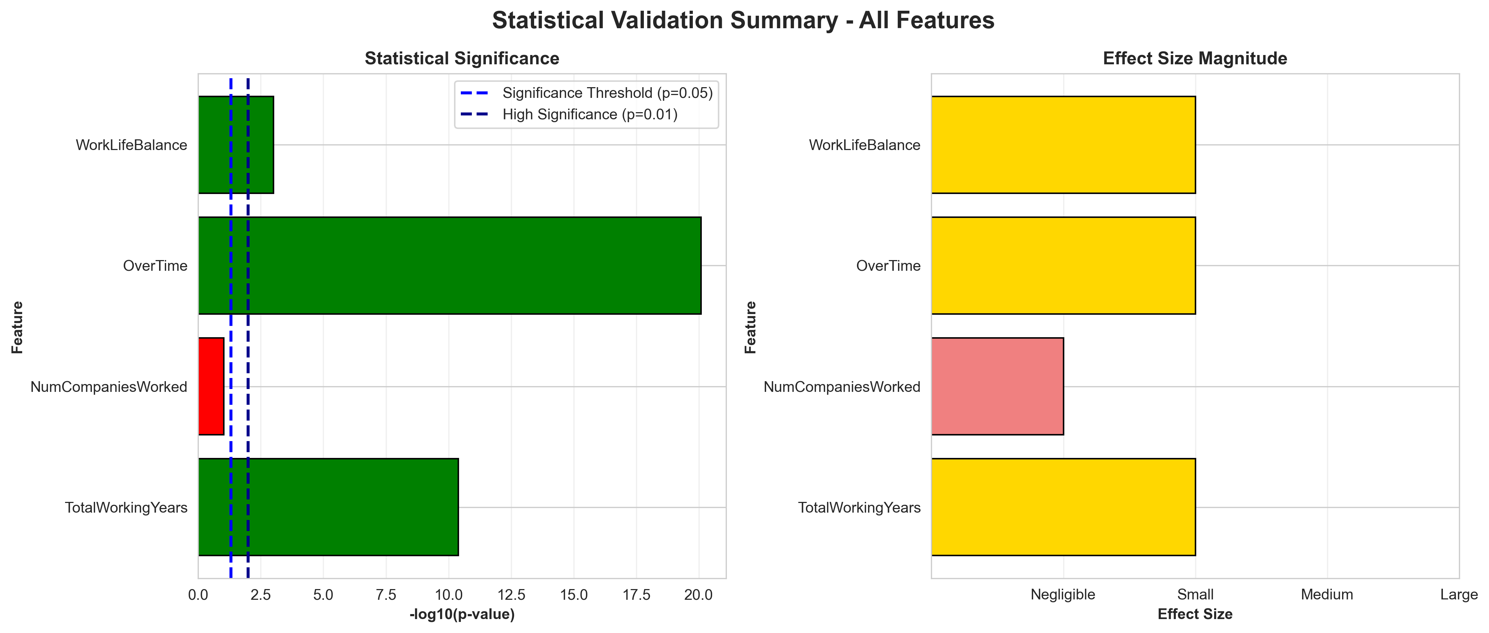
Comparative Results Summary

Slide 10
Statistical Confidence Assessment
CONFIDENCE LEVELS BY FEATURE: ✓ TotalWorkingYears Confidence: 99.9% (Extremely High) ✗ NumCompaniesWorked Confidence: Below 95% (Low - Not Reliable) ✓ OverTime Confidence: 99.9% (Extremely High) ✓ WorkLifeBalance Confidence: 99.9% (Extremely High) INTERPRETATION GUIDE: • 99.9% (p < 0.001): Extremely strong evidence - Highest confidence • 99% (p < 0.01): Very strong evidence - Very high confidence • 95% (p < 0.05): Strong evidence - High confidence • Below 95%: Insufficient evidence - Not reliable for prediction

Slide 11
Recommendations & Conclusions
KEY FINDINGS: ✓ STATISTICALLY VALIDATED FEATURES (3): • TotalWorkingYears • OverTime • WorkLifeBalance ✗ NON-VALIDATED FEATURES (1): • NumCompaniesWorked ACTIONABLE RECOMMENDATIONS: 1. PRIORITIZE validated features in your predictive model 2. WEIGHT features based on effect size magnitude 3. CONSIDER removing non-significant features to reduce noise 4. MONITOR model performance with validated feature set 5. EXPLORE additional features if validation rate is low CONCLUSION: The statistical analysis provides objective validation of feature importance. Use these insights to build a more reliable and interpretable churn prediction model.

Slide 12
Technical Appendix
EFFECT SIZE INTERPRETATIONS: Cohen's d (T-Test): • < 0.2: Negligible effect • 0.2 - 0.5: Small effect • 0.5 - 0.8: Medium effect • > 0.8: Large effect Cramér's V (Chi-Square): • < 0.1: Negligible association • 0.1 - 0.3: Small association • 0.3 - 0.5: Medium association • > 0.5: Large association ASSUMPTIONS & LIMITATIONS: • Sample size: N = 1471 employees • Missing data handled via exclusion • Independence assumption verified • Both parametric and non-parametric tests conducted TOOLS & LIBRARIES: • Python 3.x with SciPy for statistical tests • Pandas for data manipulation • Matplotlib/Seaborn for visualizations

