Slide 1

Master “C Language” In 30 Days Challenge.
This course is presented By: “TECH INVOLVERS”

Slide 2
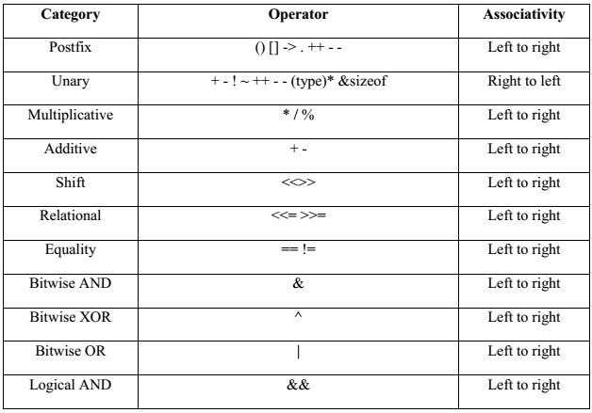
Operator Precedence and Associativity :
It decides which operator will be evaluated first in the case when there are multiple operators present in an expression.

Slide 3
Shift Operators:
Left Shift Operator (<<): The left shift operator moves the bits of the first operand to the left by the number of places indicated by the second argument.
Syntax:
result = operand1 << operand2;
Example:
unsigned int a = 5; // 0000 0101 in binary
int result = a << 2;
Output: result=20; // 0001 0100 in binary
Right Shift Operator (>>): The right shift operator shifts the bits of the first operand to the right by the number of positions specified by the second operand.
Syntax
result = operand1 >> operand2;
Example:
unsigned int a = 20; // 0001 0100 in binary
int result = a >> 2
result = 5 // 0000 0101 in binary

Slide 4
Comma Operator (,): The comma operator evaluates multiple expressions and returns the value of the last expression.comma operator has the least precedence.
Syntax:
result = (expression1, expression2,..., expressionN);
Example:
int a = 5, b = 3;
int result = (a += 2, b *= 2, a + b);
Output:
result = 15 // a = 7, b = 6, a + b =13
TASKS TO DO:
Guess the output??
Task 1:
int a=10, result;
result=(printf(“Tech involvers”),a++,a>>2);
printf(“%d”,result);
Task 2:
int a=10, result;
result=printf(“Tech involvers”),a++,a>>2;
printf(“%d”,result);

Slide 5
SELECTION STATEMENTS
If statement
If-else statement
Nested if
If statement
Syntax
if(expression){
//code to be executed
}
If Else
Syntax
if(expression){
//code to be executed if condition is true
}else{
//code to be executed if condition is false
}

Slide 6
If-ELSE-IF
Syntax
if(condition1){
//code to be executed if condition1 is true
}else if(condition2){
//code to be executed if condition2 is true
}
else if(condition3){
//code to be executed if condition3 is true
}
...
else{
//code to be executed if all the conditions are false
}

Slide 7
Nested if
Syntax
if(expression){
if(expression)
{
//code to be executed if condition is true
}
else
{
//code to be executed if condition is false
}
else
{
//code to be executed if condition is false
}

Slide 8
Switch
syntax
switch(expression){
case value1:
//code to be executed;
break; //optional
case value2:
//code to be executed;
break; //optional
:
:
:
default:
code to be executed if all cases are not matched;
}

