Slide 1

Master “C Language” In 30 Days Challenge.
This course is presented By: “TECH INVOLVERS”

Slide 2
Arrays
An array in C is a fixed-size collection of similar data items stored in contiguous memory locations.
Array Declaration
We can declare an array by specifying its name, the type of its elements, and the size of its dimensions. When we declare an array in C, the compiler allocates the memory block of the specified size to the array name.
Syntax of Array Declaration
data_type array_name [size]; or data_type array_name [size1] [size2]...[sizeN];
where N is the number of dimensions.

Slide 3
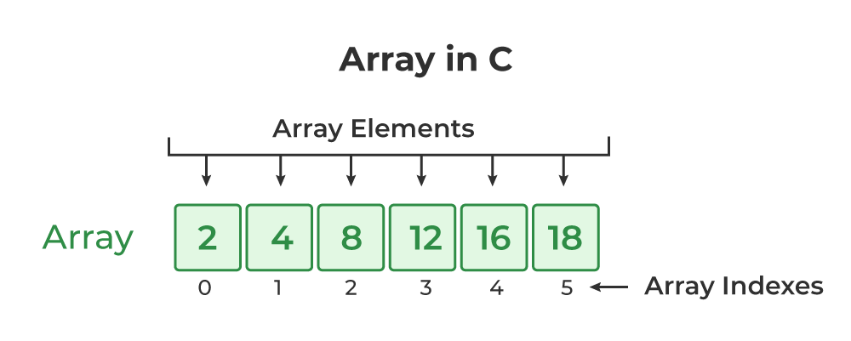

Slide 4
Array Initialization
When the array is declared or allocated memory, the elements of the array contain some garbage value. So, we need to initialize the array to some meaningful value.
1. Array Initialization with Declaration
In this method, we initialize the array along with its declaration. We use an initializer list to initialize multiple elements of the array. An initializer list is the list of values enclosed within braces { } separated b a comma.
Syntax:
data_type array_name [size] = {value1, value2, ... valueN};

Slide 5
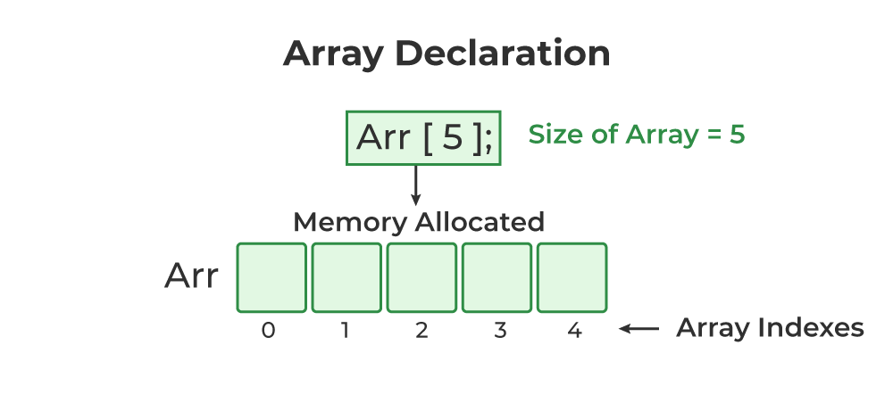

Slide 6
2. Array Initialization with Declaration without Size
If we initialize an array using an initializer list, we can skip declaring the size of the array as the compiler can automatically deduce the size of the array in these cases. The size of the array in these cases is equal to the number of elements present in the initializer list.
Syntax:
data_type array_name[] = {1,2,3,4,5};
The size of the above arrays is 5 which is automatically deduced by the compiler.
.

Slide 7
3. Array Initialization after Declaration (Using Loops)
We initialize the array after the declaration by assigning the initial value to each element individually
Syntax
for (int i = 0; i < N; i++) { array_name[i] = value(i); }
Access Array Elements
We can access any element of an array in C using the array subscript operator [ ] and the index value i of the element.
Syntax
array_name [index];
Note:
One thing to note is that the indexing in the array always starts with 0, i.e., the first element is at index 0 and the last element is at N – 1 where N is the number of elements in the array.

Slide 8
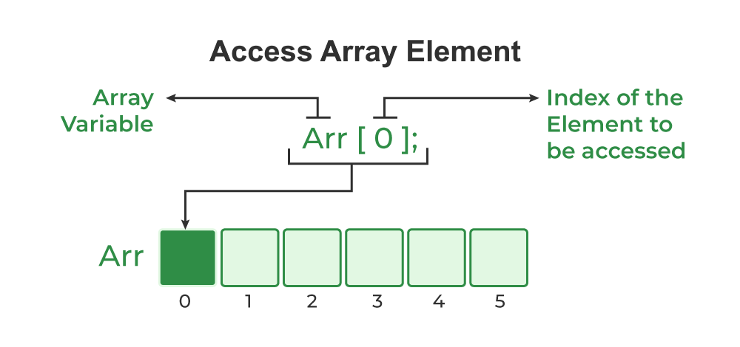

Slide 9
Update Array Element
We can update the value of an element at the given index i in a similar way to accessing an element by using the array subscript operator [ ] and assignment operator =.
Syntax
array_name[i] = new_value;
Types of Array in C
There are two types of arrays based on the number of dimensions it has. They are as follows:
One Dimensional Arrays (1D Array)
Multidimensional Arrays
1. One Dimensional Array in C
The One-dimensional arrays, also known as 1-D arrays in C are those arrays that have only one dimension.
Syntax of 1D Array in C
array_name [size];

Slide 10
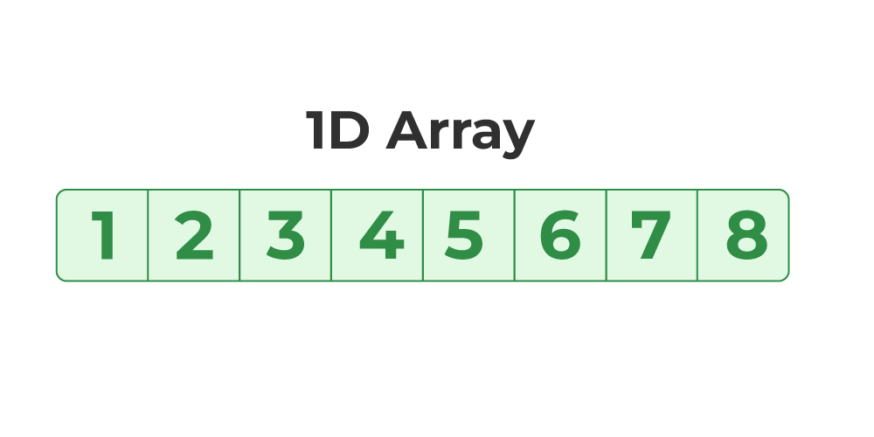
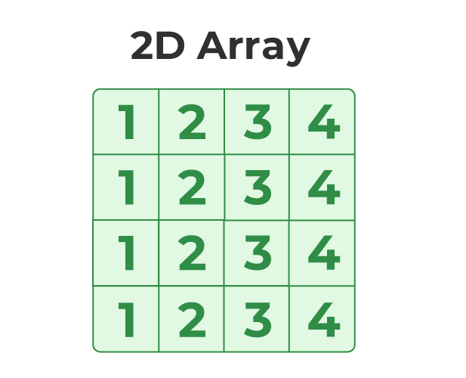

Slide 11
Two-Dimensional Array in C
A Two-Dimensional array or 2D array in C is an array that has exactly two dimensions. They can be visualized in the form of rows and columns organized in a two-dimensional plane.
Syntax of 2D Array in C
array_name[size1] [size2];
Initialization of 2D Array in C:
int arr[4][3]={{1,2,3},{2,3,4},{3,4,5},{4,5,6}};
:

Slide 12
Using Loops
int array[3][4];
int value = 1; // Initial value to fill the array
// Initialize the 2D array using nested for loops
for (int i = 0; i < 3; i++) {
for (int j = 0; j < 4; j++) {
array[i][j] = value++;
}
}
// Print the array to verify the initialization
for (int i = 0; i < 3; i++) {
for (int j = 0; j < 4; j++) {
printf("%d ", array[i][j]);
}
printf("\n");
}

