Slide 1

Master “C Language” In 30 Days Challenge.
This course is presented By: “TECH INVOLVERS”

Slide 2
INTRO TO “C” LANGUAGE
C is a general-purpose, procedural, high-level programming language used in the development of computer software and applications, system programming, games, and more.
C language was developed by Dennis M. Ritchie at the Bell Telephone Laboratories in 1972.
It is a powerful and flexible language which was first developed for the programming of the UNIX operating System.
Like syntax of Java, PHP, JavaScript, and many other languages are mainly based on the C language. C++ is nearly a superset of C language.

Slide 3
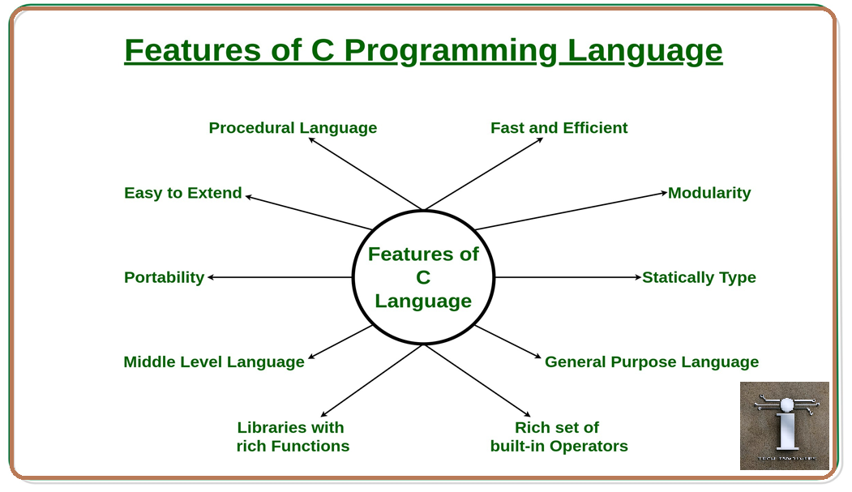

Slide 4
COMMENTS
The comments in C are human-readable explanations or notes in the source code of a C program. These are the statements that are not executed by the compiler or an interpreter
Types of comments in C
In C there are two types of comments in C language:
//Single-line comment
/*Multi-line comment*/

Slide 5
Basic Syntax
#include <stdio.h> int main() { printf("Hello World!"); return 0; }

Slide 6
Structure of C program
1 |  | #include<stdio.h> | Header
2 |  | Int/ void main() | Main
 | 3 | {
 | 4 | printf(“Hello Tech Involvers”); | Statement
 | 5 | return 0; | Return
 | 6 | }

Slide 7
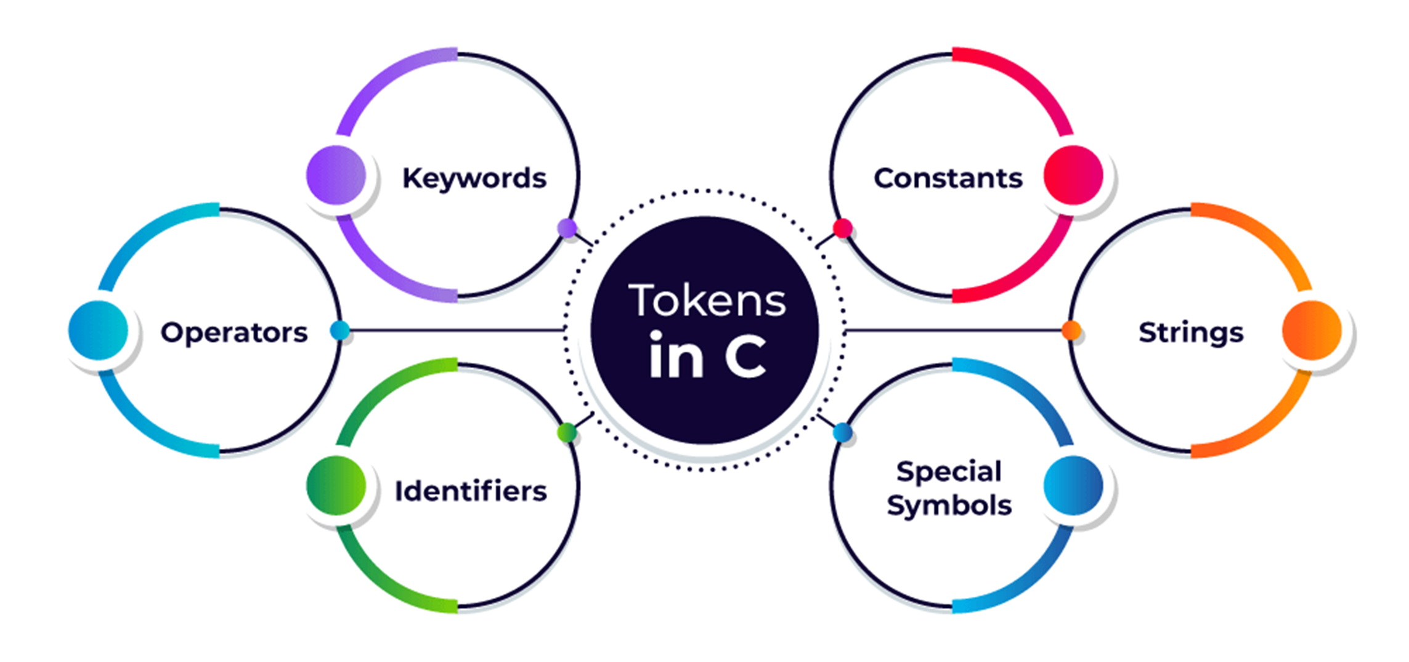
TOKEN
A token in C can be defined as the smallest individual element of the C programming language that is meaningful to the compiler. It is the basic component of a C program.

Slide 8
Keyword
Pre-defined or reserved words .
Perform A specific function in A program.
C language supports 32 keywords
Identifiers
Identifiers are used for the naming of variables, functions, and arrays.
Rules for Naming Identifiers
They must begin with a letter(a, b, c) or underscore(_).
They must consist of only letters(a, b, c), digits(1, 2, 3), or underscore(_). No other special character is allowed(@ ! $ # ^ * % & ( ) [ ] { } < > + = _ – | / \ ; : ' “ , . ?).
It should not be a keyword (“int”),(“for”) etc.
It must not contain white space(“ “), Spacebar( ), Tab( ).
It should be up to 31 characters long as only the first 31 characters are significant

Slide 9
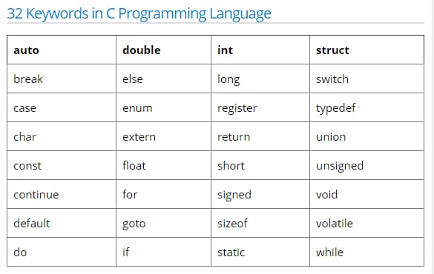
Variables in C
A variable is the name of the memory location. It is used to store information. Variables are key building elements of the C programming language used to store and modify data in computer programs

Slide 10
Constants:
The constants refer to the variables with fixed values.
Strings:
Strings are an array of characters ended with a null character (‘\0’).
Strings are always enclosed in double quotes.
Whereas, a character is enclosed in single quotes in C and C++.
Special Symbols:
Brackets [ ] Semicolon ;
Pre-processor # Asterisk *
Parenthesis ( ) Braces { }

Slide 11
C Format Specifier
The format string determines the format of the input and output. The format string always starts with a '%' character.
%d or %i for Integers
%s for Strings
%c for Characters
%f for Signed Float
%if for Double
%u for positive integer

Slide 12
%x/%X for hexadecimal
%e \ %E for exponent
%g for float with fixed precision
%p for address in hexadecimal
%u for positive integer

