Slide 1

Master “C Language” In 30 Days Challenge.
This course is presented By: “TECH INVOLVERS”

Slide 2
C Structure
In C, there are cases where we need to store multiple attributes of an entity. Structure in c is a user-defined data type that enables us to store the collection of different data types. Each element of a structure is called a member.
The .struct keyword is used to define the structure.
Syntax:
struct structure_name
{
data_type member1;
data_type member2;
.
.
.
data_type memebe[N];
};

Slide 3
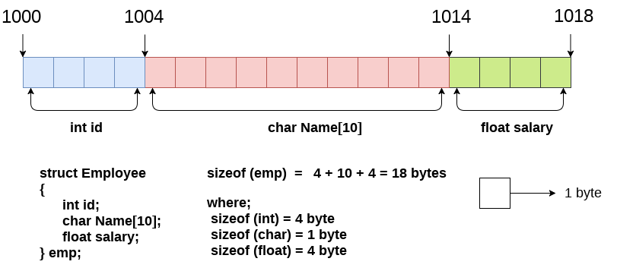
Example:
struct employee
{ int id;
char name[10];
float salary;
};

Slide 4
Declaring structure variable
There are two ways to declare structure variable
1st way:
Let's see the example to declare the structure variable by struct keyword. It should be declared within the main function.
struct employee
{ int id;
char name[50];
float salary;
};
write given code inside the main() function.
struct employee e1, e2;
The variables e1 and e2 can be used to access the values stored in the structure.

Slide 5
2nd way:
Let's see another way to declare variable at the time of defining the structure.
struct employee
{ int id;
char name[50];
float salary;
}e1,e2;
Accessing members of the structure
There are two ways to access structure members:
By . (member or dot operator)
By -> (structure pointer operator)
Let's see the code to access the id member of p1 variable by. (member) operator.
p1.id or
p1->id

Slide 6
C Structure example
#include<stdio.h>
#include <string.h>
struct employee
{ int id;
char name[50];
}e1; //declaring e1 variable for structure
int main( )
{
//store first employee information
e1.id=101;
strcpy(e1.name, “tech involvers");//copying string into char array
//printing first employee information
printf( "employee 1 id : %d\n", e1.id);
printf( "employee 1 name : %s\n", e1.name);
return 0;
}
Output:
employee 1 id : 101
employee 1 name : tech involvers

Slide 7
typedef in C
The typedef is a keyword used in C programming to provide some meaningful names to the already existing variable in the C program. It behaves similarly as we define the alias for the commands.
Syntax of typedef
typedef <existing_name> <alias_name>
Example
typedef struct student
{
char name[20];
int age;
} stud;
We will use it in main( ) to declare as follows:
stud s1,s2;

Slide 8
Example:
#include <stdio.h>
typedef struct student
{
char name[20];
int age;
}stud;
int main()
{
stud s1;
printf("Enter the details of student s1: ");
printf("\nEnter the name of the student:");
scanf("%s",&s1.name);
printf("\nEnter the age of student:");
scanf("%d",&s1.age);
printf("\n Name of the student is : %s", s1.name);
printf("\n Age of the student is : %d", s1.age);
return 0;
}
Output:
Enter the details of student s1:
Enter the name of the student :Peter
Enter the age of student: 28
Name of the student is :Peter
Age of the student is : 28

Slide 9
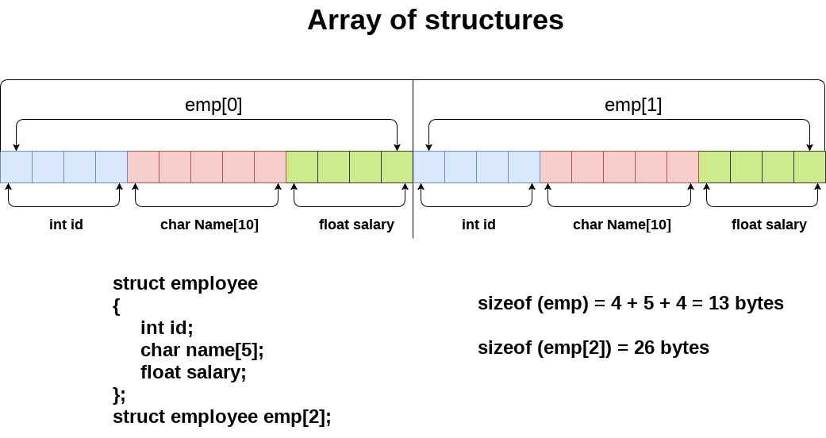
C Array of Structures:
An array of structres in C can be defined as the collection of multiple structures variables where each variable contains information about different entities. The array of structures in C are used to store information about multiple entities of different data types. The array of structures is also known as the collection of structures.

Slide 10
Detailed-Example:
struct student{
int rollno;
char name[10];
};
int main(){
int i;
struct student st[5];
printf("Enter Records of 5 students");
for(i=0;i<5;i++){
printf("\nEnter Rollno:");
scanf("%d",&st[i].rollno);
printf("\nEnter Name:");
scanf("%s",&st[i].name);
}
printf("\nStudent Information List:");
for(i=0;i<5;i++){
printf("\nRollno:%d, Name:%s",st[i].rollno,st[i].name);
}
return 0;
}
Output:
Enter Records of 5 students
Enter Rollno:1
Enter Name:rohan
Enter Rollno:2
Enter Name:siraj
Enter Rollno:3
Enter Name:babar
Enter Rollno:4
Enter Name:James
Enter Rollno:5
Enter Name:Sarfraz
Student Information List:
Rollno:1, Name:rohan
Rollno:2, Name:siraj
Rollno:3, Name:babar
Rollno:4, Name:James
Rollno:5, Name:Sarfraz

Slide 11
Union in C
Union can be defined as a user-defined data type which is a collection of different variables of different data types in the same memory location. The union can also be defined as many members, but only one member can contain a value at a particular point in time.
Union is a user-defined data type, but unlike structures, they share the same memory location.
Example:
union abc
{
int a;
char b;
}var;
int main()
{
var.a = 66;
printf("\n a = %d", var.a);
printf("\n b = %d", var.b);
}
Output:
a = 66
b = 66

