Slide 1
Isoline
Reads the ECG. Knows when not to.
Quality-aware, explainable ECG screening from scans and phone photos
Talha Salman (560) · Deep Learning Semester Project
Notes:
Hello, I am Talha Salman (560). This is Isoline, my deep learning semester project. The tagline is the whole idea: it reads the ECG, and it knows when not to.

Slide 2
The problem
ECGs often travel as printouts and phone photos, not as clean signals
Real photos are tilted, creased, shadowed and blurry
A network always gives an answer, sure or not
A wrong answer that looks confident is the dangerous case
Isoline
2 / 14
Notes:
ECGs often travel as printouts and phone photos. Most deep learning models need the clean signal, and image models usually answer with the same confidence whether the photo is crisp or crumpled. A wrong answer that looks sure of itself is the dangerous case. So my question was not only what does this ECG show, but can I trust this picture, and can I trust my own answer.

Slide 3
The idea: five steps
1 Check the picture: good, fair or bad
2 Read the image with an EfficientNet
3 Rebuild the waveform with a digitizer
4 Cross-check with a signal model (CNN + Transformer)
5 Explain with a heat map and a one-page report
Isoline
3 / 14
Notes:
Isoline works in five steps. First it checks the picture and refuses the bad ones. Then an image model reads the picture directly. A digitizer rebuilds the waveform, and a second, independent network reads that. If the two agree, the answer is marked reliable. Finally a heat map and a one-page report explain the result.

Slide 4
Dataset: PTB-XL
21,388
5
12
42,776
ECG records with a diagnosis
classes: NORM, MI, STTC, CD, HYP
leads, 10 seconds, 100 Hz
pictures made from them
Public, cardiologist-annotated, CC BY 4.0 (PhysioNet)
Official split: folds 1 to 8 train, 9 validation, 10 test
Isoline
4 / 14
Notes:
I used PTB-XL, a public collection of twelve-lead ECGs annotated by cardiologists. I kept the 21,388 records that have a diagnosis, grouped into five classes: normal, heart attack, ST T change, conduction disturbance and hypertrophy. I used the official split, so test patients were never seen in training.

Slide 5
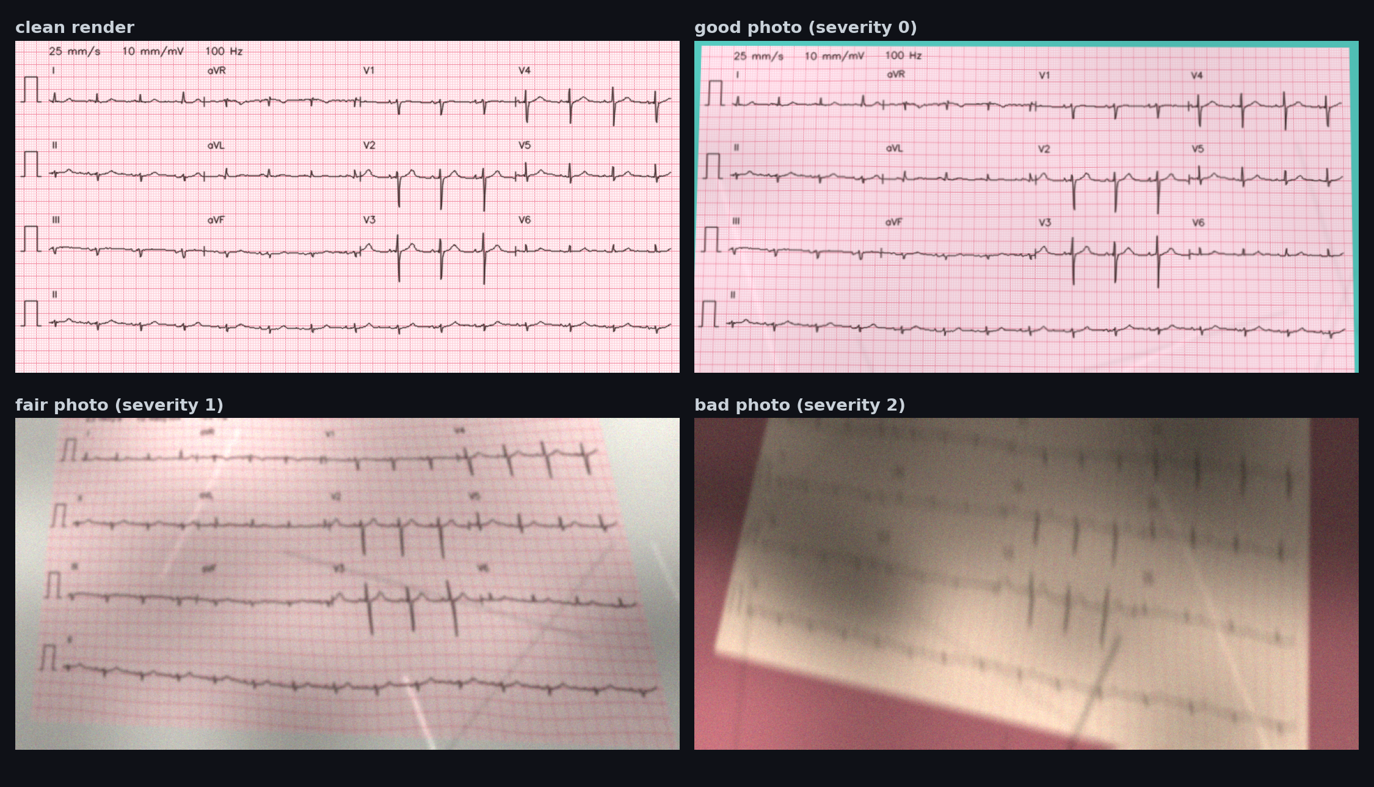
Making the pictures
One ECG: a clean print, then phone photos at three severities
Isoline
5 / 14
Notes:
PTB-XL has signals, not pictures, so I made the pictures. A renderer prints each record the way a clinic does, with grid, layout and calibration pulses. A camera lab then photographs it badly on purpose, with tilt, shadows, creases, blur, noise and compression, at three severities. That gives 42,776 pictures.

Slide 6
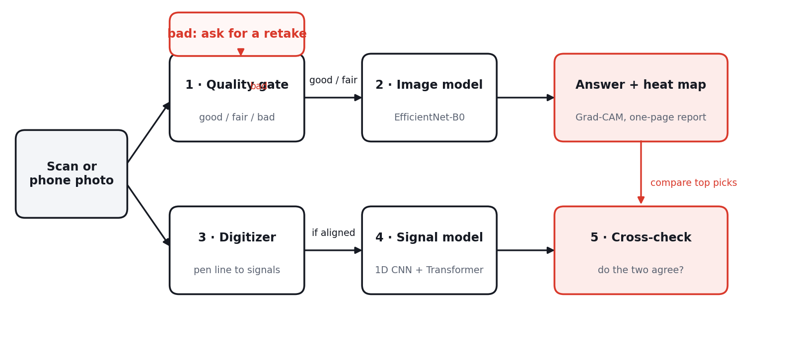
The pipeline
The image model gives the answer; the waveform path is an independent cross-check
Isoline
6 / 14
Notes:
Here is the full pipeline. The quality gate can stop a bad photo right away and ask for a retake. Otherwise the image model reads it. In parallel, the digitizer rebuilds the waveform, and if it lined up with the grid, the signal model reads that. The cross-check compares the two answers and decides how far to trust the result.

Slide 7
The two models
Image model
Signal model
EfficientNet-B0, pre-trained on ImageNet
Two heads: 5 diagnoses + photo quality
Temperature-calibrated, thresholds tuned on validation
Grad-CAM heat maps
1D residual CNN with squeeze-excitation
3-layer Transformer on top
Fine-tuned on what a printout really shows (2.5 s per lead)
Used as the cross-check
Isoline
7 / 14
Notes:
The image model is an EfficientNet-B0 with two heads, one for the five diagnoses and one for photo quality. The signal model is a one dimensional residual network with squeeze and excitation blocks, followed by a three layer Transformer. I fine-tuned it on masked signals that show only what a printout actually contains.

Slide 8
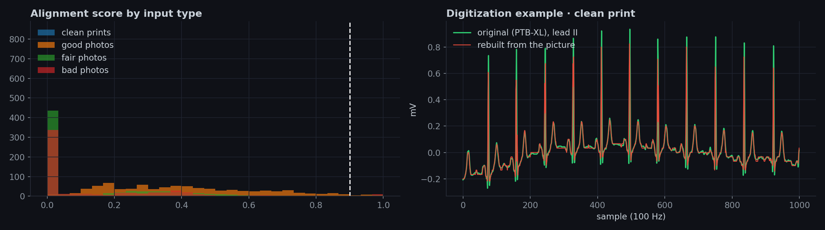
Rebuilding the waveform
Alignment scores of clean prints and photos, and one rebuilt lead
Isoline
8 / 14
Notes:
The digitizer is classical computer vision. It turns the page into an ink map, traces each lead and converts it to millivolts. To avoid trusting a bad rebuild it computes an alignment score from the calibration pulse. Clean prints score about one. Photos mostly score lower, and below 0.90 the image model answers alone.

Slide 9
Results on the held-out test set
0.929
0.921
99.1%
0.926
macro AUC, signal model
macro AUC, image model
photo-quality gate accuracy
signal model, printout layout
AUC averaged over five classes; hypertrophy is the hardest
Rebuilding the signal from a picture costs accuracy (about 0.814 AUC), so the image model answers
Isoline
9 / 14
Notes:
On the held-out test set the signal model reaches a macro AUC of 0.929, and the image model 0.921, reading only pixels. The quality gate classifies photo quality with 99.1% accuracy. Rebuilding the signal from a picture loses some information, which is why the image model gives the answer and the signal model is the cross-check.

Slide 10
Answering less, but more reliably
When Isoline answers | Answered | Top-1 accuracy
A · answer every image | 100.0% | 82.4%
B · answer unless the quality gate rejects | 87.6% | 83.0%
C · B, but withhold when the two models disagree | 59.8% | 84.9%
D · answer only when both models agree | 22.8% | 89.6%
Top-1 counts a prediction as right if it matches any recorded label of the patient.
Isoline
10 / 14
Notes:
This is the point of the project. If Isoline answers every picture, it is right 82.4% of the time. If it answers only when the photo is good enough and both models agree, it is right 89.6% of the time, on 22.8% of the pictures. The user chooses where to sit on that trade-off.

Slide 11
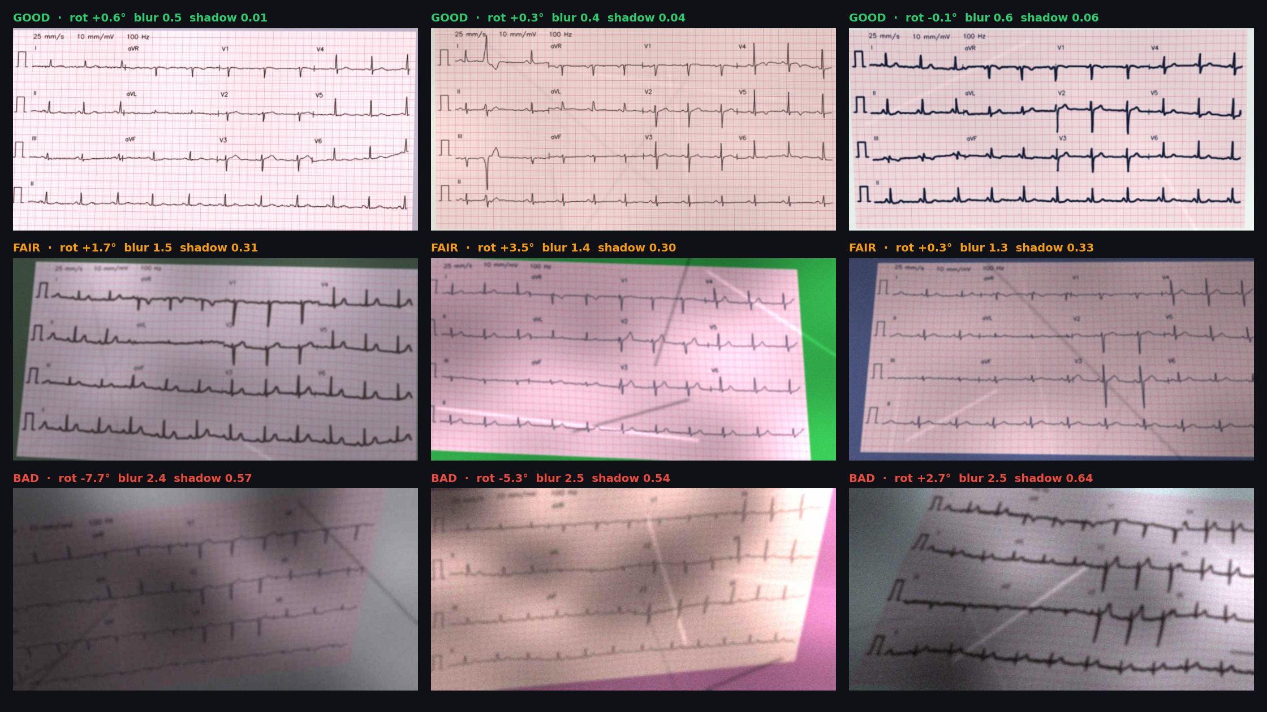
Explaining each answer
What the image model sees, with its output
Isoline
11 / 14
Notes:
Every answer comes with a Grad-CAM heat map that shows where the model looked, and a one page report with the verdict, the probabilities, the rebuilt waveforms and plain advice. There are four outcomes: reliable, flagged, image only, and rejected, when the photo is too poor to read.

Slide 12
Built to be run by anyone
GitHub: code, trained weights, notebook, example pictures
One command: python predict.py --image samples/ecg_01.jpg
Website on Vercel: dataset, results, real example outputs, report, slides, video
Live demo on Hugging Face Spaces
Isoline
12 / 14
Notes:
The repository holds the code, the trained weights, the notebook and example pictures, and one command analyses a picture. The website on Vercel shows the dataset, the results and real example outputs, and links to the report, these slides and the video. There is also a live demo on Hugging Face.

Slide 13
Limits, said plainly
Not a medical device: a learning project and a screening aid
Trained on rendered ECGs, not tested on real clinic photos
Strongly tilted photos cannot be cross-checked yet
Fewer than one pixel per sample: sharp peaks are slightly clipped
Isoline
13 / 14
Notes:
A few honest limits. This is not a medical device. All pictures are rendered from PTB-XL signals, so I have not tested on real clinic photos, and real ones will be harder. Strongly tilted photos cannot yet be cross-checked, and the resolution clips sharp peaks. The next step would be real scans.

Slide 14
Thank you
Reads the ECG. Knows when not to.
https://github.com/talhahSalman/isoline-ecg
Questions welcome
Notes:
Thank you for watching. The code, the weights, the report and the live demo are all linked on the project website.

