Slide 1
Android Development Workshop

Slide 2
What is Android?
Open source mobile OS based on Linux Kernel, developed by Android Inc.
Runs on mobile, watch, TV , cars, refrigerators, digital camera etc.
Has 7 OS versions, with 24 releases. (Latest is Nougat)
Apps developed on Android Studio
Languages: Java and C++
Scope:
Continuously developed and new features added, also new platform support.
Most installed OS on mobile devices (66% market share globally - August 2016).
6th most required career skill (mobile development) according to LinkedIn (2015).
Notes:
<number>

Slide 3
Pre-requisites
Java OOP is a must.
Familiarity with xml.
Other Mobile App platforms is a plus.
Concepts of build system like Maven and Gradle is a plus.
Knowledge of design pattern is a plus (for advance level).
Notes:
<number>

Slide 4
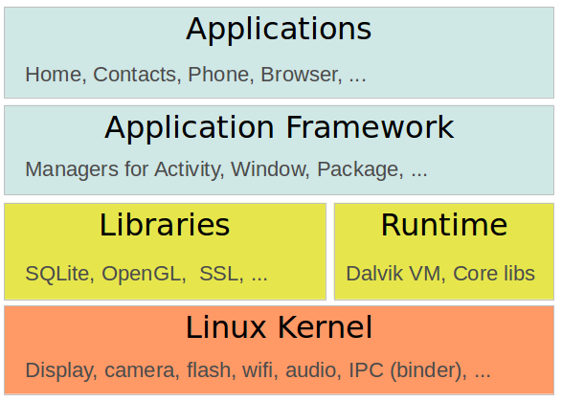
The Android System
Notes:
<number>

Slide 5
Environment Setup
JDK
Android Studio
Android SDKs
Testing:
Emulator
Device
Notes:
<number>

Slide 6
Development Environment
Project window – show files and folders
Editor – Code editor to write code
Android Monitor – Shows errors, exceptions, etc
Messages – Shows build messages and error.
Notes:
<number>

Slide 7
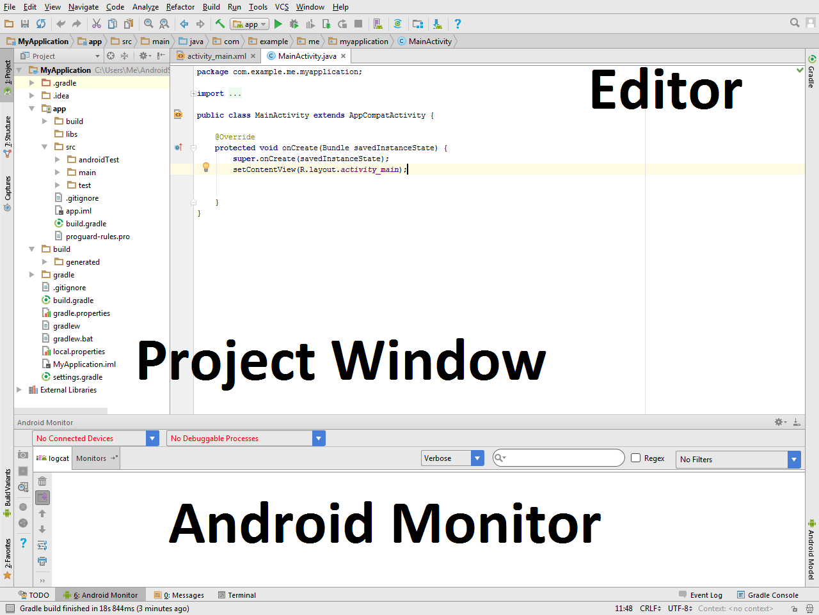

Slide 8
Project Structure
Src Folder - All source code and resource folders
Java Folder - All source code files
Res Folder - resource folders that contains images, layouts etc
Libs Folder - private or local libraries
Builds Folder - apk* files
Assets Folder – Files save with exact original name and paths
Values Folder
Colors: define color variables
Strings: define constant strings
Styles: Define app styles
Notes:
<number>

Slide 9
Terminologies
Activity – One page of app that can be used to display controls like text, buttons etc.
Resource – Images, Audio, UIs
Module – Collection of classes and resources
Widgets – View, Controls in Android are called widgets like ImagView, Button, TextView etc
ViewGroups – are containers where widgets are placed. Each layout provides its own rules to place views (widgets or other viewgroups) inside.
Listener – Are events or callbacks that are triggered on some action
Inflation - The process of showing (inflating) UI from xml file on the screen.
Layout – Xml code (file) for displaying UI elements.
Refractoring – The process of renaming the variable or file or any resource.
Notes:
<number>

Slide 10
App Overview
App starts finds Launcher Activity
OnCreate method is called, this method loads (inflates) layout file to be shown on the screen
Activity is running.
Adding behaviors.
Activity lifecycle.
Notes:
<number>

Slide 11
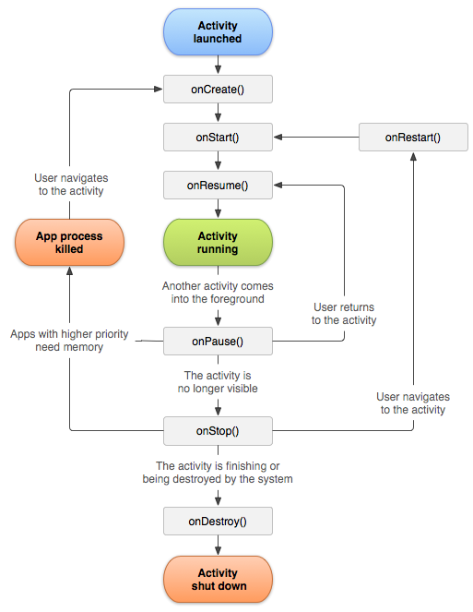
Lifecycle
Notes:
<number>

Slide 12
Views and ViewGroup
Everything is a View, Button, TextView, ImageView etc.
Views that manage other view inside them are ViewGroups.
ViewGroups are like containers that have rules to place other views.
By default, there is always a ViewGroup element declared in layout file.
Notes:
<number>

Slide 13
Adding Interactivity (1/2): Hello World App
Use of ID in xml file to give views unique id. (unique in same file)
Main Activity setContentView method
Add id to TextView.
Create TextView object in java code.
Use findViewById() method to access TextView reference that is displayed on the screen.
Use setText() method to change text.
OnCreate code is executed when Activity is being created.
Notes:
<number>

Slide 14
Adding Interactivity (2/2) : Button
OnClick events.
Adding new View : Button
XML Attributes
Create TextView object in java code.
Use findViewById() method to access TextView reference that is displayed on the screen.
Adding onClick event using onClickListener
Change text of the TextView when button is clicked.
The onClick implementation:
Anonymous Class
Instance object
Implement interface in Activity
Notes:
<number>

Slide 15
Running the app
SDK Requirements
Running on Emulator
Using AVD Manager.
Open AVD
Select Create New device
Select Resolution
Select system image
Click finish
Running on device
USB debugging feature.
Goto Settings -> About Device -> Click on Build Number 9 times
Notes:
<number>

Slide 16
Common Errors and Exceptions
Java is case sensitive.
For UI elements - Reference to an object that is not declared in xml, or is not inflated: NullPointerException
ClassCastException: when casting into wrong class type - e.g Button into TextView.
NumberFormatException: when input was text not number then calling .parse methods will result in this exception.
Security Exception: Using a feature ofwhich the permission was not declared in the AndroidManifest.xml file.
ActivityNotFoundException: Accessing activity that was not declared, or may have been deleted.
InflateException : This exception is thrown When an error conditions are occurred during creating views.
StackOverflowError: Infinite recursion/loops.
OutOfMemoryError: Asking system to allocate more memory that was allowed.
Application Not Responding (ANR) : Mainly comes when you are making network function,or some long process.
Notes:
<number>

Slide 17
Resources
Udacity Android development course
Android Developer Resources
Notes:
<number>

