Slide 1
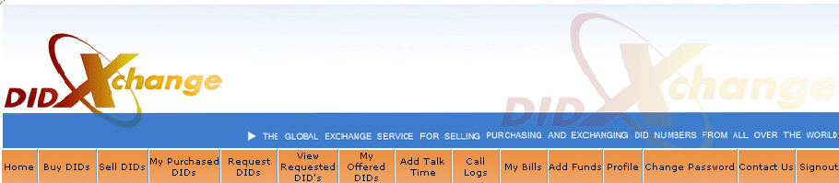
DIDXchange Training Manual
Version 2
  DIDX – Strength in Numbers

Slide 2

Benefits of DIDX membership
One interop = one interconnect 3000+ wholesale voice members from over 50 countries
Minimum wholesale quantity of 20 DID's in acct
DIDX sellers market to 3800 and growing
DIDX buyers have versatile choices
Free DIDX buyer and seller API
Flexibility and control – sellers determine their requirements, buyers can request theirs
DIDX Skypecast training most Mondays 9 AM CDT
DIDX trade show discounts, dinners, and more

Slide 3
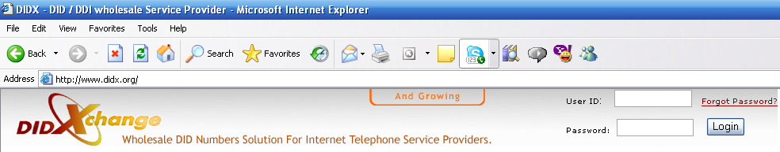
Login at didx.net
USER ID = 6 digit Account ID. Ex. 700100
Password
Click “Forgot your password?”
Enter your email address. Your PW will be emailed to you.

Slide 4
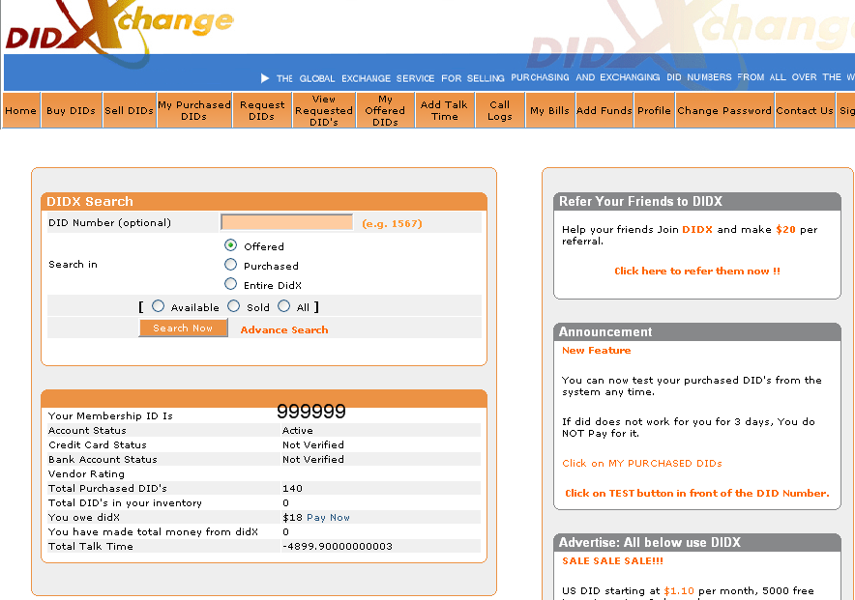

Slide 5
Completing DIDX Interop
See full details. http://www.didx.net/interop
Click Buy DID. Get free USA and free UK DID.
Point to your SIP or IAX server. Test. *See next slide.
Test DTMF. (DIDX does not support DTMF on South American DID.)
Confirm DIDX Terms and Conditions.
Fill, sign, fax service agreement.
Complete the activation call.
Wholesale w/ minimum of 20 DID in account.

Slide 6
Default RingTo Information
DIDX member supplies default ringto location
User profile includes default ringto
Member provides a keyword of “DID” to replace the DID number purchased
Example: DID@arfeen.net, while purchasing 14191111111, ringto will automatically be 14191111111@arfeen.net, even for multiple DID's.
See picture next page/slide.

Slide 7
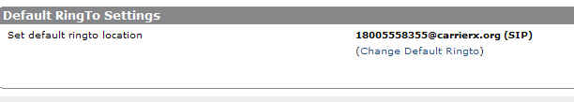
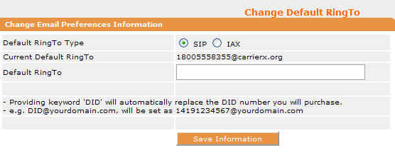
Default RingTo Picture
Click Profile
Click Ringto
Edit Ringto
Click Save Information

Slide 8
Test DID w/ FreeWorld Dialup
Download the FWD software at
http://www.freeworlddialup.com/
Setup your FreeWorldDialup USER ID.
Set your DID in DIDX to ring to
“yourFWDuserid@fwd.pulver.com”
Open your FWD software.
Make a test call to your DIDX number.
Accept the call on your FWD software.
We do not guarantee this. FWD is not our company.

Slide 9
Test DID with Gizmo Project
Go to www.sipphone.com
Download Gizmo Project software.
Setup your Gizmo Project ID.
Go to www.didx.net and set your DID to ring to
“Your GizmoProjectID@proxy01.sipphone.com
Open Gizmo Project software.
Dial your DID. Accept the call on Gizmo Project.
We cannot guarantee this. SIPphone is not our company.

Slide 10
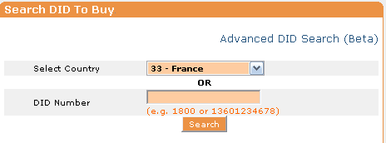
Click BUY DIDs
Select country in dropdown box. Click search.

Slide 11
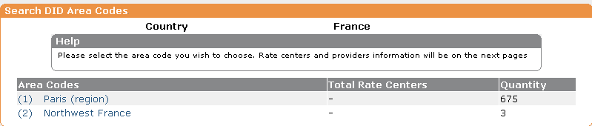
BUY DID
Click the area code you need.

Slide 12
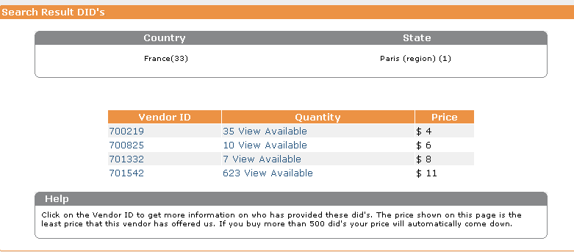
BUY DID, Search Result DID
See vendors who offer the area code by vendor ID, quantity, and price.

Slide 13
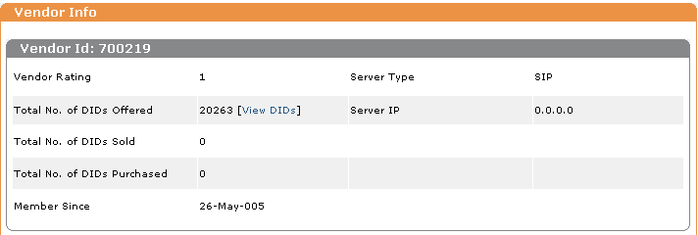
Buy DID Vendor Info
Click vendor ID. See rating*, type of server, length of DID membership.

Slide 14
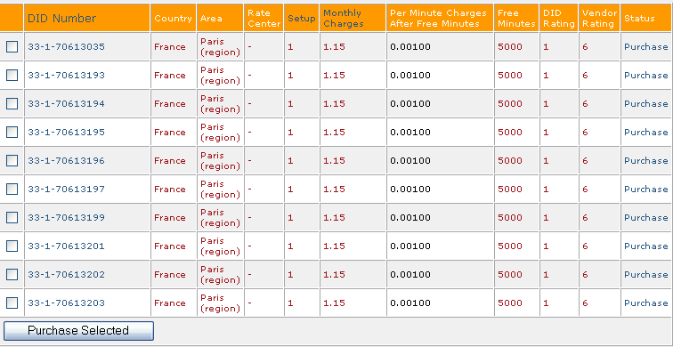
BUY DID. List of DID and info
Go back to Search Result DID. Click Quantity (beside Vendor ID). See list of DID.
Click Purchase to purchase 1 or check box and click Purchase Selected for more than 1.

Slide 15
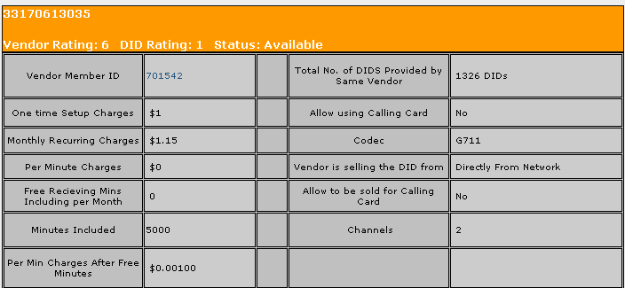
Buy DID. Individual DID.
Click DID. See Vendor ID, setup NRC, monthly RC, mins included, price/min after, calling card use, DID from, # of channels. Want to purchase? Do PRNT SCRN & save to PC for future reference.

Slide 16
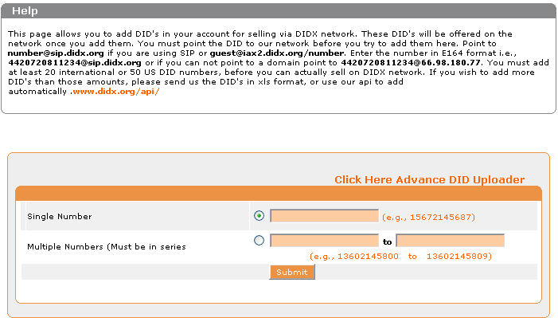
Sell DID to DIDX.net
3800+ members

Slide 17
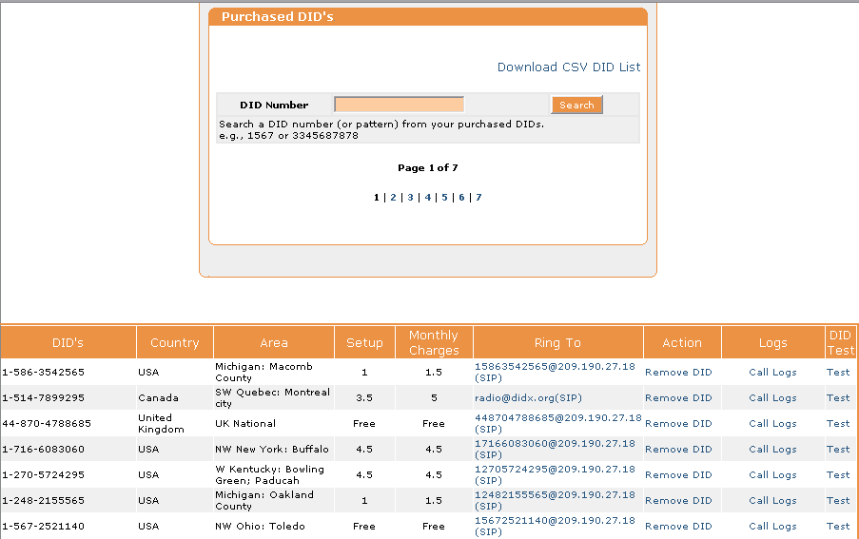
My Purchased DIDs
Flowers to protect the innocent

Slide 18
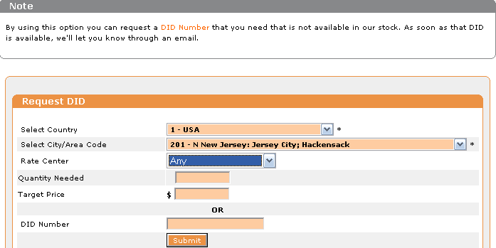
REQUEST DID
Don't see the number of DID available in the area you need? Click REQUEST DID and make request!

Slide 19
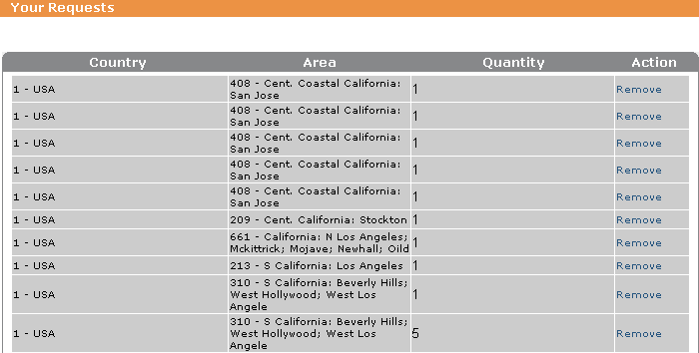
View Your Requested DID

Slide 20
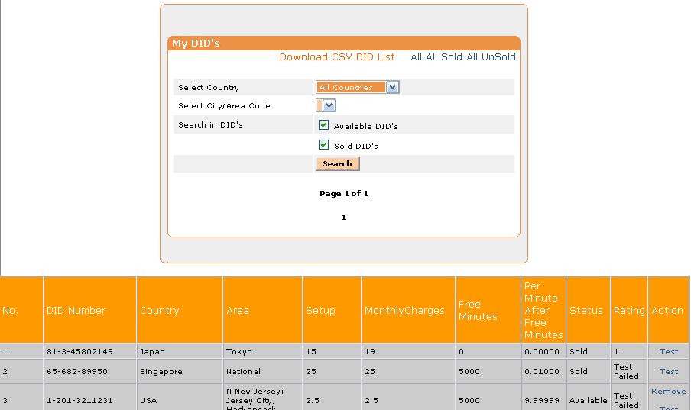
My Offered DID
Search by country, area code, available and/or sold DID
Download your list via CSV format

Slide 21
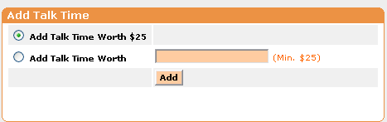
Add Talk Time
Add $25 and click Add. Or add any amt $25 minimum.
Talk time is for per min charge that some providers require on DID. When you BUY DID, this requirement should it apply will be listed on DID details.
Because of this, we recommend you do PRNT SCRN when buying for your records.

Slide 22
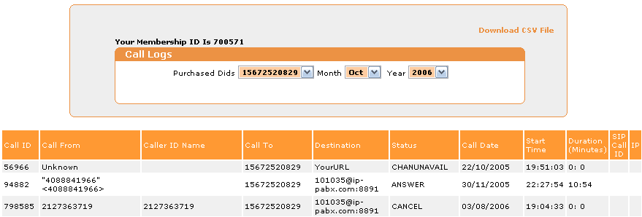
CALL LOG
Choose DID, date, year of call log to view
Download CSV file

Slide 23
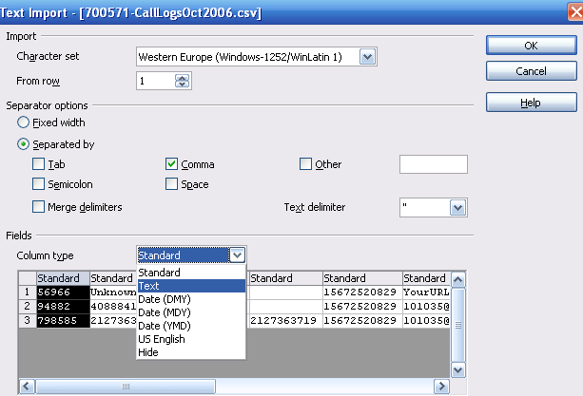
Download Call Log
Click Download CSV file. Click Save.
Change column types as needed, i.e. IP address and date. Click OK.

Slide 24
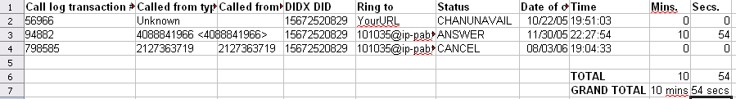
Managing Call Logs Offline
Insert “row” above first row for call log #, called from, DIDX #, ring to SIP address, status of call, date, time, mins, and secs headings.
Highlight “mins” column. CTRL G to replace :min with nothing. Same with :sec.

Slide 25
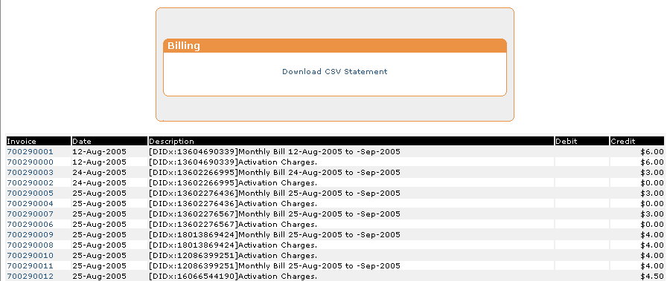
My Bills
View paid and due invoices

Slide 26
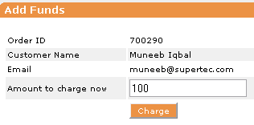
Add Funds
Secure socket layer technology at
https://www.didx.net/cgi-bin/virtual/AddFunds.cgi
Add funds to keep your DIDX balance out of the red
Minimum Add Funds is $25.

Slide 27
My Profile
Customer personal information and details.
Credit card information and billing address.
Please enter your IM and Paypal ID's.
Edit your accounting and technical contacts, server information.
Carefully check email preferences.
Take advantage of all these features to reach your business objectives.

Slide 28
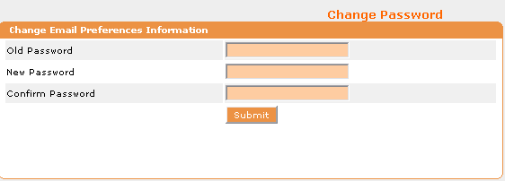
Change Password
Good news! You can change your password.
Make it one you can remember but not so easy for someone else to discover. ;-)

Slide 29
Check www.didx.net/faq
Find information on every topic you need
LNP
Vendor rating and how to improve
Payment methods to DIDX
Payment methods available to DIDX seller
Caller ID info
IP addresses to send calls
IAX or SIP info
Minimum DID quantity for DIDX wholesale service
Minimum quantity fee explanation

Slide 30
LNP USA only (also in FAQ)
Question: What is the cost for "LNP" in DIDX.org?
Answer: $15.
Question: Is there any condition before porting a number on DIDx?
Answer: The member who ports a number must have at least 20 purchased DIDs from DIDx in its account.
Question: Do I own the number I buy via DIDX?
Answer: Yes, and in order to use it, you need a carrier. The per month fee you pay is to keep the current carrier to service the number for you. If you wish to change the carrier, port the number away from the current carrier to a new carrier.
Question: How long will it take to port a DID to a new carrier?
Answer: Normally 10 days, but can be 60-90 days depending upon the cooperation with the current carrier of the DID.

Slide 31
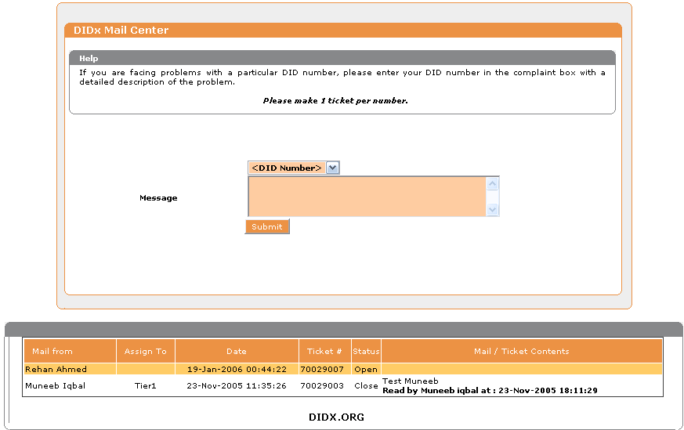
Contact Us
More efficient than phone customer service.
Permanent history of communications for you.
Copy goes to your email.

Slide 32

Thank you
From Super Technologies, Inc. and the 3800+ DIDX members at DIDXchange for your being a part of the most disruptive but practical changemaker in telecommunications...

