Slide 1
Reinforcement Learning and Game Theory
Xun ‘Natalie’ Zhang & Talha Ansari
Final Project Presentation
COMS 4721 Machine Learning for Data Science

Slide 2
4. Reinforcement Learning
Area of machine learning inspired by behavioral psychology!
Humans learn by experience, and so can machines
example of Hans the Horse
Concept of reward/loss - Human learning, and game theory are essentially the same
But, machines understand logic and math – not philosophical theories.
Markov Decision Processes

Slide 3



4.1 Markov Decision Models
Formulates the environment for implementing machine algorithms in game situations
Each game has different possible states (snapshots)
For each state (S = {s1, s1, s3,…}), we have a reward (R), and a set of actions (A = {a1, a2,...})
Another important aspect is the concept of Policy and Value
 | (1) | (2) | (3) | (4)
(1)
(2)
(3)

Slide 4
4.1 Markov Decision Models (2)
Policy (P) is a set of actions which lead each state in the game to another particular state
Value (of a policy, P) uses the actions described by P to calculate the value of each state of the game
Value, of a particular state, can be described as the potential reward (current and future expected) of being in a state.
Algorithms exist (e.g. value iteration) to recursively achieve this
Set values as rewards
Iteratively add to the values the weighted average of the neighboring values
But, finding the value requires knowledge of reward and probability.
What if we don’t have it? This is where ‘learning’ comes in

Slide 5

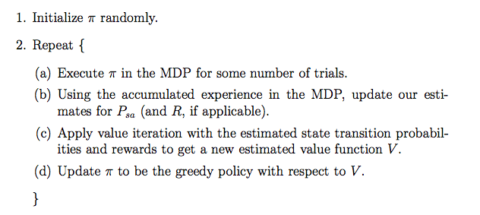
4.1 Markov Decision Models (3)
Estimate probability by experience
Estimate reward by taking the average of the reward experienced by the playing agents (e.g. robot) when in the particular state
Final algorithm…

Slide 6
5. Reinforcement Learning in Game Theory
X
O
X
[0,0,0,0,0,0,0,0,0]
[1,0,0,0,0,0,0,0,0]
[0,1,0,0,0,0,0,0,0]
….
[0,0,0,0,0,0,0,0,1]
….
[0,1,0,0,0,0,2,0,0]
….

Slide 7
6. Wrapping up
Games are everywhere
There are optimal strategies to play games
Humans play games making use of their experience and learning from past experiences
Reinforcement Learning, and Markov Decision Process tries to mimic the human learning experience in to computers
Resulting in, ‘Reinforcement Learning in Game Theory’

