Slide 1
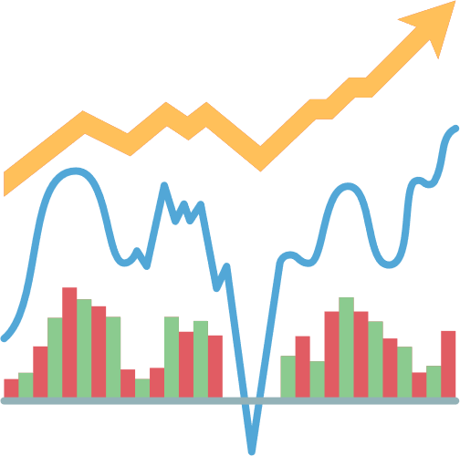
Sales Analysis

Slide 2

Data Loading
SQL
Data is initially loaded into SQL for the sales analysis project, serving as the foundational step in the ETL (Extract, Transform, Load) process. SQL acts as a robust repository, facilitating efficient storage and retrieval of sales data. Subsequently, Power BI leverages this dataset, executing transformations and visualizations that empower insightful analysis and the creation of dynamic, interactive dashboards.

Slide 3

Power BI
ETL
Visualize
Power BI's ETL streamlines sales data, extracting, transforming, and loading for swift insights. With a user-friendly interface, it empowers quick transformations, facilitating dynamic visualizations. Power BI ensures efficient data processing for actionable sales analysis.
Power BI excels in visualization, transforming sales data into compelling charts and graphs. Its interactive dashboards offer a user-friendly experience, enabling users to derive meaningful insights at a glance. With a rich array of visualization options, Power BI enhances the clarity and impact of sales analysis presentations.

Slide 4
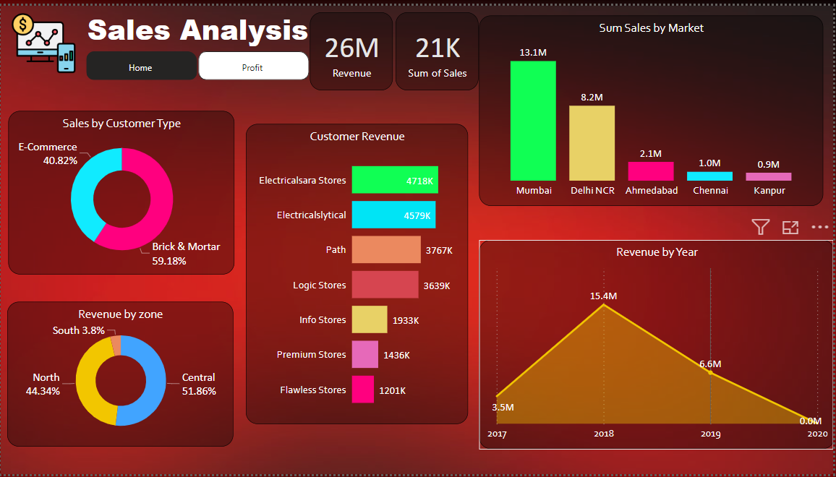

Slide 5
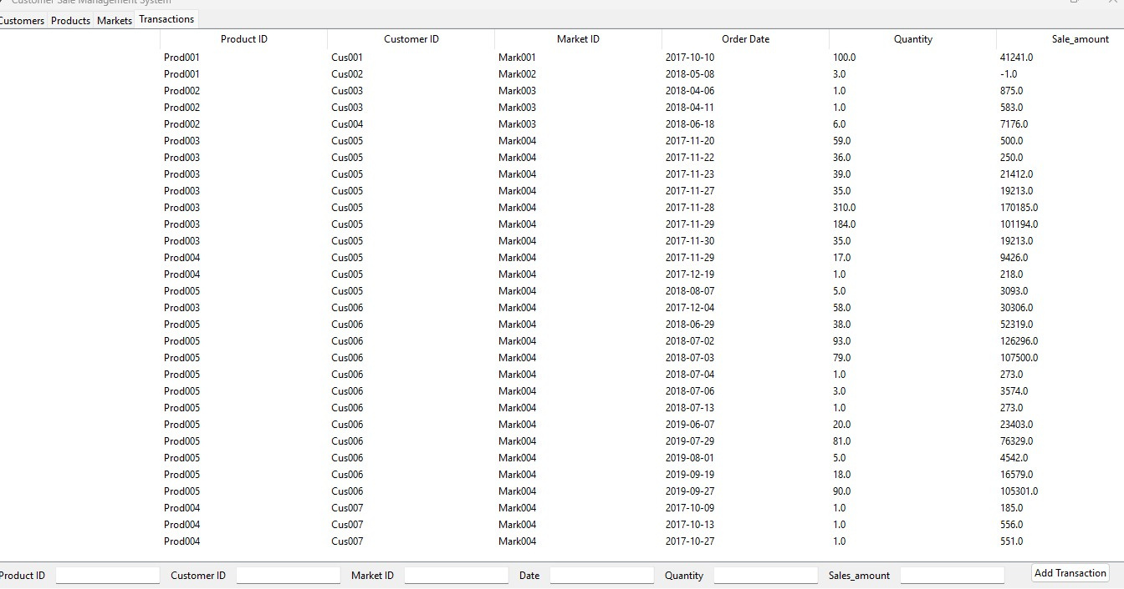
Python Interface
The Python interface plays a pivotal role in dynamically inputting data values into the sales dataset. Through custom scripts, it allows seamless integration, enabling users to interactively input and modify data. This functionality enhances the dataset's flexibility and supports automation, contributing to a more agile and responsive sales analysis process.

