Slide 1
CRICKET ARENA
Be a Champion!

Slide 2
PRESENTED BY:
PRESENTED TO:
Talha Patni (64085) Humayun Khalid (64086)
FYP Jury & Team

Slide 3
PROBLEM STATEMENT
Cricket enthusiasts, teams, and organizers face challenges in managing sports activities efficiently. Lack of a centralized platform for ground booking, tournament creation, live score updates, player recruitment, and match scheduling hinders seamless organization. Our app aims to provide a user-friendly solution, streamlining sports management and enhancing the overall sports experience for players and organizers alike.

Slide 4
INTRODUCTION
Cricket Arena is defined as that the root grass player have area to fulfill their dreams by our app cricket arena.
Our project have 3 panels:
1. Ground App:
In this app only ground owner register their ground and confirm the bookings via this app.
2. Admin Panel:
This is only for admin in user login interface by specific email and pass, admin have view and delete operations in all features of user app and also only have rights to make captain of users team.

Slide 5
3. User App:
There are multiple features i.e.:
Ground Booking: In this feature user have an accessibility to book ground by sending request to owner of ground after confirming it user have an option to pay online via jazz cash.
Team: User create his own team by request any user or their friend to make a team by accepting his request a team formed in user profile.
Tournament: In this feature user have right to create tournament and also join tournament with his team.
Team VS Team: In this feature user send request to other team for play.
Looking For: Any team have less player so by this feature user have rights to send any other player for join with them.
Score Card: Anyone in app can make their score card.
Live Score: Cricket Arena app have facility to view live score of international matches by our feature.

Slide 6
BUSINESS FLOW
Cricket Arena business flow starts with user registration, enabling them to book sports grounds and create tournaments. Team captain recruit players, scheduling matches with opponents. After matches, results and Performance are displayed. Notifications keep users informed, and feedback helps improve app features for an enhanced sports management experience.

Slide 7
TECHONOLOGIES USED
Flutter for Mobile App Development
Firebase for Database
Dart for Flutter
API Integration for Live Score

Slide 8
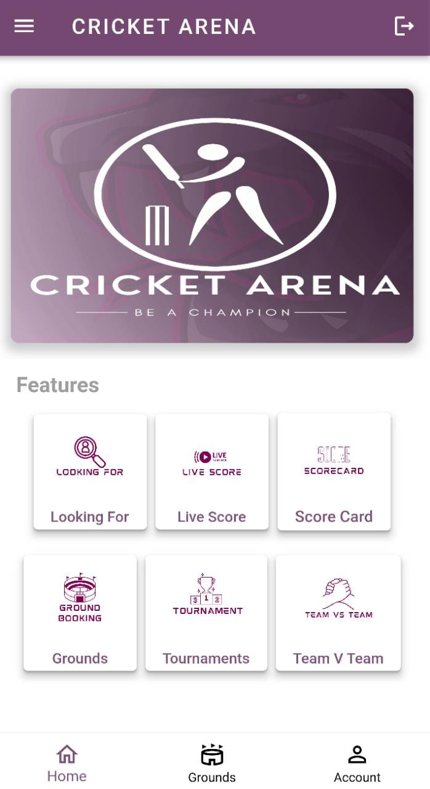
PROJECT OVERVIEW
DRAWER
BANNER
Drawer have profile info & all request options.
Slider for promotions.
FEATURES
Main menu features.
ACCOUNT
In Account i.e. user profile & have feature for create team.

Slide 9
01
GROUND BOOKING
02
FEATURES
TOURNAMENT
03
SCORE CARD
04
TEAM

Slide 10
05
TEAM VS TEAM
06
FEATURES
LIVE SCORE
07
LOOKING FOR

Slide 11
01
GROUND BOOKING
Ground staff can register their ground via Ground app & user can book ground via User app.

Slide 12
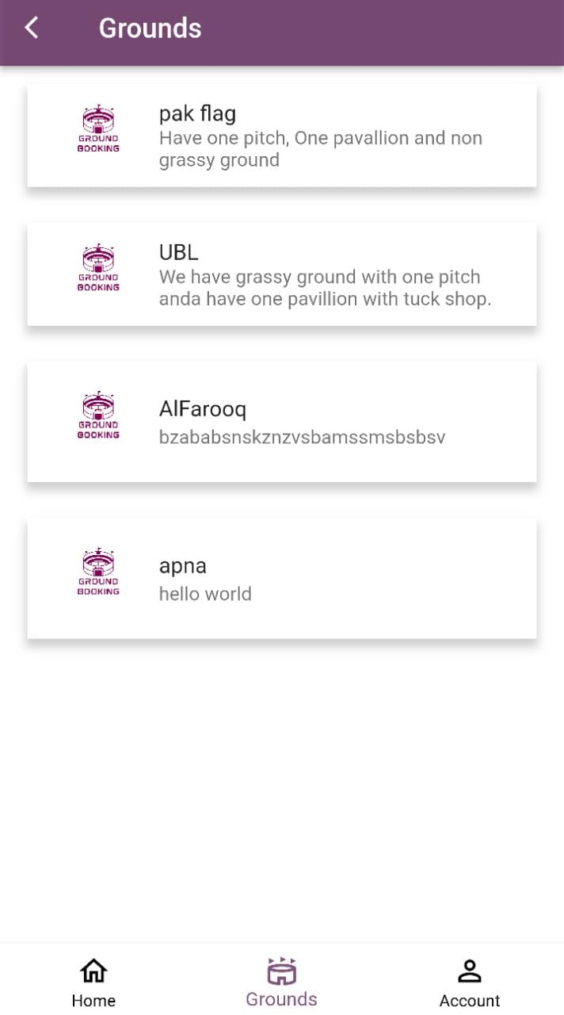
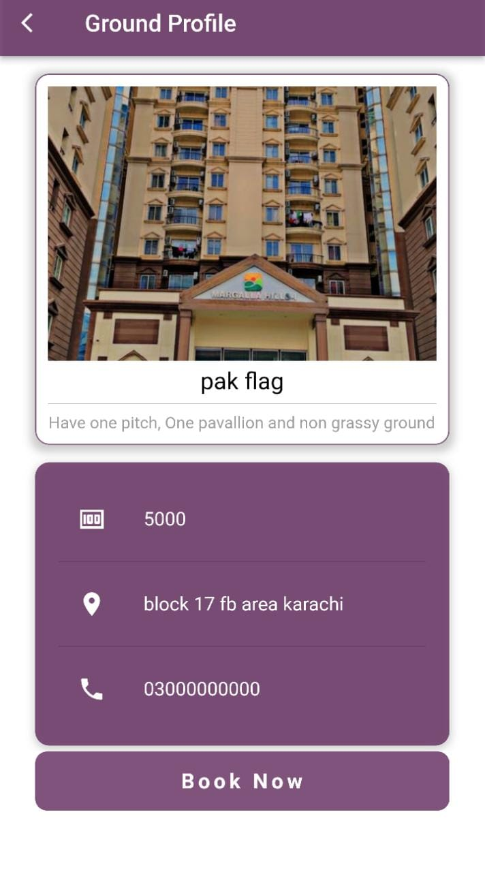
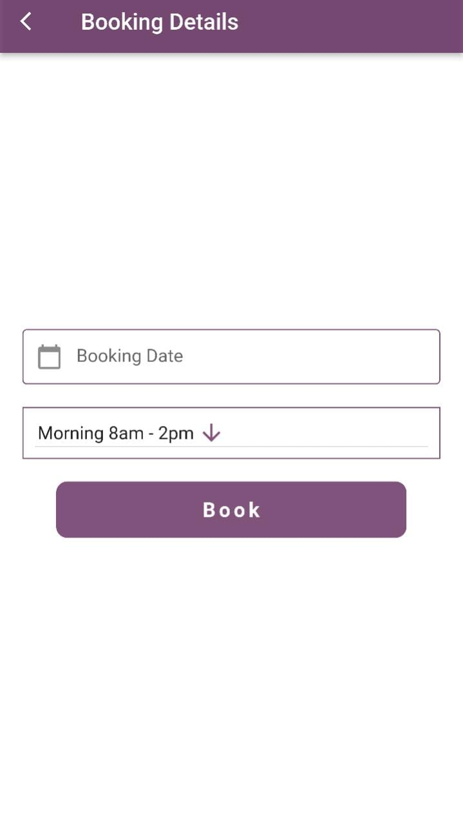
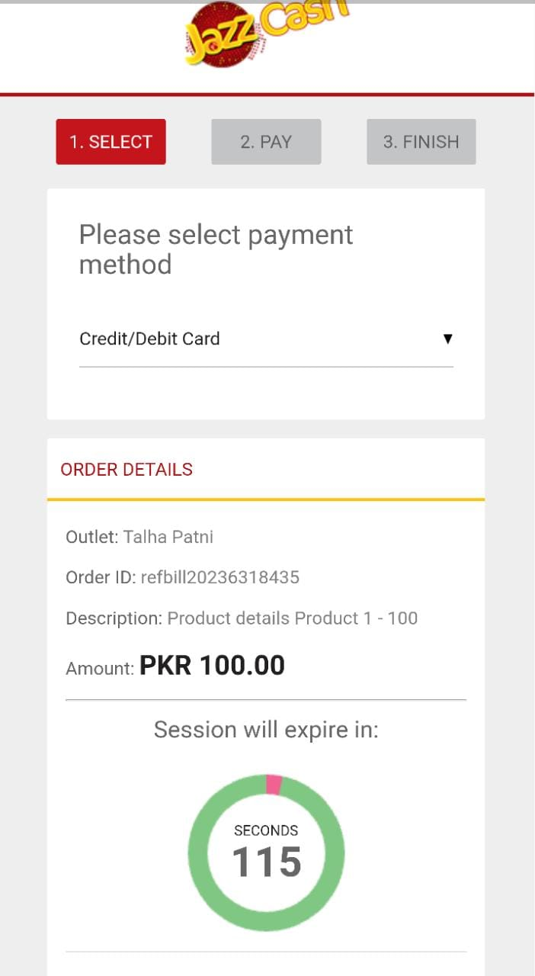
SCREENSHOTS

Slide 13
TOURNAMENT
02
User can register their tournament & other user can join tournament via User app.

Slide 14
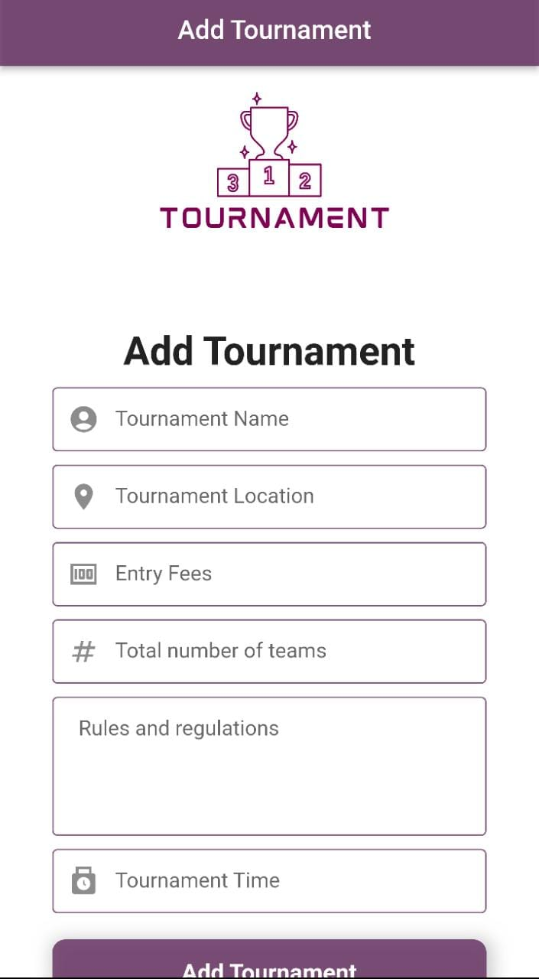
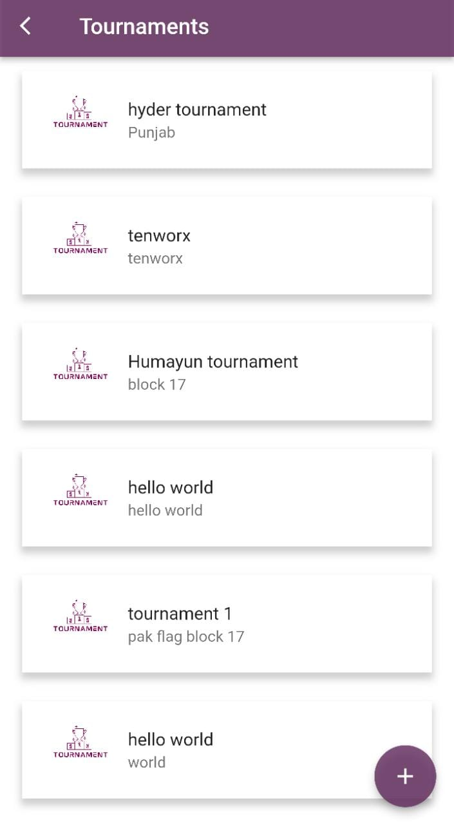
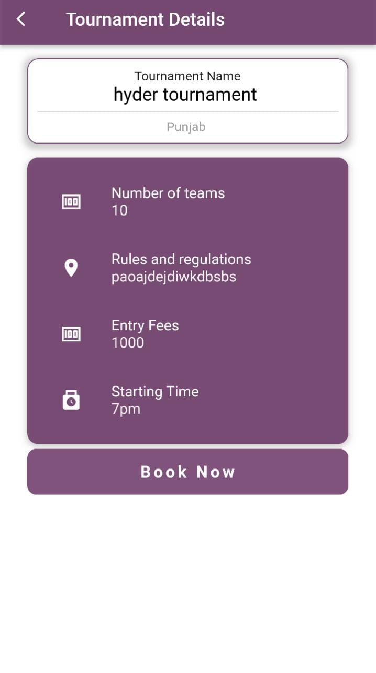
SCREENSHOTS

Slide 15
03
SCORE CARD
User can create their current match scorecard & take screenshot of their stats.

Slide 16
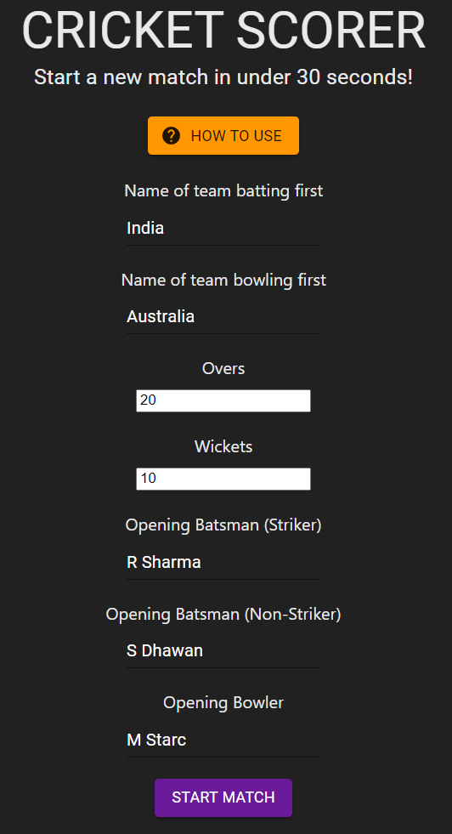
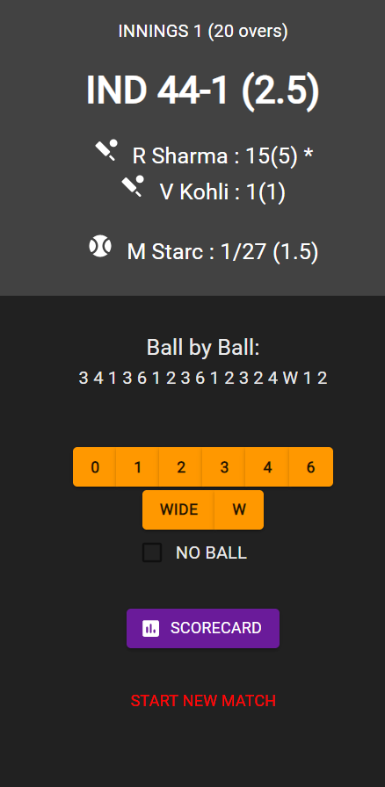
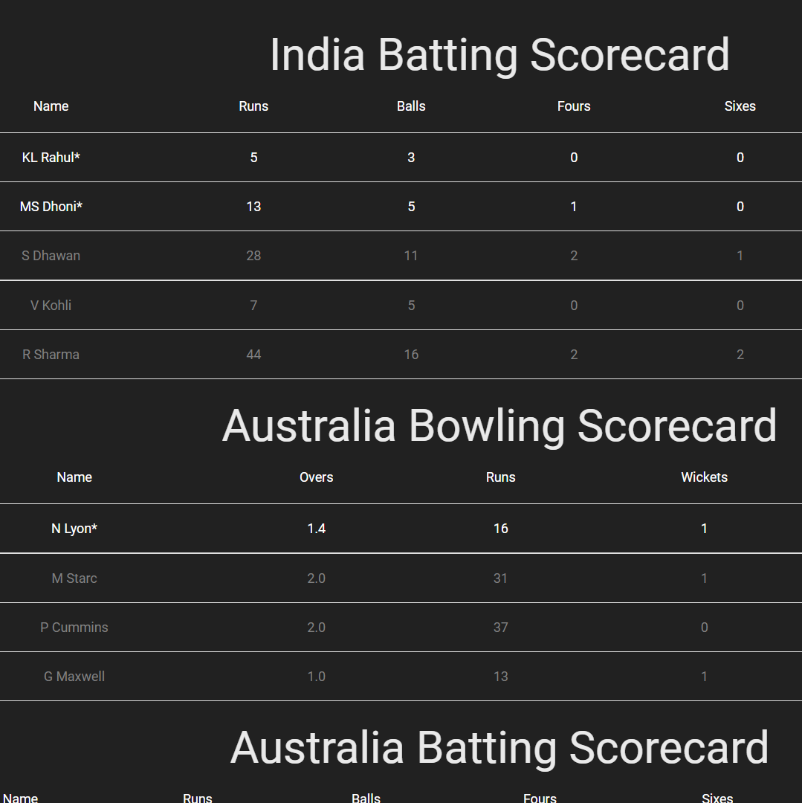
SCREENSHOTS

Slide 17
TEAM
04
Have feature to create team & send request to others users to join the team.

Slide 18
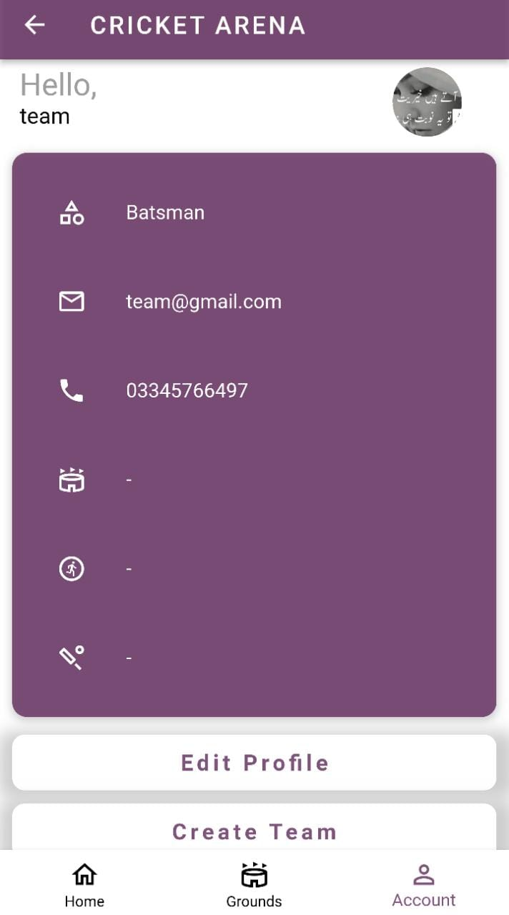
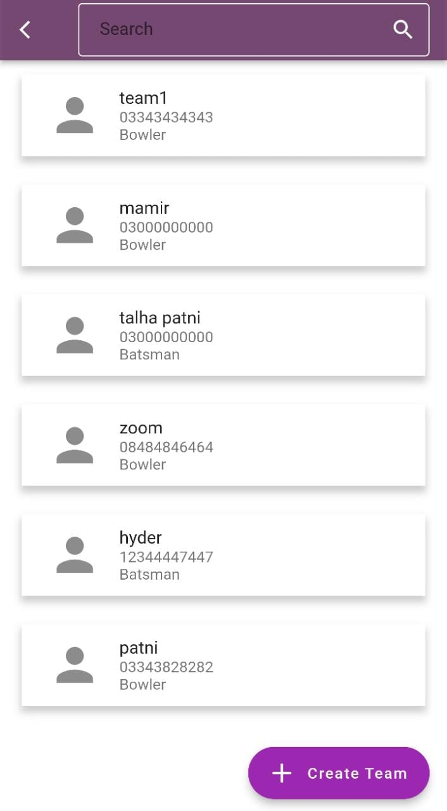
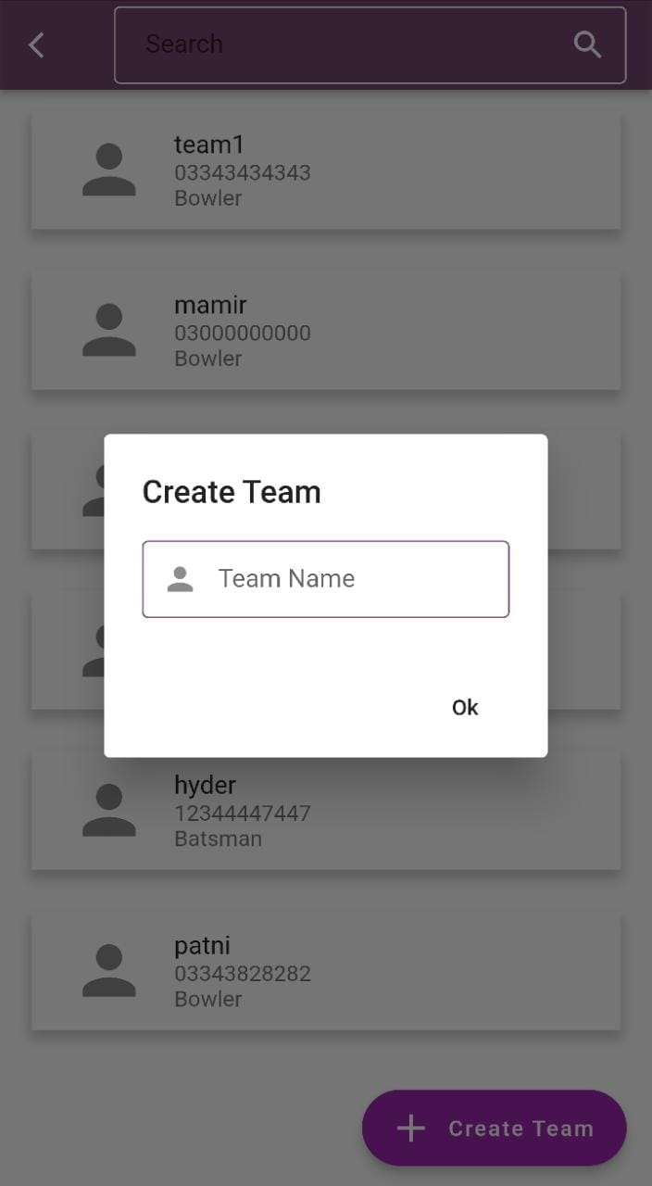
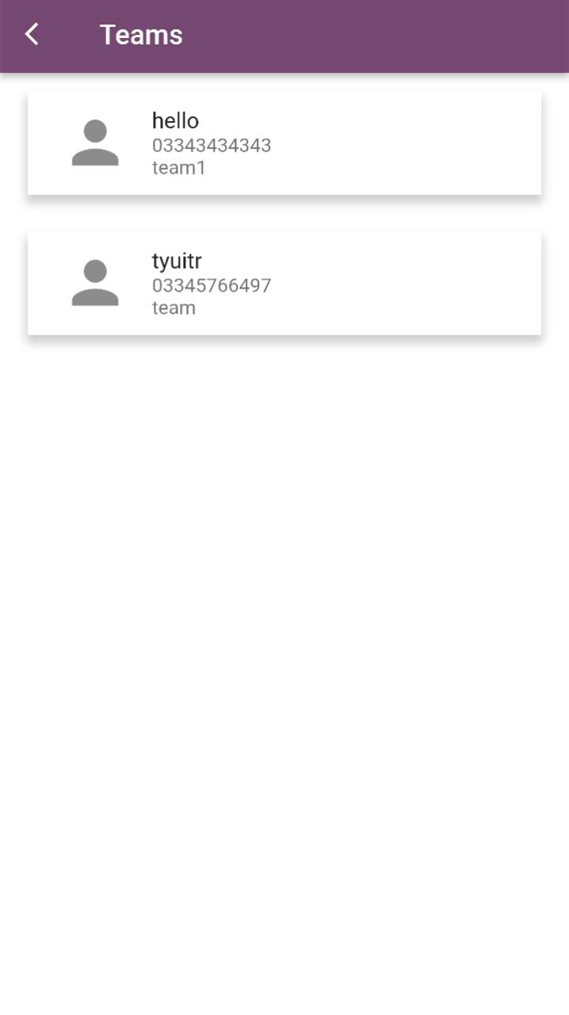
SCREENSHOTS

Slide 19
05
TEAM VS TEAM
User can send request to others teams for play.

Slide 20
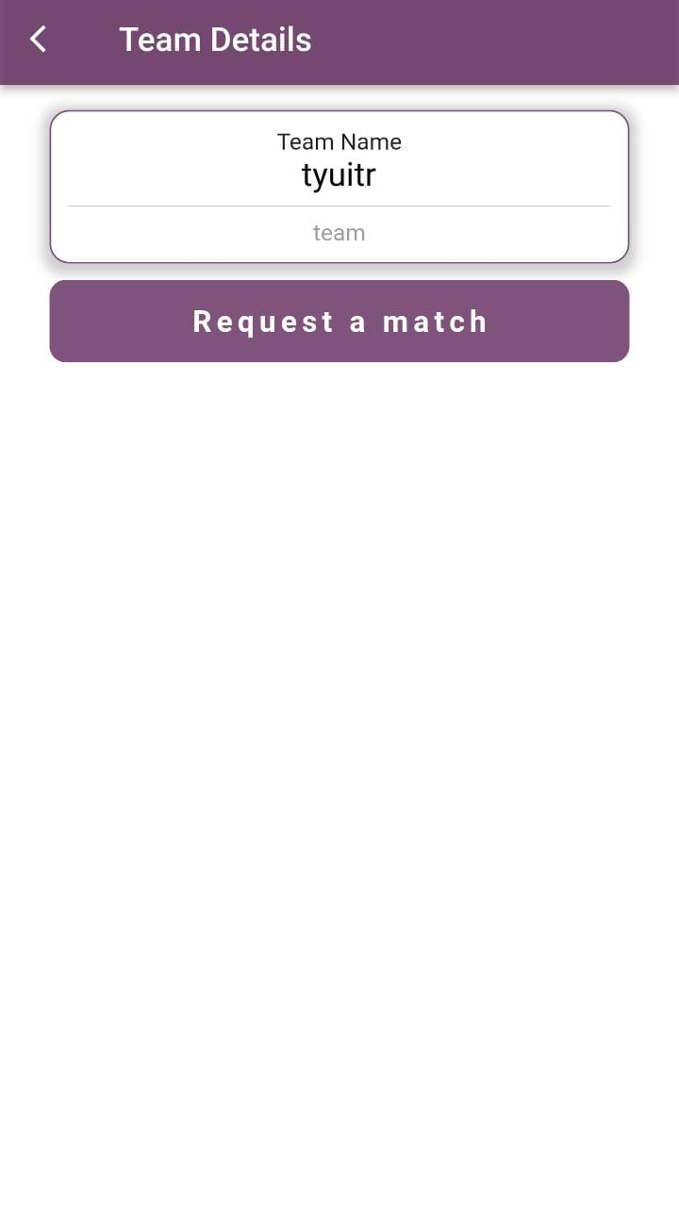
SCREENSHOTS

Slide 21
LIVE SCORE
06
View match updates.

Slide 22
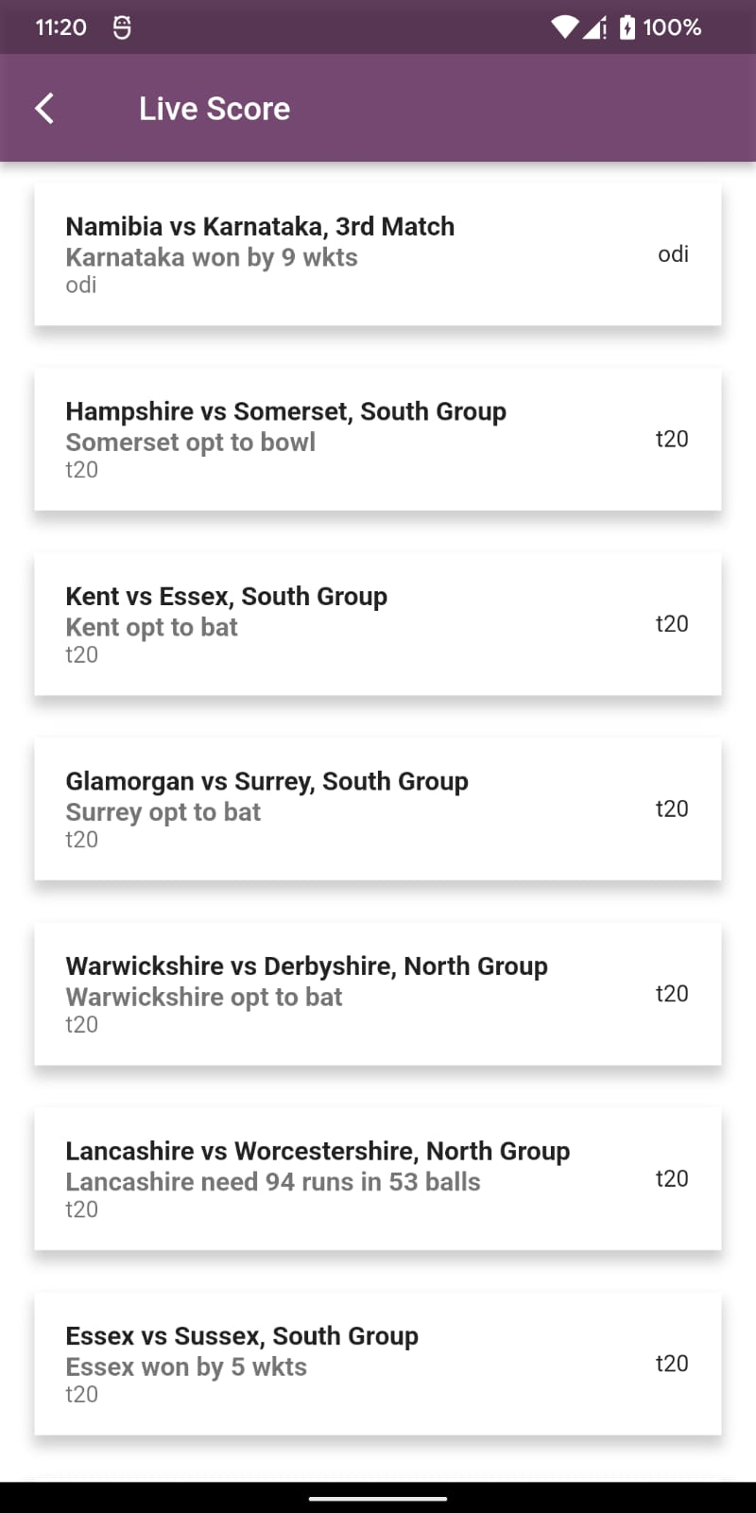
SCREENSHOTS

Slide 23
07
LOOKING FOR
Have an option to search player for join the team as per requirements.

Slide 24
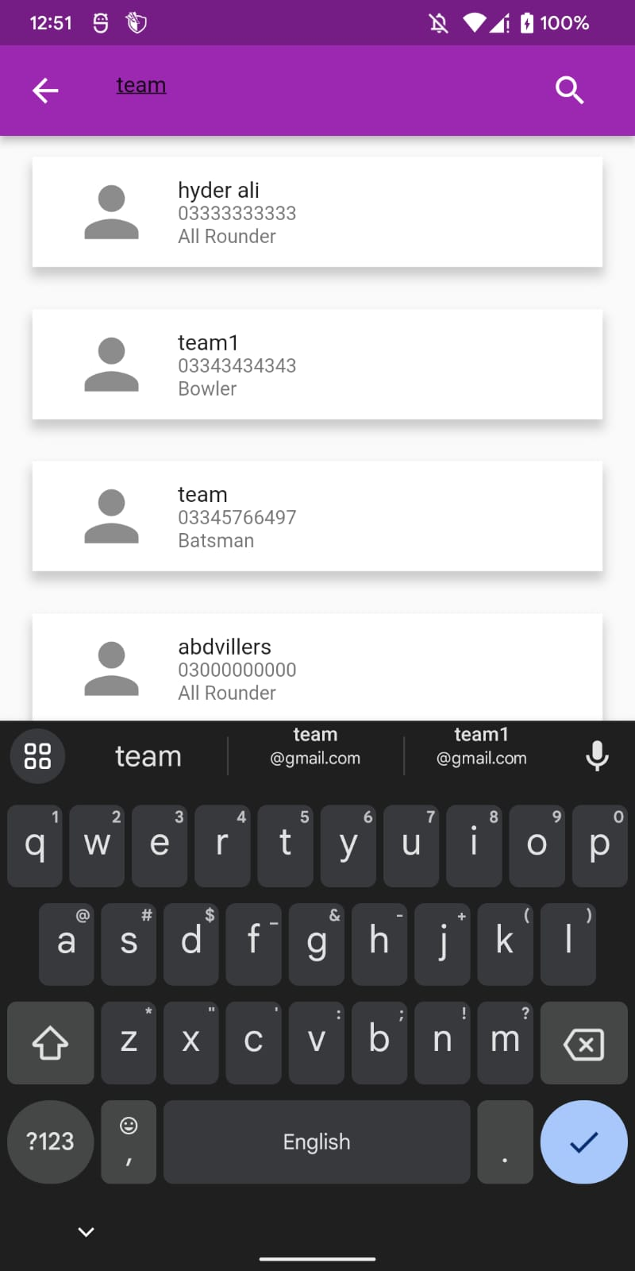
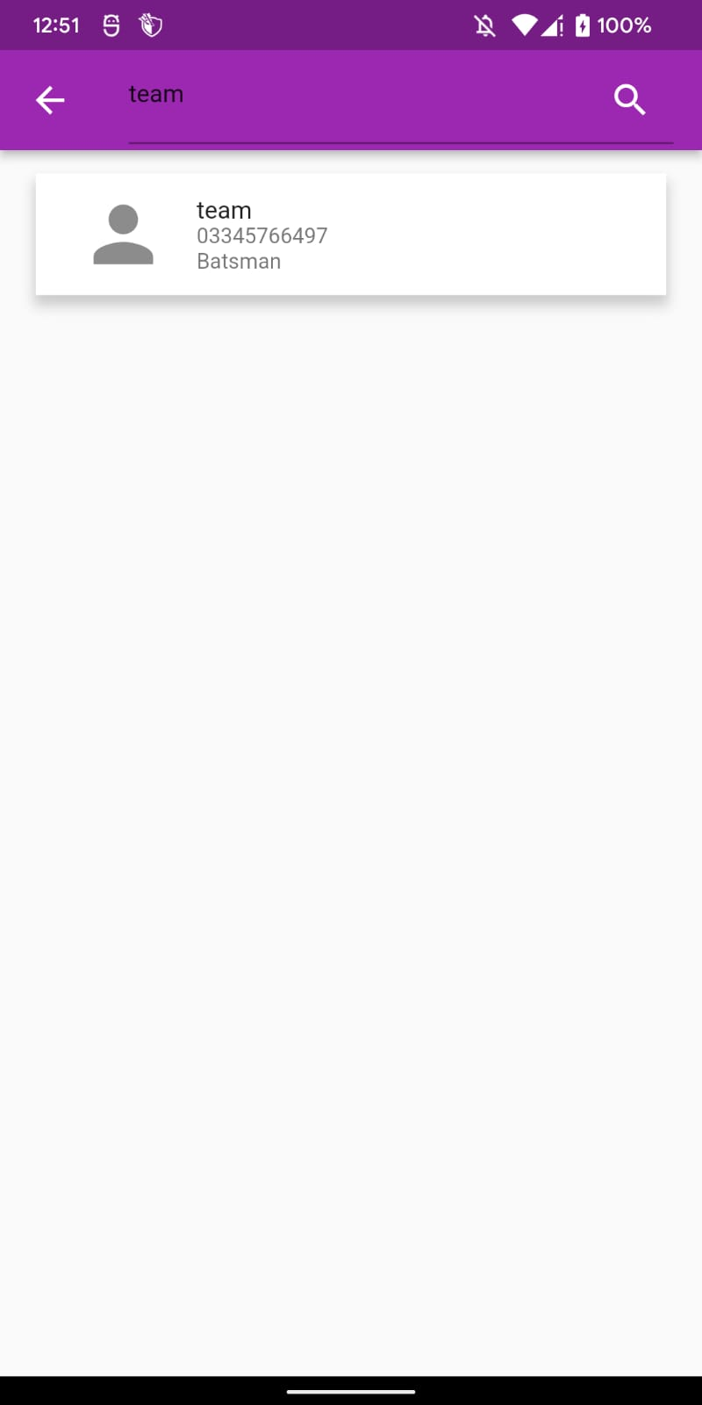
SCREENSHOTS

Slide 25
THANKS!
Do you have any questions?
Be a Champion!

