Slide 1
PROJECT STATUS · AUGUST 2026 · GROUP STUDIES · TU ILMENAU
Synthetic Fog Augmentation
for Semantic Segmentation
Both backbone sweeps are complete. MiT-B2 with NN-depth fog augmentation reaches 0.603 mIoU on real ACDC fog — up from a 0.414 no-fog baseline, and ahead of every “no real ACDC labels” method benchmarked in the ACDC paper.
58
0.603
+0.125
24 / 24
experiments total (34 ResNet-101 + 24 MiT-B2)
best mIoU — MiT-B2 + NN-depth (baseline 0.414)
gained from the backbone swap alone, same fog config
MiT-B2 sweep complete — every config beat its ResNet pair
COMPLETE Both sweeps finished; results, figures, and reproducibility tooling regenerated end to end.

Slide 2
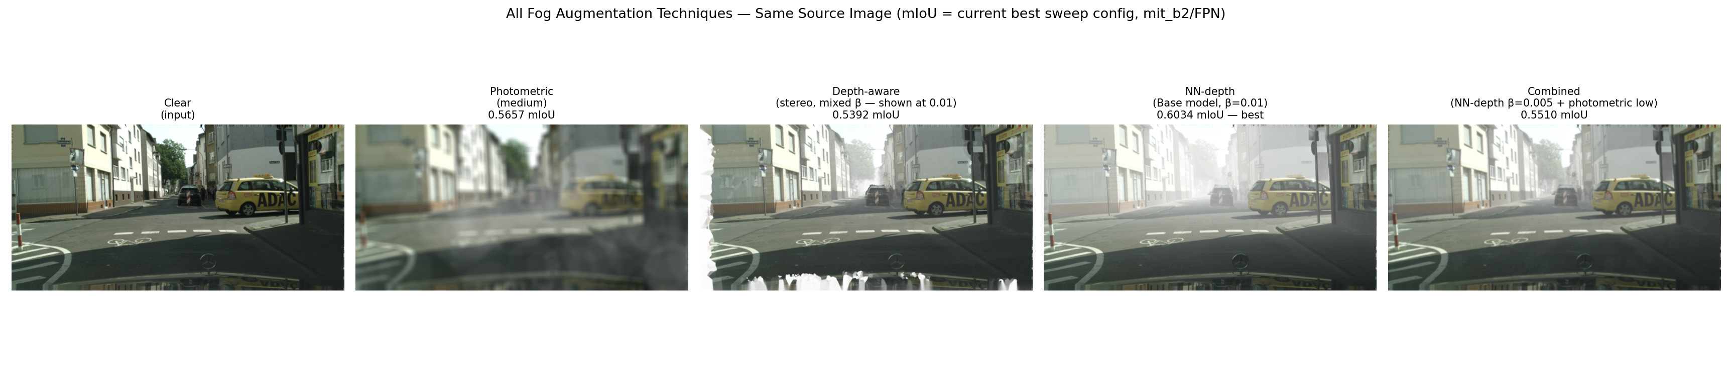
METHODOLOGY FIX · WHY AUGMENTATION WAS HURTING, NOT HELPING
Fog Probability — Stop Fogging Every Image
THEN — ORIGINAL METHODOLOGY
NOW — PROBABILISTIC FOG
■
Fog on 100% of training images. Every batch was foggy — the model never saw a clear image.
■
fog_prob p ∈ {0.1, 0.3, 0.5, 0.7}. Each image is fogged with probability p — a genuine mix of clear + foggy training data.
■
One fixed intensity per run. No diversity in fog strength within a run.
■
Mixed-intensity variant. Random β per image instead of one fixed strength.
■
23 new ResNet-101 runs, then repeated on MiT-B2. Same protocol throughout — only the augmentation recipe (and later, backbone) changed.
■
Result: all 10 augmented runs lost to baseline (0.414). Root cause: underfitting under heavy, relentless fog.
Outcome: with p < 1, every technique family beats the no-fog baseline on real ACDC fog — on both backbones.
Same source image under each technique (label = current best sweep config, MiT-B2/FPN, and its ACDC mIoU).

Slide 3
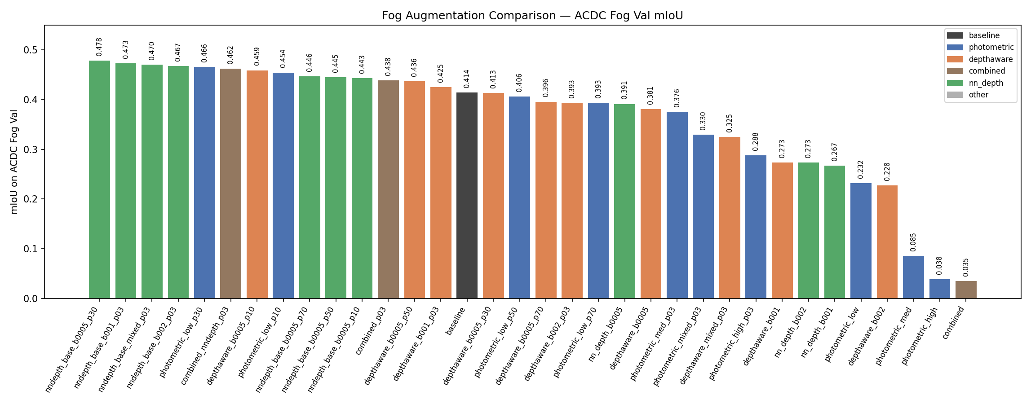
RESNET-101 SWEEP · FINAL
Fog Augmentation Beats Baseline (ResNet-101)
13 runs above baseline
Best: NN-depth, +6.4 pts
Sweet spot: p = 0.1–0.3
“Combined” rescued
Baseline (0.414) drops from rank 1 of 11 to mid-table once p < 1.
β=0.005, p=0.3 → 0.478 — monocular depth wins again.
Light-to-moderate fog exposure helps; p=0.7 drifts back down.
0.035 → 0.462 — stacking techniques works once fog is occasional.

Slide 4
BACKBONE UPGRADE · ARCHITECTURE
ResNet-101 / DeepLabV3+ → MiT-B2 / FPN
RESNET-101 / DEEPLABV3+ · CONVOLUTIONAL
MIT-B2 / FPN · TRANSFORMER (SEGFORMER)
■
Local receptive fields. Each layer sees a small neighborhood; global context only emerges after stacking 101 layers.
■
Self-attention encoder. Every patch attends to every other patch within one layer — global context from the start.
■
Decoder: ASPP. Atrous (dilated) convolutions at several rates + global pooling — needs a dilation-capable encoder.
■
Decoder: FPN. Top-down pyramid fusion, no dilation needed — why it pairs with a transformer where DeepLabV3+ can't.
■
~44.5M backbone params. Larger, and the bottleneck this upgrade replaces.
■
~25M backbone params. Smaller than ResNet-101, yet wins on every matched config.
Evidence: SegFormer paper (Xie et al., NeurIPS 2021), Cityscapes-C fog corruption benchmark — MiT-B5/SegFormer 78.5 mIoU vs. DeepLabV3+ (Xception-71) 64.1 mIoU. Same architectural family; our own 10-epoch POC (matched, both backbones, with/without fog) confirmed the effect for MiT-B2 before committing to the full 24-config resweep.
Why they can't just be swapped: DeepLabV3+ requires a dilation-capable encoder for its ASPP head — attempting mit_b2 raised “ValueError: MixVisionTransformer encoder does not support dilated mode.” FPN has no such requirement, so it's the decoder used with mit_b2 throughout.

Slide 5
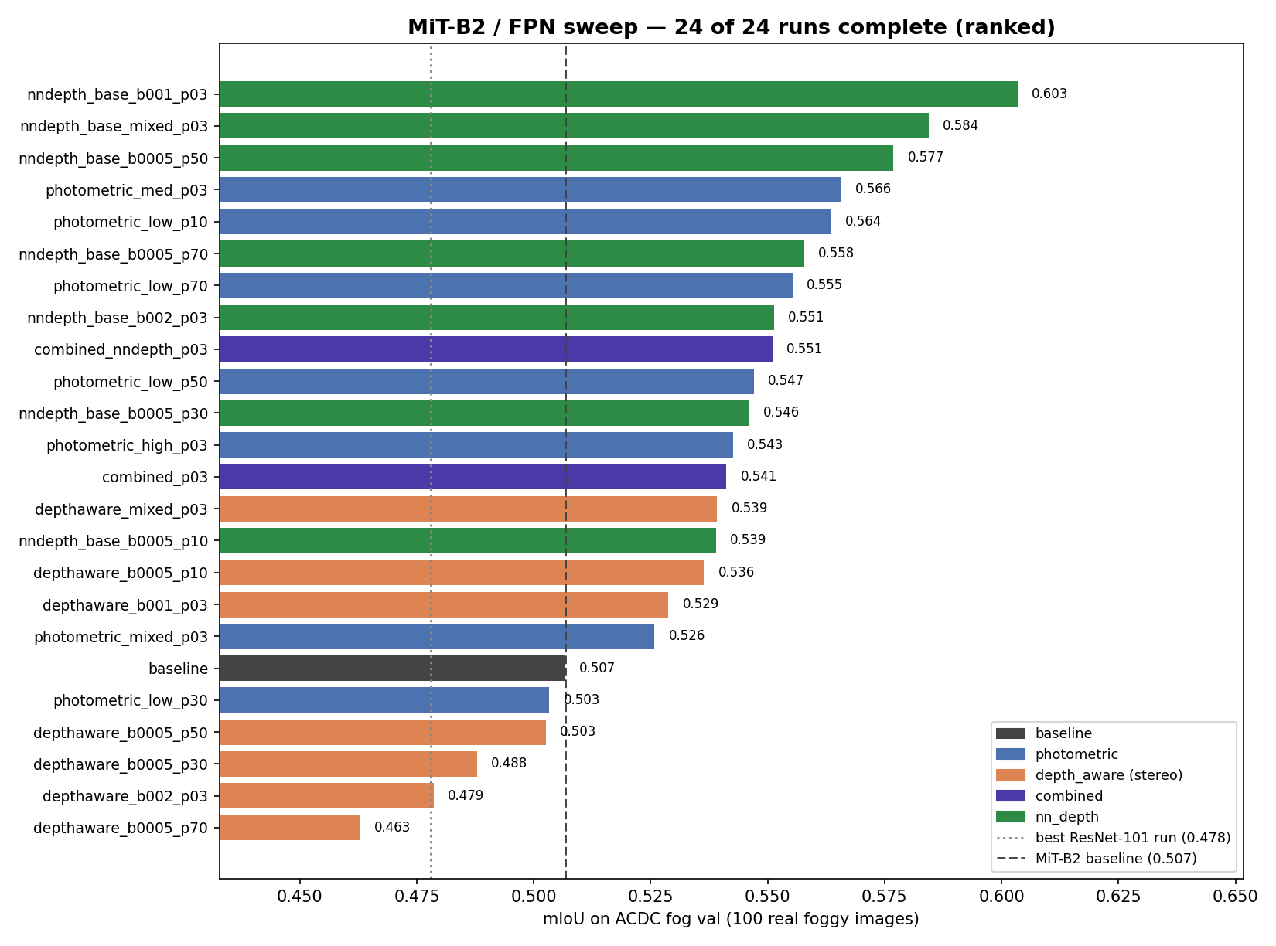
MIT-B2 SWEEP · FINAL — ALL 24 RUNS COMPLETE
New Best: 0.603 mIoU
■
New best: 0.603
NN-depth β=0.01, p=0.3 — +9.7 pts over the MiT-B2 baseline (0.507).
■
Every config improved.
All 24 ResNet↔MiT-B2 pairs — mean Δ = +0.117, range +0.038 to +0.254.
■
18 of 23 fog configs beat baseline.
All 6 NN-depth and both combined configs are above the no-fog baseline.
■
Depth-aware (stereo) lags.
Weakest family on MiT-B2 — monocular NN-depth is the clear winner on both backbones.

Slide 6
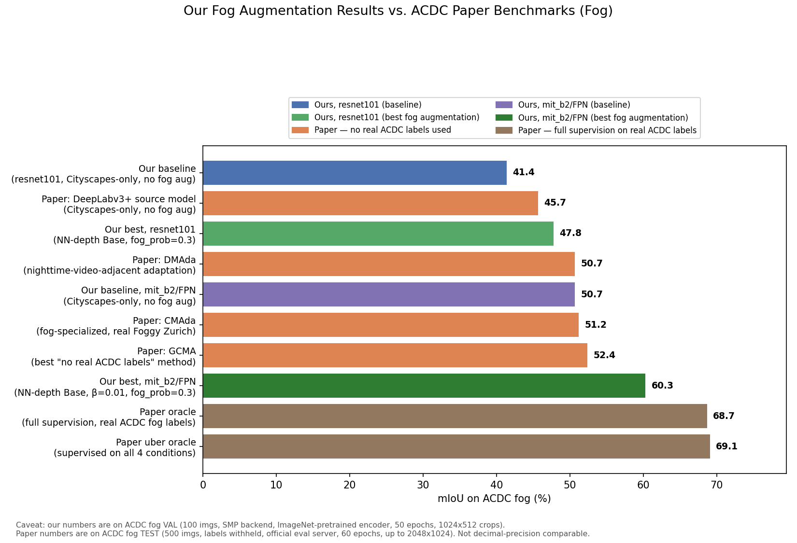
EXTERNAL CONTEXT · FINAL
Where We Stand vs. Published ACDC Methods
■
We beat the paper's own source model.
Our best ResNet run (47.8) tops the ACDC paper's un-adapted DeepLabV3+ (45.7); our MiT-B2 baseline alone (50.7) already exceeds it with no fog augmentation at all.
■
We clear the “no real ACDC labels” tier.
Our MiT-B2 best (60.3) beats DMAda (50.7), CMAda (51.2), and GCMA (52.4) — all of which use real foggy imagery and/or domain adaptation; we use only synthetic fog on Cityscapes.
■
Oracle remains ahead, as expected.
Full supervision on real ACDC fog labels (68.7–69.1) still leads — that's the ceiling with labels we deliberately never use.
Caveat: ours is ACDC fog val (100 imgs, SMP backend, 50 epochs); paper numbers are the held-out test set (500 imgs, official eval server, up to 2048×1024). Directionally meaningful, not decimal-precision comparable.

Slide 7
METHODOLOGICAL RIGOR · ADDRESSING THE OBVIOUS QUESTIONS
No Leakage, No Overfitting
TRAIN / EVAL SEPARATION
CONVERGENCE, NOT MEMORIZATION
■
Training only ever touches Cityscapes. Both the train and in-training-val loaders come from CityscapesDataset — ACDC is never referenced.
Winning run (nndepth_base_b001_p03_mitb2):
epoch
train loss
Cityscapes val mIoU
■
ACDC is evaluation-only, by construction. Its own docstring: “evaluation only — never train on this.” Only evaluate.py instantiates it.
5
0.254
0.651
25
0.151
0.749
50
0.128
0.776
■
Checkpoint selection never sees ACDC either. best.pth is picked purely by Cityscapes-val mIoU during training.
Loss and val mIoU improve together the whole way — no divergence, the signature of healthy convergence rather than overfitting.
Honest caveat: fog_prob/β were chosen by comparing ACDC scores across the 24-config sweep — a form of hyperparameter selection on the eval set. Individual models never see ACDC during training; a fully held-out number would need a second split or the official ACDC test server.

Slide 8
OPEN ITEMS · READY FOR Q&A
What's Left, and What's Ready to Demo
Multi-seed runs
ACDC test-server submission
Per-class failure analysis
Current results are single-seed per condition — needed for statistical significance.
Only val used so far; submit the MiT-B2 NN-depth winner to the held-out test server.
New winner still weak on wall/fence/truck (IoU 0.29–0.34) — worth a dedicated look.
Ready to demo live: show_fog_config.py renders any fog technique on any Cityscapes image, looked up by filename; demo_random_image.py fogs and segments any arbitrary photo (not Cityscapes/ACDC) on the spot — both usable live in the meeting if useful.

