Slide 1
PROJECT STATUS UPDATE · JULY 2026 · GROUP STUDIES · TU ILMENAU
Synthetic Fog Augmentation
for Semantic Segmentation
Fog augmentation now beats the no-fog baseline in every technique family. Two changes since the last status: probabilistic fog application (the “fog prob” fix) and a stronger MiT-B2 backbone — together lifting best mIoU from 0.414 to 0.603.
56
+6.4 pts
0.603
19 / 24
experiments total (45 new since last status)
best fog config vs baseline, ResNet-101
best mIoU — MiT-B2 (was 0.414)
backbone sweep: 18 done · 1 training now
LIVE MiT-B2 sweep running on the A5000 right now — photometric-low p=0.1, epoch 27/50; 5 runs queued; full sweep complete in ~16 h.

Slide 2
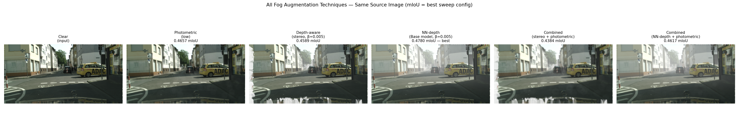
NEW TECHNIQUE · THE FIX SINCE LAST STATUS
Fog Probability — Stop Fogging Every Image
THEN — LAST STATUS
NOW — PROBABILISTIC FOG (NEW)
■
Fog on 100% of training images. Every batch was foggy — the model never saw a clear image.
■
fog_prob p ∈ {0.1, 0.3, 0.5, 0.7}. Each image is fogged with probability p — the model trains on a mix of clear + foggy (professor's “mostly real, some generated”).
■
One fixed intensity per run. No diversity in fog strength within a run.
■
Mixed-intensity variant. Random β per image instead of one fixed strength.
■
Result: all 10 augmented runs lost to baseline (0.414). Root cause: underfitting under heavy, relentless fog.
■
23 new ResNet-101 runs sweeping the p × β matrix. Same protocol as before — only the augmentation recipe changed.
Outcome: with p < 1, every technique family now beats the no-fog baseline on real ACDC fog.
Same source image under each technique (label = best sweep config · its ACDC mIoU).

Slide 3
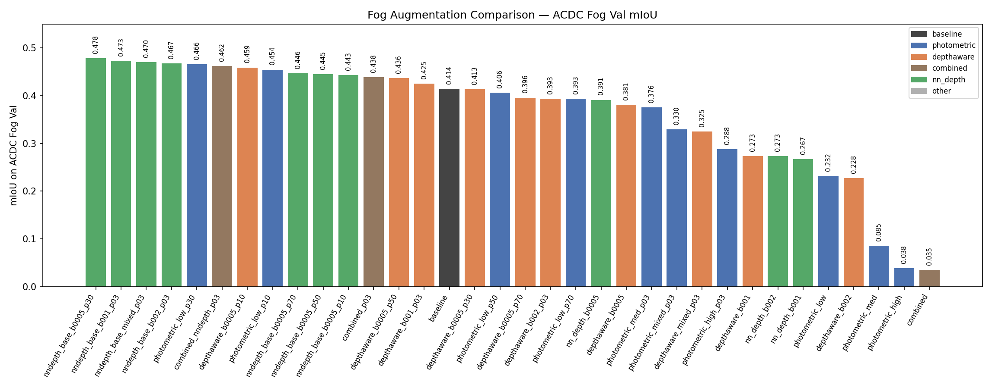
IMPROVED · RESULTS WITH FOG PROBABILITY (RESNET-101)
Fog Augmentation Now Beats Baseline
13 runs above baseline
Best: NN-depth, +6.4 pts
Sweet spot: p = 0.1–0.3
“Combined” rescued
Baseline (0.414) drops from rank 1 of 11 to mid-table once p < 1.
β=0.005, p=0.3 → 0.478 — monocular depth wins again.
Light-to-moderate fog exposure helps; p=0.7 drifts back down.
0.035 → 0.462 — stacking techniques works once fog is occasional.

Slide 4
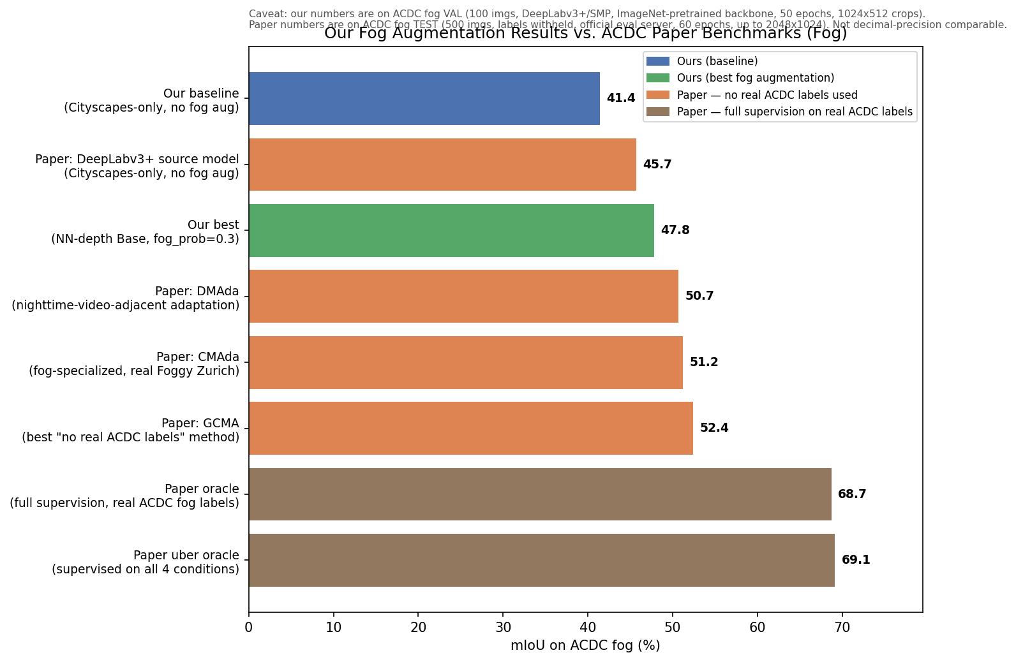
IMPROVED · EXTERNAL CONTEXT
Where We Stand vs. Published ACDC Methods
■
We now pass the paper's source model. Our best ResNet run (47.8) tops the ACDC paper's un-adapted DeepLabV3+ (45.7).
■
Approaching specialist methods. GCMA / CMAda (51–52) use real foggy imagery + domain adaptation; we use only synthetic fog on Cityscapes.
■
MiT-B2 changes the picture. Best backbone-sweep run (60.3) would clear every “no real ACDC labels” method — pending the caveat below.
Caveat: ours is ACDC fog val (100 imgs); paper numbers are the held-out test set (500 imgs, eval server). Directionally meaningful, not decimal-comparable.

Slide 5
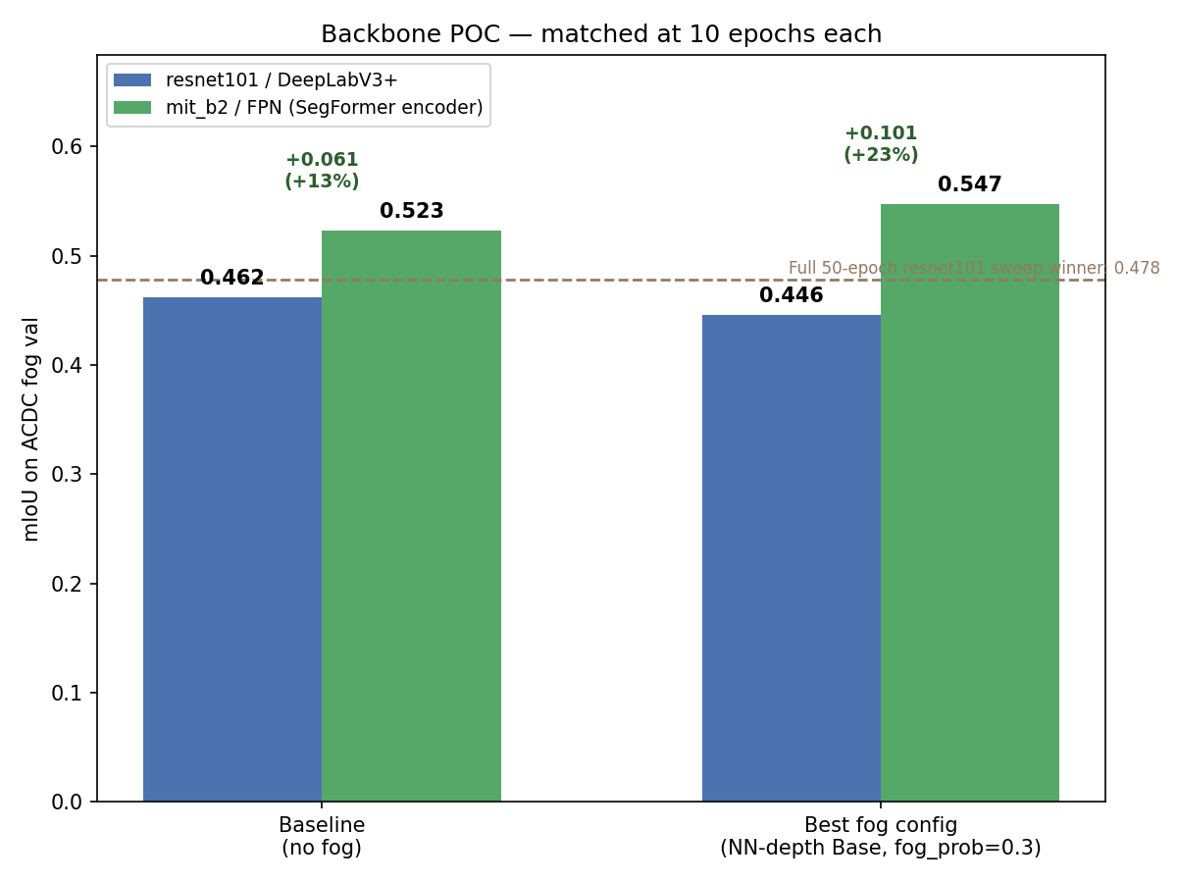
NEW TECHNIQUE · BACKBONE UPGRADE
POC: SegFormer Encoder (MiT-B2 / FPN)
■
Why: ResNet-101 / DeepLabV3+ was the bottleneck — transformer encoders are known to be more robust to domain shift like fog.
■
POC design: 4 runs, matched at 10 epochs each — both backbones, with and without the best fog config (NN-depth, p=0.3).
■
Result: +13% / +23%. MiT-B2 wins on baseline (+13% rel.) and by more with fog (+23% rel.) — fog augmentation helps the stronger backbone more.
■
10 epochs already beat 50. MiT-B2's 10-epoch fog run (0.547) tops the full 50-epoch ResNet sweep winner (0.478).
Decision: rerun the entire 24-config fog sweep on MiT-B2 at full 50 epochs.

Slide 6
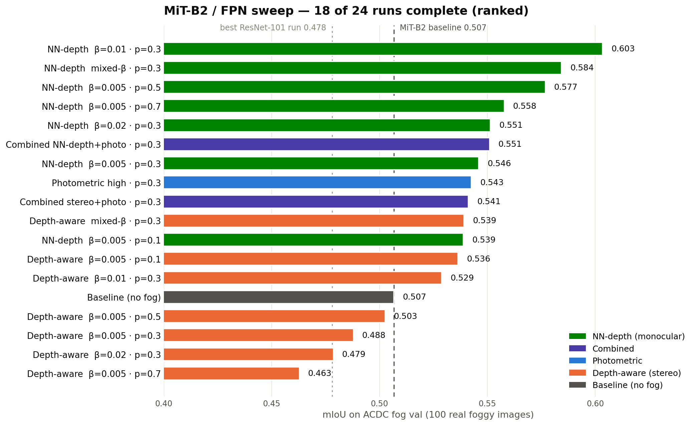
IMPROVED · BACKBONE RESWEEP (IN PROGRESS)
MiT-B2 Full Sweep — Results So Far
■
New best: 0.603. NN-depth β=0.01, p=0.3 — +9.7 pts over the MiT-B2 baseline (0.507).
■
Fog gain grows. +9.7 pts on MiT-B2 vs +6.4 on ResNet — the augmentation is worth more on the stronger model.
■
13 of 18 beat baseline. All five NN-depth and both combined configs are above it.
■
Depth-aware lags here. Stereo-depth fog is the weakest family on MiT-B2 — monocular NN-depth is the clear winner.

Slide 7
IN PROGRESS · NEXT 24 HOURS
What's Running Now — and What to Expect
RUNNING NOW · RTX A5000
QUEUED — 5 CONFIGS (~14.5 H)
photometric_low p=0.1 (MiT-B2)
photometric_low p = 0.3, 0.5, 0.7
photometric_med p = 0.3
photometric_mixed p = 0.3
epoch 27 / 50 · ~200 s per epoch · ~1.3 h remaining
Loss converging normally (avg 0.14 at epoch 27) — on track for the usual ~0.75 Cityscapes-val mIoU.
Sweep script is idempotent and resumable — completes the full 24-run MiT-B2 matrix by early tomorrow morning.
WHAT TO EXPECT
Photometric lands mid-table
Leader unlikely to change
Then: final compilation
On ResNet, photometric-low p=0.3 was the family's best (0.466); photometric-high p=0.3 already scores 0.543 on MiT-B2 — above baseline, below NN-depth's 0.603.
NN-depth β=0.01 p=0.3 (0.603) should stay on top — the finished families' ordering matches the ResNet sweep.
Recompile all 56 results, regenerate figures (family comparison, paper benchmark incl. MiT-B2), update report.
Still open: multi-seed runs for significance · ACDC test-server submission of the best MiT-B2 model · per-class failure analysis on the new winner.

