Slide 1

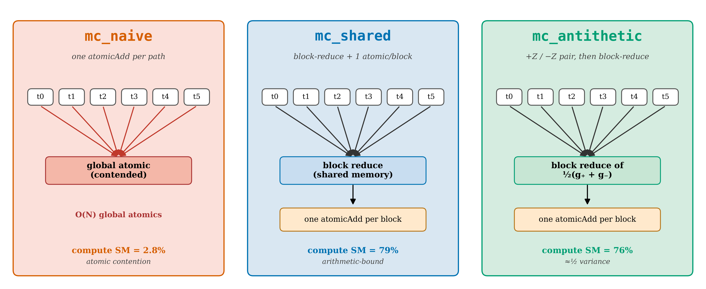
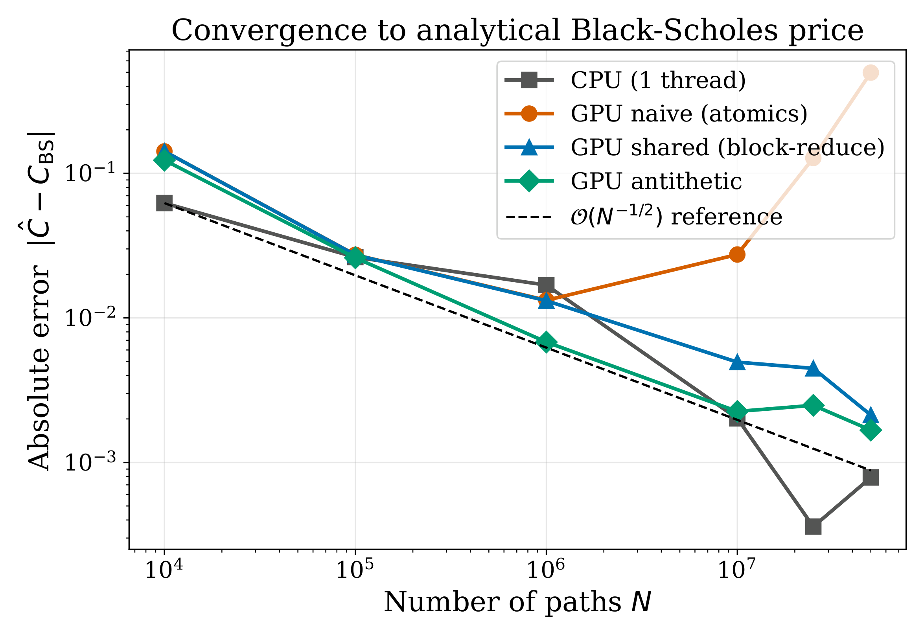
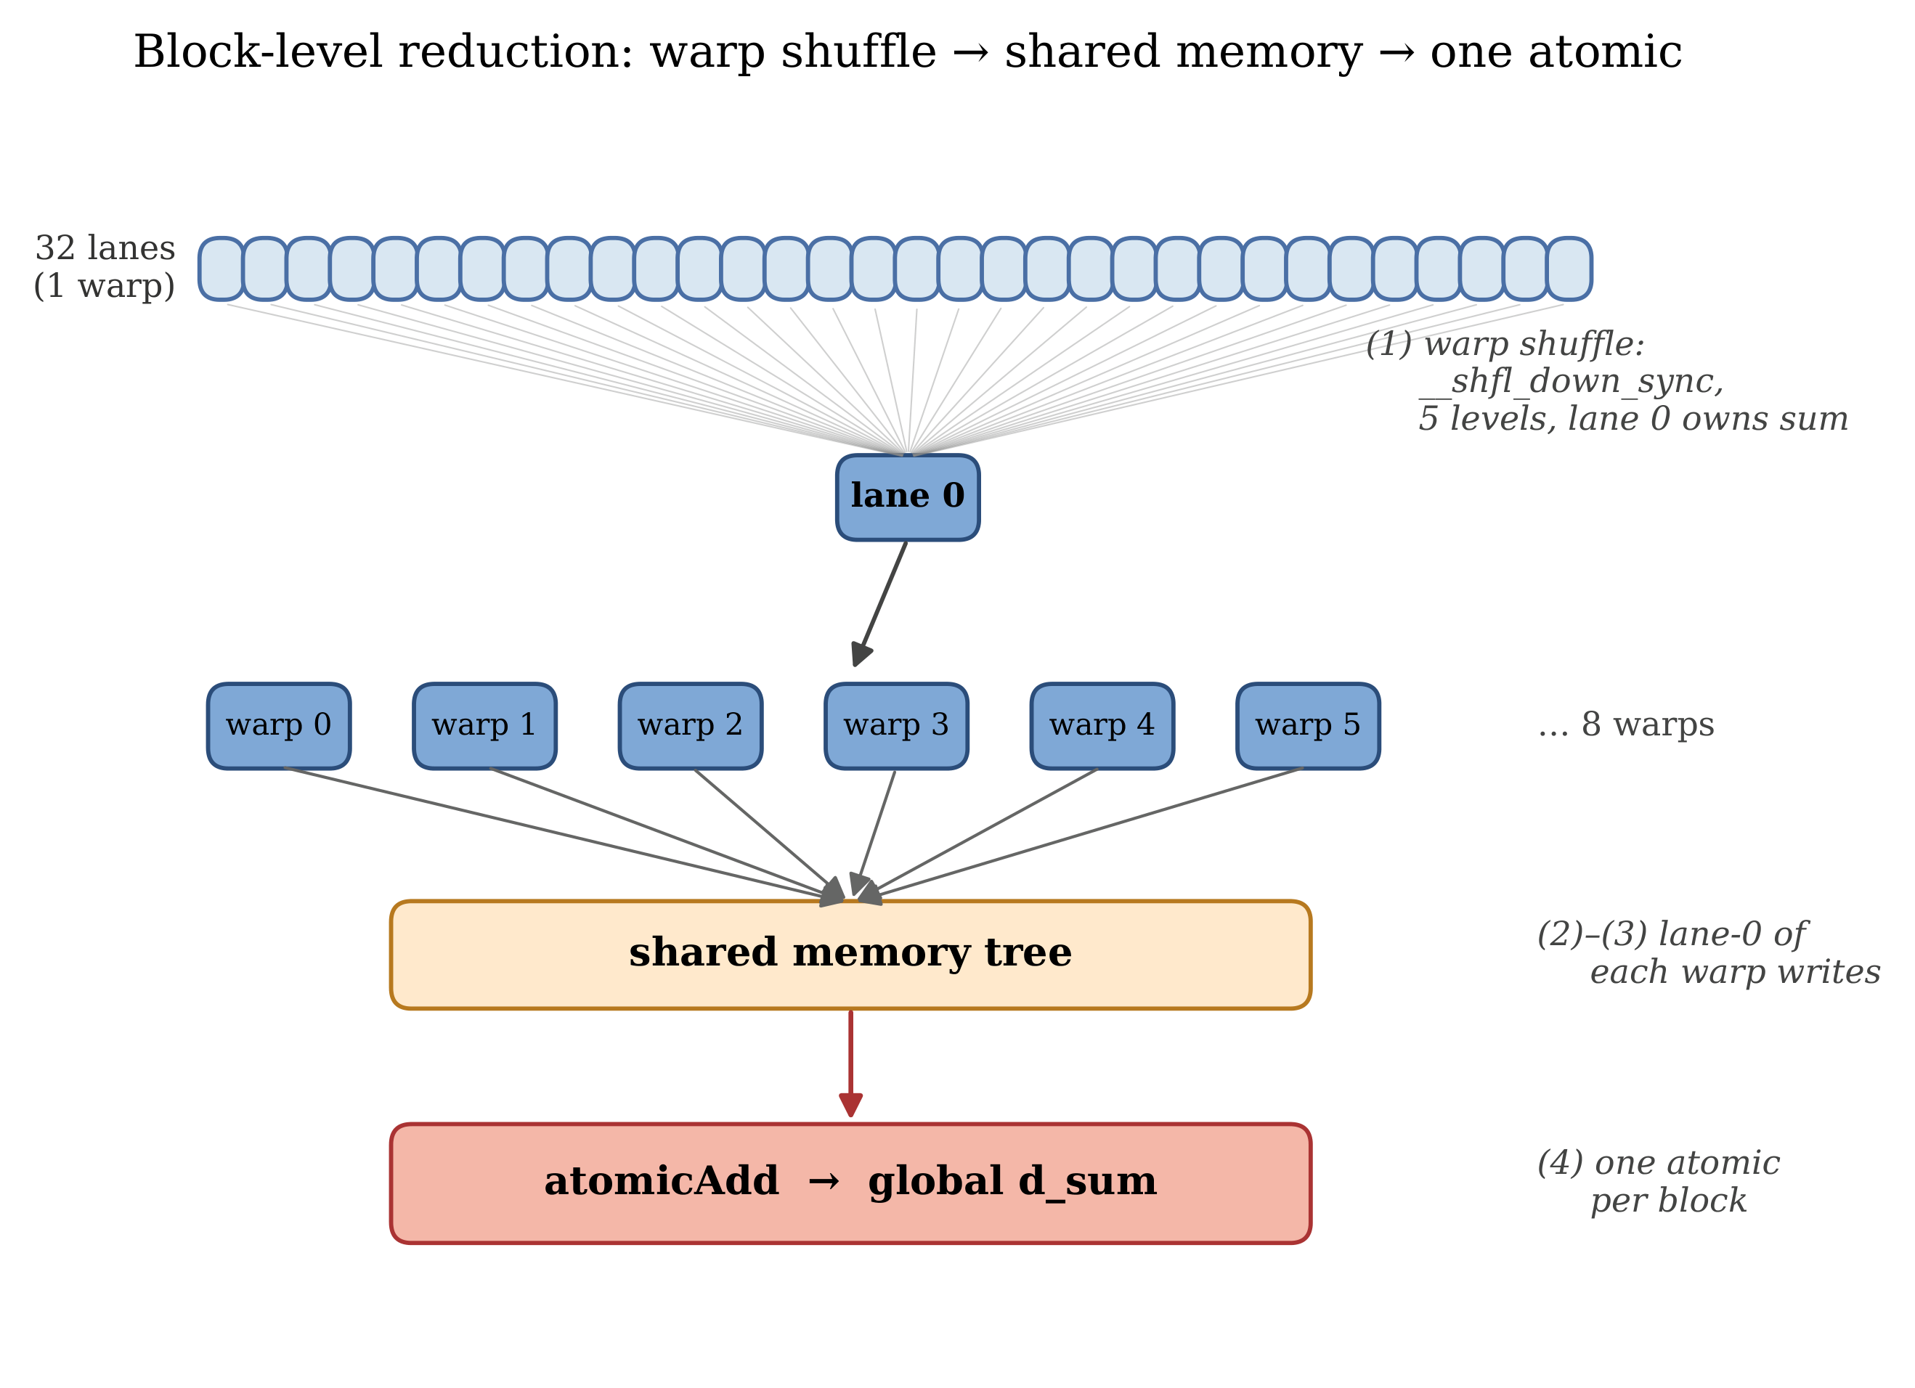
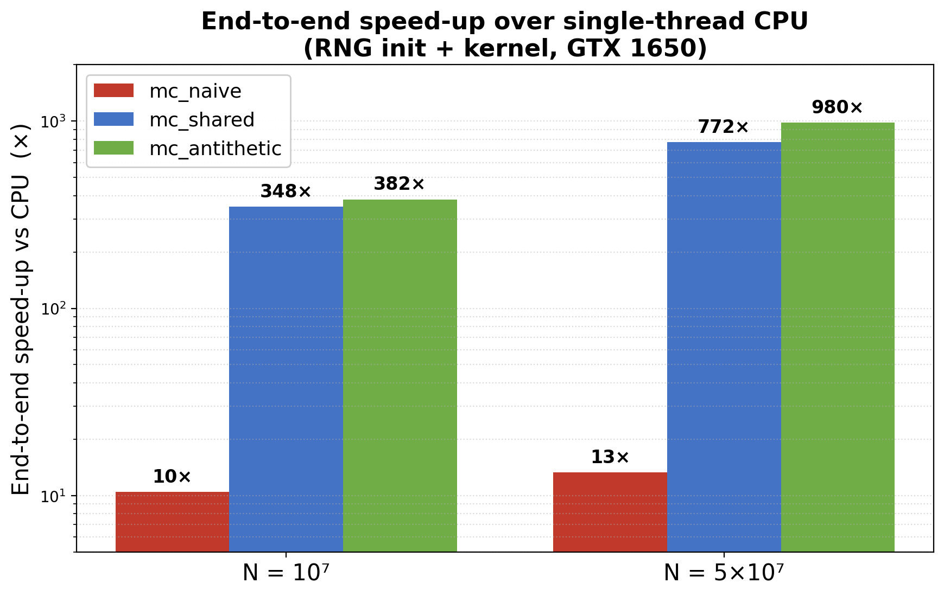
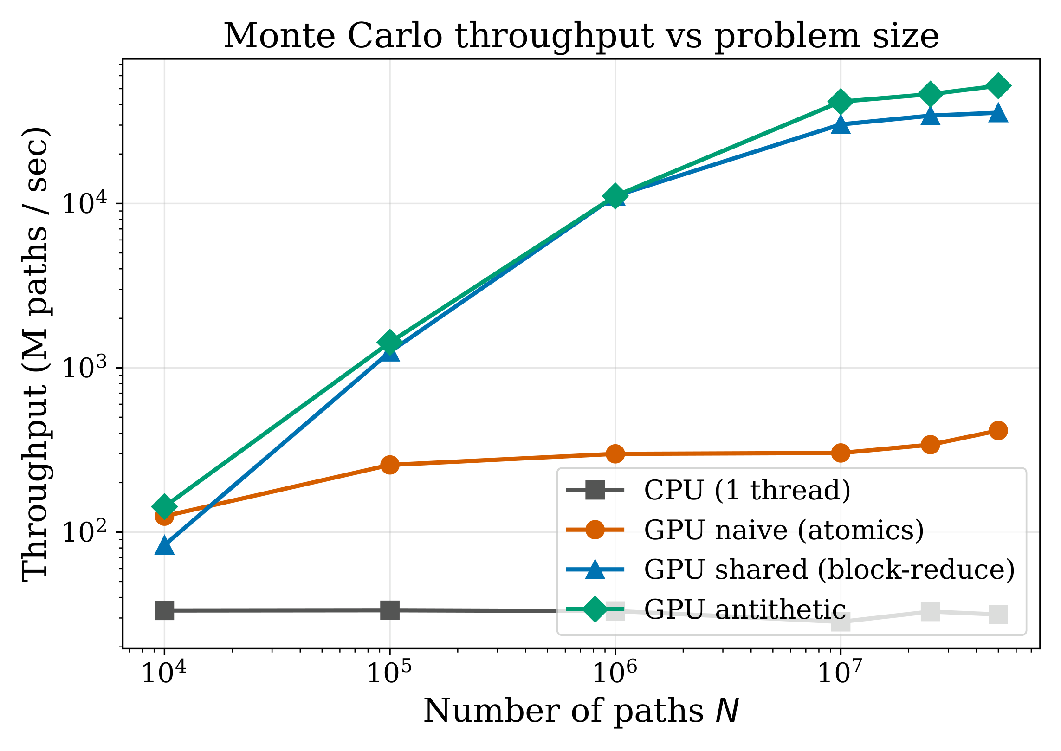
GPU-Accelerated Monte Carlo Simulation
for European Option Pricing
Talha Sarlık (704241052) · Mehmet Bedirhan Önder (704251026) · Istanbul Technical University
BLG 562E — Parallel Computing for GPUs Using CUDA
PROJECT OVERVIEW
THE THREE KERNELS — WHERE THEY DIFFER
Monte Carlo simulation prices a financial option by averaging the discounted payoff over many randomly simulated price paths. The method is accurate and flexible but expensive.
We price European call and put options under the Black-Scholes model. For our parameters this model has a closed-form price of 10.4506, which we use as exact ground truth. Starting from a single-threaded CPU baseline, we build three CUDA kernels: a naive version, a shared-memory reduction, and antithetic variates. A grid-stride refactor unifies all three.
Each version isolates one performance lesson. We benchmark every version against the CPU baseline, reporting the median of 5 runs, and validate each against the analytical price. The speed-ups we report are therefore full end-to-end numbers, not cherry-picked kernel timings.
4 · GRID-STRIDE REFACTOR (KEY)
VALIDATION
1 · mc_naive — one thread per path
The key change shared by all three kernels. Launching one thread per path makes the cuRAND state grow with N and dominate runtime. Instead, we launch a fixed 16,384-thread grid where each thread strides over many paths, reading its RNG state once and accumulating payoffs in registers. This makes RNG initialization 65× cheaper and flips the kernels from memory-bound to compute-bound—the single most important optimization here.
Each CUDA thread handles one complete price path. The thread generates a random number from its own cuRAND state, simulates how the stock price moves over time using geometric Brownian motion, and calculates the option payoff at the end.
The problem is how we add up the results. Every path has to update the same two values in memory using atomicAdd. Because all threads write to the same place, these updates happen one at a time instead of in parallel. The result: even though 94% of the GPU's threads are active, the cores sit idle ~97% of the time, and actual compute usage is only 2.75%. This is our intentionally "bad" baseline that later versions improve on.
Cost @ N=10⁶ | Before | After (gain)
cuRAND states | 48 B × N | 48 B × 16,384
init_rng | 44.6 ms | 0.68 ms (65×)
mc_shared | 1.06 ms | 0.08 ms (13×)
mc_antithetic | 0.61 ms | 0.07 ms (8.7×)
Absolute error vs N with a 0.5/√N reference; antithetic sits below it.
2 · mc_shared — block reduction
BENCHMARK — THE RUNS
Impl. (N=10⁶) | Estimate | Abs err | σ
mc_cpu | 10.4501 | 0.0005 | 0.0
mc_naive | 10.4718 | 0.0212 | 1.4
mc_shared | 10.4719 | 0.0213 | 1.4
mc_antithetic | 10.4593 | 0.0088 | 0.8
Same path simulation as the naive version, but with a smarter reduction. Each thread accumulates its payoffs in a private register, then threads within a block combine their totals using warp-shuffle instructions and shared memory—so only one thread per block does a single atomicAdd to the global total. This cuts global atomic updates from ~2·N down to about 128 total (independent of path count), eliminating the L2 bottleneck. Compute throughput jumps to 79%.
• Sweep N ∈ {10⁴ … 5×10⁷}, 5 runs per size, seeds 1–5; report the median.
• A warm-up launch precedes each batch (drops JIT / cold-cache outliers).
• GPU timed with CUDA events; CPU with wall-clock (QPC / clock_gettime).
• Every run validated against the analytical Black–Scholes price (within 4σ).
CONCLUSIONS
• Each kernel isolates one lesson: atomic contention (naive) → hierarchical reduction (shared) → variance reduction (antithetic).
• The grid-stride refactor is the key change: state O(N)→O(threads), init 65× faster, optimized kernel 13× faster, memory-bound → compute-bound.
• Honest end-to-end speed-up ≈382× at 10⁷ paths (≈980× at 5×10⁷) — past the 200× goal; kernel-only reaches ≈1650×.
• All kernels validate within 1σ of Black–Scholes; optimized kernels run at 76–79% of the GTX 1650 FP32 peak.
RESULTS — END-TO-END SPEED-UP
CONFIGURATION & REFERENCES
3 · mc_antithetic — variance reduction (±Z)
GPU: NVIDIA GTX 1650 (Turing TU117, sm_75, 16 SM, 4 GB GDDR5, 1.39 GHz, 128 GB/s). CPU: AMD Ryzen 7 5800H (single-thread ≈ 30 M paths/s). OS: Windows 11.
Toolchain: CUDA 12.4, nvcc (host MSVC 19.42), FP32, cuRAND XORWOW. Build flags: -O3 -arch=sm_75 -lineinfo -std=c++14.
Refs: Black & Scholes (1973) · Glasserman (2003) · Williams et al., Roofline (CACM 2009) · NVIDIA cuRAND & Nsight Compute guides.
This adds a variance-reduction trick on top of the shared-memory kernel. Since European payoffs move predictably with the random draw Z, each sample is paired with its mirror image, −Z, and the two payoffs are averaged into a single effective sample.
The two halves of each pair are negatively correlated, so much of the random noise cancels out. This roughly halves the variance—giving the same accuracy as nearly doubling the number of paths—for just one extra exponential calculation. And because the cuRAND state is read only once per pair, each effective sample is actually cheaper than in mc_shared.
RESULTS — THROUGHPUT
Throughput vs N (log–log). CPU ≈30 M/s; mc_naive saturates at ≈415 M/s (atomic bus); optimizedkernels reach tens of G paths/s.
Notes:
Prints as 33.1 x 46.8 (A0) at 100%. When printed using the library printing service, this will require trimming from 36 inch wide paper. To fill 36 inch paper roll, scale to 108.5% (prints as ~ 36 X 51).

