Slide 1

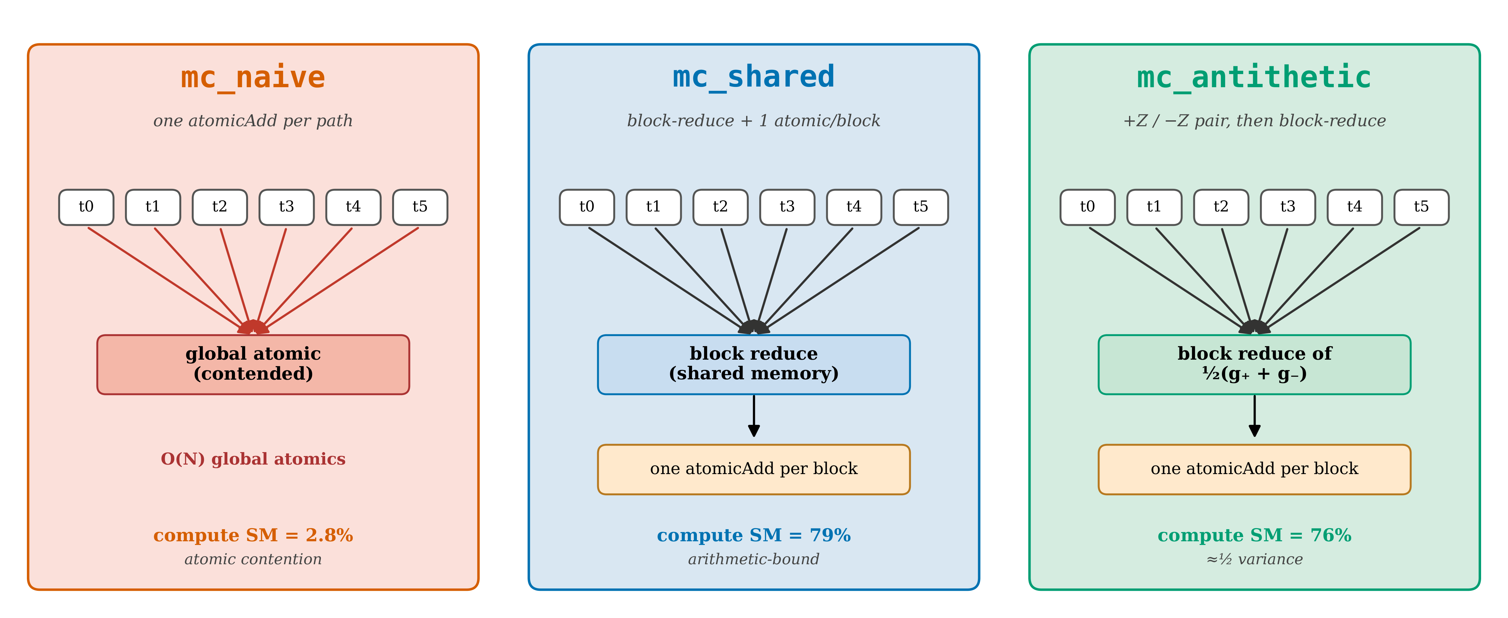
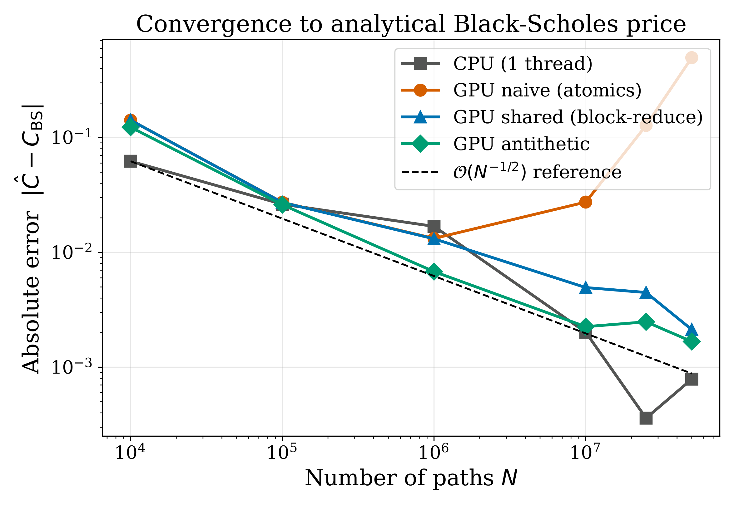
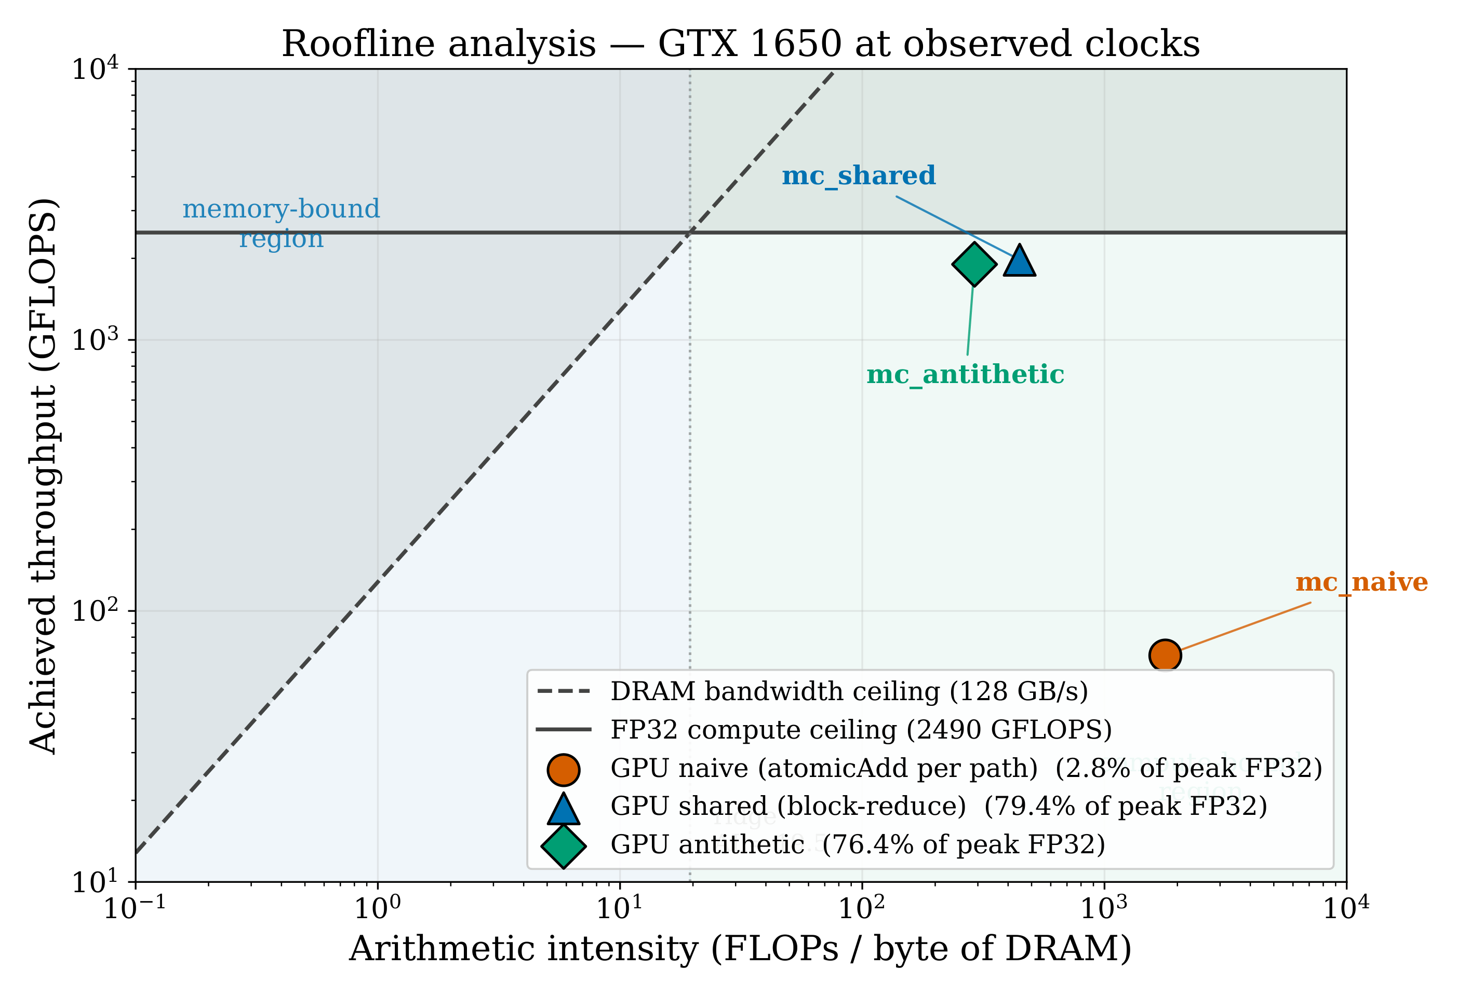
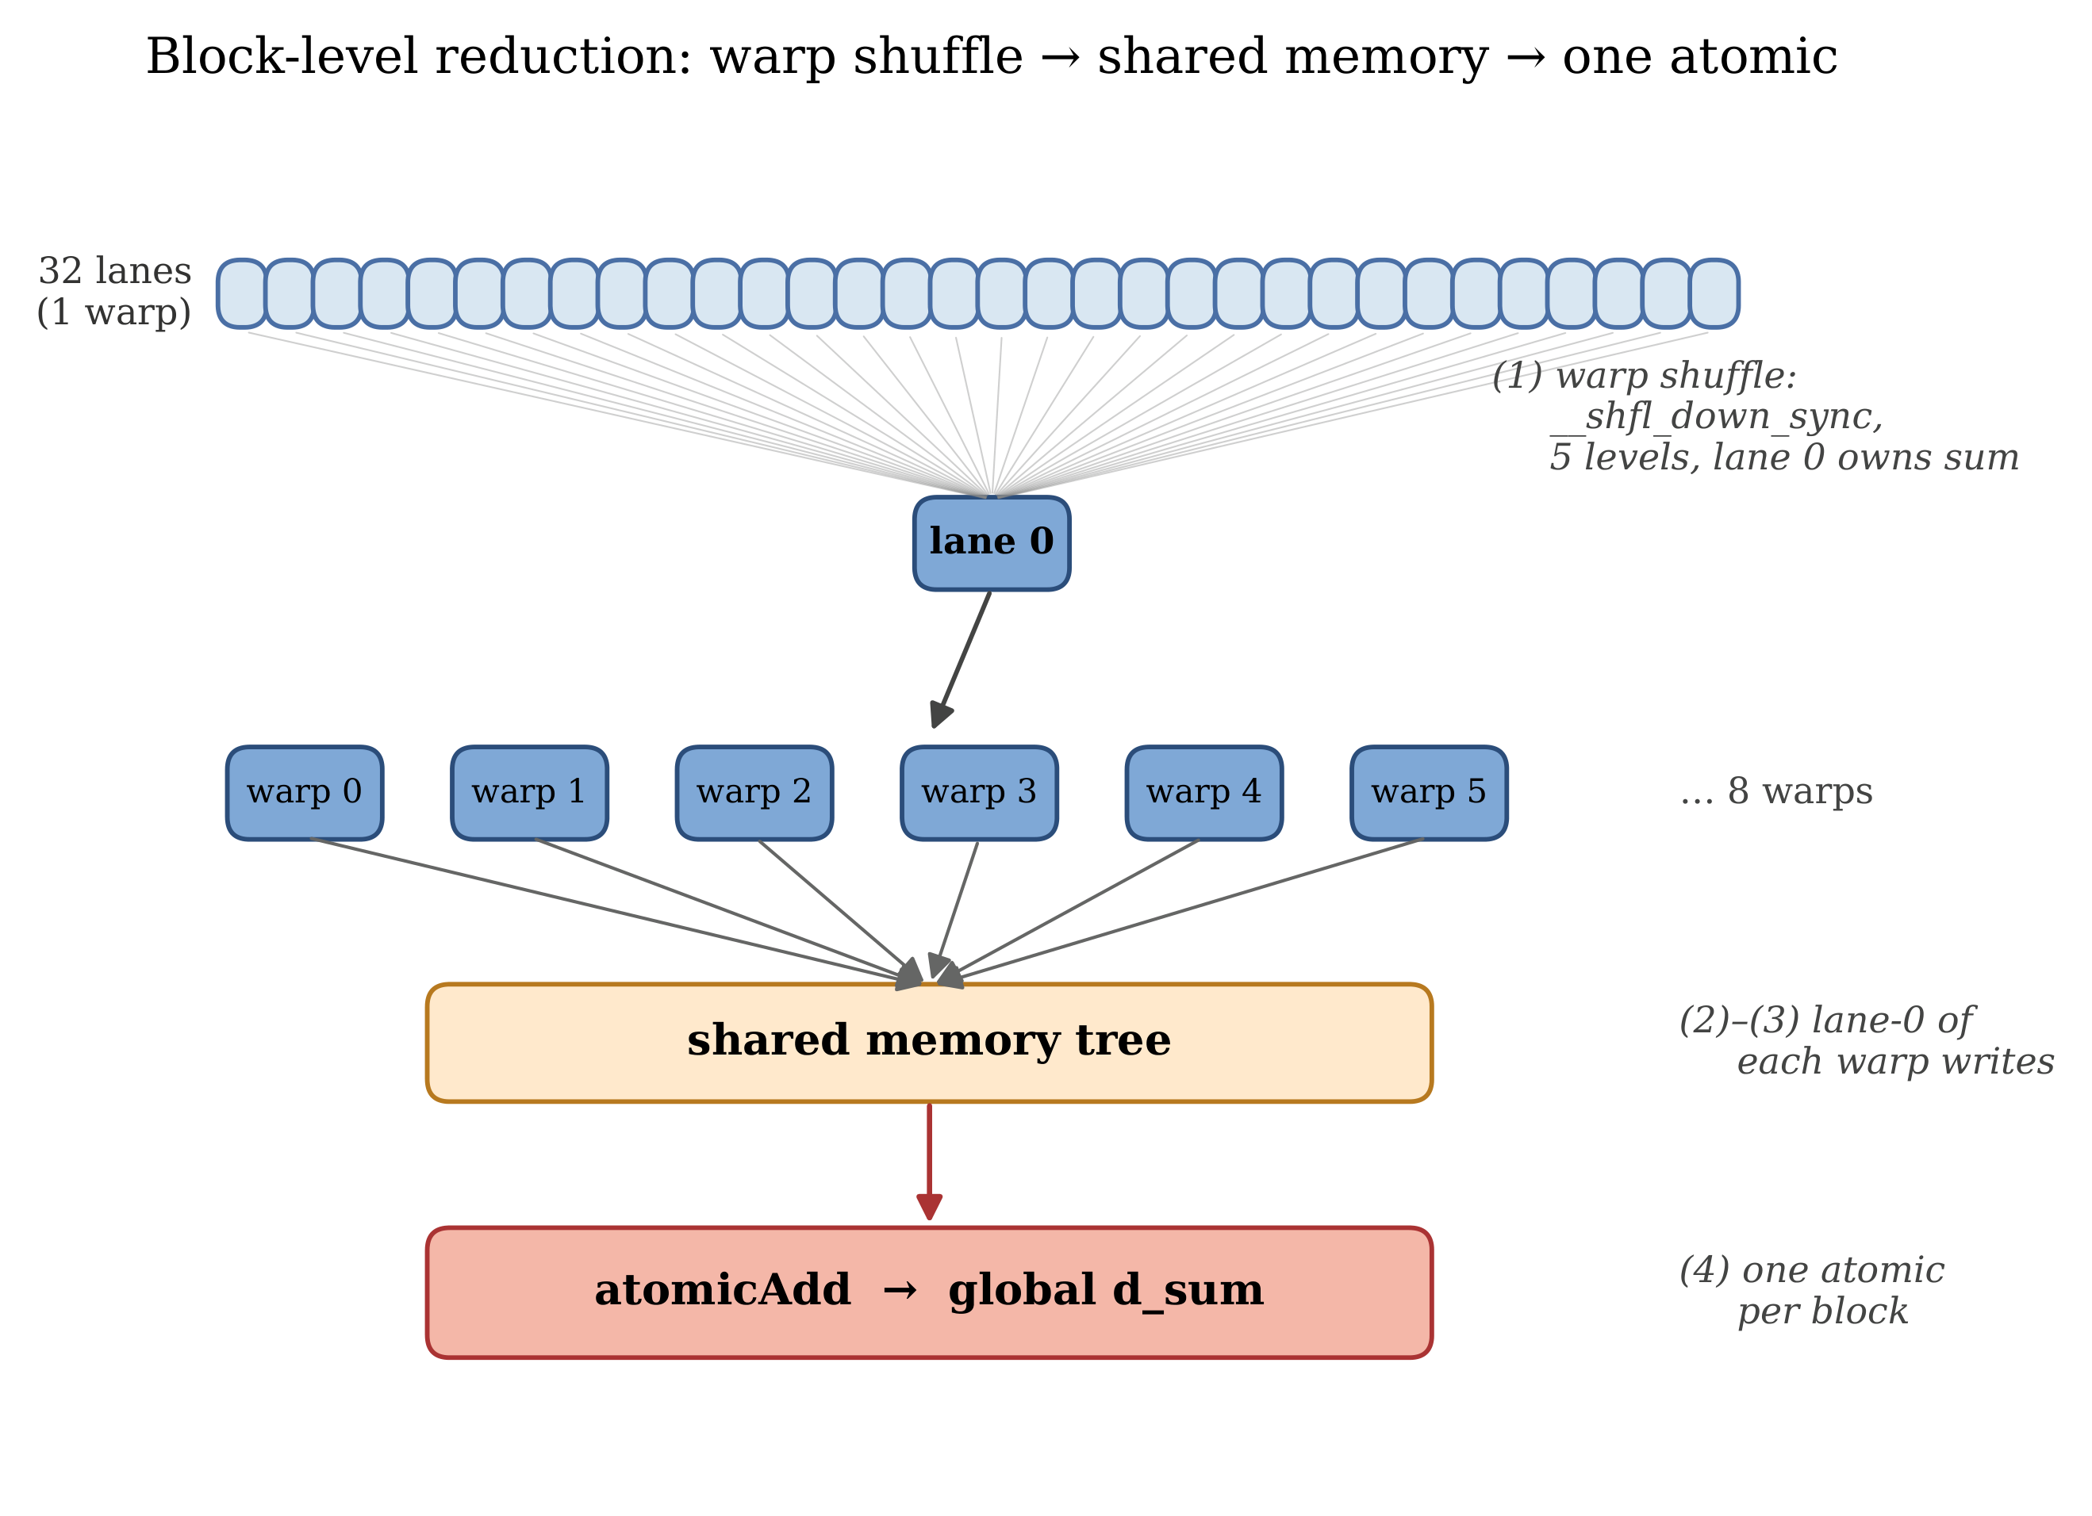
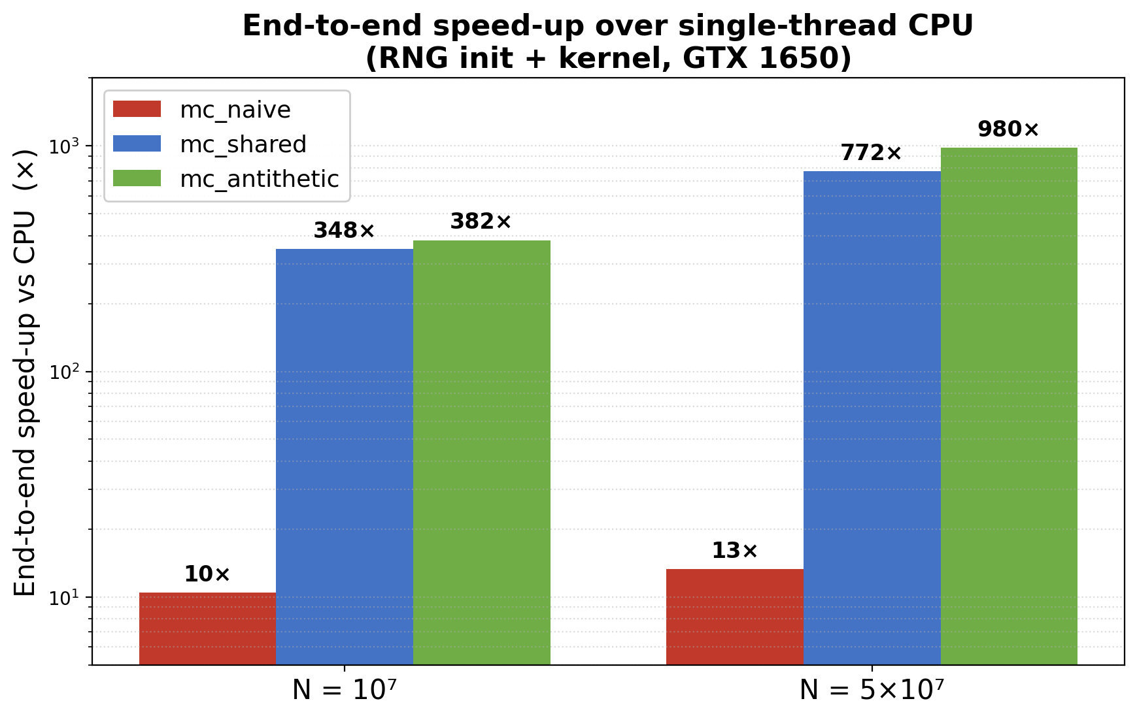
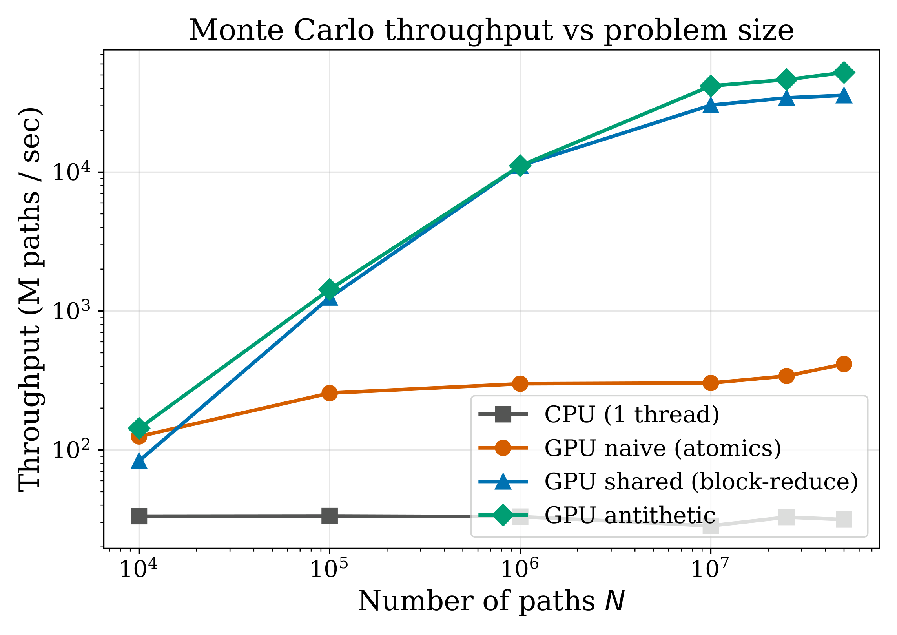
GPU-Accelerated Monte Carlo Simulation
for European Option Pricing
Talha Sarlık (704241052) · Mehmet Bedirhan Önder (704251026) · Istanbul Technical University
BLG 562E — Parallel Computing for GPUs Using CUDA
PROJECT OVERVIEW
THE THREE KERNELS — WHERE THEY DIFFER
Monte Carlo pricing averages the discounted payoff over many simulated price paths — flexible and accurate, but expensive: the error shrinks only as 1/√N.
• Target: European call/put under Black–Scholes; the closed-form price 10.4506 is our exact ground truth.
• Build: single-thread CPU baseline, then three CUDA kernels — naive, shared-memory reduction, antithetic variates — unified by a grid-stride refactor.
• Honest numbers: median of 5 runs, end-to-end timings (RNG init + kernel), every run validated.
Three independent kernels — benchmarked separately, one lesson each:
1 · mc_naive
2.8% SM
2 · mc_shared
79% SM
3 · mc_antithetic
½ variance
4 · GRID-STRIDE REFACTOR — applied to all three · RNG init 65× ↓
Best (antithetic): 382× end-to-end at N = 10⁷ · 980× at 5×10⁷
4 · GRID-STRIDE REFACTOR (KEY)
VALIDATION
1 · mc_naive — one thread per path
• Problem: one thread per path means the cuRAND state array grows with N (48 B × N) and its init dominates runtime.
• Fix: a fixed 16,384-thread grid; each thread strides over many paths, reads its RNG state once, sums in registers.
• Effect: init 65× cheaper; kernels flip from memory-bound to compute-bound — the single most important change.
• One thread = one full path: own cuRAND state, one exact GBM step to expiry, payoff at the end.
• The catch: every path updates the same two global values with atomicAdd — the writes serialize in L2.
• Profiler verdict: 94% occupancy, yet SM throughput is only 2.8% — cores sit idle ~97% of the time.
• Intentionally simple baseline — the next two kernels fix exactly this.
Cost @ N=10⁶ | Before | After (gain)
cuRAND states | 48 B × N | 48 B × 16,384
init_rng | 44.6 ms | 0.68 ms (65×)
mc_shared | 1.06 ms | 0.08 ms (13×)
mc_antithetic | 0.61 ms | 0.07 ms (8.7×)
Error vs N with an O(1/√N) guide — naive’s FP32 atomic sum degrades at 5×10⁷.
2 · mc_shared — block reduction
BENCHMARK — THE RUNS
Impl. (N=10⁶) | Estimate | Abs err | σ
mc_cpu | 10.4501 | 0.0005 | 0.0
mc_naive | 10.4718 | 0.0212 | 1.4
mc_shared | 10.4719 | 0.0213 | 1.4
mc_antithetic | 10.4593 | 0.0088 | 0.8
• Same simulation, smarter sum: each thread accumulates payoffs in a private register.
• Reduction: warp shuffle → shared-memory tree → one atomicAdd per block (below).
• Payoff: global atomics fall from ~2·N to ~128, independent of N — L2 bottleneck gone; SM throughput 2.8% → 79%.
• Sweep N ∈ {10⁴ … 5×10⁷}, 5 runs per size, seeds 1–5; report the median.
• A warm-up launch precedes each batch (drops JIT / cold-cache outliers).
• GPU timed with CUDA events; CPU with wall-clock (QPC / clock_gettime).
• Every run validated against the analytical Black–Scholes price (within 4σ).
5 · ROOFLINE — WHY IT’S FAST
RESULTS — END-TO-END SPEED-UP
Optimized kernels sit on the FP32 compute ceiling; mc_naive is stuck far below both ceilings at 2.8% of peak.
CONCLUSIONS
• One lesson per kernel: atomic contention (naive) → hierarchical reduction (shared) → variance reduction (±Z).
• Grid-stride is the key refactor: state O(N) → O(threads), init 65× faster, kernel 13× faster, memory- → compute-bound.
• Honest end-to-end speed-up ≈382× at 10⁷ paths (≈980× at 5×10⁷) — past the 200× goal; kernel-only ≈1652×.
• Antithetic agrees with Black–Scholes to 0.8σ (all kernels ≤ 1.4σ at N = 10⁶); optimized kernels reach 76–79% of FP32 peak.
3 · mc_antithetic — variance reduction (±Z)
• The trick: on top of mc_shared, pair every draw Z with its mirror −Z and average the two payoffs into one sample.
• Why it works: the pair is negatively correlated, so noise cancels — ~½ the variance ≈ the accuracy of 2× the paths.
• The cost: one extra exp() per pair — and one RNG-state read per pair makes each effective sample cheaper than in mc_shared.
RESULTS — THROUGHPUT
CONFIGURATION & REFERENCES
ĝ = ½ [ g(+Z) + g(−Z) ]
GPU: NVIDIA GTX 1650 (Turing TU117, sm_75, 16 SM, 4 GB GDDR5, 128 GB/s) · CPU: AMD Ryzen 7 5800H · Windows 11.
Toolchain: CUDA 12.4, nvcc + MSVC, FP32, cuRAND XORWOW · flags: -O3 -arch=sm_75 -lineinfo -std=c++14.
Refs: Black–Scholes (1973) · Glasserman (2003) · Williams et al., Roofline (CACM 2009) · NVIDIA cuRAND & Nsight guides.
Throughput vs N (log–log). CPU ≈30 M/s; mc_naive saturates at ≈415 M/s (atomic bus); optimized kernels reach tens of G paths/s.
382×
end-to-end vs CPU · N = 10⁷
980×
end-to-end vs CPU · N = 5×10⁷
1652×
kernel-only speed-up · N = 5×10⁷
2.8% → 79%
SM throughput · naive → optimized
0.8σ
antithetic error vs Black–Scholes · N = 10⁶
Notes:
Prints as 33.1 x 46.8 (A0) at 100%. When printed using the library printing service, this will require trimming from 36 inch wide paper. To fill 36 inch paper roll, scale to 108.5% (prints as ~ 36 X 51).

