Slide 1
HVIZ
HTTP(S) Traffic aggregation and Visualization for Network Forensic
Presenters:
M. Talha Shafique FA14-BCS-112
Jawad Javaid FA14-BCS-124

Slide 2
Outline:
What is HVIZ?
Introduction to HVIZ
Need of HVIZ
Architecture of HVIZ
HVIZ modules
HVIZ Aggregation Events
HVIZ( Offline)
HVIZ(Online)
HVIZ(Client/Server)

Slide 3
Outline:
Visualization
Visualization Architecture
D3
Cef Sharp
Visualization for Offline
Visualization of Client Server module
3

Slide 4
What is HVIZ?
HTTP(S) Traffic aggregation and Visualization (HVIZ) is a Network forensic tool that will help investigator to track the attacker.
HVIZ filters the HTTP(S) request then analyses the HTTP(S) request to help investigator which request is a normal and which is malicious request.

Slide 5
Introduction to HVIZ:
HVIZ is technique used, which analyze traffic by reconstruct and visualizes the HTTP(S) of individual hosts.
HVIZ is a latest technique which we are using to overcome HTTP(S) analysis problem.

Slide 6
Need of HVIZ:
Increase in Browsing.
Increase in Internet Usage.
Online Fraud and Threats.
Cybercrime and Data leakage.
Observing network traffic is difficult task.
Malicious activates rely on HTTP communication.

Slide 7
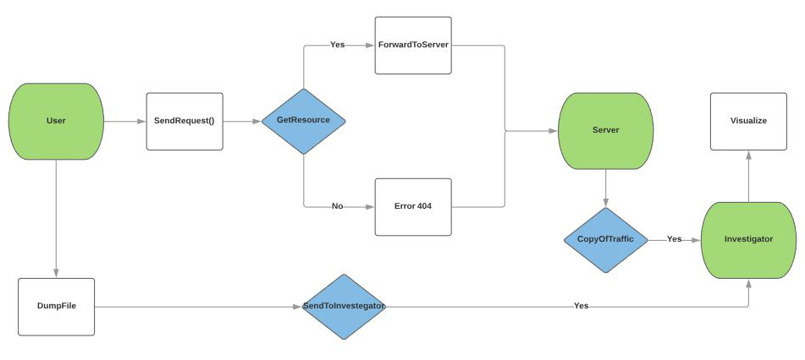
HVIZ architecture:

Slide 8
HVIZ modules:
HVIZ consists of different modules:
1. Offline Reading
2. Online Capturing and Reading.
3. Client Server.
4. Visualization.

Slide 9
HVIZ Three Aggregation Events:
Head Requests.
Click stream Requests.
Embedded Requests.

Slide 10
HVIZ (Offline):
HVIZ can read offline packet captured with extension (.pcap).
It first filter out all request on bases of three events.
It then visualize the traffic.

Slide 11
HVIZ (Online):
HVIZ\can capture it’s own traffic like most of the existing Web traffic sniffers do.
HVIZ can also capture the HTTPS request.
Most of the Web sniffer don’t capture the encrypted Traffic.
HVIZ save these capture traffic includes HTTP and HTTP(S) in it’s own log file.

Slide 12
HVIZ (Client/Server):
HVIZ can also be used to capture the traffic from Client side.
Server is created inside HVIZ to capture traffic from Client side.
All captured traffic will be save in HVIZ .log file.
Saved file name will be depend upon Client IP address.
Captured Traffic can be visualized at any time.

Slide 13
HVIZ Visualization

Slide 14
Need of Visualization:
Visualization is essential and main feature of HVIZ.
It helps an investigator to understand what events are happening

Slide 15
Visualization Architecture:
Visualization combines following libraries to visualize.
      D3
      CefSharp

Slide 16
D3
Document Data Driven
Dynamic web library to visualize Data.

Slide 17
CefSharp
Chromium Embedded Framework.
Fast and efficient browser for C#.net

Slide 18
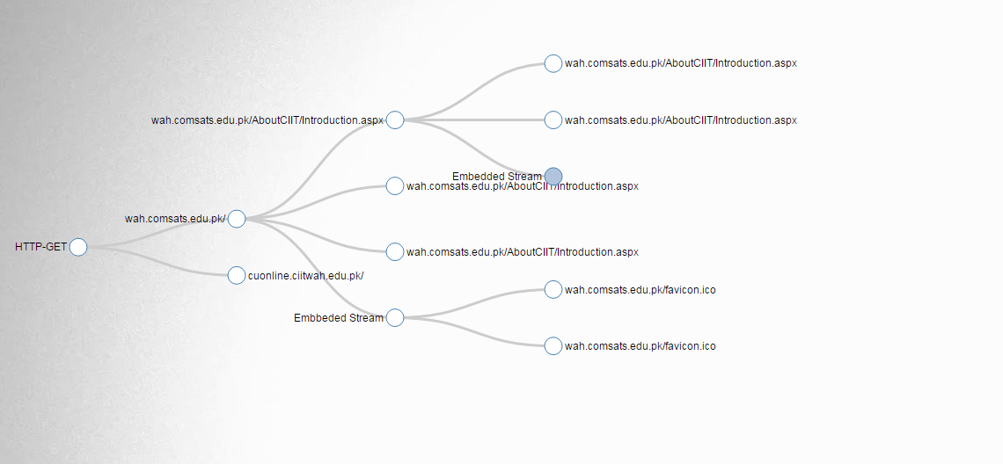
Visualization for Offline
\

Slide 19
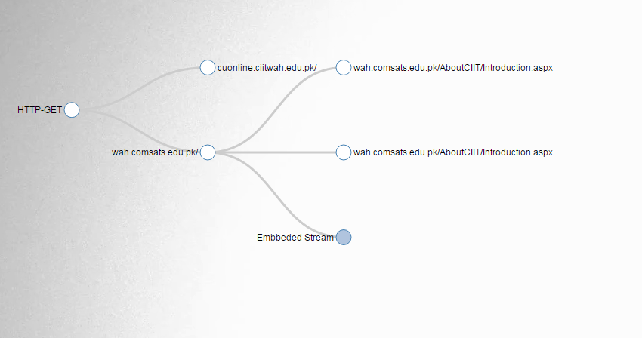
Contd

Slide 20
Visualization of Client Server module
Same as offline module.
Difference comes programmatically only.

Slide 21
THANKS!
Any questions?

