Slide 1

Computer Vision Project
Exercise 2: Writer Identification with Local Features
Friedrich-Alexander-Universität
Technische Fakultät

Slide 2
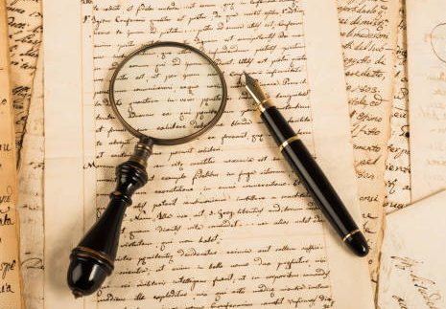
Objective
Develop a system to identify the writer of historical documents using local image features.
Steps Involved
Extract local features(SIFT) from Images.
Encode Images using VLAD with a 100-cluster codebook.
Evaluate retrieval performance using Mean Average Precision (mAP).
Enhance results using Exemplar SVM.

Slide 3
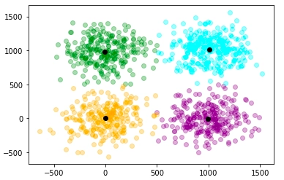
Methodology – Data Loading & Codebook Generation
1. Load Labels and Features
Load image IDs and their class labels from files
Load local SIFT descriptors from gzipped pickle files
2. Sample Descriptors from Train Set
Randomly sample 500,000 descriptors from training images
This reduces computation and captures representative features
3. Compute Codebook with MiniBatchKMeans
Uses MiniBatchKMeans to cluster sampled descriptors into 100 clusters
This forms the codebook used for encoding

Slide 4
Methodology – VLAD Encoding & Normalization
1. Compute VLAD Encoding
For each image, assign each descriptor to nearest cluster center
Compute residuals: difference between descriptor and assigned cluster center
Sum residuals per cluster to form VLAD vector (concatenated residuals)
2. Normalize VLAD Vector
Apply power normalization: element-wise signed square root to reduce burstiness(dominance of very frequent visual patterns)
Apply L2 normalization: Final VLAD vector is a unit length, and no single element dominates, for fair similarity comparison
3. Repeat for Train and Test Sets
Compute normalized VLAD vectors for all training and test images

Slide 5
Methodology – Exempler SVM & Evaluation
1. Evaluate Initial Retrieval with VLAD mAP
Compute pairwise Euclidean distances between all VLAD vectors
Calculate mean average precision (mAP) for retrieval performance
2. Train Exemplar SVM for Each Test Image
Test VLAD vector as positive, all train vectors as negative samples
Use LinearSVC with strong regularization (C=1000) and balanced weights
Extract and normalize SVM weight vector as new improved encoding
3. Evaluate Final Retrieval with SVM-enhanced Encodings
Concatenate train VLADs and SVM-enhanced test encodings
Compute mAP again to show improvement in retrieval accuracy

Slide 6
Results Overview
VLAD Encoding mAP:
Achieved 0.739 mean average precision on combined train & test set
Good baseline retrieval performance using VLAD vector representation
Exemplar SVM Improvement:
Trained individual SVMs for each test encoding to better separate positives from negatives
mAP improved to 0.825, showing significant performance boost
Key Takeaway:
Exemplar SVM fine-tunes VLAD encodings, leading to more discriminative and accurate retrieval results

Slide 7
Conclusion
VLAD encoding provides a strong baseline for writer identification with a mAP of ~0.74.
Applying Exemplar SVMs on top of VLAD significantly improves retrieval performance (mAP increased to ~0.83).
Codebook size and descriptor sampling critically affect encoding quality and computation time.
Combining local features with discriminative models like SVM enhances system robustness.

