Slide 1

Amortization schedule
Dr. Ejaz Aslam

Slide 2

Amortization schedule
An amortization schedule is a table that provides the details of the periodic payments for an amortizing loan. The principal of an amortizing loan is paid down over the life of the loan. Typically, an equal amount of payment is made every period.

Slide 3
Amortization schedule
An amortization schedule is a table that provides the periodic payment information for an amortizing loan.
The loan amount, interest rate, term to maturity, payment periods, and amortization method determine what an amortization schedule looks like.
Amortization methods include the straight line, declining balance, annuity, bullet, balloon, and negative amortization

Slide 4
Understanding Amortization Schedules
Periodic payments are made for amortizing loans, such as a car or home mortgage. Each payment consists of two components – interest charge and principal repayment. The percentage of interest or principal repayment varies for different loans.
Predetermined interest rate and the outstanding balance of the loan.
The remaining portion of the periodic payment
Remaining balance of an amortizing loan diminishes as time passes, with principals repaid.

Slide 5

Example of Amortization Schedule
Consider a $30,000 fully amortizing loan with a term of five years and a fixed rate of return 6%. Payments are made on a monthly basis. The following table shows the amortization schedule for the first and last six months.

Slide 6
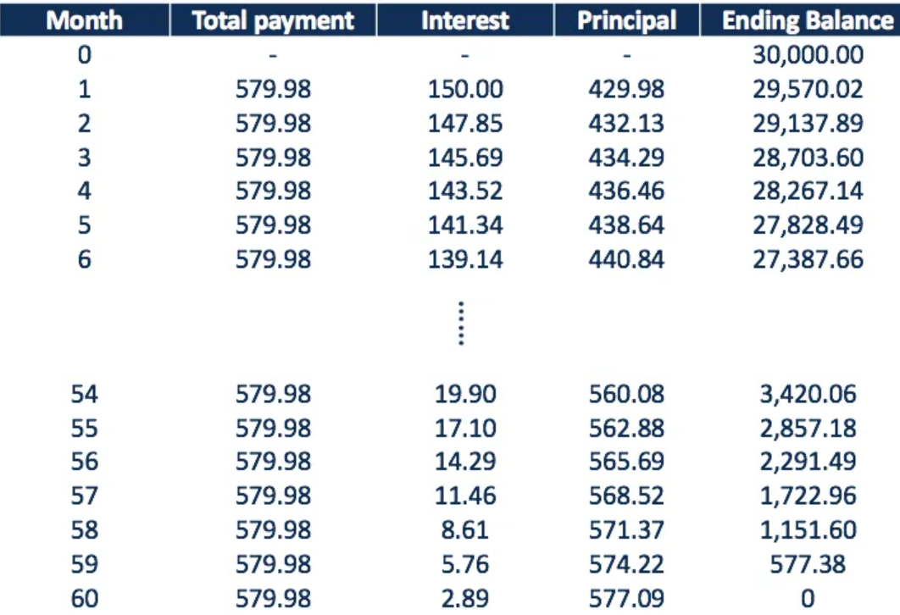

Slide 7
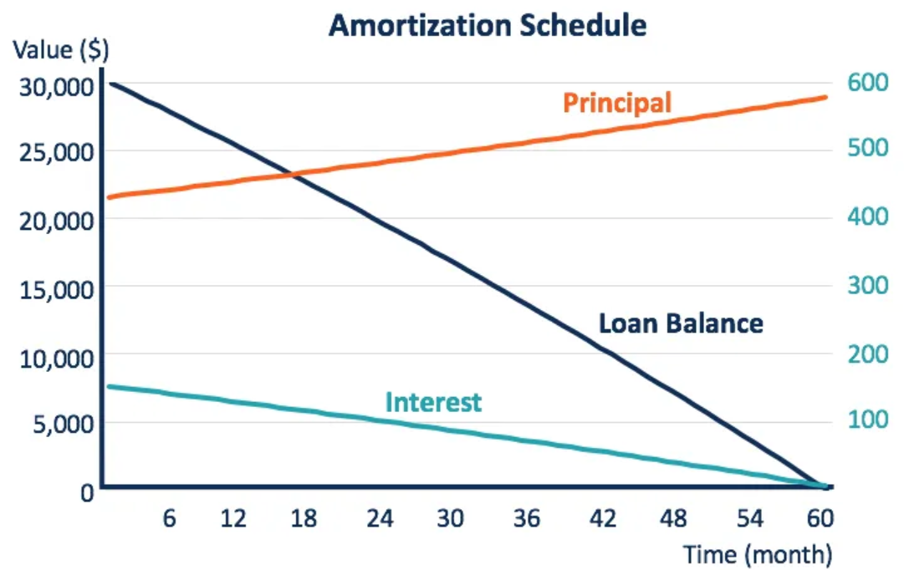

Slide 8
Methods for Amortization Schedule
1. Straight line
The straight-line amortization, also known as linear amortization, is where the total interest amount is distributed equally over the life of a loan. It is a commonly used method in accounting due to its simplicity. With fixed periodic total payment and interest amount, the principal repayment is also constant over the life of the loan

Slide 9

2. Declining balance
The declining-balance method is an accelerated method of amortization where the periodic interest payment declines, but the principal repayment increases with the age of the loan. In such a method, each periodic payment is greater than the interest charged (interest rate times the beginning loan balance of the period); the remaining part repays the principal, and the loan balance declines. The declining loan balance leads to lower interest charges, and thus accelerates the repayment of the principal.

Slide 10

3. Annuity
A loan amortized in the annuity method comprises a series of payments made between equal time intervals. The payments are also typically made in equal amounts. There are two types of annuity: ordinary annuity, for which payments are made at the end of each period, and annuity due, for which payments are made at the beginning of each period.
Different types of annuities can cause a slight difference between their amortization schedules. The higher the interest rate or the longer the loan life, the greater the difference. The amortization schedule example above uses the ordinary annuity method.

Slide 11
4. Bullet
Bullet loans are not typically amortized over the life of loans. Generally, the periodic payments of a bullet loan cover the interest charges only. It leaves a large amount of the final payment at the maturity of the loan, which repays the entire principal.
Therefore, the balance outstanding of a bullet loan remains unchanged over the life of the loan and is lowered immediately to zero at maturity.

Slide 12
5. Balloon
A balloon loan is similar to a bullet loan, which usually repays its entire principal at maturity. Occasionally, it is amortized with small amounts of principal repayments, but still leaves the majority paid at maturity. In such a case, the balance outstanding slightly decreases over the loan life and falls to zero at maturity.

Slide 13
6. Negative amortization
In the negative amortization method, the total payment of a period is lower than the interest charged for that period. It means that there is nothing left from the periodic payment to repay the principal, and the remaining interest charge will accumulate to increase the outstanding balance of the loan. The loan balance increases over time and will be repaid at maturity.

Slide 14
Simple interest rate formula
SI = P × R × T,
where P= Principal,
R= rate of interest,
and T= time period.

Slide 15
20000*(0.06*1/12) = 3200
20000(1+0.08)^2 -20000 = 3328
R = Pi/ 1-(1+i)^-n

Slide 16
compound interest
P (1 + r/n)^(nt)
where P is the initial principal balance,
r is the interest rate,
n is the number of times interest is compounded per time period and t is the number of time periods

Slide 17
Detail
Compound interest (or compounding interest) is the interest on a loan or deposit calculated based on both the initial principal and the accumulated interest from previous periods. Thought to have originated in 17th-century Italy, compound interest can be thought of as "interest on interest," and will make a sum grow at a faster rate than simple interest, which is calculated only on the principal amount.
The rate at which compound interest accrues depends on the frequency of compounding, such that the higher the number of compounding periods, the greater the compound interest.

Slide 18
Example
Take a three-year loan of $10,000 at an interest rate of 5% that compounds annually.
What would be the amount of interest?
$10,000 [(1 + 0.05) ³ – 1] = $10,000 [1.157625 – 1] = $1,576.25

Slide 19
Time Value of Money Consideration
Understanding the time value of money and the exponential growth created by compounding is essential for investors looking to optimize their income and wealth allocation.
FV = PV (1 +i)^{n}
PV = FV / (1 + i) ^{n}

Slide 20
Examples
The future value of $10,000 compounded at 5% annually for three years:
For example, the future value of $10,000 compounded at 5% annually for three years:
= $10,000 (1 + 0.05) ³
= $10,000 (1.157625)
= $11,576.25
The present value of $11,576.25 discounted at 5% for three years:
= $11,576.25 / (1 + 0.05) ³
= $11,576.25 / 1.157625
= $10,000

