Slide 1

“ELISA”
Presented By: Rida Batool (009) Course Instructor: Dr. Sumbal Nazir
Subject: Advance Analytical Techniques
School of Zoology
Minhaj University Lahore

Slide 2
What we will discuss…
What is ELISA?
What are immunoassays?
What are the uses of ELISA?
What type of results do you get from ELISA?
How does the ELISA technique work?

Slide 3
What is ELISA?
“ELISA” stands for “enzyme-linked immunosorbent assay.” Another name for it is an EIA test.
ELISA is a common laboratory testing technique that detects and counts certain antibodies, antigens, proteins and hormones in bodily fluid samples. This includes blood, plasma, pee, saliva (spit) and cerebrospinal fluid (CSF).

Slide 4
Continue…
Researchers consider ELISA to be the gold standard of immunoassays. Tests that use ELISA can help diagnose a wide range of conditions, from bacterial and viral infections (like Lyme disease and HIV) to endocrine conditions, like thyroid disease.
Home pregnancy tests are even based on the ELISA technique. They detect the presence of a hormone called human chorionic gonadotrophin (HCG) — the “pregnancy hormone.”

Slide 5
What are immunoassays?
Immunoassays are tests that rely on the interaction between antigens and antibodies in a laboratory setting (not in your body).
To understand how immunoassays work, it helps to understand how antibodies and antigens function in your body. Antibodies are substances your immune system makes that bind to unwanted substances in order to eliminate them from your body. An antigen is any kind of marker that antibodies can recognize. Antigens are usually proteins or sugars found on the surfaces of cells or viruses.

Slide 6
Continue…
Antigens exist on several types of cells, including
  Viruses.
  Bacteria.
  Allergens, like food allergens or airborne allergens.
  Parasites.
  Proteins.
  Tumor cells.
  Normal cells in your body.
For immunoassays, laboratory scientists use antigens or antibodies they have in the lab to check for the presence of certain antigens or antibodies in your bodily fluid sample (like a blood sample).

Slide 7
What are the uses of ELISA?
Several medical tests involve the use of the ELISA technique. But it’s important to note that your laboratory test results won’t say “ELISA test.” This is because ELISA is a laboratory technique, and there are countless variations of the tests that use it.

Slide 8
Continue…
One common use of the ELISA technique is to detect and measure antibodies, including:
Antibodies against bacterial, viral or fungal infections: Examples of bacterial infections include Lyme disease, brucellosis and syphilis. Examples of viral infections include HIV and hepatitis A, B and C. An example of a fungal infection is a yeast infection (candida).
Autoantibodies: These are antibodies your immune system uses to destroy your own cells. Many autoimmune diseases result from autoantibody attacks. Type 1 diabetes is an example of this. Your body sends out autoantibodies to destroy the insulin-producing cells in your pancreas for unknown reasons.

Slide 9
Continue…
Other common uses of ELISA include:
Detecting and estimating hormone levels, like human chorionic gonadotropin (HCG), follicle-stimulating hormone (FSH) and testosterone.
Tracking disease outbreaks in communities, like chlamydia or influenza (the flu) outbreaks.
Screening blood donations for possible viral components, like HIV.

Slide 10
Continue…
Detecting nonmedical drug use, like the presence of amphetamines or cocaine in your body. These are only screening tests.
Detecting and estimating the levels of tumor markers. These are any substance in your body that provides information about cancer. One example is prostate-specific antigen (PSA) for prostate cancer.
Detecting dust and food allergies.
Checking if you’ve received a vaccine for certain conditions, like mumps and rubella.

Slide 11
What type of results do you get from ELISA?
The results of ELISA vary based on what it’s testing and the laboratory that processed the test. Many ELISA tests have a positive or negative result, but some might be invalid:
Positive result: A positive result means that the test detected the substance it was checking for.
Negative result: A negative result means that the test didn’t detect any of the substance it was checking for.
Invalid result: An invalid result means there was an error in the testing. This could mean an issue with the sample collection or the test itself. You’ll need to take another test.

Slide 12
How does the ELISA technique work?
There are several variations of an ELISA technique depending on whether it’s checking for antibodies or antigens. An example of checking for antibodies can give you an idea of how it works. Most tests that use ELISA are automated — machines do most of the processing work. But to understand the technique, this example will highlight a manual preparation of the test.

Slide 13
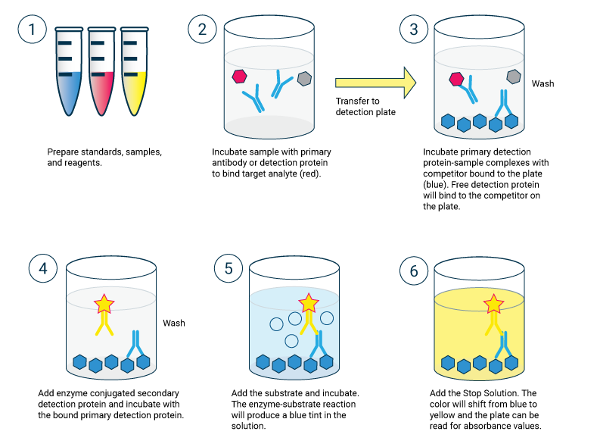
Continue…
Let’s say you’re getting screened for HIV (human immunodeficiency virus) through the ELISA technique, and you’ve already given a blood sample. A medical laboratory scientist or technician first attaches a portion of the HIV virus to a solid surface, like a medical tube or plastic plate. This virus acts as the antigen.

Slide 14
Continue…
The laboratory scientist will then add your blood sample to the tube or plate. If your blood sample contains antibodies for HIV, they’ll bind to the antigen (the virus, in this case). If your blood sample doesn’t contain antibodies for HIV, nothing will happen.
The laboratory scientist then adds another antibody that “knows” the HIV antibodies. They bind to any antibody that’s already attached to the antigen. This second antibody is linked with an enzyme (a substance that speeds up a chemical reaction). This is the “enzyme-linked” portion of ELISA.

Slide 15
Continue…
In the final step, the laboratory scientist adds a substance that reacts with the enzyme. This makes the substances change color if the antibodies are present. In other words, if the test is positive, then a color reaction will occur. If you don’t have antibodies to that certain antigen (the HIV virus, in this case), there will be no color change. This would read as a negative result.
The intensity of the color change is proportional to the amount of the antibody. So ELISA can determine both the presence of the antibody and how much of it there is.

Slide 16
Thank You …!
Any Questions…?

