Slide 1

Lecture 5 – Informed Search

Slide 2

BASIS FOR COMPARISON | INFORMED SEARCH | UNINFORMED SEARCH
Basic | Uses knowledge to find the steps to the solution. | No use of knowledge
Efficiency | Highly efficient as consumes less time and cost. | Efficiency is mediatory
Cost | Low | Comparatively high
Performance | Finds solution more quickly | Speed is slower than informed search
Algorithms | Heuristic depth first and breadth-first search, and A* search | Depth-first search, breadth-first search and lowest cost first search

Slide 3

Idea: use an evaluation function for each node
  Estimate of desirability
Expand most desirable unexpanded node
Implementation:
  fringe is a queue sorted in decreasing order of desirability
Special cases:
  Uniform Cost Search (uninformed)
  Greedy (best-first) Search (informed)
  A* Search (informed)

Slide 4

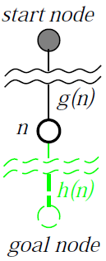
Evaluation function f(n) = g(n) + h(n)
  g(n) = exact cost so far to reach n
  h(n) = estimated cost to goal from n
  f(n) = estimated total cost of cheapest path through n to goal
Special cases:
  Uniform Cost Search: f(n) = g(n)
  Greedy (best-first) Search: f(n) = h(n)
  A* Search: f(n) = g(n) + h(n)

Slide 5
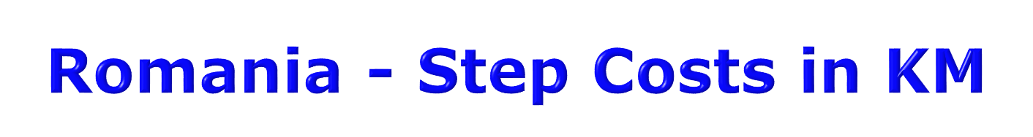

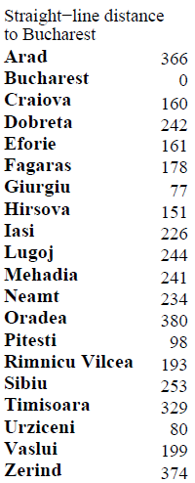

Slide 6

Evaluation function h(n) (heuristic)
  Estimated cost of the cheapest path from n to a goal node
E.g., h_{SLD}(n) = straight-line distance from n to Bucharest
Greedy search expands the node that appears to be closest to goal.

Slide 7



Slide 8


Slide 9


Slide 10

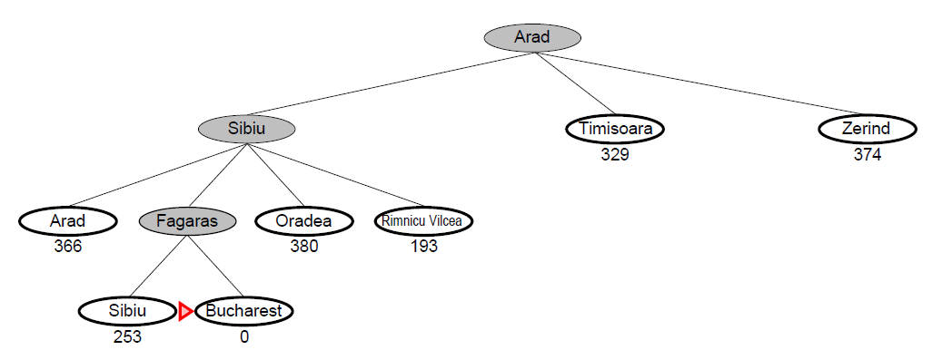

Slide 11

Complete? No – can get stuck in loops, e.g., with Oradea as goal and start from Iasi:
  Iasi → Neamt → Iasi → Neamt →
Time? O(b^{m}), but a good heuristic can give dramatic improvement
Space? O(b^{m}) -- keeps all nodes in memory
Optimal? No.
  Complete in finite space with repeated state checking

Slide 12

Idea: Avoid expanding paths that are already expensive
Evaluation function f(n) = g(n) + h(n)
  g(n) = exact cost so far to reach n
  h(n) = estimated cost to goal from n
  f(n) = estimated total cost of cheapest path through n to goal
A* search uses an admissible heuristic:
  h(n) ≤ h*(n) where h*(n) is the true cost from n
  Also h(n) ≥ 0, and h(G)=0 for any goal G
  E.g., h_{SLD}(n) is an admissible heuristic because it doesn’t overestimate the actual road distance.

Slide 13
If we are trying to find the cheapest solution, a reasonable thing to try first is the node with the lowest value of g(n) + h(n)
This strategy is more than just reasonable
  Provided that h(n) satisfies certain conditions, A* using TREE search is both complete and optimal.

Slide 14



Slide 15


Slide 16


Slide 17


Slide 18


Slide 19


Slide 20


Suppose some suboptimal goal G₂ has been generated and is in the fringe. Let n be an unexpanded node in the fringe such that n is on a shortest path to an optimal goal G.
f(G₂) = g(G₂) since h(G₂) = 0
g(G₂) > g(G) since G₂ is non-optimal
f(G) = g(G) since h(G) = 0
f(G₂) > f(G) from above

Slide 21
Suppose some suboptimal goal G₂ has been generated and is in the fringe. Let n be an unexpanded node in the fringe such that n is on a shortest path to an optimal goal G.
f(G₂) > f(G) from above
h(n) ≤ h*(n) since h is admissible
g(n) + h(n)≤ g(n) + h*(n)
f(n) ≤ f(G)
Hence f(G₂) > f(n), and A* will never select G₂ for expansion

Slide 22


Failure to detect repeated states can turn a linear problem into an exponential one!
  We don’t want to expand a node that has already been expanded

Slide 23


Maintain a closed-list containing those nodes that have already been expanded. Then, if a node is encountered that is already in closed-list, it is simply ignored
This guarantees that no loops are generated, and essentially converts the graph into a tree

Slide 24

Its very well to prune the search space by ignoring repeated states
But the problem is that Graph-search can end up discovering sub-optimal solutions
  Basically, a loop means that there might be more then one path to a node
  Once we discover a path to a node, then any other paths to the same node are ignored by graph-search
  However, it is not necessary that the first path is the optimal one
  Hence, sub-optimal solutions can be returned.

Slide 25
Solution?
  We can adopt a uniform-cost approach, in which we keep track of all the paths that have been currently generated
  Then, we select only that path which has the least-cost.

Slide 26

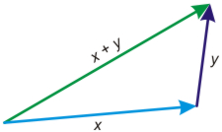
This proof can break down with Graph-search
A* can return sub-optimal solutions, if we don’t apply the uniform-cost approach
However, this is really messy and expensive
A much better solution is to ensure that the heuristic that you have selected is consistent
Triangle inequality

Slide 27


A heuristic is consistent if for every node n, every successor n' of n generated by any action a,
h(n) ≤ c(n,a,n') + h(n')
If h is consistent, we have
f(n') = g(n') + h(n')
= g(n) + c(n,a,n') + h(n')
≥ g(n) + h(n)
= f(n)
i.e., f(n) is non-decreasing along any path.
Theorem: If h(n) is consistent, A* using GRAPH-SEARCH is optimal

Slide 28


A* expands nodes in order of increasing f value
Gradually adds "f-contours" of nodes
Contour i has all nodes with f=f_{i}, where f_{i} < f_{i+1}

Slide 29

Complete? Yes (unless there are infinitely many nodes with f ≤ f(G) )
Time? Exponential
Space? Keeps all nodes in memory
Optimal? Yes

Slide 30



