Slide 1


Distance Learning
Remote education using technology for learning from any location.

Slide 2
Agenda
Overview
Academic Aspects
Requirements Aspects
Financial Model

Slide 3
Overview
Utilizes technology to deliver education remotely, allowing students to access course materials, interact with instructors, and collaborate with peers from any location.
Offers flexibility and convenience, enabling individuals to pursue education at their own pace and schedule, opening up opportunities for lifelong learning.

Slide 4
Overview
Objectives:
Accessibility
Flexibility
Quality Education
Affordability
Lifelong Learning
Personalized Learning
Global Reach and Collaboration
Continuous Support
Integration of Technology

Slide 5
Overview
Goals:
Increase Access
Enhance flexibility
Promote lifelong learning
Facilitate personalized learning
Foster collaboration and interaction
Ensure quality education
Embrace technological advancement
Support career advancement and employability

Slide 6
Overview
Programs:
Online Degrees
Master Track Certificates
Certification / Diplomas
Short Courses

Slide 7
Online Degree
Overview
Bachelors of Science in Computer Science
PKR 8 Lakh (varies as per location)
3-6 years
30 courses, 2 projects, 25 hours per weak
100% online
Hands-on learning from anywhere.
Online classes
No offline examination
Taught in English

Slide 8
Online Degree
Overview
Learn job relevant computer science skills
Enjoy maximum flexibility with a 100% online programme
Earn a credential at every milestone
Benefit from open eligibility criteria
News and events regarding computer science degree programme
Frequently asked question about this degree

Slide 9
Online Degree
Admissions
Who is this degree for?
High school graduates (with or without science background)
Students already enrolled in degree program
Working professional who don’t have the time and opportunity
Business owner who can’t afford to relocate
Switch career to IT or Computer Science

Slide 10
Online Degree
Admissions
How to Apply and Enroll?
Complete the degree application by providing the required information & documents.
Submit your application at the earliest point possible.
Wait for a decision on your application. If accepted, you will hear from the admissions office with an offer letter and instructions on next steps.

Slide 11
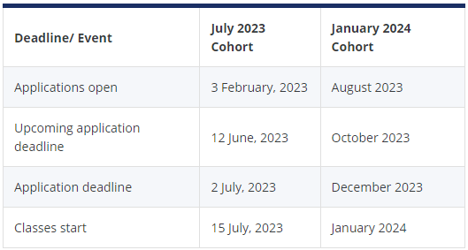
Online Degree
Admissions
Cohorts and Deadlines:

Slide 12
Online Degree
Admissions
Eligibility Criteria:
Applicant should have passed the qualifying examination conducted by their respective Board of Higher/Senior Secondary School Education.
Applicant must have adequate proficiency in English.
Applicant must have adequate proficiency in Mathematics (minimum 60%).

Slide 13
Online Degree
Admissions
Class Profile:
Average age: 24 years
Youngest student: 15 years
Eldest student: 64 years
Students for different countries
38% of students are working professionals, pursuing full-time jobs at companies

Slide 14
Online Degree
Academics
Curriculum:
Faculty with research expertise.
In-demand skills in Computer Science.
Problem-solving and programming logic.
Real-world projects and case studies.
Interpersonal and leadership skills.
Specialization options for domain expertise.

Slide 15
Online Degree
Academics
Tracks:
Application Development (Full Stack)
Computing Systems and Systems Programming
Databases and Data Analytics
Algorithmics & Theoretical Computer Science

Slide 16
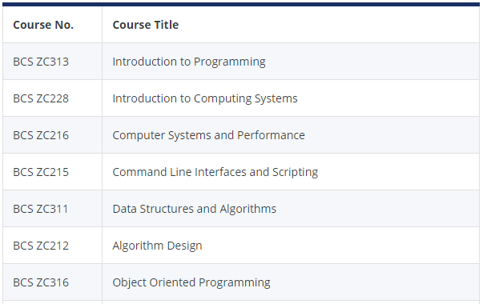
Online Degree
Academics
Core Courses:

Slide 17
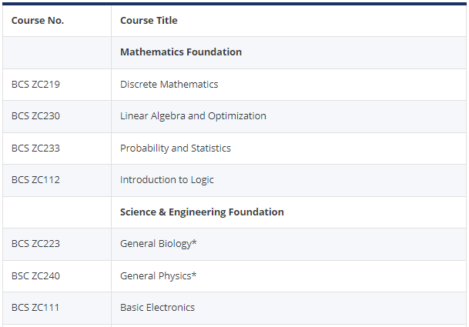
Online Degree
Academics
Foundation Courses:

Slide 18
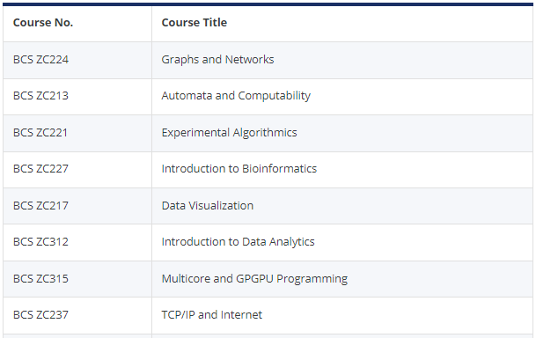
Online Degree
Academics
Elective Courses:

Slide 19
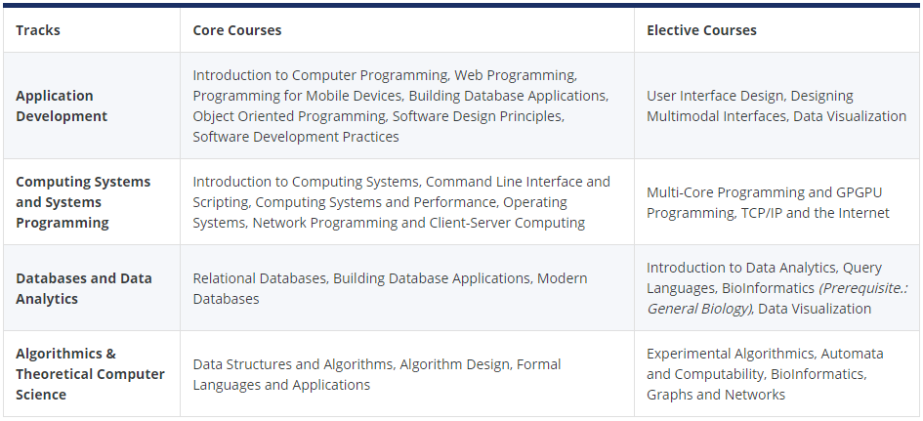
Online Degree
Academics
Specialized Tracks:

Slide 20
Online Degree
Academics
Assessments:
Graded Quizzes
Assignments
Case Studies
Lab Exercises
Comprehensive final examination
Term Projects
Final year project

Slide 21
Online Degree
Academics
Programme Length:
Four year bachelor’s degree programme.
Academic year has two semesters.
Semester duration is 22 to 26 weeks (5 to 6 months).
Semester will have 6 courses (except for the final semester).
Flexibility to complete the programme in up to six years.

Slide 22
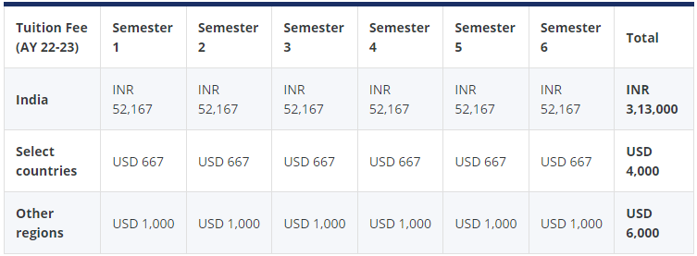
Online Degree
Tuition and Financing
Tuition Fee:

Slide 23
Online Degree
Tuition and Financing
Tuition Fee:
Taking a break during/between semesters
Choosing to complete fewer courses
Unable to meet minimum qualifying marks
The semester fee does not cover the cost of textbooks

Slide 24
Online Degree
Tuition and Financing
Financial Aid:
Option to split your tuition fee in easy monthly installments
Interest rates may apply depending upon your bank and instalment tenure

Slide 25
Online Degree
Student Experience
Alumni:
Share Career Experience
Post picture
Post video
Guide Current Students
Review

Slide 26
Online Degree
Career Outcomes
With this degree, you will be qualified to pursue roles such as:
Software Engineer
Systems Engineer
Full Stack Developer
Data Analyst
Application Developer
Web Programmer
Game Developer

Slide 27
Online Degree
Alumni Benefits
Join a global community of professional alums as you expand your network, explore new opportunities, and advance your career:
Lifelong Learning
Career Development
Networking Opportunities
Access to new courses
Alumni networks and communities
Exclusive offers and discounts

Slide 28
Online Degree
Career Services
Students to meet industry requirements:
Industry-Aligned Design
Job Readiness
Comprehensive Career Support
Holistic Skill Development

Slide 29
Online Degree
Course (Introduction to Programming)
About this course:
The course focuses on problem-solving through programming, specifically using the C Programming Language. It covers a wide range of topics in fundamental programming concepts, preparing students for the BS Computer Science degree program by developing their ability to write C programs to solve scientific problems and understand the components of a computer.

Slide 30
Online Degree
Course (Introduction to Programming)
What you will learn:
Learn about various constructs supported by C Language and use them to write programs which can solve scientific problems.
Write programs using various constructs supported by the C language such as assignment, sequencing, conditional and iteration.
Perform indirect memory level operations of a computer through pointers and dynamic memory allocation.
Create, edit and delete files on a computer using programs.

Slide 31
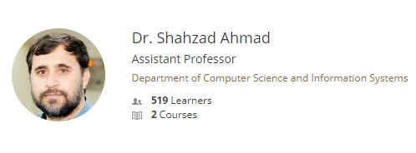
Online Degree
Course (Introduction to Programming)
Instructor:

Slide 32
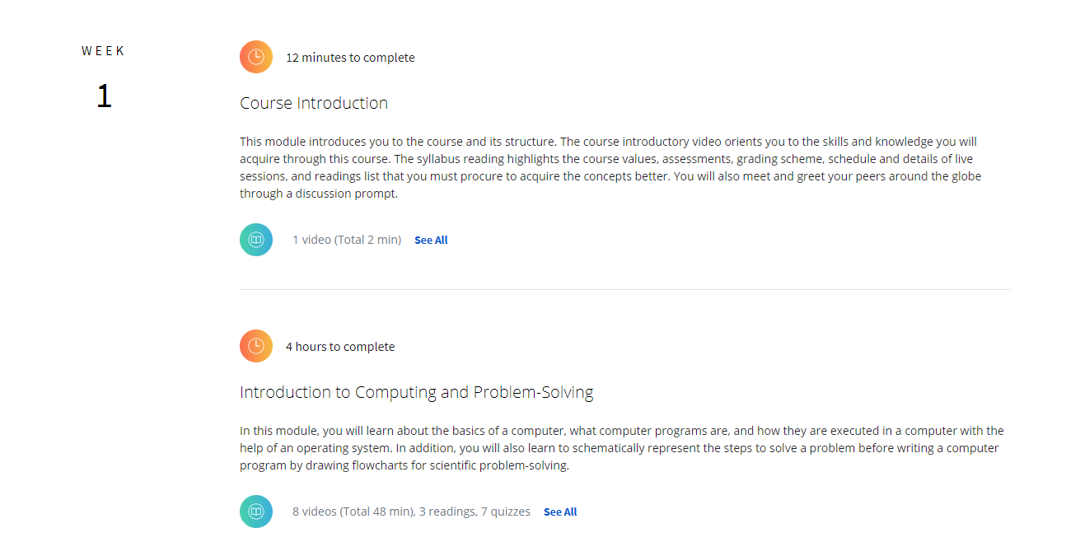
Online Degree
Course (Introduction to Programming)
Syllabus:

Slide 33
Online Degree
Course (Introduction to Programming)
Enrollment:
Add to Wishlist
Pay for the course
Start studying through online medium
Learn about the course and get skills
FAQ’s:
When will I have access to the lectures and assignments?
What will I get if I purchase the Certificate?
Is financial aid available?

Slide 34
THANK YOU

