Slide 1



FAU (MADE)
Analysis of Domestic Flights to USA Cities
Presented by Muhammad Talha

Slide 2

Main Question

Slide 3

Introduction
Analyze 2020 flight data between major USA cities to understand the relationship between city attributes and incoming flights. Explore top destinations, routes, and conduct network analysis. Utilize ETL, Data Modeling, and Data Warehousing with two datasets: a Parquet of flight info and a CSV file with city details from 2020.

Slide 4

Motivation

Slide 5
Goals
01
02
03
Identify Trends
City Type Analysis
Top Cities and Routes
04
05
06
Temporal Analysis
Network Analysis
Data Visualization

Slide 6
Datasources
Air Flight Dataset
Top 100 US Cities Population
Data Type: Parquet
License: CC0: Public Domain
Description: This dataset encompasses all flight information, including details on cancellations and delays by airline. The data spans from January 2018, extracted from the "On-Time" database of the TranStats data library.
Data Type: CSV
License: CC0: Public Domain
Description: The dataset includes information on the top 100 US cities by population, derived from Wikipedia. It lists each city, its rank based on 2020 population, area data, and populations in both 2020 and 2010.

Slide 7
Analysis

Slide 8
Number of Flights per City

Slide 9
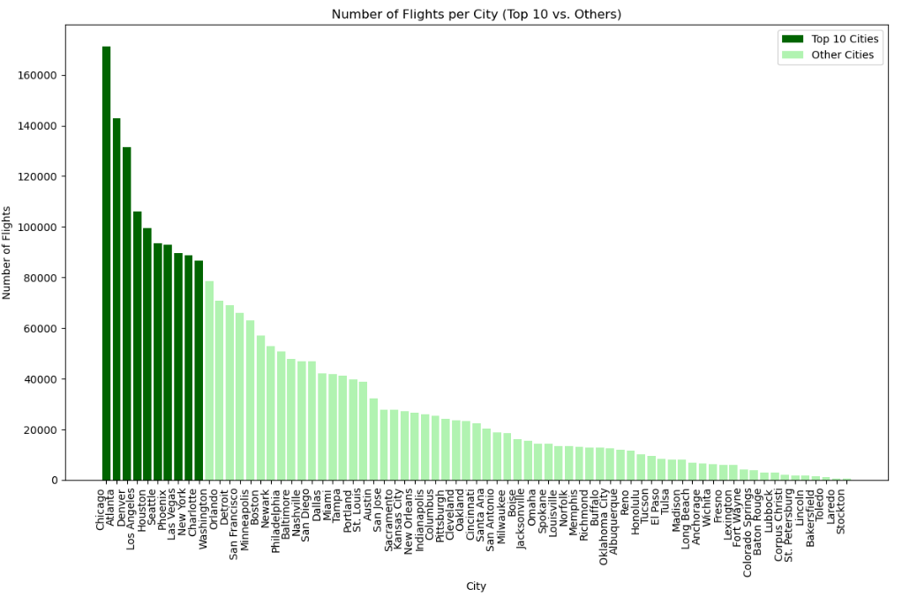

Slide 10
City Attributes vs. Number of Flights

Slide 11
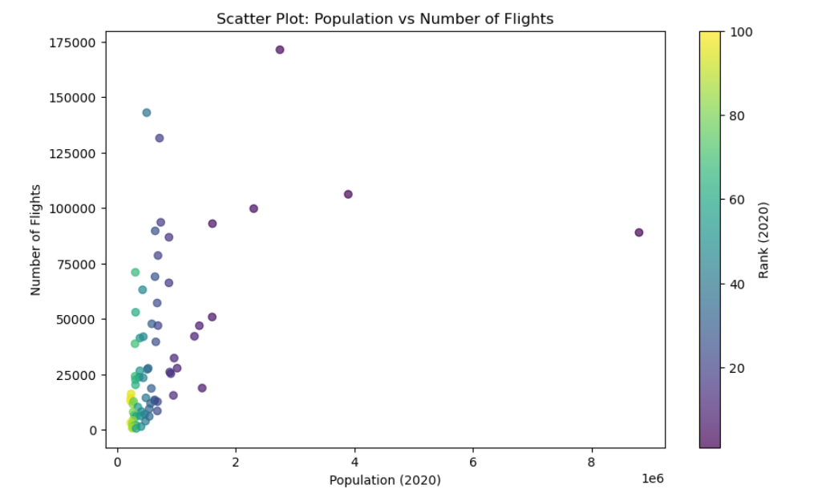

Slide 12
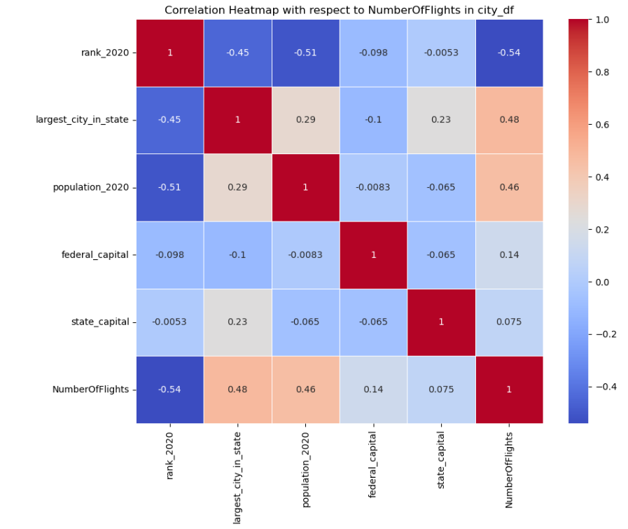

Slide 13
Major Relations Analysis
01
02
03
Rank vs. Population, Largest City in State, NumberOfFlights
Largest City in State vs. Population, State Capital, NumberOfFlights
Population vs. NumberOfFlights
04
Federal Capital vs. NumberOfFlights

Slide 14
Time Analysis

Slide 15
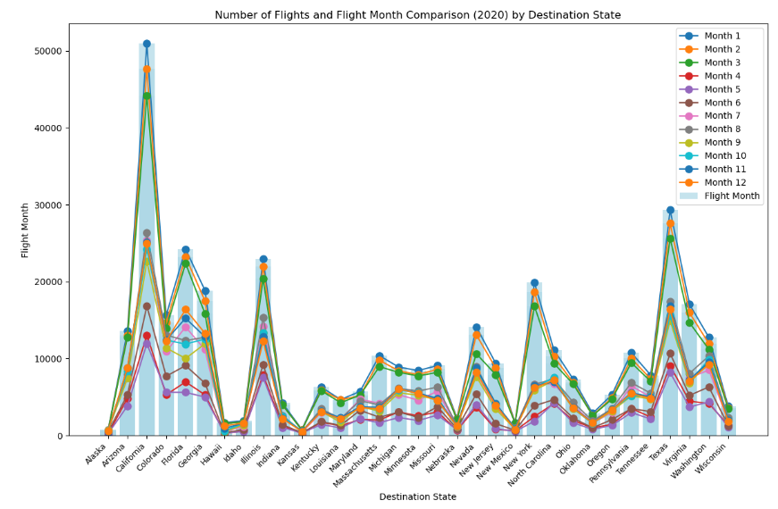
City Attributes vs. Number of Flights

Slide 16
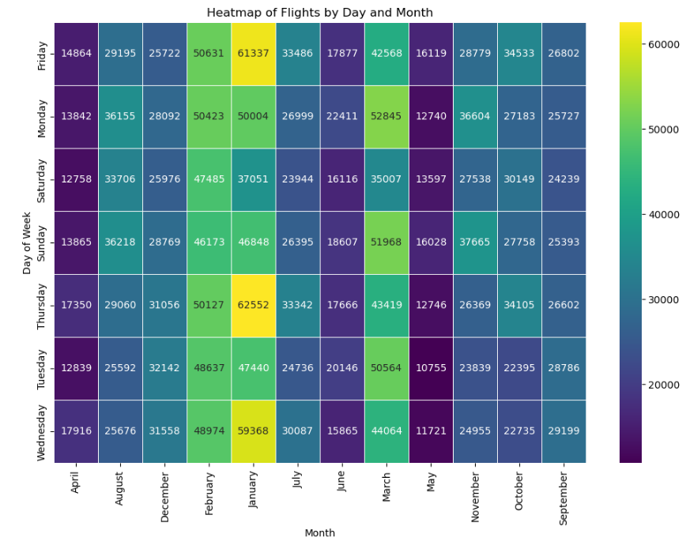

Slide 17
Data Engineering and ETL

Slide 18
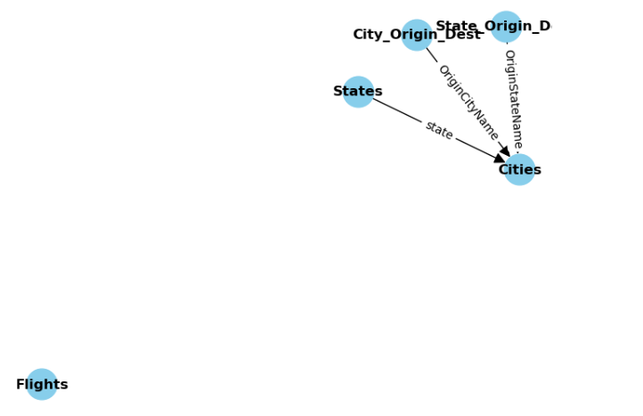

Slide 19
State Names and Number of Flights in comparison with State Names and their Population

Slide 20
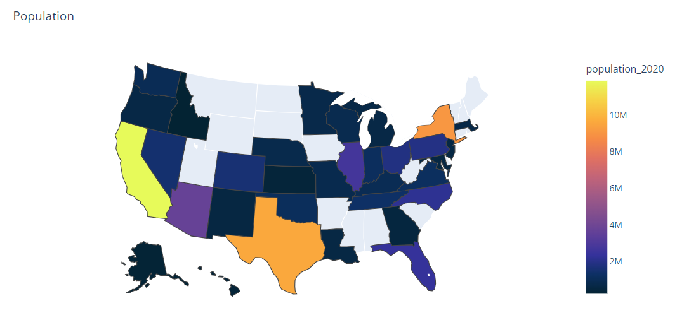
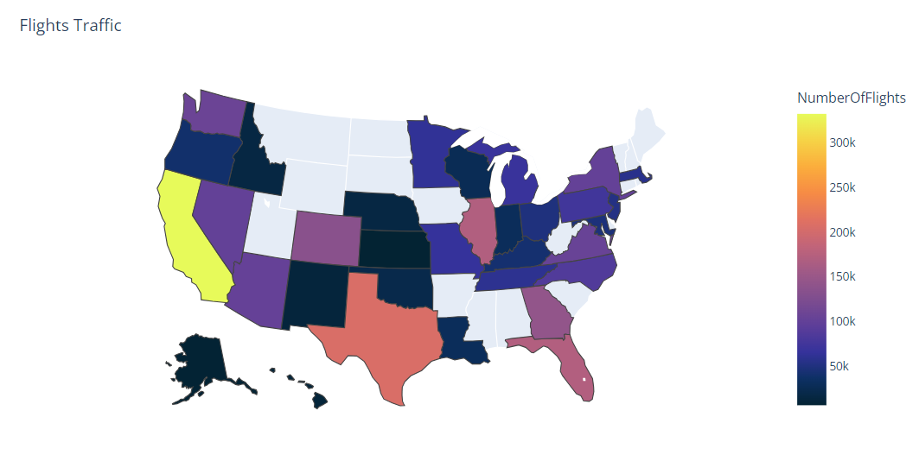

Slide 21
State Connections Map of Flights

Slide 22
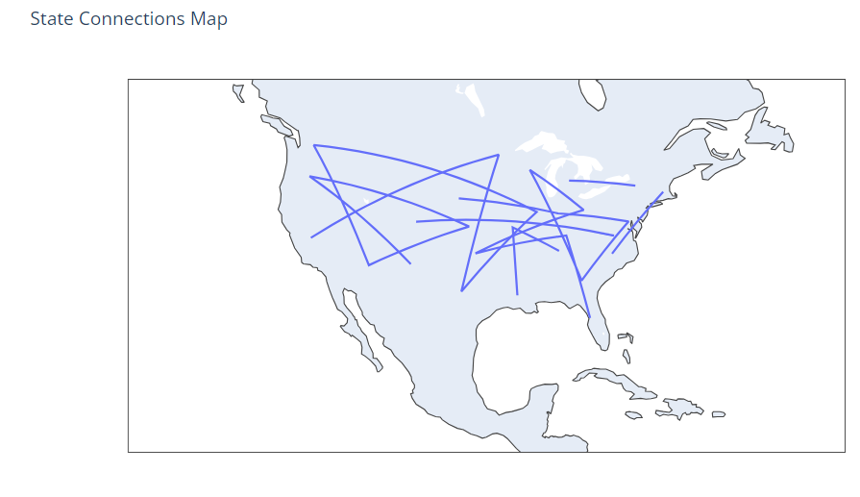

Slide 23
Flights Traffic Heatmap by City in 2020

Slide 24
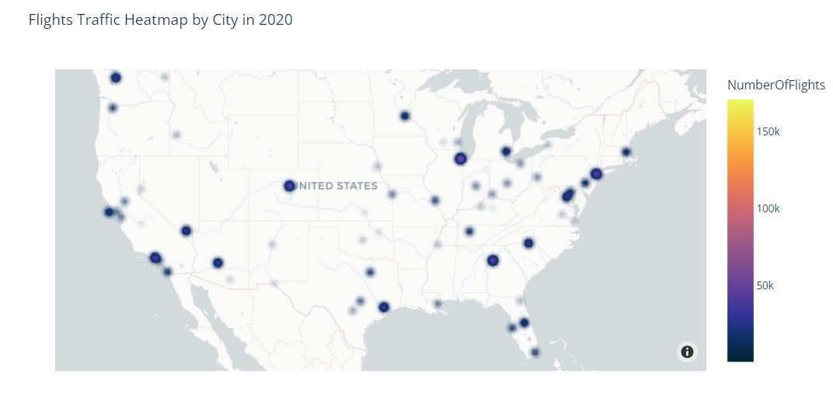

Slide 25
Conclusion
our exploration of flight data highlights the prominence of specific cities in air travel. The major relations analysis unveils correlations between city attributes and flight patterns, offering valuable insights for further investigation. Understanding these dynamics is crucial for efficient planning and decision-making in the realm of air travel.

Slide 26
Thank
You

