Slide 1

Lists and Iterators
Presentation for use with the textbook Data Structures and Algorithms in Java, 6th edition, by M. T. Goodrich, R. Tamassia, and M. H. Goldwasser, Wiley, 2014

Slide 2
Lists
A List is an ordered collection of items of some type T:
➡ each element has a position in the list ➡ duplicate elements are allowed
A list is a linear collection, like a stack and queue, but more flexible: adding and removing elements from a list does not have to happen at one end or the other.

Slide 3
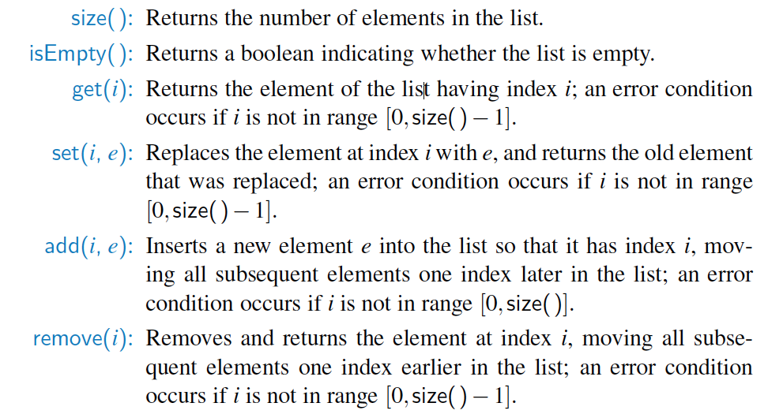
The java.util.List ADT
The java.util.List interface includes the following methods:

Slide 4
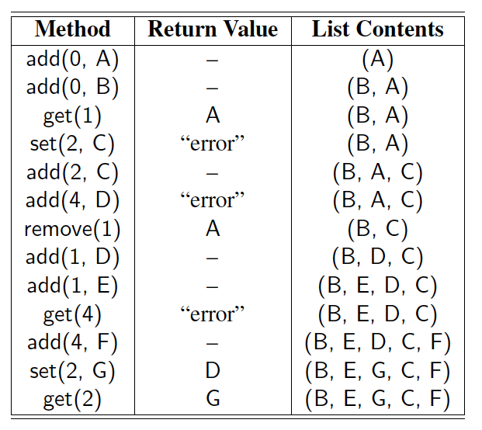
Example
A sequence of List operations:

Slide 5
Array Lists
An obvious choice for implementing the list ADT is to use an array, A, where A[i] stores (a reference to) the element with index i.
With a representation based on an array A, the get(i) and set(i, e) methods are easy to implement by accessing A[i] (assuming i is a legitimate index).
A
0
1
2
i
n

Slide 6
Insertion
In an operation add(i, o), we need to make room for the new element by shifting forward the n − i elements A[i], …, A[n − 1]
In the worst case (i = 0), this takes O(n) time
A
0
1
2
i
n
A
0
1
2
i
n
A
o
0
1
2
i
n

Slide 7
Element Removal
In an operation remove(i), we need to fill the hole left by the removed element by shifting backward the n − i − 1 elements A[i + 1], …, A[n − 1]
In the worst case (i = 0), this takes O(n) time
A
o
0
1
2
i
n
A
0
1
2
i
n
A
0
1
2
i
n

Slide 8
Performance
In an array-based implementation of a dynamic list:
The space used by the data structure is O(n)
Indexing the element at i takes O(1) time
add and remove run in O(n) time
In an add operation, when the array is full, instead of throwing an exception, we can replace the array with a larger one …

Slide 9
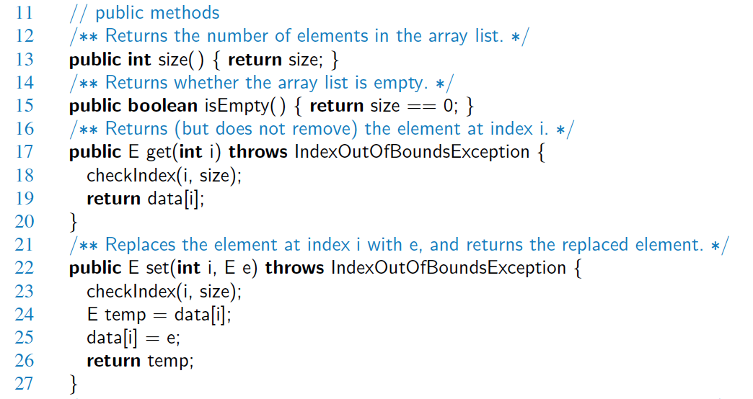
Java Implementation

Slide 10
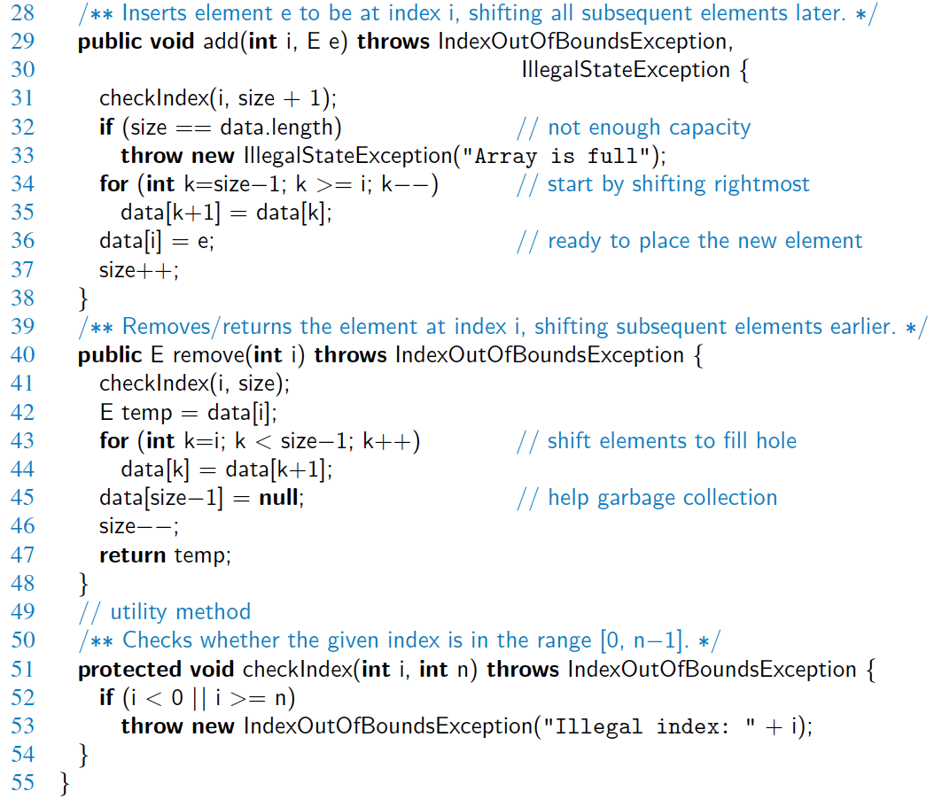
Java Implementation, 2

Slide 11
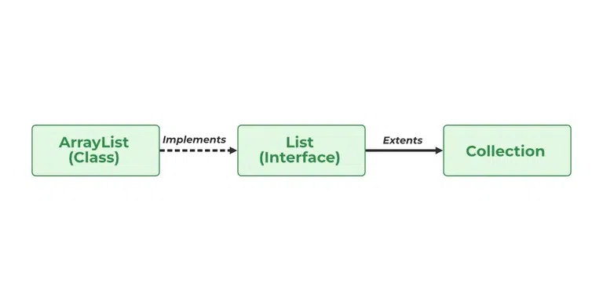
Java Lists ADT
The List interface in Java provides a way to store the ordered collection. It is a child interface of Collection. It is an ordered collection of objects in which duplicate values can be stored. Since List preserves the insertion order, it allows positional access and insertion of elements.
Declaration of Java List Interface
public interface List<E> extends Collection<E> ;
List<Obj> list = new ArrayList<Obj> ();
Notes:
Source: https://www.geeksforgeeks.org/list-interface-java-examples/

Slide 12
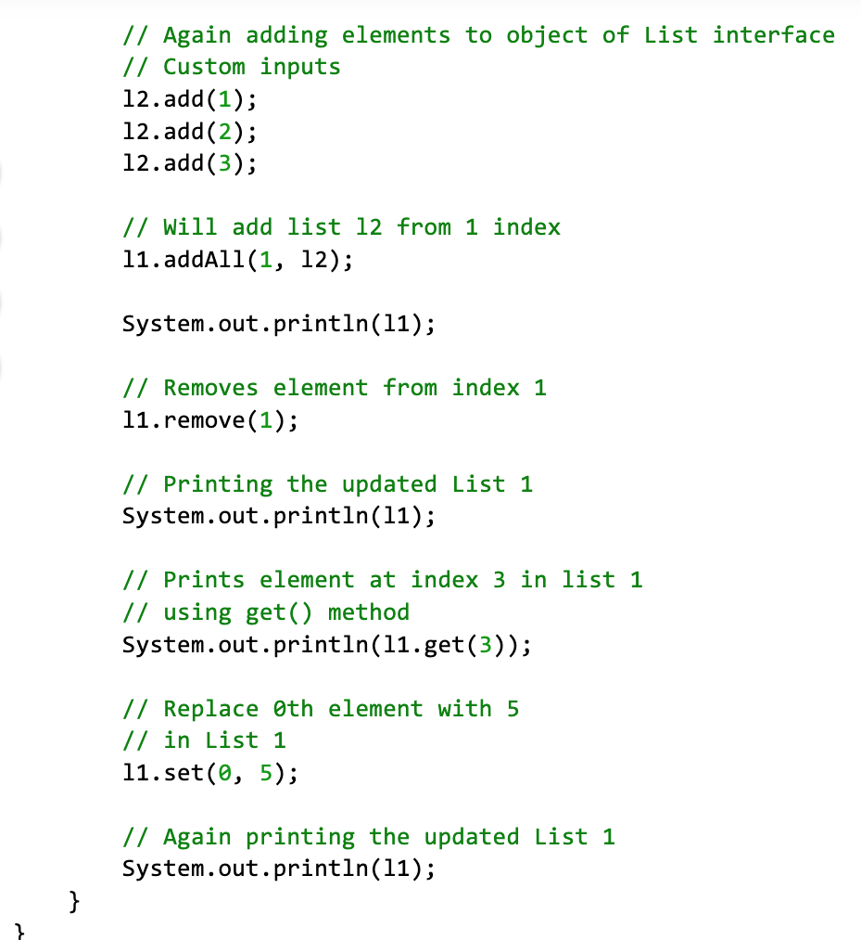
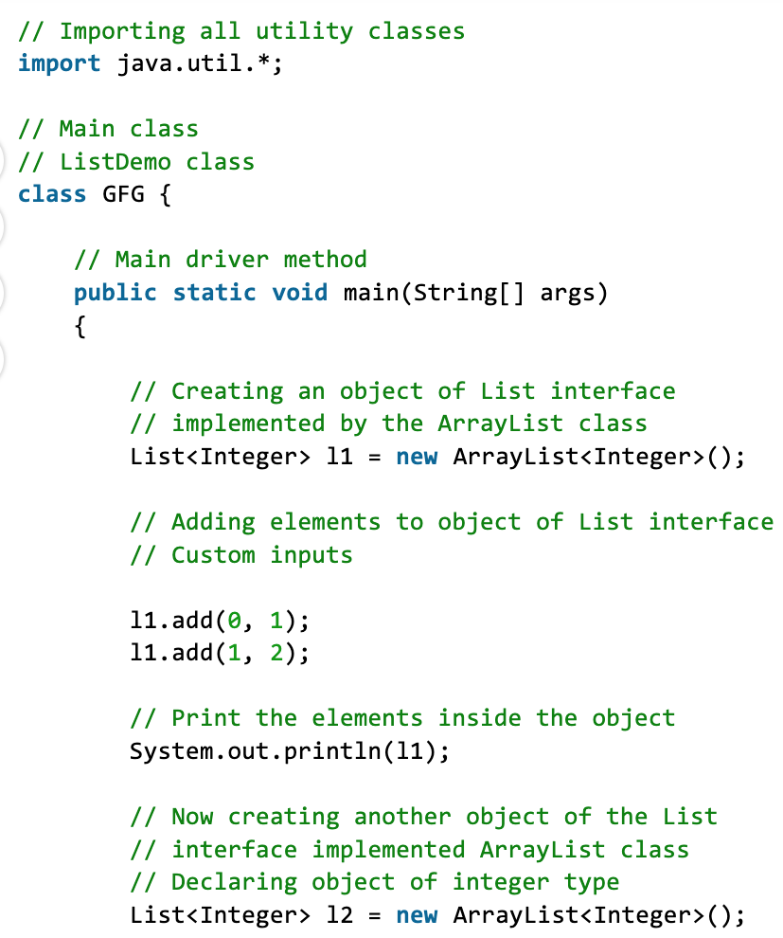
Notes:
Source: https://www.geeksforgeeks.org/list-interface-java-examples/

Slide 13
Growable Array-based Array List
Let push(o) be the operation that adds element o at the end of the list
When the array is full, we replace the array with a larger one
How large should the new array be?
Incremental strategy: increase the size by a constant c
Doubling strategy: double the size
Algorithm push(o)
if t = S.length − 1 then
A ← new array of
size …
for i ← 0 to n−1 do
A[i] ← S[i]
S ← A
S[n] ← o
n ← n + 1

Slide 14
Comparison of the Strategies
We compare the incremental strategy and the doubling strategy by analyzing the total time T(n) needed to perform a series of n push operations
We assume that we start with an empty list represented by a growable array of size 1
The average time taken by a push operation over the series of operations is called amortized time of a push operation, i.e., T(n)/n

Slide 15
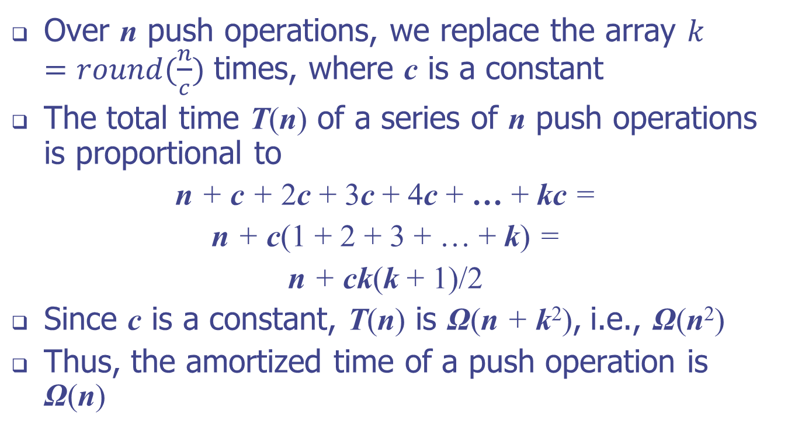
Incremental Strategy Analysis
Over n push operations, we replace the array $k=round(\frac{n}{c})$ times, where c is a constant
The total time T(n) of a series of n push operations is proportional to
n + c + 2c + 3c + 4c + … + kc =
n + c(1 + 2 + 3 + … + k) =
n + ck(k + 1)/2
Since c is a constant, T(n) is Ω(n + k²), i.e., Ω(n²)
Thus, the amortized time of a push operation is Ω(n)
Notes:
k is greater than n/c for the worst case, so we say it is lower-bounded by n^2, which yields Ω(n^2)
Let c > 0 represent the fixed increment in capacity that is used for each resize event. During the series of n push operations, time will have been spent initializing arrays of size c, 2c, 3c, ..., kc for k = round(n/c), and therefore, the overall time is proportional to c+2c+3c+···+kc.
Therefore, performing the n push operations takes Ω(n) time.

Slide 16
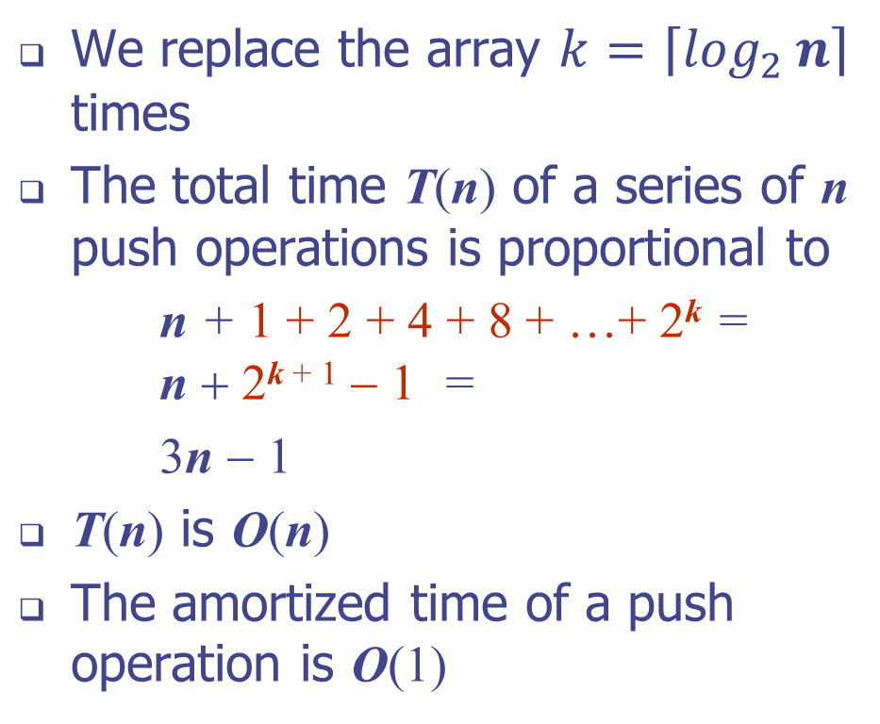
Doubling Strategy Analysis
We replace the array $k=\left\lceil \log_{2}{n}\right\rceil$ times
The total time T(n) of a series of n push operations is proportional to
n + 1 + 2 + 4 + 8 + …+ 2^{k} = n + 2^{k + 1} − 1 =
3n − 1
T(n) is O(n)
The amortized time of a push operation is O(1)
geometric series
2
4
1
1
8

Slide 17
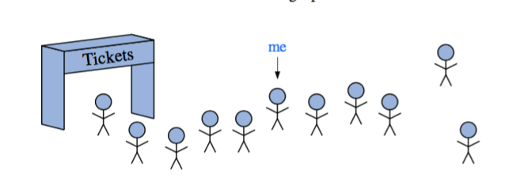
Positional List
Notes:
Our goal is to design an abstract data type that provides a user a way to refer to elements anywhere in a sequence, and to perform arbitrary insertions and deletions. This would allow us to efficiently describe actions such as a person deciding to leave the line before reaching the front, or allowing a friend to “cut” into line right behind him or her.

Slide 18
Positional Lists
To provide for a general abstraction of a sequence of elements with the ability to identify the location of an element, we define a positional list ADT.
A position acts as a marker or token within the broader positional list.
A position p is unaffected by changes elsewhere in a list; the only way in which a position becomes invalid is if an explicit command is issued to delete it.
A position instance is a simple object, supporting only the following method:
P.getElement( ): Return the element stored at position p.
Notes:
in defining the positional list ADT, we also introduce the concept of a position, which formalizes the intuitive notion of the “location” of an element relative to others in the list.
To provide a general abstraction for the location of an element within a structure, we define a simple position abstract data type. A position supports the following single method: getElement()
A position acts as a marker or token within a broader positional list. A position p, which is associated with some element e in a list L, does not change, even if the index of e changes in L due to insertions or deletions elsewhere in the list. Nor does position p change if we replace the element e stored at p with another element. The only way in which a position becomes invalid is if that position (and its element) are explicitly removed from the list.

Slide 19
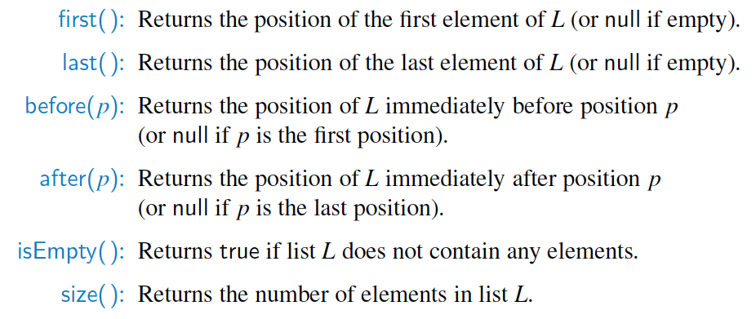
Positional List ADT
Accessor methods:

Slide 20
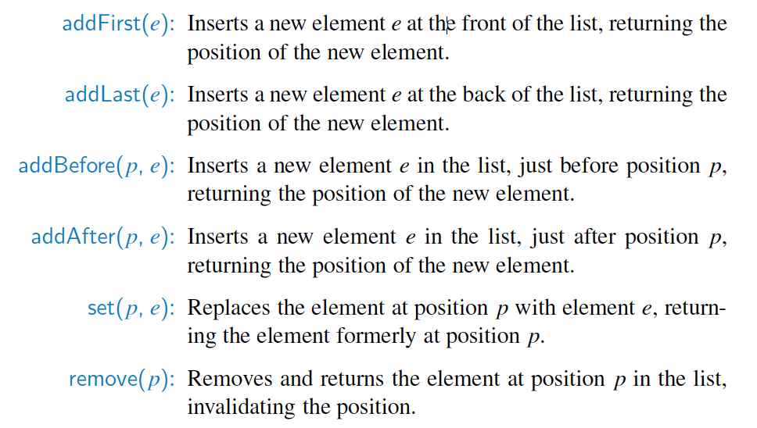
Positional List ADT, 2
Update methods:

Slide 21
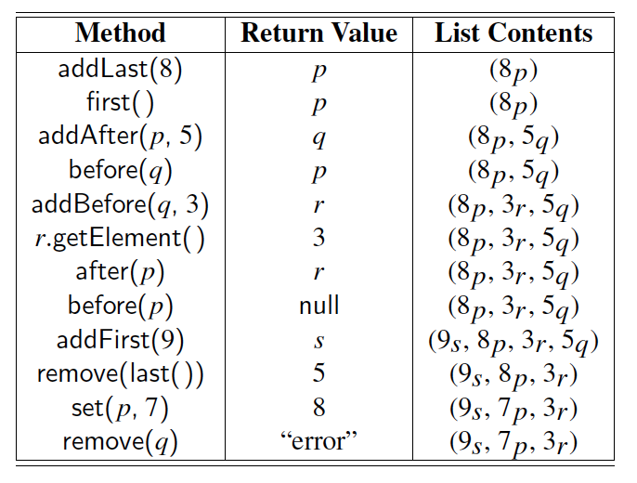
Example
A sequence of Positional List operations:

Slide 22
Positional List Implementation
The most natural way to implement a positional list is with a doubly-linked list.
prev
next
element
node
header
nodes/positions
trailer
elements

Slide 23
Insertion
Insert a new node, q, between p and its successor.
p
A
B
C
p
A
B
q
C
X
p
q
A
B
X
C

Slide 24
Deletion
Remove a node, p, from a doubly-linked list.
p
A
B
C
D
A
B
C
p
D
A
B
C

Slide 25
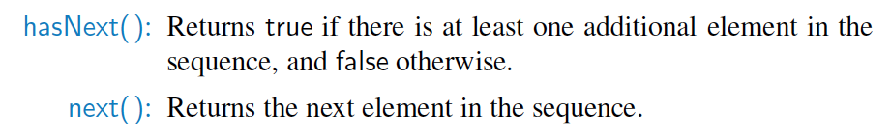
Iterators
An iterator is a software design pattern that abstracts the process of scanning through a sequence of elements, one element at a time.
Notes:
An iterator is a software design pattern that abstracts the process of scanning through a sequence of elements, one element at a time. The underlying elements might be stored in a container class, streaming through a network, or generated by a series of computations.

Slide 26
The Iterable Interface
Java defines a parameterized interface, named Iterable, that includes the following single method:
iterator( ): Returns an iterator of the elements in the collection.
An instance of a typical collection class in Java, such as an ArrayList, is iterable; it produces an iterator for its collection as the return value of the iterator( ) method.
Each call to iterator( ) returns a new iterator instance, thereby allowing multiple (even simultaneous) traversals of a collection.

Slide 27
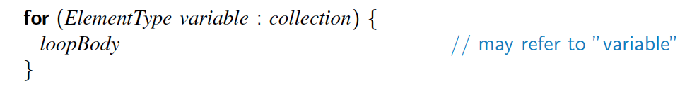
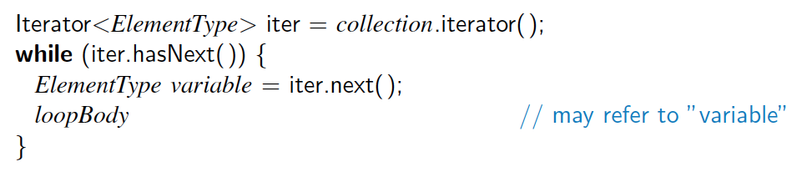
The for-each Loop
Java’s Iterable class also plays a fundamental role in support of the “for-each” loop syntax:
is equivalent to:

