Slide 1
Trees
Presentation for use with the textbook Data Structures and Algorithms in Java, 6th edition, by M. T. Goodrich, R. Tamassia, and M. H. Goldwasser, Wiley, 2014
Mammal
Dog
Cow
Cat

Slide 2
What is a Tree
In computer science, a tree is an abstract model of a hierarchical structure
A tree consists of nodes with a parent-child relation
Applications:
Organization charts
File systems
Programming environments
Computers”R”Us
Sales
Manufacturing
R&D
US
International
Laptops
Desktops
Europe
Asia
Canada
Notes:
A tree is an abstract data type that stores elements hierarchically. With the exception of the top element, each element in a tree has a parent element and zero or more children elements.

Slide 3
Tree Terminology
Root: node without parent (A)
Internal node: node with at least one child (A, B, C, F)
External node (a.k.a. leaf ): node without children (E, I, J, K, G, H, D)
Ancestors of a node: parent, grandparent, grand-grandparent, etc.
Depth of a node: number of ancestors
Height of a tree: maximum depth of any node (3)
Descendant of a node: child, grandchild, grand-grandchild, etc.
Subtree: tree consisting of a node and its descendants
A
subtree
B
C
D
E
F
G
H
I
J
K
Notes:
We typically call the top element the root of the tree.
Formally, we define a tree T as a set of nodes storing elements such that the nodes have a parent-child relationship that satisfies the following properties:
If T is nonempty, it has a special node, called the root of T, that has no parent.
Each node v of T different from the root has a unique parent node w; every node with parent w is a child of w.
Two nodes that are children of the same parent are siblings. A node v is external if v has no children. A node v is internal if it has one or more children. External nodes are also known as leaves.
Let p be a position within tree T. The depth of p is the number of ancestors of p, other than p itself.
We next define the height of a tree to be equal to the maximum of the depths of its positions (or zero, if the tree is empty).

Slide 4
Tree ADT
We use positions to abstract nodes
Generic methods:
integer size()
boolean isEmpty()
Iterator iterator()
Iterable positions()
Accessor methods:
position root()
position parent(p)
Iterable children(p)
Integer numChildren(p)
Query methods:
boolean isInternal(p)
boolean isExternal(p)
boolean isRoot(p)
Additional update methods may be defined by data structures implementing the Tree ADT

Slide 5
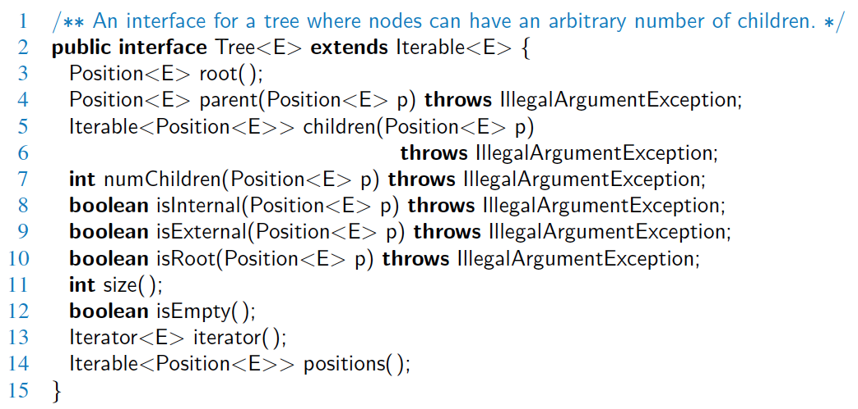
Java Interface
Methods for a Tree interface:

Slide 6
Preorder Traversal
A traversal visits the nodes of a tree in a systematic manner
In a preorder traversal, a node is visited before its descendants
Application: print a structured document
Algorithm preOrder(v)
visit(v)
for each child w of v
preorder (w)
1
Make Money Fast!
2
5
9
1. Motivations
2. Methods
References
3
4
6
7
8
1.1 Greed
1.2 Avidity
2.1 Stock Fraud
2.2 Ponzi Scheme
2.3 Bank Robbery
Notes:
Visit()
Leftchild(v)
Rightchild(v)

Slide 7
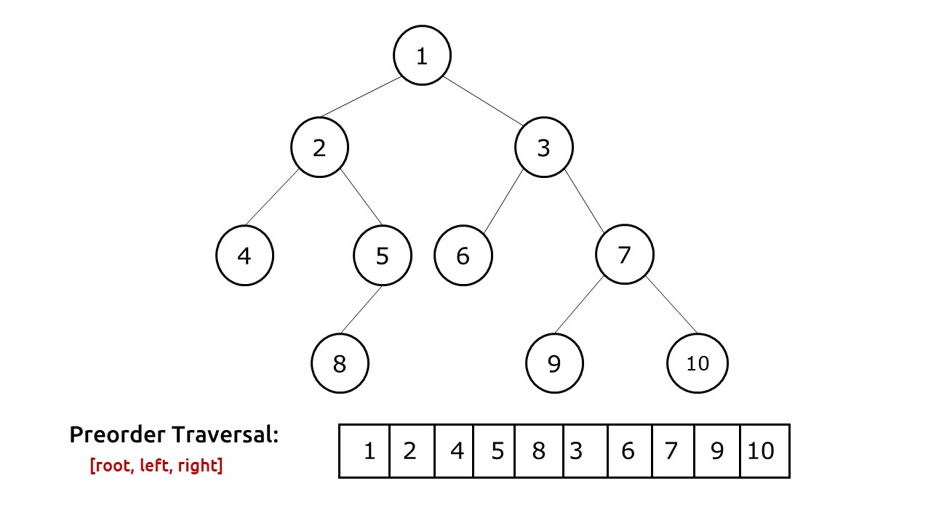
Preorder Traversal Example
Notes:
https://takeuforward.org/data-structure/preorder-traversal-of-binary-tree/

Slide 8
Postorder Traversal
In a postorder traversal, a node is visited after its descendants
Application: compute space used by files in a directory and its subdirectories
Algorithm postOrder(v)
for each child w of v
postOrder (w)
visit(v)
9
cs16/
8
3
7
homeworks/
programs/
todo.txt 1K
1
2
4
5
6
h1c.doc 3K
h1nc.doc 2K
DDR.java 10K
Stocks.java 25K
Robot.java 20K
Notes:
Leftchild(v)
Rightchild(v)
Visit()

Slide 9
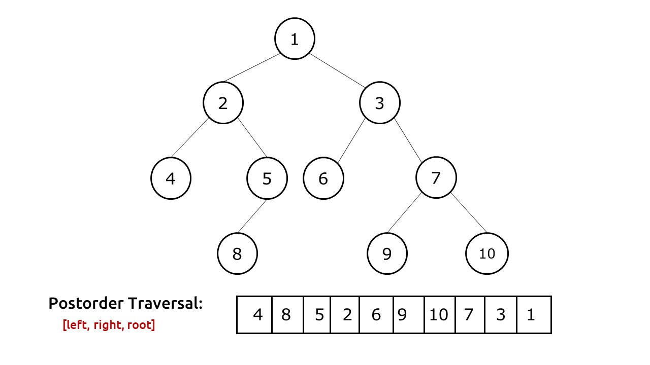
Postorder Traversal
Notes:
https://takeuforward.org/data-structure/post-order-traversal-of-binary-tree/

Slide 10
Binary Trees
A binary tree is a tree with the following properties:
Each internal node has at most two children (exactly two for proper binary trees)
The children of a node are an ordered pair
We call the children of an internal node left child and right child
Alternative recursive definition: a binary tree is either
a tree consisting of a single node, or
a tree whose root has an ordered pair of children, each of which is a binary tree
Applications:
arithmetic expressions
decision processes
searching
A
B
C
D
E
F
G
H
I
Notes:
A binary tree is an ordered tree with the following properties:
Every node has at most two children.
Each child node is labeled as being either a left child or a right child.
A left child precedes a right child in the order of children of a node.

Slide 11
Arithmetic Expression Tree
Binary tree associated with an arithmetic expression
internal nodes: operators
external nodes: operands
Example: arithmetic expression tree for the expression (2 × (a − 1) + (3 × b))
+
×
×
2
−
3
b
a
1

Slide 12
Decision Tree
Binary tree associated with a decision process
internal nodes: questions with yes/no answer
external nodes: decisions
Example: dining decision
Want a fast meal?
Yes
No
How about coffee?
Hungry
Yes
No
Yes
No
Cafe
Patisserie
Dumplings
Salad

Slide 13
Properties of Proper Binary Trees
Notation
n number of nodes
e number of external nodes
i number of internal nodes
h height
Properties:
e = i + 1
n = 2e − 1
h ≤ i
h ≤ (n − 1)/2
e ≤ 2^{h}
h ≥ log₂ e
h ≥ log₂ (n + 1) − 1

Slide 14
BinaryTree ADT
The BinaryTree ADT extends the Tree ADT, i.e., it inherits all the methods of the Tree ADT
Additional methods:
position left(p)
position right(p)
position sibling(p)
The above methods return null when there is no left, right, or sibling of p, respectively
Update methods may be defined by data structures implementing the BinaryTree ADT

Slide 15
Inorder Traversal
In an inorder traversal a node is visited after its left subtree and before its right subtree
Algorithm inOrder(v)
if left (v) ≠ null
inOrder (left (v))
visit(v)
if right(v) ≠ null
inOrder (right (v))
6
2
8
1
4
7
9
3
5
Notes:
Leftchild(v)
Visit()
Rightchild(v)

Slide 16
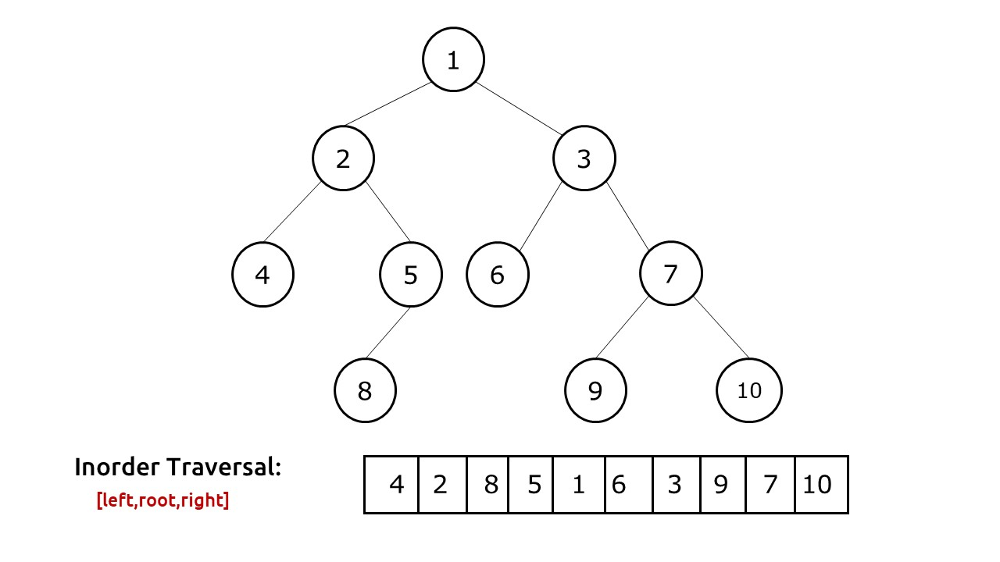
Inorder Traversal Example
Notes:
https://takeuforward.org/data-structure/inorder-traversal-of-binary-tree/

Slide 17
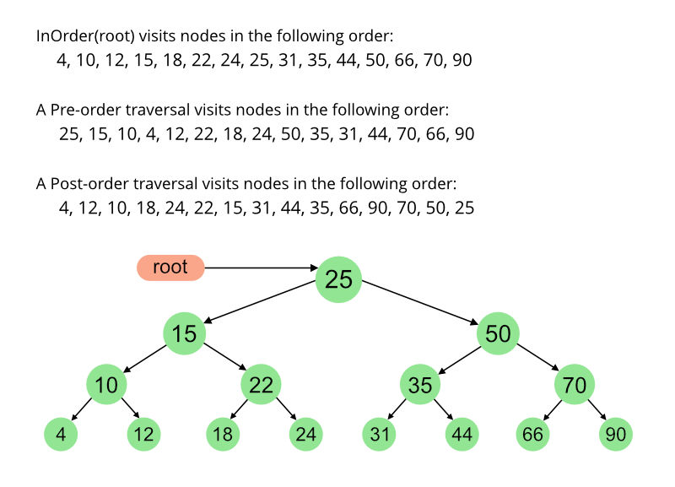
Traversal Examples
Notes:
Inorder: Left root right
Preorder: root left right
Post order: left right root

Slide 18
Print Arithmetic Expressions
Specialization of an inorder traversal
print operand or operator when visiting node
print “(“ before traversing left subtree
print “)“ after traversing right subtree
Algorithm printExpr(v)
if left (v) ≠ null print(‘(’)
printExpr (left(v))
print(v.element ())
if right(v) ≠ null
printExpr (right(v))
print (‘)’)
+
×
×
2
−
3
b
((2 × (a − 1)) + (3 × b))
a
1
Notes:
Left root right

Slide 19
Evaluate Arithmetic Expressions
Specialization of a postorder traversal
recursive method returning the value of a subtree
when visiting an internal node, combine the values of the subtrees
Algorithm evalExpr(v)
if isExternal (v)
return v.element ()
else
x ← evalExpr(left(v))
y ← evalExpr(right(v))
◊ ← operator stored at v
return x ◊ y
+
×
×
2
−
3
2
5
1
Notes:
Left right root

Slide 20
Linked Structure for Trees
A node is represented by an object storing
Element
Parent node
Sequence of children nodes
Node objects implement the Position ADT
∅
B
∅
∅
A
D
F
B
A
D
F
C
E
∅
∅
C
E

Slide 21
Linked Structure for Binary Trees
A node is represented by an object storing
Element
Parent node
Left child node
Right child node
Node objects implement the Position ADT
∅
B
∅
∅
B
A
D
A
D
∅
∅
∅
∅
C
E
C
E

Slide 22
Array-Based Structure for Binary Trees
Nodes are stored in an array Z
0
A
A
B
D
…
G
H
…
1
2
0
1
2
9
10
B
D
Node v is stored at Z[rank(v)]
rank(root) = 0
if node is the left child of parent(node), rank(node) = 2 ⋅ rank(parent(node)) + 1
if node is the right child of parent(node), rank(node) = 2 ⋅ rank(parent(node)) + 2
3
4
5
6
E
F
C
J
9
10
G
H

Slide 23
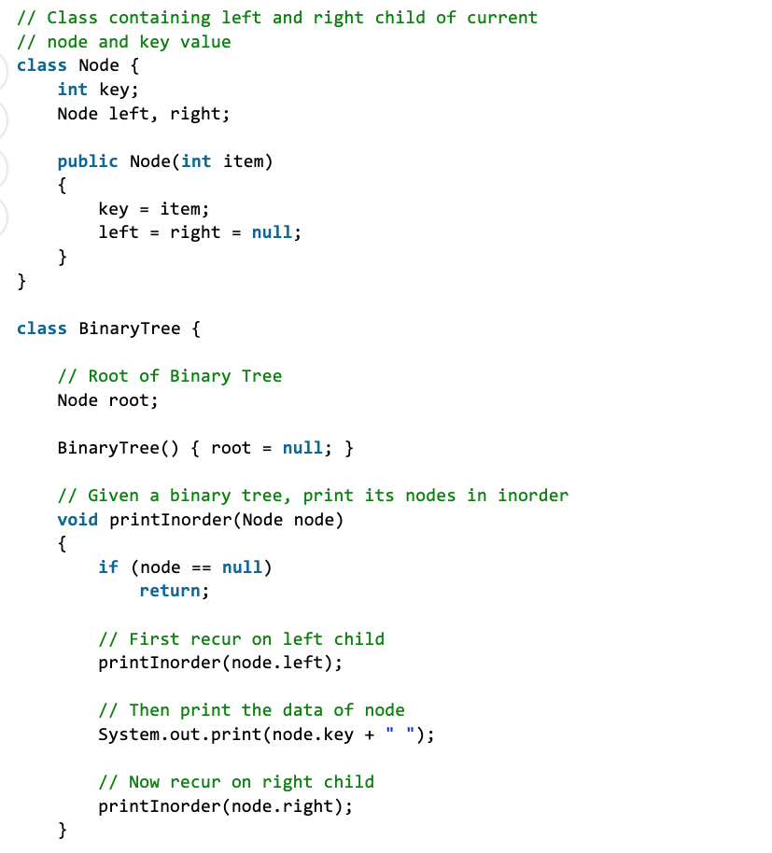
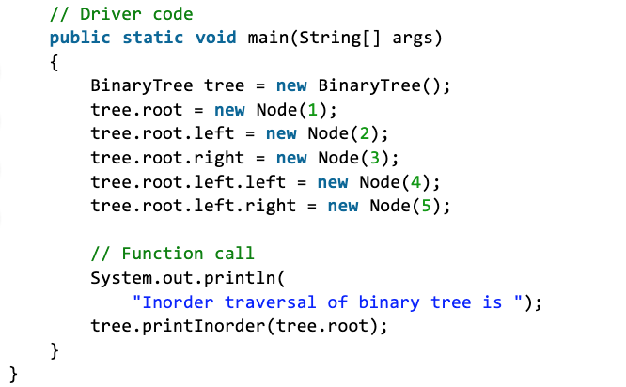
Java Implementation-InOrder
[Left- root- right]
Notes:
Left root right
https://www.geeksforgeeks.org/tree-traversals-inorder-preorder-and-postorder/

