Slide 1
Heaps
Presentation for use with the textbook Data Structures and Algorithms in Java, 6th edition, by M. T. Goodrich, R. Tamassia, and M. H. Goldwasser, Wiley, 2014
2
5
6
9
7
Notes:
When using an unsorted list to store entries, we can perform insertions in O(1) time, but finding or removing an element with minimal key requires an O(n)-time loop through the entire collection. In contrast, if using a sorted list, we can trivially find or remove the minimal element in O(1)time, but adding a new element to the queue may require O(n) time to restore the sorted order.
In this section, we provide a more efficient realization of a priority queue using a data structure called a binary heap. This data structure allows us to perform both insertions and removals in logarithmic time.

Slide 2
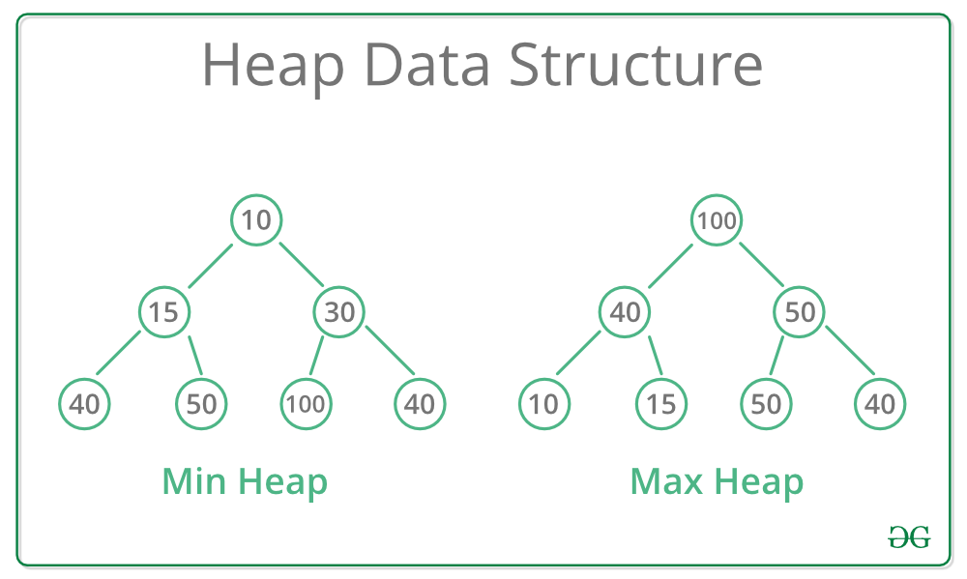
Heaps
A Heap is a special Tree-based data structure in which the tree is a complete binary tree.
Generally, Heaps can be of two types:
Max-Heap: In a Max-Heap the key present at the root node must be greatest among the keys present at all of it’s children. The same property must be recursively true for all sub-trees in that Binary Tree.
Min-Heap: In a Min-Heap the key present at the root node must be minimum among the keys present at all of it’s children. The same property must be recursively true for all sub-trees in that Binary Tree.

Slide 3
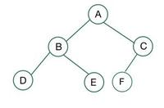
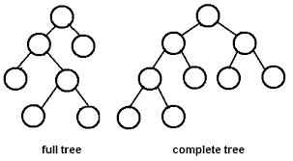
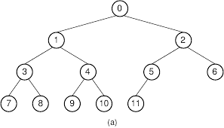
Complete Binary Tree
A complete binary tree is a special type of binary tree where all the levels of the tree are filled completely except the lowest level nodes which are filled from as left as possible.
Complete trees

Slide 4
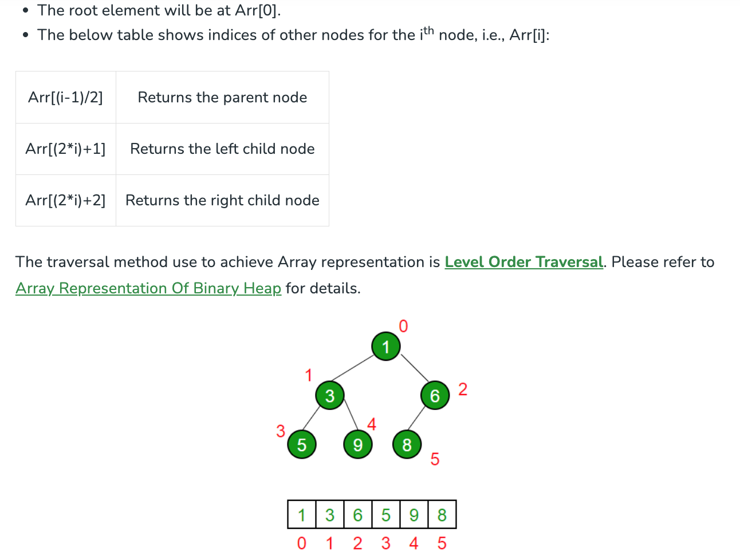
Array Representation of Binary Heap
Notes:
https://www.geeksforgeeks.org/binary-heap/

Slide 5
Heap Applications
Priority Queues: Heaps are commonly used to implement priority queues, where elements with higher priority are extracted first. This is useful in many applications such as scheduling tasks, handling interruptions, and processing events.
Sorting Algorithms: Heapsort, a comparison-based sorting algorithm, is implemented using the Heap data structure. It has a time complexity of O(n log n), making it efficient for large datasets.
Graph algorithms: Heaps are used in graph algorithms such as Dijkstra’s shortest path algorithm, Prim’s minimum spanning tree algorithm, and the A* search algorithm.
File Compression: Heaps are used in data compression algorithms such as Huffman coding, which uses a priority queue implemented as a min-heap to build a Huffman tree.
Dynamic programming: Heaps are used in dynamic programming algorithms such as the greedy algorithm, where elements are processed in order of priority.
Medical Applications: In medical applications, heaps are used to store and manage patient information based on priority, such as vital signs, treatments, and test results.

Slide 6
Recall Priority Queue ADT
A priority queue stores a collection of entries
Each entry is a pair (key, value)
Main methods of the Priority Queue ADT
insert(k, v) inserts an entry with key k and value v
removeMin() removes and returns the entry with smallest key
Additional methods
min() returns, but does not remove, an entry with smallest key
size(), isEmpty()
Applications:
Standby flyers
Auctions
Stock market

Slide 7

Recall PQ Sorting
We use a priority queue
Insert the elements with a series of insert operations
Remove the elements in sorted order with a series of removeMin operations
The running time depends on the priority queue implementation:
Unsorted sequence gives selection-sort: O(n²) time
Sorted sequence gives insertion-sort: O(n²) time
Can we do better?
Algorithm PQ-Sort(S, C)
Input sequence S, comparator C for the elements of S
Output sequence S sorted in increasing order according to C
P ← priority queue with comparator C
while ¬S.isEmpty ()
e ← S.remove (S. first ())
P.insert (e.getKey(),e.getVal())
while ¬P.isEmpty()
e ← P.removeMin()
S.addLast(e)

Slide 8
Heaps
A heap is a binary tree storing entries at its nodes and satisfying the following properties:
Heap-Order: for every node v other than the root, key(v) ≥ key(parent(v))
Complete Binary Tree: let h be the height of the heap
for i = 0, … , h - 1, there are 2^{i} nodes of depth i (the maximal number of nodes possible)
The remaining nodes at level h reside in the leftmost possible positions at that level
The last node of a heap is the rightmost node of maximum depth
2
5
6
9
7
last node
Notes:
A heap is a binary tree T that stores entries at its positions, and that satisfies two additional properties: a relational property defined in terms of the way keys are stored in T and a structural property defined in terms of the shape of T itself.
The fundamental way the heap achieves this improvement is to use the structure of a binary tree to find a compromise between elements being entirely unsorted and perfectly sorted.
Heap-Order Property: In a heap T, for every position p other than the root, the key stored at p is greater than or equal to the key stored at p’s parent.
For the sake of efficiency, we want the heap T to have as small a height as possible. We enforce this requirement by insisting that the heap T satisfy an additional structural property; it must be what we term complete.
Complete Binary Tree Property: A heap T with height h is a complete binary tree if levels 0,1,2, . . . ,h−1 of T have the maximal number of nodes possible(namely, level i has 2i nodes, for 0 ≤ i ≤ h−1) and the remaining nodes at level h reside in the leftmost possible positions at that level.

Slide 9
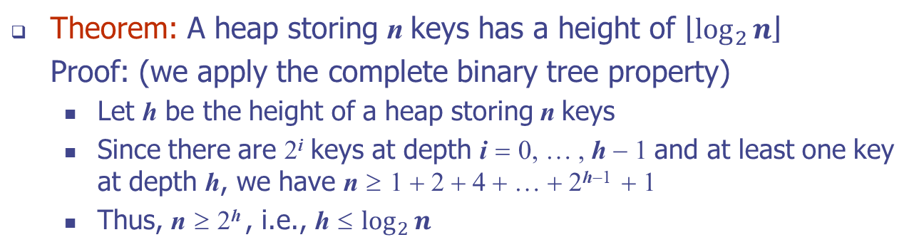
Height of a Heap
Theorem: A heap storing n keys has a height of $\left\lfloor \log_{2}{n}\right\rfloor$
Proof: (we apply the complete binary tree property)
Let h be the height of a heap storing n keys
Since there are 2^{i} keys at depth i = 0, … , h − 1 and at least one key at depth h, we have n ≥ 1 + 2 + 4 + … + 2^{h−1} + 1
Thus, n ≥ 2^{h} , i.e., h ≤ $\log_{2}{n}$
depth
keys
0
1
1
2
h−1
2^{h−1}
h
1
Notes:
A heap T storing n entries has height h = ⌊log n⌋.
If you remember from the doubling strategy analysis in growable array-based lists, 1 + 2 + 4 + 8 + …+ 2^{k} = 2^{k + 1} − 1

Slide 10
Heaps and Priority Queues
We can use a heap to implement a priority queue
We store a (key, element) item at each node
We keep track of the position of the last node
(2, Sue)
(5, Pat)
(6, Mark)
(9, Jeff)
(7, Anna)

Slide 11
Insertion into a Heap
Method insert of the priority queue ADT corresponds to the insertion of a key k to the heap
The insertion algorithm consists of three steps
Find the insertion node z (the new last node)
Store k at z
Restore the heap-order property (discussed next)
2
5
z
6
9
7
insertion node
2
5
6
z
9
7
1

Slide 12
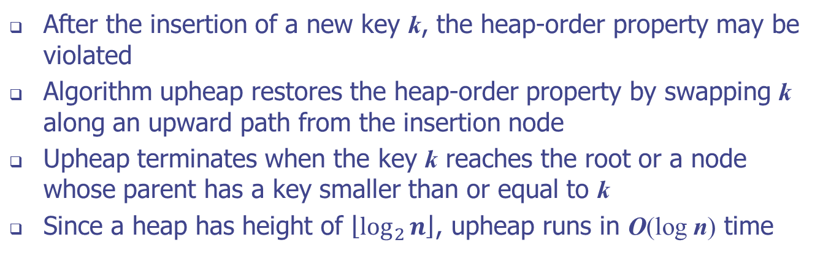
Upheap
After the insertion of a new key k, the heap-order property may be violated
Algorithm upheap restores the heap-order property by swapping k along an upward path from the insertion node
Upheap terminates when the key k reaches the root or a node whose parent has a key smaller than or equal to k
Since a heap has height of $\left\lfloor \log_{2}{n}\right\rfloor$, upheap runs in O(log n) time
2
1
5
1
5
2
z
z
9
7
6
9
7
6

Slide 13
Upheap

Slide 14
Removal from a Heap
Method removeMin of the priority queue ADT corresponds to the removal of the root key from the heap
The removal algorithm consists of three steps
Replace the root key with the key of the last node w
Remove w
Restore the heap-order property (discussed next)
2
5
6
w
9
7
last node
7
5
w
6
9
new last node

Slide 15
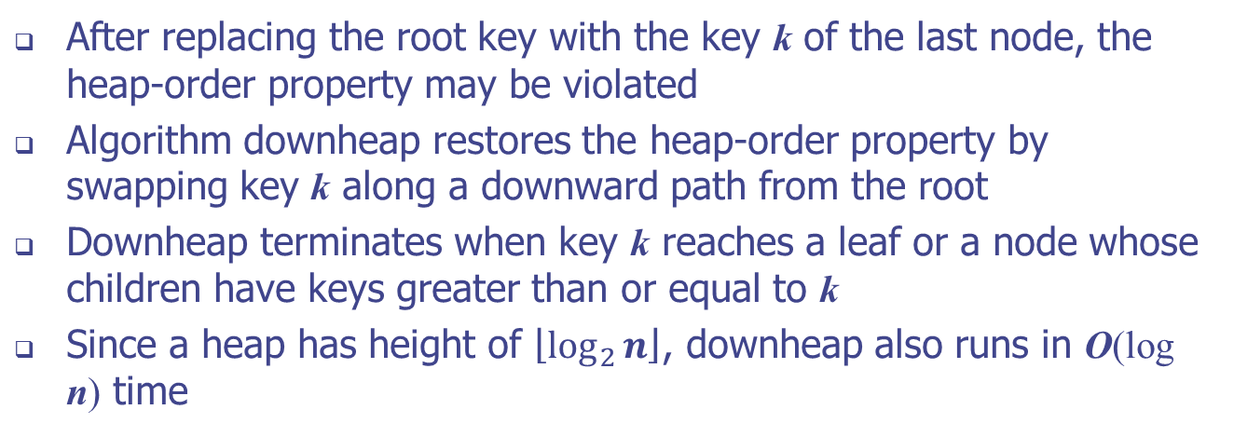
Downheap
After replacing the root key with the key k of the last node, the heap-order property may be violated
Algorithm downheap restores the heap-order property by swapping key k along a downward path from the root
Downheap terminates when key k reaches a leaf or a node whose children have keys greater than or equal to k
Since a heap has height of $\left\lfloor \log_{2}{n}\right\rfloor$, downheap also runs in O(log n) time
7
5
5
w
6
7
w
6
9
9

Slide 16
Downheap
Notes:
A swap either resolves the violation of the heap-order property or propagates it one level down in the heap.

Slide 17
Heap-Sort
Consider a priority queue with n items implemented by means of a heap
the space used is O(n)
methods insert and removeMin take O(log n) time
methods size, isEmpty, and min take time O(1) time
Using a heap-based priority queue, we can sort a sequence of n elements in O(n log n) time
The resulting algorithm is called heap-sort
Heap-sort is much faster than quadratic sorting algorithms, such as insertion-sort and selection-sort
Notes:
https://www.geeksforgeeks.org/heap-sort/

Slide 18
Array-based Heap Implementation
We can represent a heap with n keys by means of an array of length n
For the node at rank i
the left child is at rank 2i + 1
the right child is at rank 2i + 2
Links between nodes are not explicitly stored
Operation add corresponds to inserting at rank n + 1
Operation removeMin corresponds to removing at rank 0
Yields in-place heap-sort
2
5
6
9
7
2
5
6
9
7
0
1
2
3
4

Slide 19
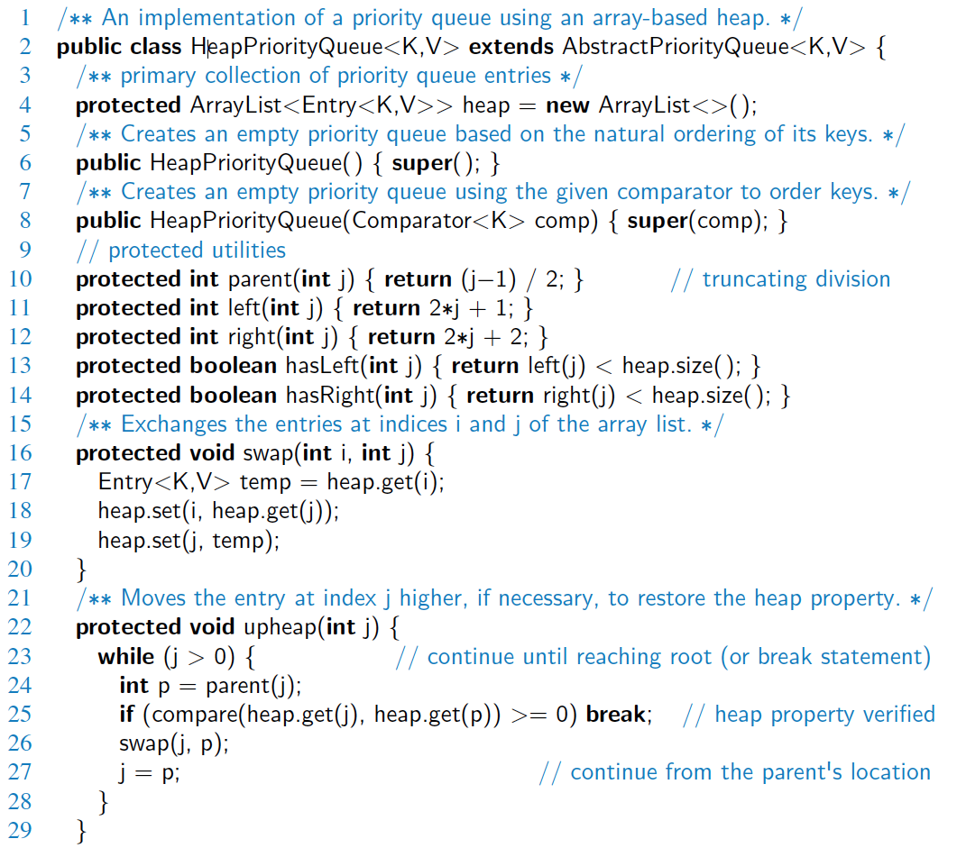
Java Implementation

Slide 20
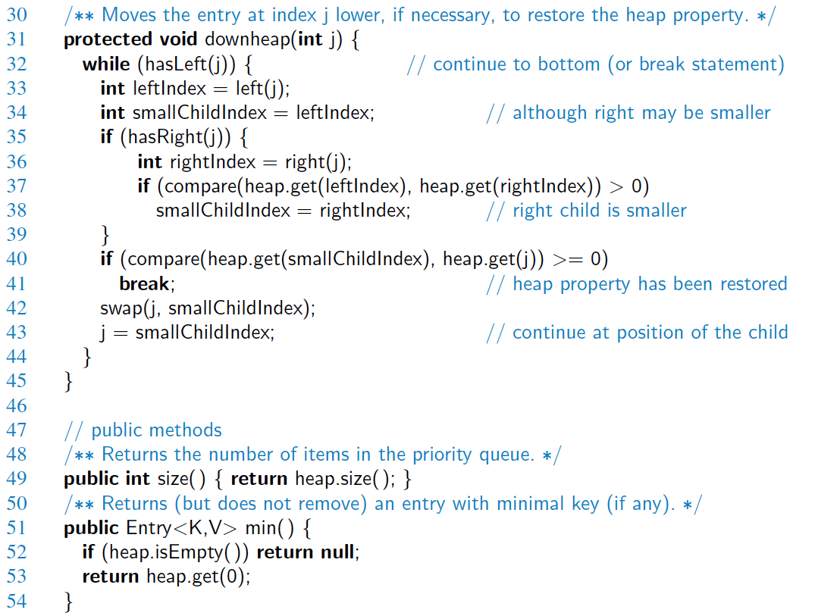
Java Implementation, 2

Slide 21
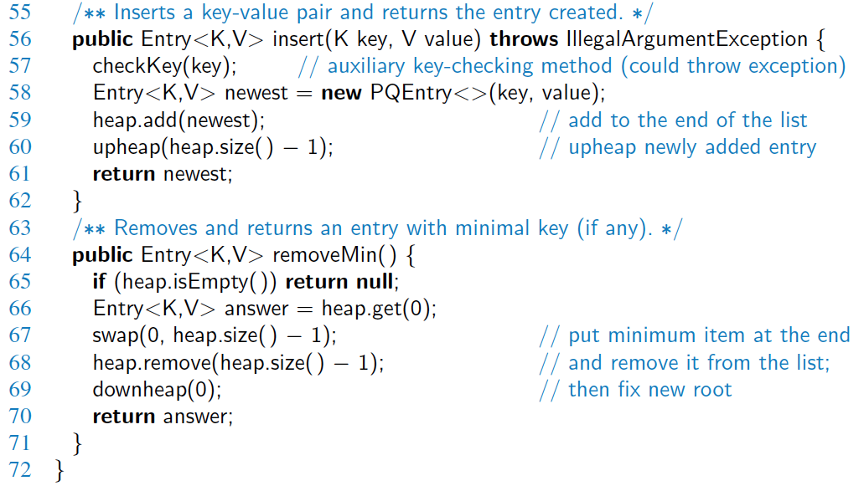
Java Implementation, 3

Slide 22
Merging Two Heaps
We are given two heaps and a key k
We create a new heap with the root node storing k and with the two heaps as subtrees
We perform downheap to restore the heap-order property
3
2
8
5
4
6
7
3
2
8
5
4
6
2
3
4
8
5
7
6

Slide 23
Bottom-up Heap Construction
We can construct a heap storing n given keys in using a bottom-up construction with log n phases
In phase i, pairs of heaps with 2^{i} −1 keys are merged into heaps with 2^{i+1}−1 keys
2^{i} −1
2^{i} −1
2^{i+1}−1

Slide 24
Example
16
15
4
12
6
7
23
20
25
5
11
27
16
15
4
12
6
7
23
20
Notes:
bottom-up heap construction for h = 3.

Slide 25
Example (contd.)
25
5
11
27
16
15
4
12
6
9
23
20
15
4
6
23
16
25
5
12
11
9
27
20

Slide 26
Example (contd.)
7
8
15
4
6
23
16
25
5
12
11
9
27
20
4
6
15
5
8
23
16
25
7
12
11
9
27
20

Slide 27
Example (end)
10
4
6
15
5
8
23
16
25
7
12
11
9
27
20
4
5
6
15
7
8
23
16
25
10
12
11
9
27
20

