Slide 1

Java Primer 2: I/O Methods and Control Flow
Presentation for use with the textbook Data Structures and Algorithms in Java, 6th edition, by M. T. Goodrich, R. Tamassia, and M. H. Goldwasser, Wiley, 2014

Slide 2
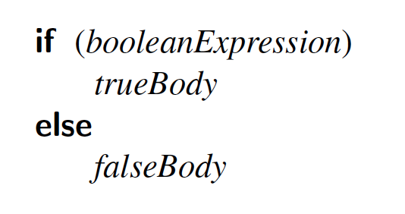
If Statements
The syntax of a simple if statement is as follows:
booleanExpression is a boolean expression and trueBody and falseBody are each either a single statement or a block of statements enclosed in braces (“{” and “}”).

Slide 3
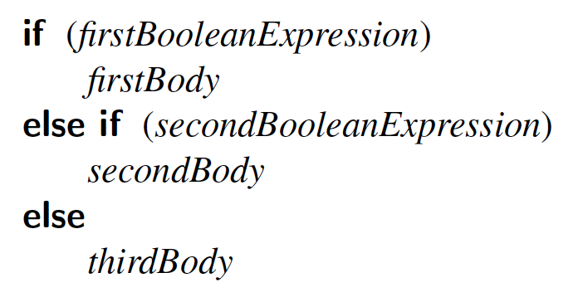
Compound if Statements
There is also a way to group a number of boolean tests, as follows:

Slide 4
Switch Statements
Java provides for multiple-value control flow using the switch statement.
The switch statement evaluates an integer, string, or enum expression and causes control flow to jump to the code location labeled with the value of this expression.
If there is no matching label, then control flow jumps to the location labeled “default.”
This is the only explicit jump performed by the switch statement, however, so flow of control “falls through” to the next case if the code for a case is not ended with a break statement

Slide 5
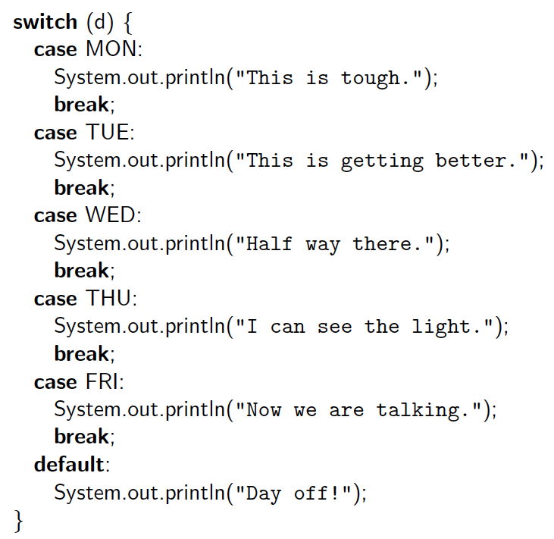
Switch Example

Slide 6
Break and Continue
Java supports a break statement that immediately terminate a while or for loop when executed within its body.
Java also supports a continue statement that causes the current iteration of a loop body to stop, but with subsequent passes of the loop proceeding as expected.

Slide 7
While Loops
The simplest kind of loop in Java is a while loop.
Such a loop tests that a certain condition is satisfied and will perform the body of the loop each time this condition is evaluated to be true.
The syntax for such a conditional test before a loop body is executed is as follows:
while (booleanExpression)
loopBody

Slide 8
Do-While Loops
Java has another form of the while loop that allows the boolean condition to be checked at the end of each pass of the loop rather than before each pass.
This form is known as a do-while loop, and has syntax shown below:
do
loopBody
while (booleanExpression)

Slide 9
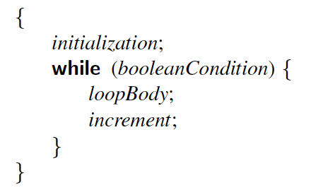
For Loops
The traditional for-loop syntax consists of four sections—an initialization, a boolean condition, an increment statement, and the body—although any of those can be empty.
The structure is as follows:
for (initialization; booleanCondition; increment)
loopBody
Meaning:

Slide 10
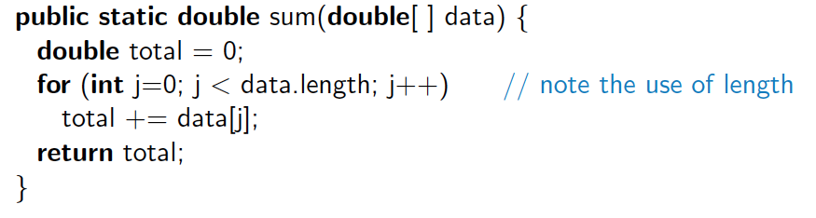
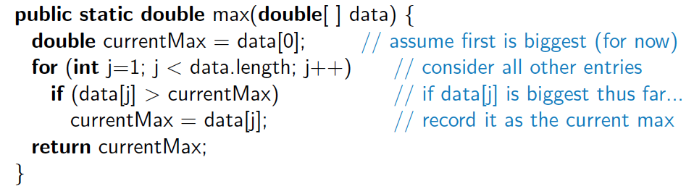
Example For Loops
Compute the sum of an array of doubles:
Compute the maximum in an array of doubles:

Slide 11
For-Each Loops
Since looping through elements of a collection is such a common construct, Java provides a shorthand notation for such loops, called the for-each loop.
The syntax for such a loop is as follows:
for (elementType name : container)
loopBody

Slide 12
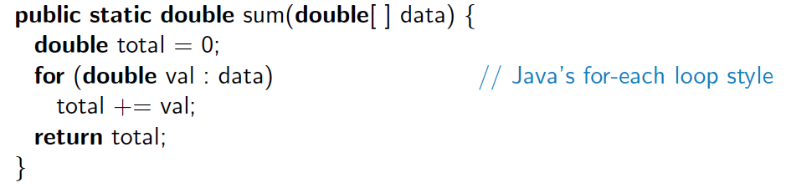
For-Each Loop Example
Computing a sum of an array of doubles:
When using a for-each loop, there is no explicit use of array indices.
The loop variable represents one particular element of the array.

Slide 13
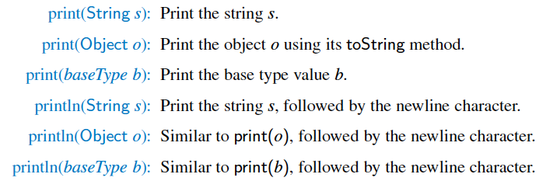
Simple Output
Java provides a built-in static object, called System.out, that performs output to the “standard output” device, with the following methods:

Slide 14
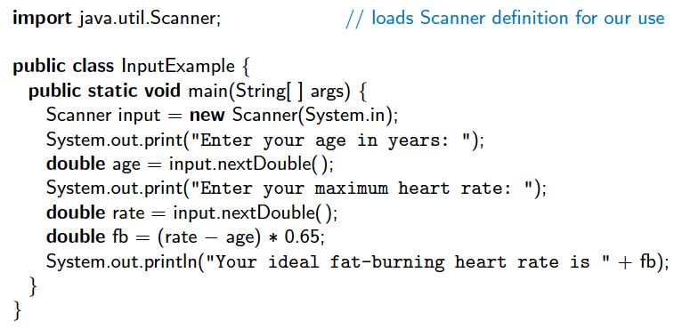
Simple Input
There is also a special object, System.in, for performing input from the Java console window.
A simple way of reading input with this object is to use it to create a Scanner object, using the expression
new Scanner(System.in)
Example:

Slide 15
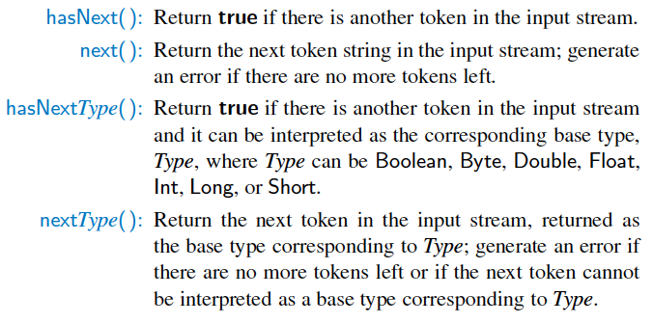
java.util.Scanner Methods
The Scanner class reads the input stream and divides it into tokens, which are strings of characters separated by delimiters.

Slide 16
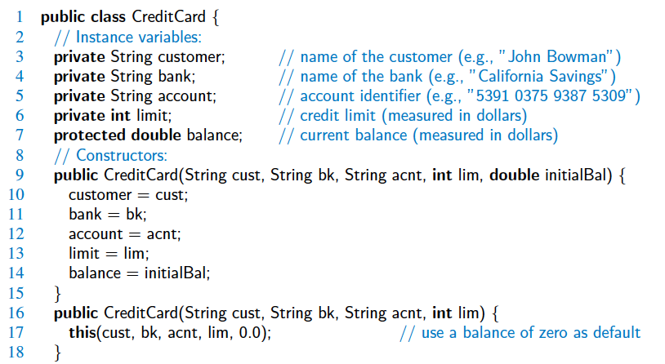
Sample Program

Slide 17
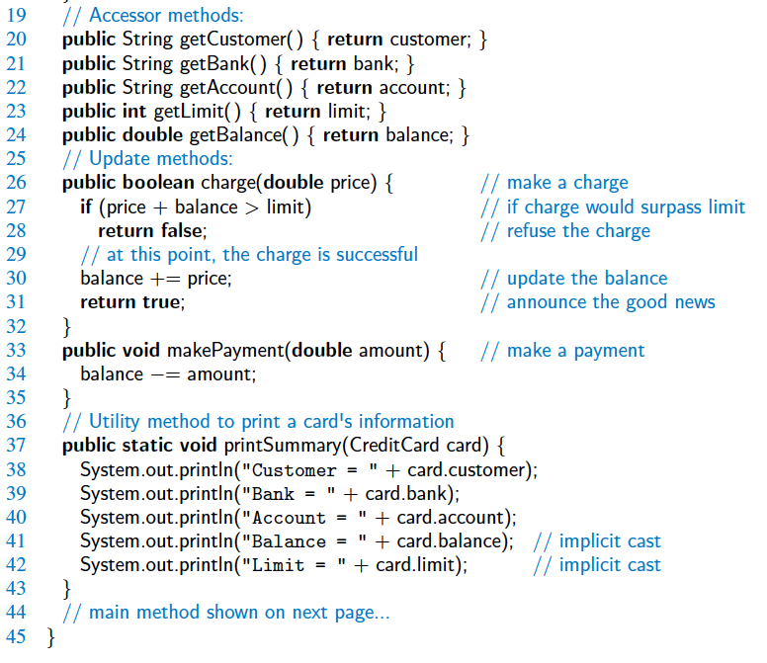
Sample Program

Slide 18
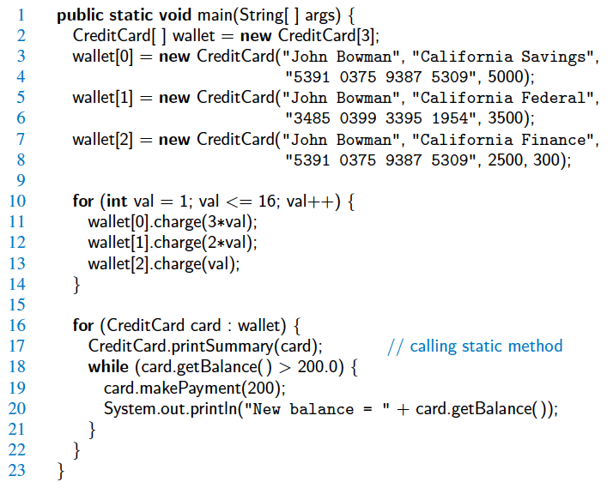
Sample Program

