Slide 1


Object-Oriented Programming
Presentation for use with the textbook Data Structures and Algorithms in Java, 6th edition, by M. T. Goodrich, R. Tamassia, and M. H. Goldwasser, Wiley, 2014

Slide 2
Terminology
Each object created in a program is an instance of a class.
Each class presents to the outside world a concise and consistent view of the objects that are instances of this class, without going into too much unnecessary detail or giving others access to the inner workings of the objects.
The class definition typically specifies instance variables, also known as data members, that the object contains, as well as the methods, also known as member functions, that the object can execute.

Slide 3
Goals
Robustness
We want software to be capable of handling unexpected inputs that are not explicitly defined for its application.
Adaptability
Software needs to be able to evolve over time in response to changing conditions in its environment.
Reusability
The same code should be usable as a component of different systems in various applications.

Slide 4
Abstract Data Types
Abstraction is to distill a system to its most fundamental parts.
Applying the abstraction paradigm to the design of data structures gives rise to abstract data types (ADTs).
An ADT is a model of a data structure that specifies the type of data stored, the operations supported on them, and the types of parameters of the operations.
An ADT specifies what each operation does, but not how it does it.
The collective set of behaviors supported by an ADT is its public interface.

Slide 5
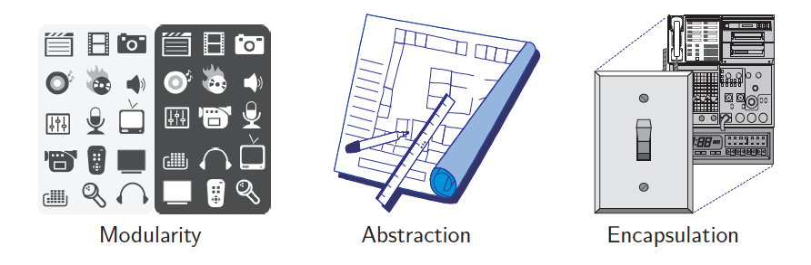
Object-Oriented Design Principles
Modularity
Abstraction
Encapsulation
Notes:
Modularity is the process of decomposing a problem (program) into a set of modules so as to reduce the overall complexity of the problem.
Abstraction aims to hide complexity from users and show them only relevant information.
Encapsulation helps with data security, allowing you to protect the data stored in a class from system-wide access. As the name suggests, it safeguards the internal contents of a class like a capsule.
Encapsulation is the process of binding both attributes and methods together within a class. Through encapsulation, the internal details of a class can be hidden from outside.

Slide 6
Interfaces and Abstract Classes
The main structural element in Java that enforces an application programming interface (API) is an interface.
An interface is a collection of method declarations with no data and no bodies.
Interfaces do not have constructors and they cannot be directly instantiated.
When a class implements an interface, it must implement all of the methods declared in the interface.
An abstract class also cannot be instantiated, but it can define one or more common methods that all implementations of the abstraction will have.

Slide 7

Design Patterns
Algorithmic patterns:
Recursion
Amortization
Divide-and-conquer
Prune-and-search
Brute force
Dynamic programming
The greedy method
Software design patterns:
Iterator
Adapter
Position
Composition
Template method
Locator
Factory method
Notes:
Amortized analysis is a technique used in computer science to analyze the average-case time complexity of algorithms that perform a sequence of operations, where some operations may be more expensive than others. The idea is to spread the cost of these expensive operations over multiple operations, so that the average cost of each operation is constant or less.
The Factory Method Design Pattern is a creational pattern that provides an interface for creating objects but allows subclasses to decide which class to instantiate.

Slide 8
Object-Oriented Software Design
Responsibilities: Divide the work into different actors, each with a different responsibility.
Independence: Define the work for each class to be as independent from other classes as possible.
Behaviors: Define the behaviors for each class carefully and precisely, so that the consequences of each action performed by a class will be well understood by other classes that interact with it.

Slide 9
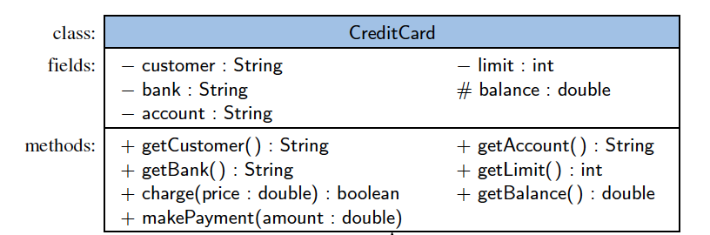
Unified Modeling Language (UML)
A class diagram has three portions.
The name of the class
The recommended instance variables
The recommended methods of the class.

Slide 10
Class Definitions
A class serves as the primary means for abstraction in object-oriented programming.
In Java, every variable is either a base type or is a reference to an instance of some class.
A class provides a set of behaviors in the form of member functions (also known as methods), with implementations that belong to all its instances.
A class also serves as a blueprint for its instances, effectively determining the way that state information for each instance is represented in the form of attributes (also known as fields, instance variables, or data members).

Slide 11
Constructors
A user can create an instance of a class by using the new operator with a method that has the same name as the class.
Such a method, known as a constructor, has as its responsibility is to establish the state of a newly object with appropriate initial values for its instance variables.

Slide 12
Inheritance
A mechanism for a modular and hierarchical organization is inheritance.
This allows a new class to be defined based upon an existing class as the starting point.
The existing class is typically described as the base class, parent class, or superclass, while the newly defined class is known as the subclass or child class.
There are two ways in which a subclass can differentiate itself from its superclass:
A subclass may specialize an existing behavior by providing a new implementation that overrides an existing method.
A subclass may also extend its superclass by providing brand new methods.

Slide 13
Inheritance and Constructors
Constructors are never inherited in Java; hence, every class must define a constructor for itself.
All of its fields must be properly initialized, including any inherited fields.
The first operation within the body of a constructor must be to invoke a constructor of the superclass, which initializes the fields defined in the superclass.
A constructor of the superclass is invoked explicitly by using the keyword super with appropriate parameters.
If a constructor for a subclass does not make an explicit call to super or this as its first command, then an implicit call to super( ), the zero-parameter version of the superclass constructor, will be made.

Slide 14
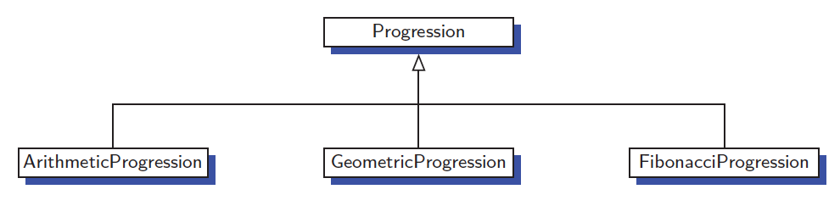
An Extended Example
A numeric progression is a sequence of numbers, where each number depends on one or more of the previous numbers.
An arithmetic progression determines the next number by adding a fixed constant to the previous value.
A geometric progression determines the next number by multiplying the previous value by a fixed constant.
A Fibonacci progression uses the formula N_{i+1}=N_{i}+N_{i-1}

Slide 15
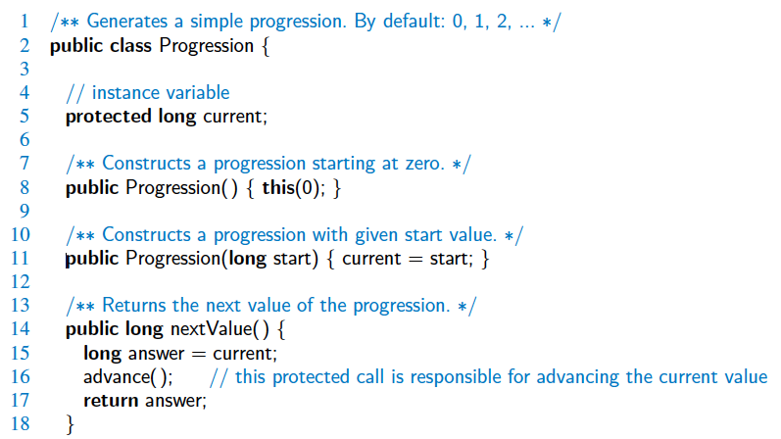
The Progression Base Class

Slide 16
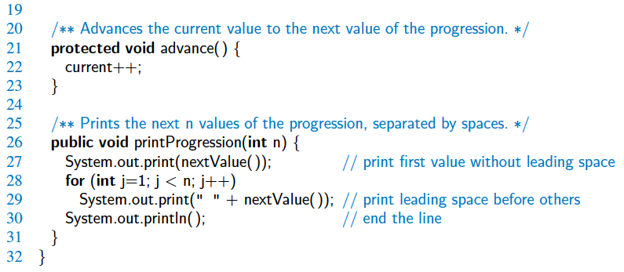
The Progression Base Class, 2

Slide 17
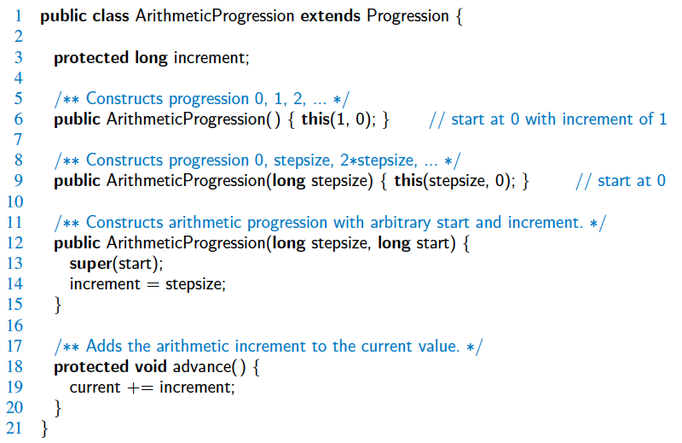
ArithmeticProgression Subclass

Slide 18
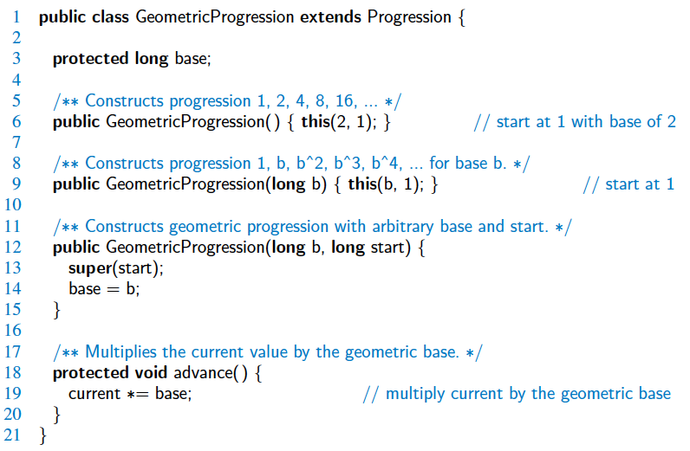
GeometricProgression Subclass

Slide 19
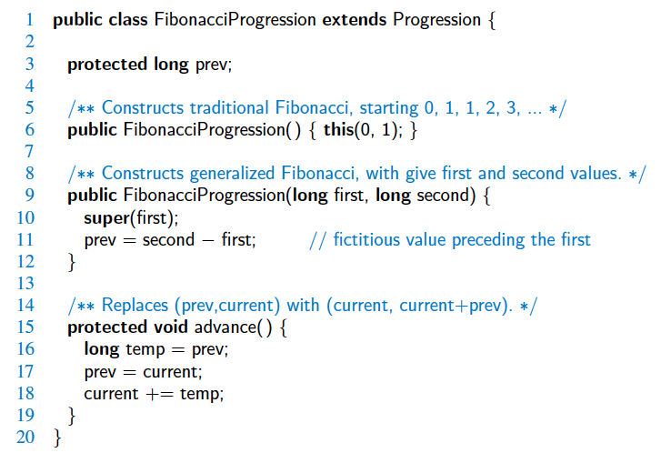
FibonacciProgression Subclass

Slide 20
Exceptions
Exceptions are unexpected events that occur during the execution of a program.
An exception might result due to an unavailable resource, unexpected input from a user, or simply a logical error on the part of the programmer.
In Java, exceptions are objects that can be thrown by code that encounters an unexpected situation.
An exception may also be caught by a surrounding block of code that “handles” the problem.
If uncaught, an exception causes the virtual machine to stop executing the program and to report an appropriate message to the console.

Slide 21
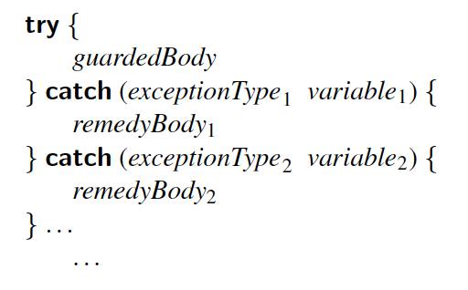
Catching Exceptions
The general methodology for handling exceptions is a try-catch construct in which a guarded fragment of code that might throw an exception is executed.
If it throws an exception, then that exception is caught by having the flow of control jump to a predefined catch block that contains the code to apply an appropriate resolution.
If no exception occurs in the guarded code, all catch blocks are ignored.

Slide 22
Throwing Exceptions
Exceptions originate when a piece of Java code finds some sort of problem during execution and throws an exception object.
This is done by using the throw keyword followed by an instance of the exception type to be thrown.
It is often convenient to instantiate an exception object at the time the exception has to be thrown. Thus, a throw statement is typically written as follows:
throw new exceptionType(parameters);
where exceptionType is the type of the exception and the parameters are sent to that type’s constructor.

Slide 23
The throws Clause
When a method is declared, it is possible to explicitly declare, as part of its signature, the possibility that a particular exception type may be thrown during a call to that method.
The syntax for declaring possible exceptions in a method signature relies on the keyword throws (not to be confused with an actual throw statement).
For example, the parseInt method of the Integer class has the following formal signature:
public static int parseInt(String s) throws NumberFormatException;

Slide 24
Casting
Casting with Objects allows for conversion between classes and subclasses.
A widening conversion occurs when a type T is converted into a “wider” type U:
T and U are class types and U is a superclass of T.
T and U are interface types and U is a superinterface of T.
T is a class that implements interface U.
Example:
CreditCard card = new PredatoryCreditCard(...);

Slide 25
Narrowing Conversions
A narrowing conversion occurs when a type T is converted into a “narrower” type S.
T and S are class types and S is a subclass of T.
T and S are interface types and S is a subinterface of T.
T is an interface implemented by class S.
In general, a narrowing conversion of reference types requires an explicit cast.
Example:
PredatoryCreditCard pc = (PredatoryCreditCard) card;

Slide 26
Generics
Java includes support for writing generic classes and methods that can operate on a variety of data types while often avoiding the need for explicit casts.
The generics framework allows us to define a class in terms of a set of formal type parameters, which can then be used as the declared type for variables, parameters, and return values within the class definition.
Those formal type parameters are later specified when using the generic class as a type elsewhere in a program.

Slide 27
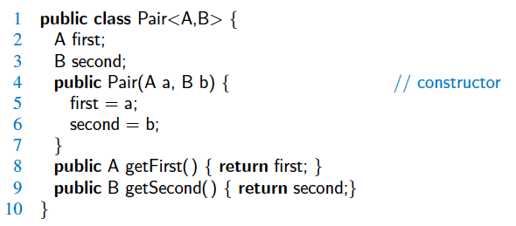

Syntax for Generics
Types can be declared using generic names:
They are then instantiated using actual types:

Slide 28
Nested Classes
Java allows a class definition to be nested inside the definition of another class.
The main use for nesting classes is when defining a class that is strongly affiliated with another class.
This can help increase encapsulation and reduce undesired name conflicts.
Nested classes are a valuable technique when implementing data structures, as an instance of a nested use can be used to represent a small portion of a larger data structure, or an auxiliary class that helps navigate a primary data structure.

