Slide 1
Doubly Linked Lists
Presentation for use with the textbook Data Structures and Algorithms in Java, 6th edition, by M. T. Goodrich, R. Tamassia, and M. H. Goldwasser, Wiley, 2014
Notes:
we are unable to efficiently delete a node at the tail of a singly linked list.

Slide 2
Doubly Linked List
A doubly linked list can be traversed forward and backward
Nodes store:
element
link to the previous node
link to the next node
Special trailer and header nodes
prev
next
element
node
header
nodes/positions
trailer
elements
Notes:
To provide greater symmetry, we define a linked list in which each node keeps an explicit reference to the node before it and a reference to the node after it. Such a structure is known as a doubly linked list.

Slide 3
Insertion
Insert a new node, q, between p and its successor.
p
A
B
C
p
A
B
q
C
X
p
q
A
B
X
C

Slide 4
Deletion
Remove a node, p, from a doubly linked list.
p
A
B
C
D
A
B
C
p
D
A
B
C

Slide 5
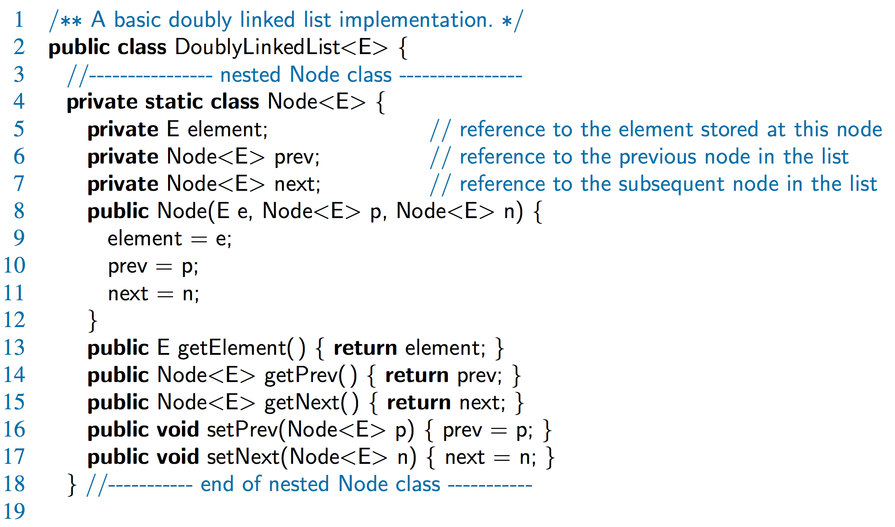
Doubly-Linked List in Java

Slide 6
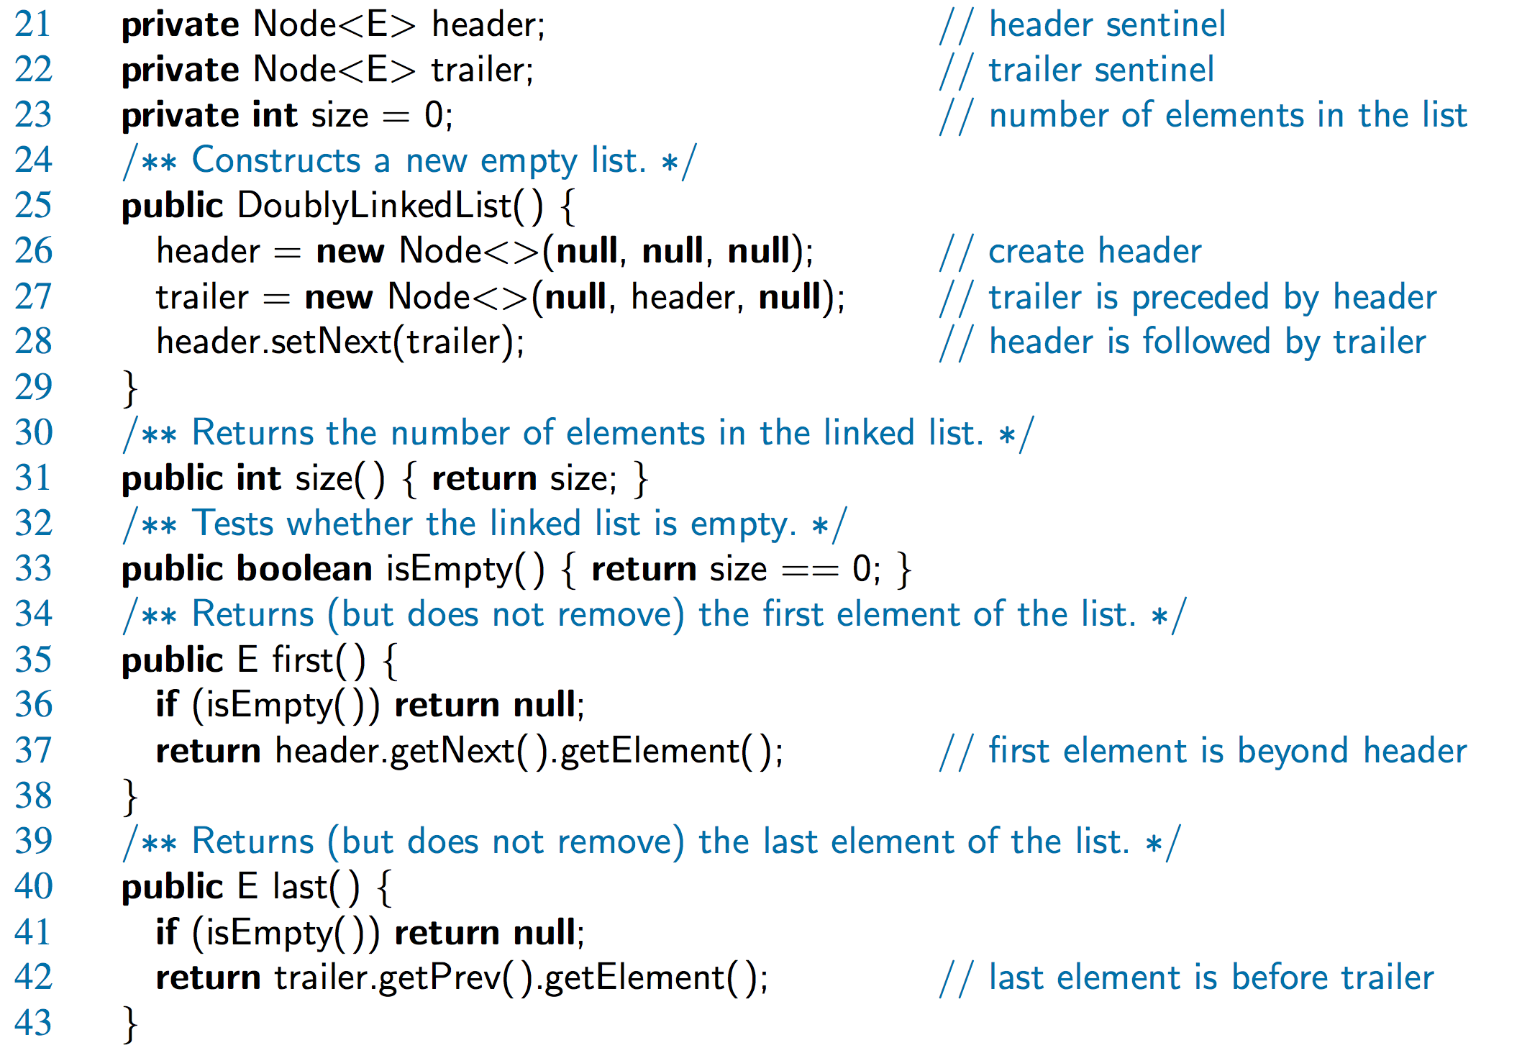
Doubly-Linked List in Java, 2

Slide 7
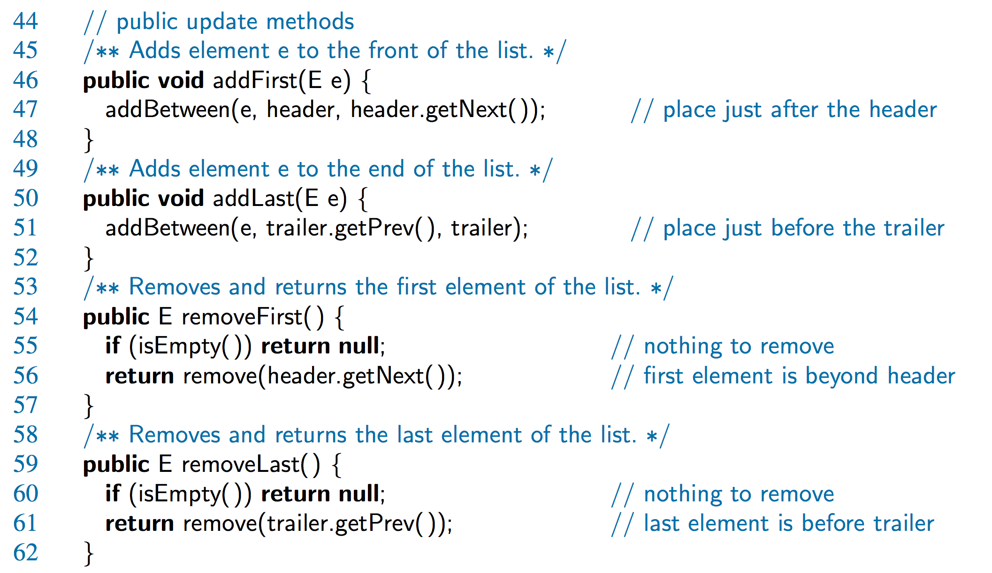
Doubly-Linked List in Java, 3

Slide 8
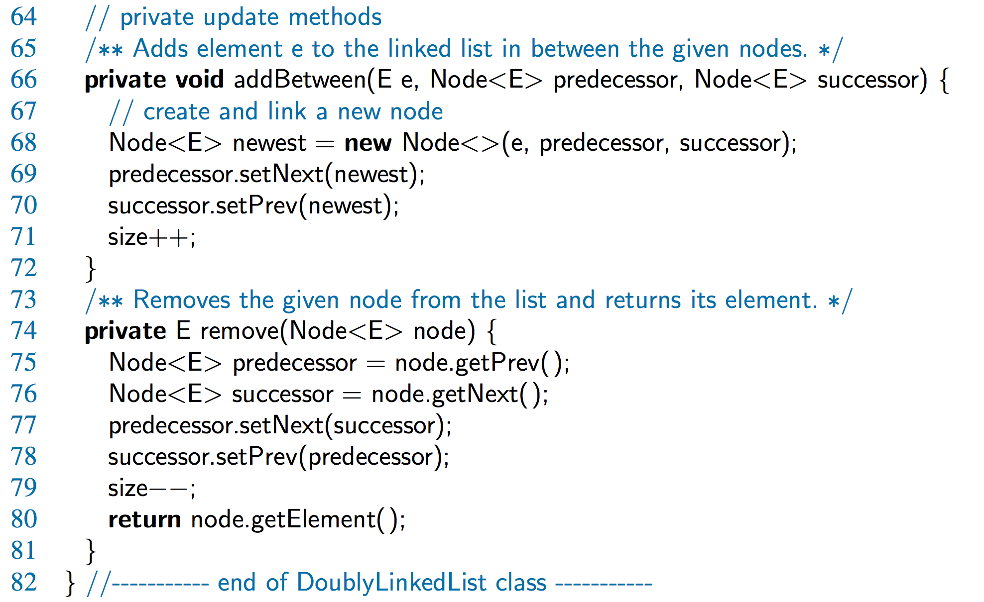
Doubly-Linked List in Java, 4

