Slide 1
Singly Linked Lists
Presentation for use with the textbook Data Structures and Algorithms in Java, 6th edition, by M. T. Goodrich, R. Tamassia, and M. H. Goldwasser, Wiley, 2014
Notes:
Arrays are great for storing things in a certain order, but they have drawbacks. The capacity of the array must be fixed when it is created, and insertions and deletions at interior positions of an array can be time consuming if many elements must be shifted.
No predetermined fixed size.

Slide 2
Singly Linked List
A singly linked list is a concrete data structure consisting of a sequence of nodes, starting from a head pointer
Each node stores
element
link to the next node
next
element
node
head
∅
A
B
C
D
Notes:
In a singly linked list, each node stores a reference to an object that is an element of the sequence, as well as a reference to the next node of the list
The tail of a list can be found by traversing the linked list— starting at the head and moving from one node to another by following each node’s next reference.

Slide 3
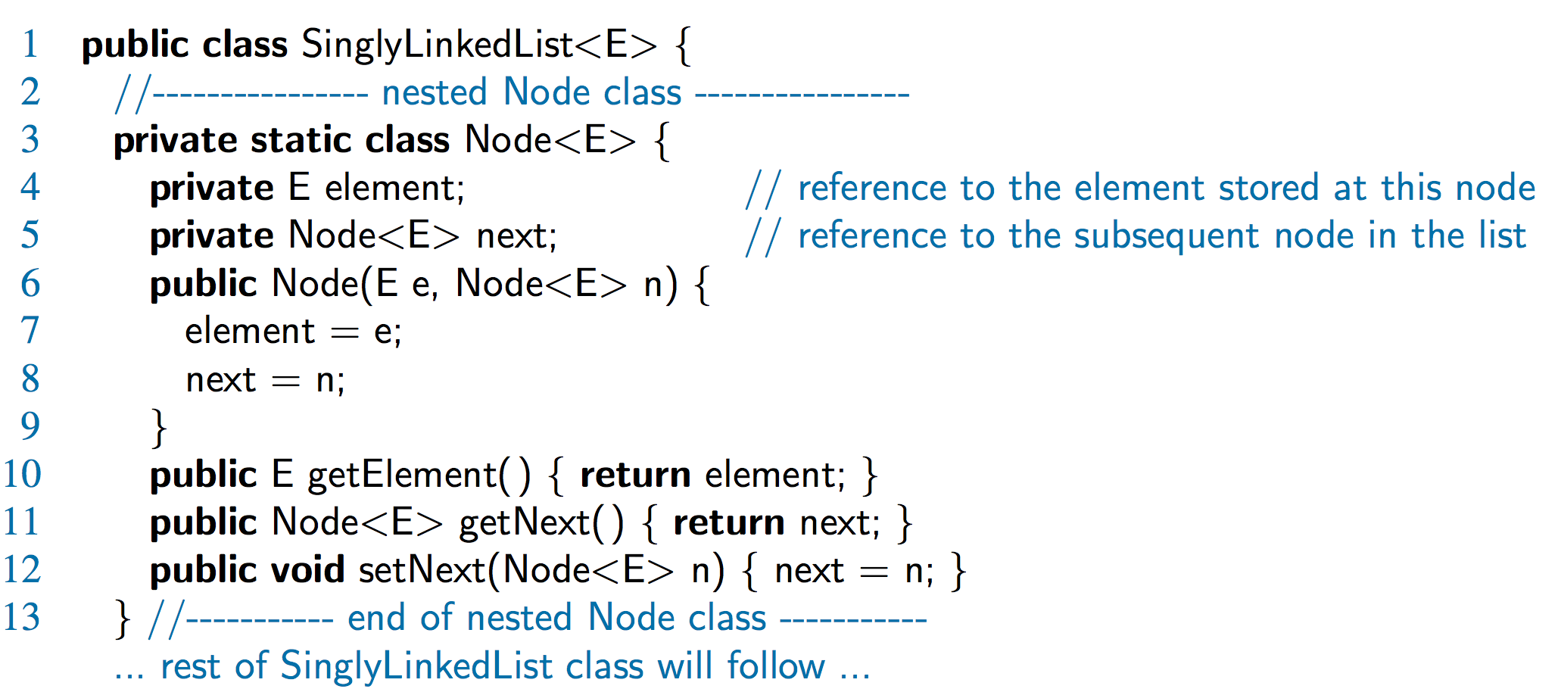
A Nested Node Class

Slide 4
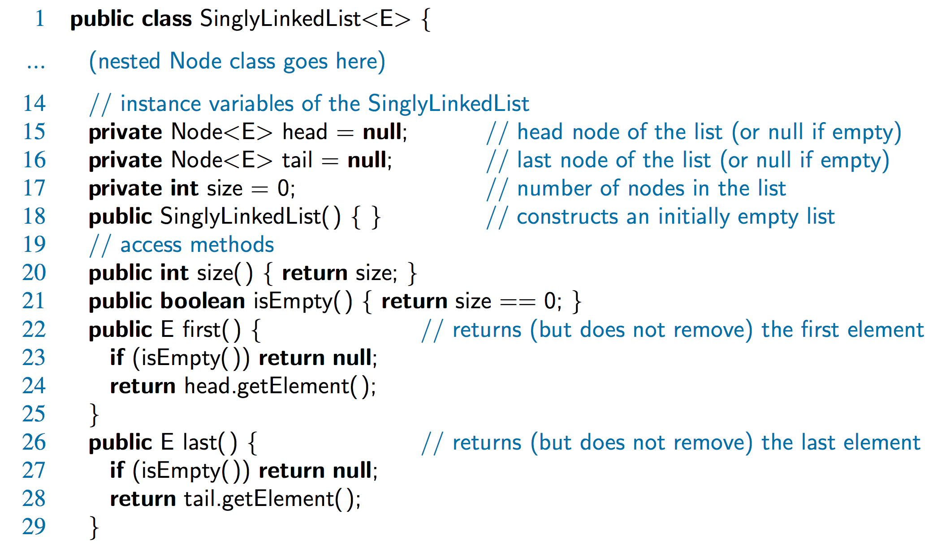
Accessor Methods

Slide 5
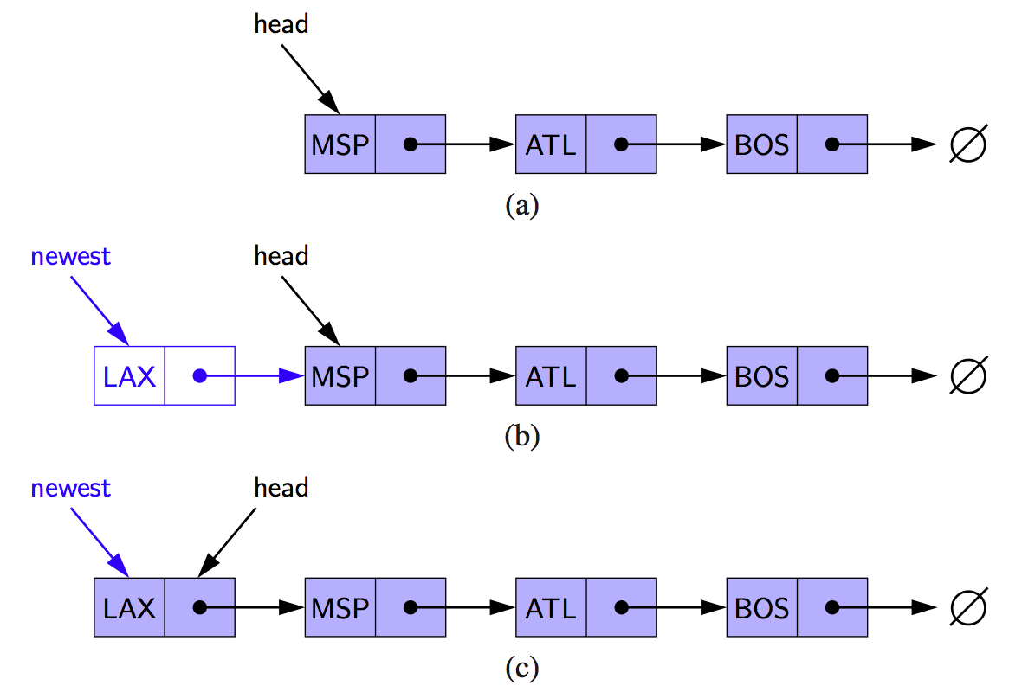
Inserting at the Head
Allocate new node
Insert new element
Have new node point to old head
Update head to point to new node
Notes:
The main idea is that we create a new node, set its element to the new element, set its next link to refer to the current head, and set the list’s head to point to the new node.
Note that we set the next pointer of the new node before we reassign variable head to it.

Slide 6
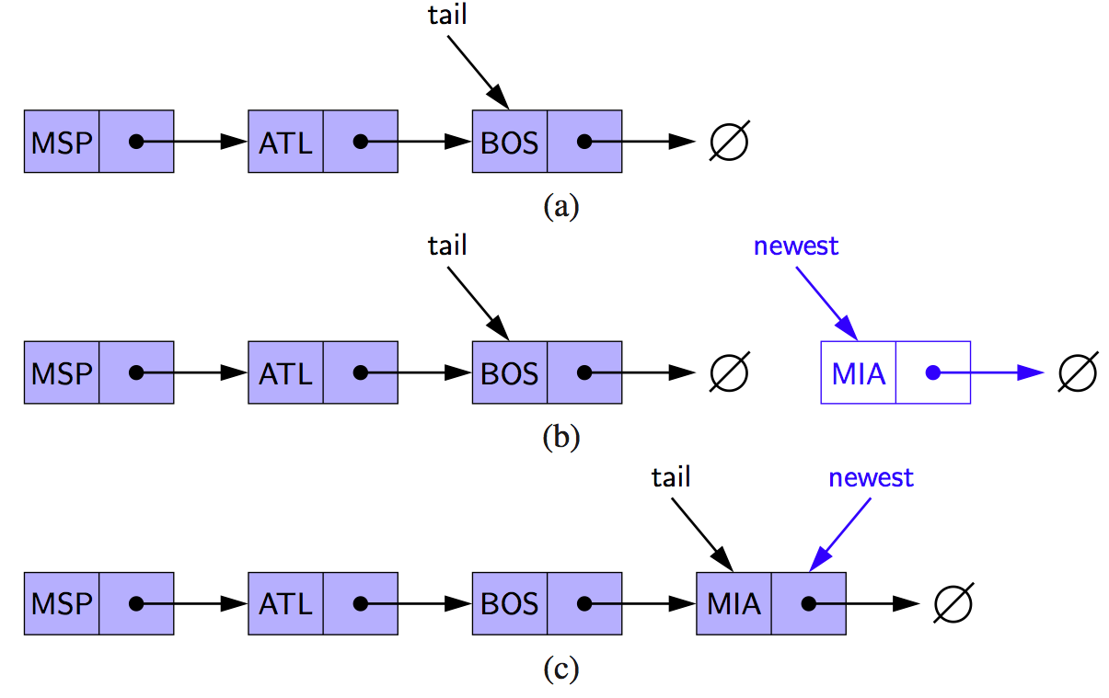
Inserting at the Tail
Allocate a new node
Insert new element
Have new node point to null
Have old last node point to new node
Update tail to point to new node
Notes:
we create a new node, assign its next reference to null, set the next reference of the tail to point to this new node, and then update the tail reference itself to this new node.
Note that we must set the next link of the tail node in (b) before we assign the tail variable to point to the new node in (c).

Slide 7
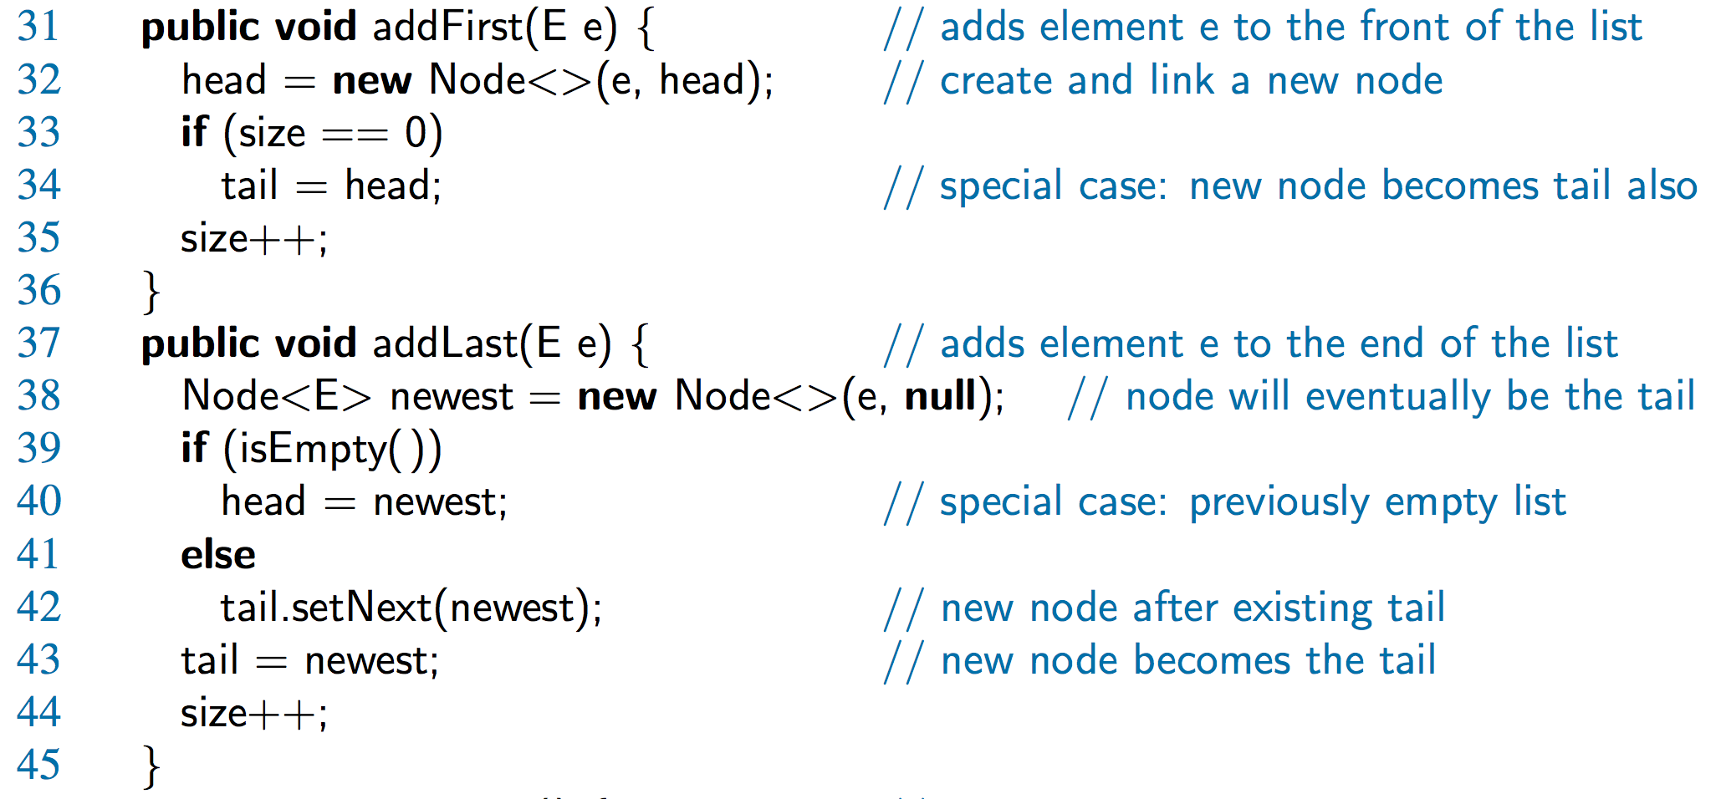
Java Methods

Slide 8
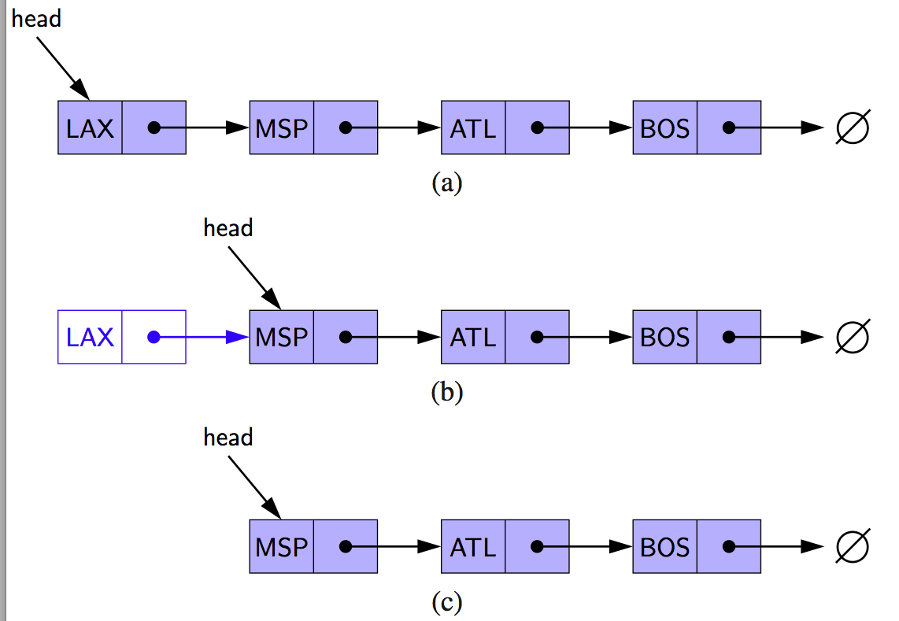
Removing at the Head
Update head to point to next node in the list
Allow garbage collector to reclaim the former first node

Slide 9
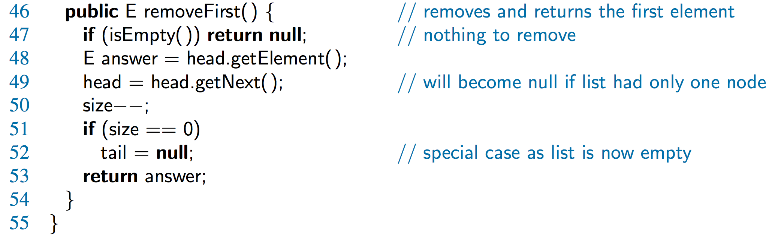
Java Method

Slide 10
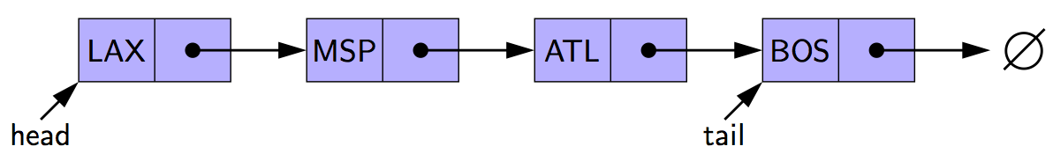
Removing at the Tail
Removing at the tail of a singly linked list is not efficient!
There is no constant-time way to update the tail to point to the previous node
Notes:
The only way to access this node is to start from the head of the list and search all the way through the list. But such a sequence of link-hopping operations could take a long time. If we want to support such an operation efficiently, we will need to make our list doubly linked.

