Slide 1
Recursion
Presentation for use with the textbook Data Structures and Algorithms in Java, 6th edition, by M. T. Goodrich, R. Tamassia, and M. H. Goldwasser, Wiley, 2014

Slide 2
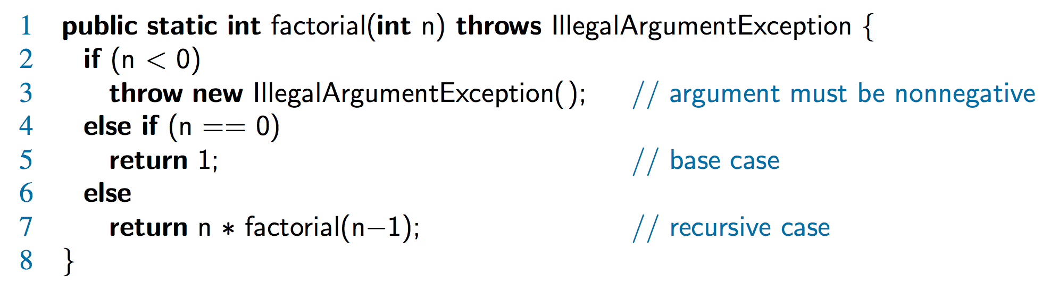
The Recursion Pattern
Recursion: when a method calls itself
Classic example – the factorial function:
n! = 1· 2· 3· ··· · (n-1)· n
Recursive definition:
As a Java method:

Slide 3
Content of a Recursive Method
Base case(s)
Values of the input variables for which we perform no recursive calls are called base cases (there should be at least one base case).
Every possible chain of recursive calls must eventually reach a base case.
Recursive calls
Calls to the current method.
Each recursive call should be defined so that it makes progress towards a base case.

Slide 4
Visualizing Recursion
Recursion trace
A box for each recursive call
An arrow from each caller to callee
An arrow from each callee to caller showing return value
Example
return
4
*
call
6
=
24
final answer
recursiveFactorial
(
4
)
return
3
*
call
2
=
6
recursiveFactorial
(
3
)
return
2
*
call
1
=
2
recursiveFactorial
(
2
)
return
1
*
call
1
=
1
recursiveFactorial
(
1
)
return
call
1
recursiveFactorial
(
0
)

Slide 5
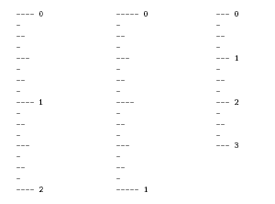
Example: English Ruler
Print the ticks and numbers like an English ruler:

Slide 6
Using Recursion
Slide by Matt Stallmann included with permission.
drawInterval(length)
Input: length of a ‘tick’
Output: ruler with tick of the given length in the middle and smaller rulers on either side
drawInterval(length)
if( length > 0 ) then
drawInterval ( length − 1 )
draw line of the given length
drawInterval ( length − 1 )

Slide 7
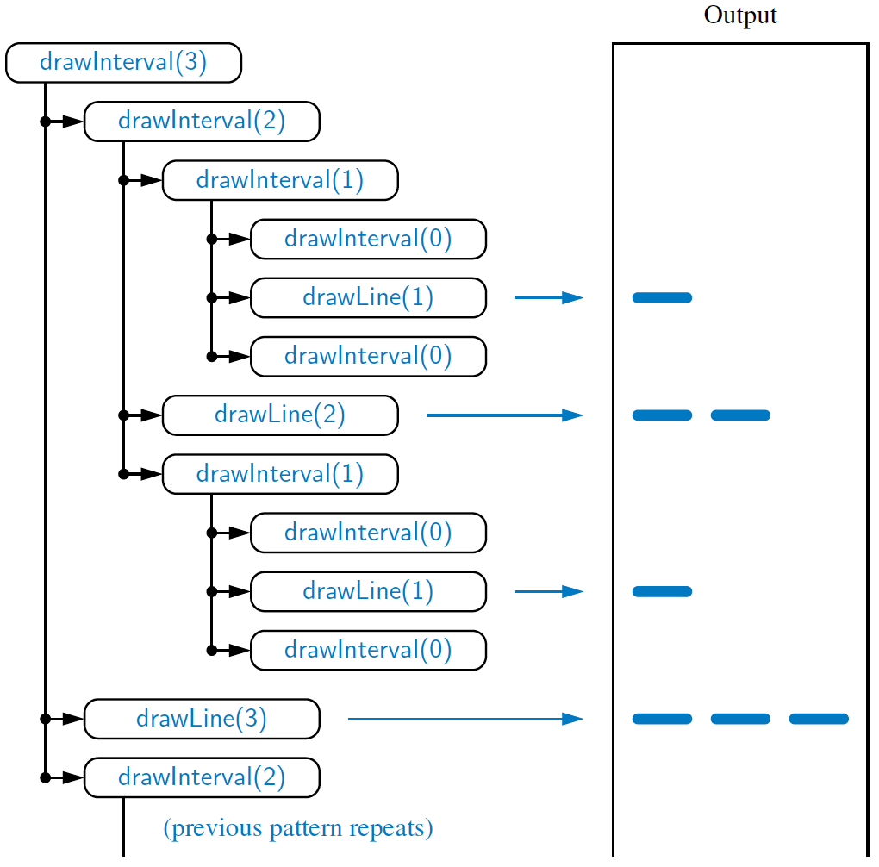
Recursive Drawing Method
The drawing method is based on the following recursive definition
An interval with a central tick length L >1 consists of:
An interval with a central tick length L−1
An single tick of length L
An interval with a central tick length L−1

Slide 8
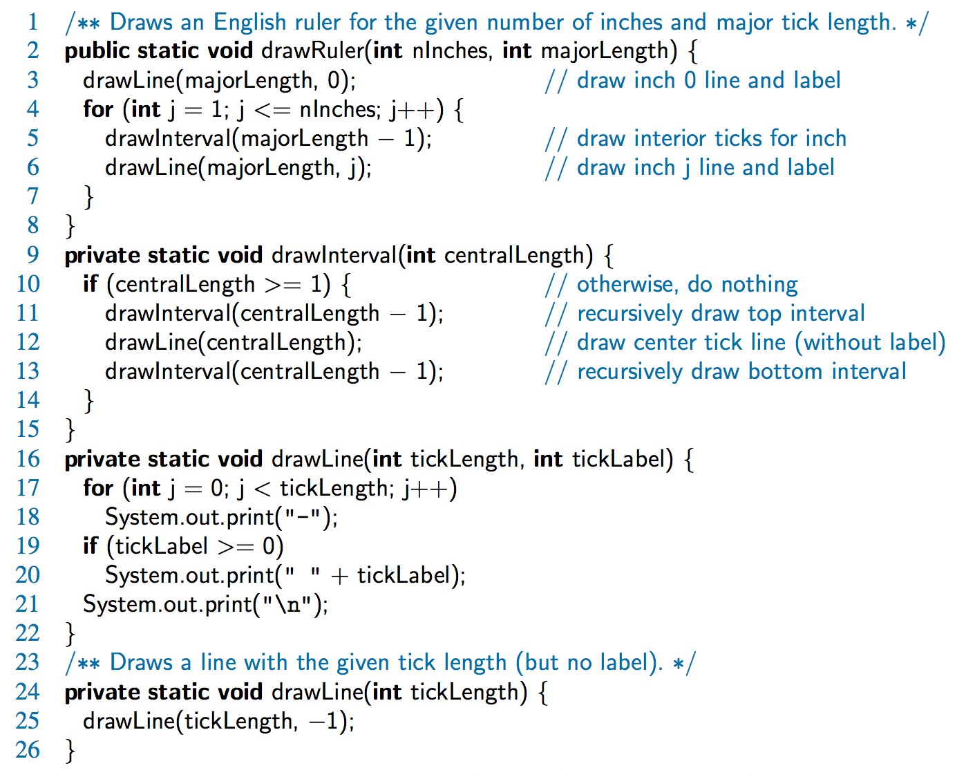
A Recursive Method for Drawing Ticks on an English Ruler
Note the two recursive calls

Slide 9
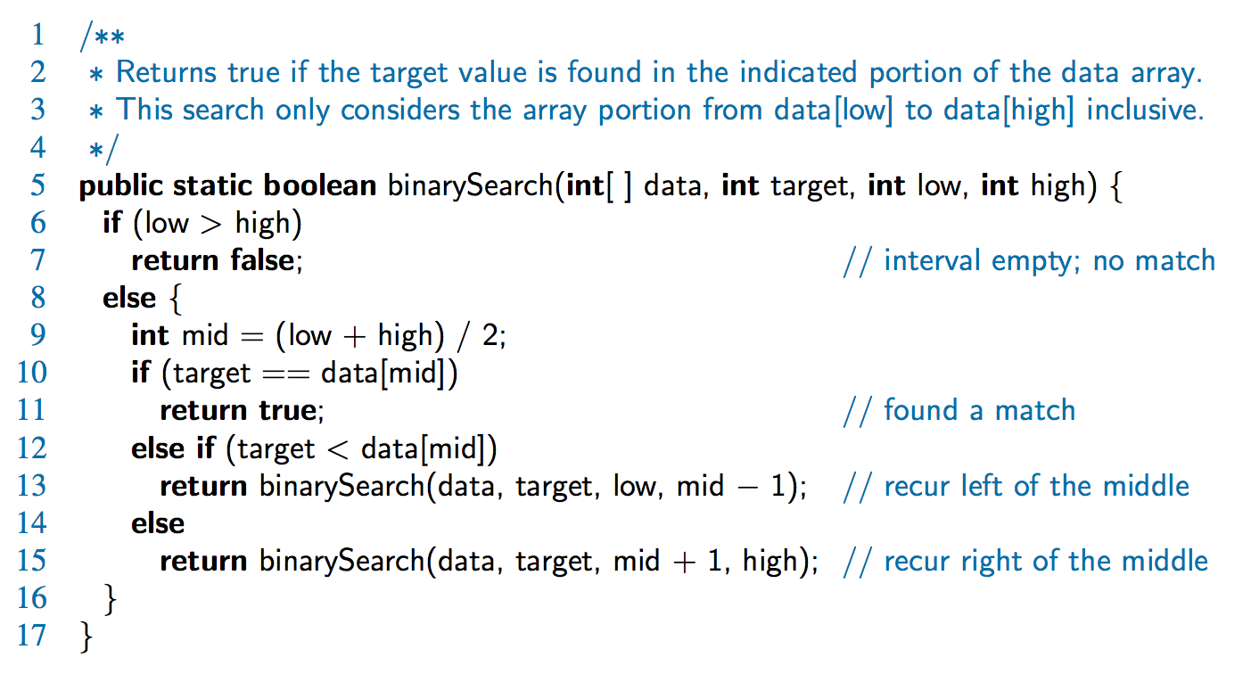
Binary Search
Search for an integer in an ordered list

Slide 10
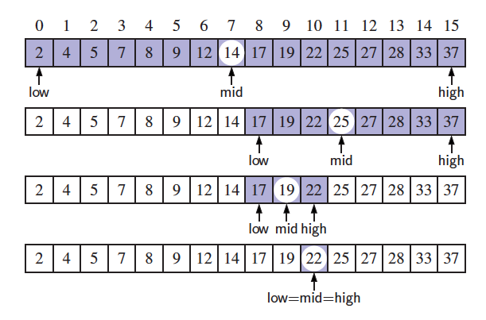
Visualizing Binary Search
We consider three cases:
If the target equals data[mid], then we have found the target.
If target < data[mid], then we recur on the first half of the sequence.
If target > data[mid], then we recur on the second half of the sequence.
Notes:
21

Slide 11
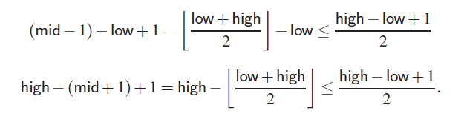
Analyzing Binary Search
Runs in O(log n) time.
The remaining portion of the list is of size high – low + 1
After one comparison, this becomes one of the following:
Thus, each recursive call divides the search region in half; hence, there can be at most log n levels

Slide 12
Linear Recursion
Test for base cases
Begin by testing for a set of base cases (there should be at least one).
Every possible chain of recursive calls must eventually reach a base case, and the handling of each base case should not use recursion.
Recur once
Perform a single recursive call
This step may have a test that decides which of several possible recursive calls to make, but it should ultimately make just one of these calls
Define each possible recursive call so that it makes progress towards a base case.

Slide 13
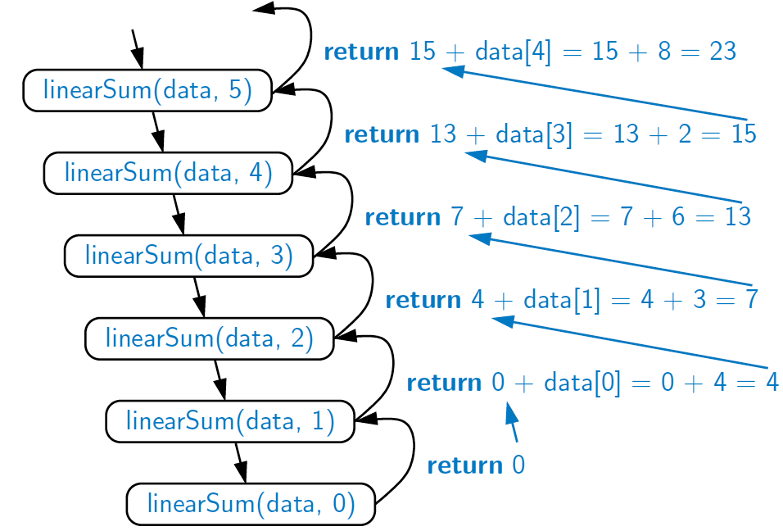
Example of Linear Recursion
Recursion trace of linearSum(data, 5) called on array data = [4, 3, 6, 2, 8]
Algorithm linearSum(A, n):
Input:
Array, A, of integers
Integer n such that
0 ≤ n ≤ |A|
Output:
Sum of the first n integers in A
if n = 0 then
return 0
else
return
linearSum(A, n - 1) + A[n - 1]

Slide 14
Reversing an Array
Algorithm reverseArray(A, i, j):
Input: An array A and nonnegative integer indices i and j
Output: The reversal of the elements in A starting at index i and ending at j
if i < j then
Swap A[i] and A[ j]
reverseArray(A, i + 1, j − 1)
return

Slide 15
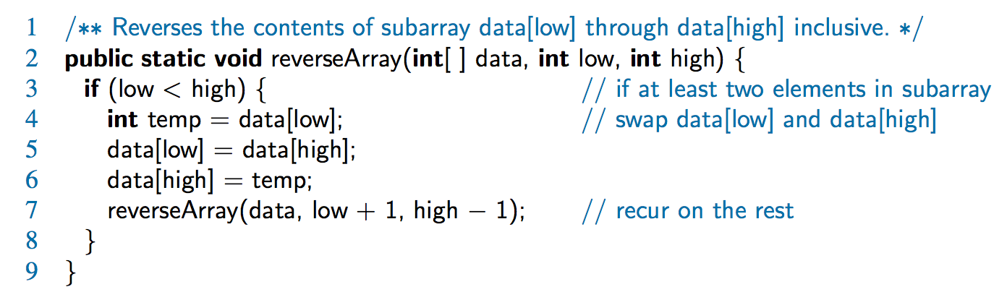
Defining Arguments for Recursion
In creating recursive methods, it is important to define the methods in ways that facilitate recursion.
This sometimes requires we define additional parameters that are passed to the method.
For example, we defined the array reversal method as reverseArray(A, i, j), not reverseArray(A)

Slide 16
Computing Powers
The power function, p(x,n)=x^{n}, can be defined recursively:
This leads to an power function that runs in O(n) time (for we make n recursive calls)
We can do better than this, however

Slide 17
Recursive Squaring
We can derive a more efficient linearly recursive algorithm by using repeated squaring:
For example,
2⁴ = 2^{(4/2)2} = (2^{4/2})² = (2²)² = 4² = 16
2⁵ = 2^{1+(4/2)2} = 2(2^{4/2})² = 2(2²)² = 2(4²) = 32
2⁶ = 2^{(6/ 2)2} = (2^{6/2})² = (2³)² = 8² = 64
2⁷ = 2^{1+(6/2)2} = 2(2^{6/2})² = 2(2³)² = 2(8²) = 128

Slide 18
Recursive Squaring Method
Algorithm Power(x, n):
Input: A number x and integer n = 0
Output: The value x^{n}
if n = 0 then
return 1
if n is odd then
y = Power(x, (n - 1)/ 2)
return x · y ·y
else
y = Power(x, n/ 2)
return y · y

Slide 19
Analysis
Algorithm Power(x, n):
Input: A number x and integer n = 0
Output: The value x^{n}
if n = 0 then
return 1
if n is odd then
y = Power(x, (n - 1)/ 2)
return x · y · y
else
y = Power(x, n/ 2)
return y · y
Each time we make a recursive call we halve the value of n; hence, we make log n recursive calls. That is, this method runs in O(log n) time.
It is important that we use a variable twice here rather than calling the method twice.

Slide 20
Tail Recursion
Tail recursion occurs when a linearly recursive method makes its recursive call as its last step.
The array reversal method is an example.
Such methods can be easily converted to non-recursive methods (which saves on some resources).
Example:
Algorithm IterativeReverseArray(A, i, j ):
Input: An array A and nonnegative integer indices i and j
Output: The reversal of the elements in A starting at index i and ending at j
while i < j do
Swap A[i ] and A[ j ]
i = i + 1
j = j - 1
return

Slide 21

Binary Recursion
Binary recursion occurs whenever there are two recursive calls for each non-base case.
Example from before: the drawInterval method for drawing ticks on an English ruler.

Slide 22
Another Binary Recursive Method
Problem: add all the numbers in an integer array A:
Algorithm BinarySum(A, i, n):
Input: An array A and integers i and n
Output: The sum of the n integers in A starting at index i
if n = 1 then
return A[i]
return BinarySum(A, i, n/ 2) + BinarySum(A, i + n/ 2, n/ 2)
Example trace:
0
,
8
0
,
4
4
,
4
0
,
2
2
,
2
4
,
2
6
,
2
0
,
1
1
,
1
2
,
1
3
,
1
4
,
1
5
,
1
6
,
1
7
,
1

Slide 23
Computing Fibonacci Numbers
Fibonacci numbers are defined recursively:
F₀ = 0
F₁ = 1
F_{i} = F_{i-1} ⁺ F_{i-2} for i > 1.
Recursive algorithm (first attempt):
Algorithm BinaryFib(k):
Input: Nonnegative integer k
Output: The kth Fibonacci number F_{k}
if k = 1 then
return k
else
return BinaryFib(k − 1) + BinaryFib(k − 2)

Slide 24
Analysis
Let n_{k} be the number of recursive calls by BinaryFib(k)
n₀ = 1
n₁ = 1
n₂ = n₁ + n₀ + 1 = 1 + 1 + 1 = 3
n₃ = n₂ + n₁ + 1 = 3 + 1 + 1 = 5
n₄ = n₃ + n₂ + 1 = 5 + 3 + 1 = 9
n₅ = n₄ + n₃ + 1 = 9 + 5 + 1 = 15
n₆ = n₅ + n₄ + 1 = 15 + 9 + 1 = 25
n₇ = n₆ + n₅ + 1 = 25 + 15 + 1 = 41
n₈ = n₇ + n₆ + 1 = 41 + 25 + 1 = 67.
Note that n_{k} at least doubles every other time
That is, n_{k} > 2^{k/2}. It is exponential!

Slide 25
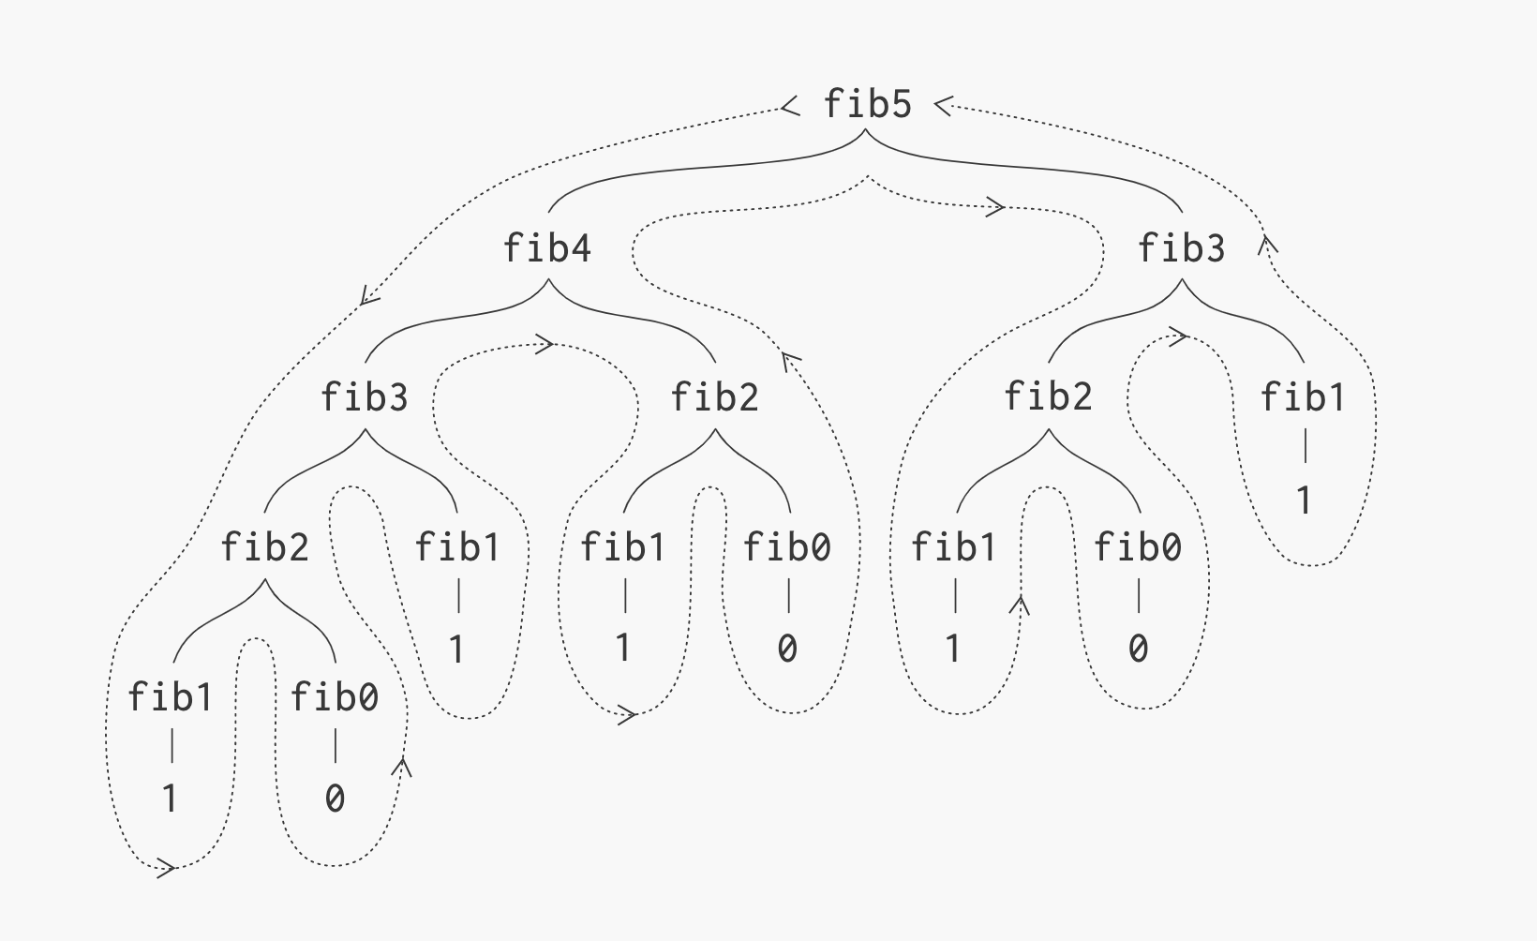

Slide 26
A Better Fibonacci Algorithm
Use linear recursion instead
Algorithm LinearFibonacci(k):
Input: A nonnegative integer k
Output: Pair of Fibonacci numbers (F_{k} , F_{k−1})
if k = 1 then
return (k, 0)
else
(i, j) = LinearFibonacci(k − 1)
return (i +j, i)
LinearFibonacci makes k−1 recursive calls

Slide 27
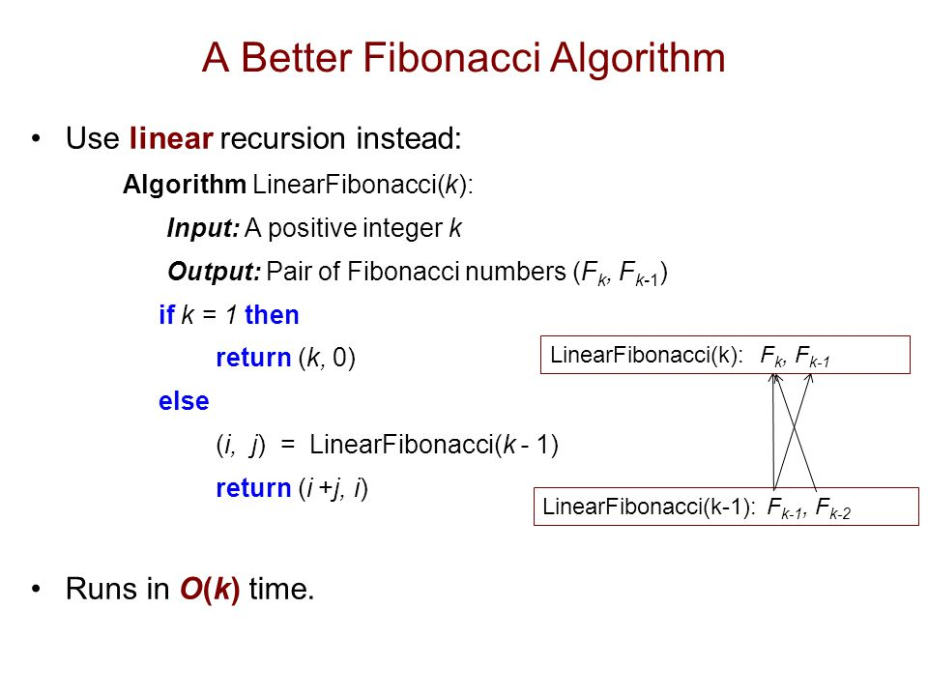

Slide 28
Multiple Recursion
Motivating example:
summation puzzles
pot + pan = bib
dog + cat = pig
boy + girl = baby
Multiple recursion:
makes potentially many recursive calls
not just one or two

Slide 29
Algorithm for Multiple Recursion
Algorithm PuzzleSolve(k,S,U):
Input: Integer k, sequence S, and set U (universe of elements to test)
Output: Enumeration of all k-length extensions to S using elements in U without repetitions
for all e in U do
Remove e from U {e is now being used}
Add e to the end of S
if k = 1 then
Test whether S is a configuration that solves the puzzle
if S solves the puzzle then
return “Solution found: ” S
else
PuzzleSolve(k - 1, S,U)
Add e back to U {e is now unused}
Remove e from the end of S

Slide 30
Example
Slide by Matt Stallmann included with permission.
cbb + ba = abc
a,b,c stand for 7,8,9; not necessarily in that order
799 + 98 = 897
[] {a,b,c}
[a] {b,c}
a=7
[b] {a,c}
b=7
[c] {a,b}
c=7
[ab] {c}
a=7,b=8
c=9
[ac] {b}
a=7,c=8
b=9
[ca] {b}
c=7,a=8
b=9
[cb] {a}
c=7,b=8
a=9
[ba] {c}
b=7,a=8
c=9
[bc] {a}
b=7,c=8
a=9
might be able to
stop sooner

Slide 31
Visualizing PuzzleSolve
Initial call
PuzzleSolve
(
3
,
()
,{
a
,
b
,
c
}
)
PuzzleSolve
(
2
,
b
,{
a
,
c
}
)
PuzzleSolve
(
2
,
c
,{
a
,
b
PuzzleSolve
}
)
(
2
,
a
,{
b
,
c
}
)
PuzzleSolve
(
1
,
ab
,{
c
}
)
PuzzleSolve
(
1
,
ba
,{
c
}
)
PuzzleSolve
(
1
,
ca
,{
b
}
)
abc
bac
cab
PuzzleSolve
(
1
,
ac
,{
b
}
)
PuzzleSolve
(
1
,
bc
,{
a
}
)
PuzzleSolve
(
1
,
cb
,{
a
}
)
acb
bca
cba

