Slide 1
Presentation for use with the textbook Data Structures and Algorithms in Java, 6th edition, by M. T. Goodrich, R. Tamassia, and M. H. Goldwasser, Wiley, 2014
Queues
© 2014 Goodrich, Tamassia, Goldwasser
Queues
1
Notes:
Queues
1
Stores, theaters, reservation centers, and other similar services typically process customer requests according to the FIFO principle.
30.10.2023

Slide 2
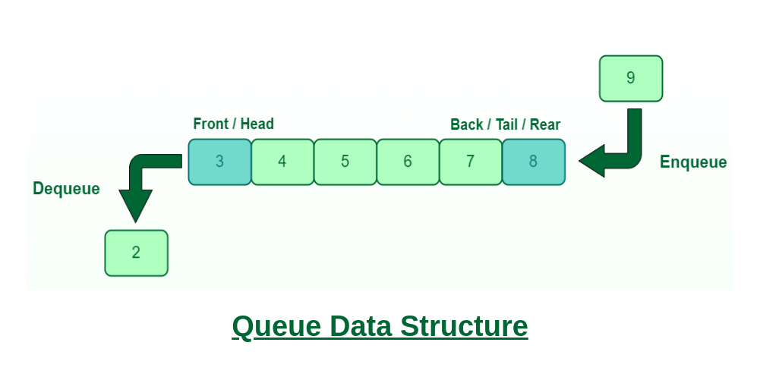
FIFO=FIRST IN-FIRST OUT
The Queue ADT
The Queue ADT stores arbitrary objects
Insertions and deletions follow the first-in first-out scheme
Insertions are at the rear of the queue and removals are at the front of the queue
Main queue operations:
enqueue(object): inserts an element at the end of the queue
object dequeue(): removes and returns the element at the front of the queue
Auxiliary queue operations:
object first(): returns the element at the front without removing it
integer size(): returns the number of elements stored
boolean isEmpty(): indicates whether no elements are stored
Boundary cases:
Attempting the execution of dequeue or first on an empty queue returns null
© 2014 Goodrich, Tamassia, Goldwasser
Queues
2
Notes:
Queues
2
a queue is a collection of objects that are inserted and removed according to the first-in, first-out (FIFO) principle.
elements can be inserted at any time, but only the element that has been in the queue the longest can be next removed.
30.10.2023

Slide 3
FIFO:FIRST IN-FIRST OUT
Example
Operation Output Q
enqueue(5) – (5)
enqueue(3) – (5, 3)
dequeue() 5 (3)
enqueue(7) – (3, 7)
dequeue() 3 (7)
first() 7 (7)
dequeue() 7 ()
dequeue() null ()
isEmpty() true ()
enqueue(9) – (9)
enqueue(7) – (9, 7)
size() 2 (9, 7)
enqueue(3) – (9, 7, 3)
enqueue(5) – (9, 7, 3, 5)
dequeue() 9 (7, 3, 5)
© 2014 Goodrich, Tamassia, Goldwasser
Queues
3

Slide 4
Applications of Queues
Direct applications
Waiting lists, bureaucracy
Access to shared resources (e.g., printer)
Multiprogramming
Indirect applications
Auxiliary data structure for algorithms
Component of other data structures
© 2014 Goodrich, Tamassia, Goldwasser
Queues
4
Notes:
A queue would therefore be a logical choice for a data structure to handle calls to a customer service center, or a wait-list at a restaurant. FIFO queues are also used by many computing devices, such as a networked printer, or a Web server responding to requests.
Real-world examples of a first-in, first-out queue. (a) People waiting in line to purchase tickets; (b) phone calls being routed to a customer service center.
Process scheduling is one of the most important functions of an operating system that supports multiprogramming. This function is heavily dependent on queues. There are three types of queues that are used in process scheduling: Job Queue, Ready Queue, Device Queue

Slide 5
Array-based Queue
Use an array of size N in a circular fashion
Two variables keep track of the front and size
f index of the front element
sz number of stored elements
When the queue has fewer than N elements, array location r = (f + sz) mod N is the first empty slot past the rear of the queue
normal configuration
Q
0
1
2
f
r
wrapped-around configuration
Q
0
1
2
r
f
© 2014 Goodrich, Tamassia, Goldwasser
Queues
5
Notes:
One strategy is to execute a loop to shift all other elements of the queue one cell to the left, so that the front of the queue is again aligned with cell 0 of the array. Unfortunately, the use of such a loop would result in an O(n) running time for the dequeue method.
Circular array

Slide 6
Queue Operations
We use the modulo operator (remainder of division)
Algorithm size()
return sz
Algorithm isEmpty()
return (sz == 0)
Q
0
1
2
f
r
Q
0
1
2
r
f
© 2014 Goodrich, Tamassia, Goldwasser
Queues
6

Slide 7
Queue Operations (cont.)
Algorithm enqueue(o)
if size() = N – 1 then
throw IllegalStateException
else
r ← (f + sz) mod N
Q[r] ← o
sz ← (sz + 1)
Operation enqueue throws an exception if the array is full
This exception is implementation-dependent
Q
0
1
2
f
r
Q
0
1
2
r
f
© 2014 Goodrich, Tamassia, Goldwasser
Queues
7

Slide 8
Queue Operations (cont.)
Note that operation dequeue returns null if the queue is empty
Algorithm dequeue()
if isEmpty() then
return null
else
o ← Q[f]
f ← (f + 1) mod N
sz ← (sz − 1)
return o
Q
0
1
2
f
r
Q
0
1
2
r
f
© 2014 Goodrich, Tamassia, Goldwasser
Queues
8
Notes:
We will replace a dequeued element in the array with a null reference, and maintain an explicit variable f to represent the index of the element that is currently at the front of the queue. Such an algorithm for dequeue would run in O(1) time.

Slide 9
Queue Interface in Java
Java interface corresponding to our Queue ADT
Assumes that first() and dequeue() return null if queue is empty
public interface Queue<E> {
int size();
boolean isEmpty();
E first();
void enqueue(E e);
E dequeue(); }
© 2014 Goodrich, Tamassia, Goldwasser
Queues
9

Slide 10
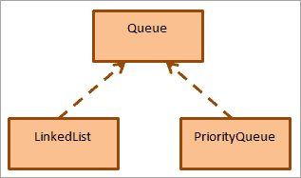
Queue Interface in Java
The general definition of the Queue interface is:
public interface Queue<E> extends Collection<E>
As the Queue is an interface, it cannot be instantiated. We need some concrete classes to implement the functionality of the Queue interface. Two classes implement the Queue interface i.e. LinkedList and PriorityQueue.
Notes:
Source: https://www.softwaretestinghelp.com/java-queue-interface/

Slide 11
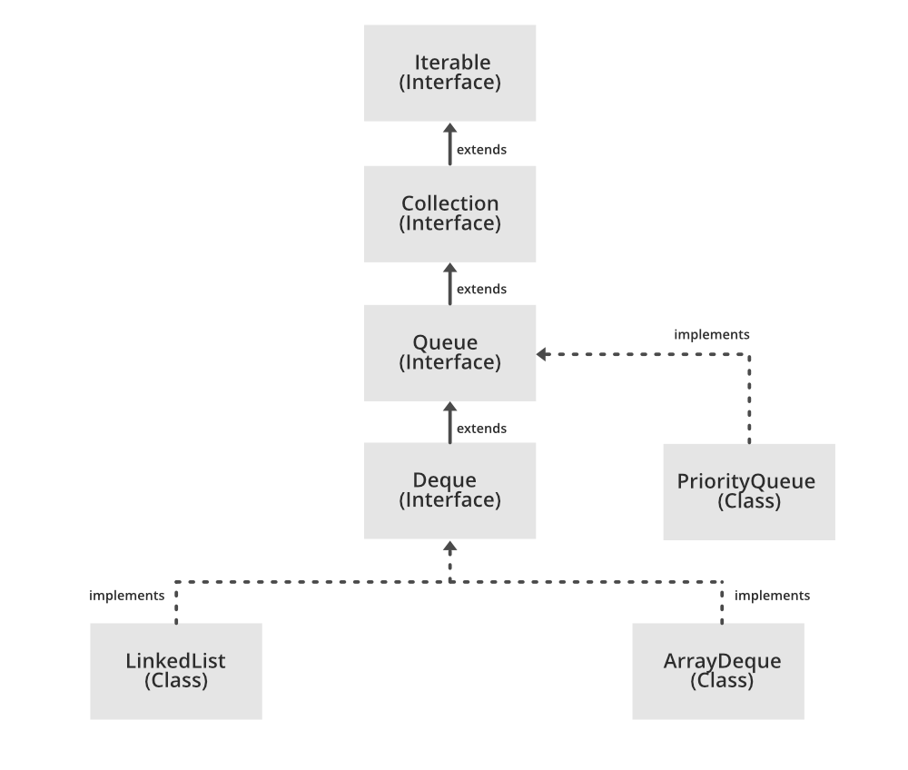
Queue Interface in Java
Notes:
Source: https://www.geeksforgeeks.org/queue-interface-java/

Slide 12
How to Use Queue in Java
How To Use A Queue In Java?
To use a queue in Java, we must first import the queue interface as follows:
import java.util.queue; Or import java.util.*;
Once this is imported, we can create a queue as shown below:
Queue<String> str_queue = new LinkedList<> ();
As Queue is an interface, we use a LinkedList class that implements the Queue interface to create a queue object.
Similarly, we can create a queue with other concrete classes.
Queue<String> str_pqueue = new PriorityQueue<> ();
Queue<Integer> int_queue = new ArrayDeque<> ();

Slide 13
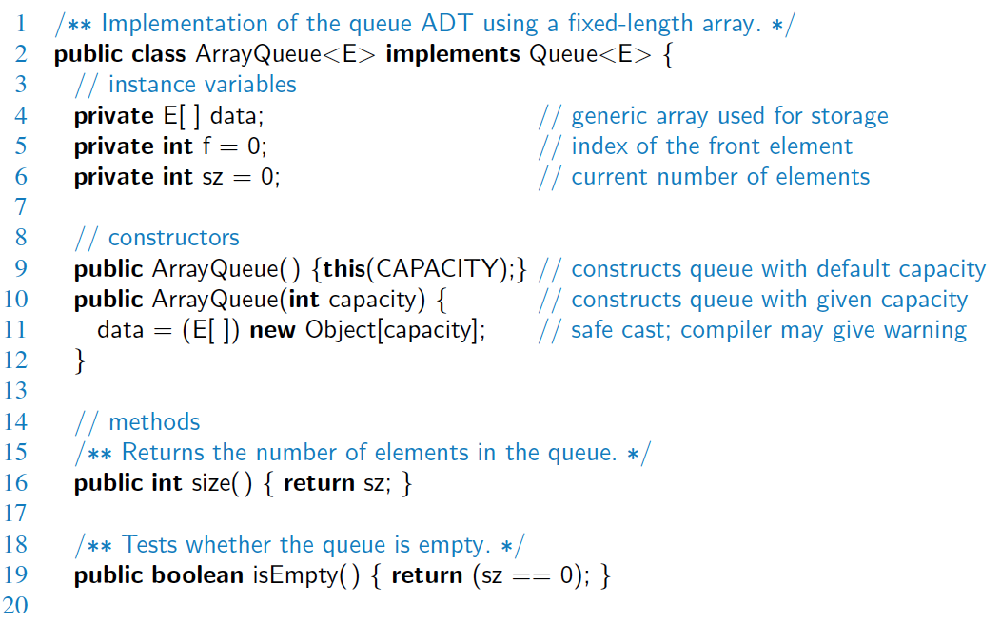
Array-based Implementation
© 2014 Goodrich, Tamassia, Goldwasser
Queues
13
Notes:
private static final int CAPACITY= 10;

Slide 14
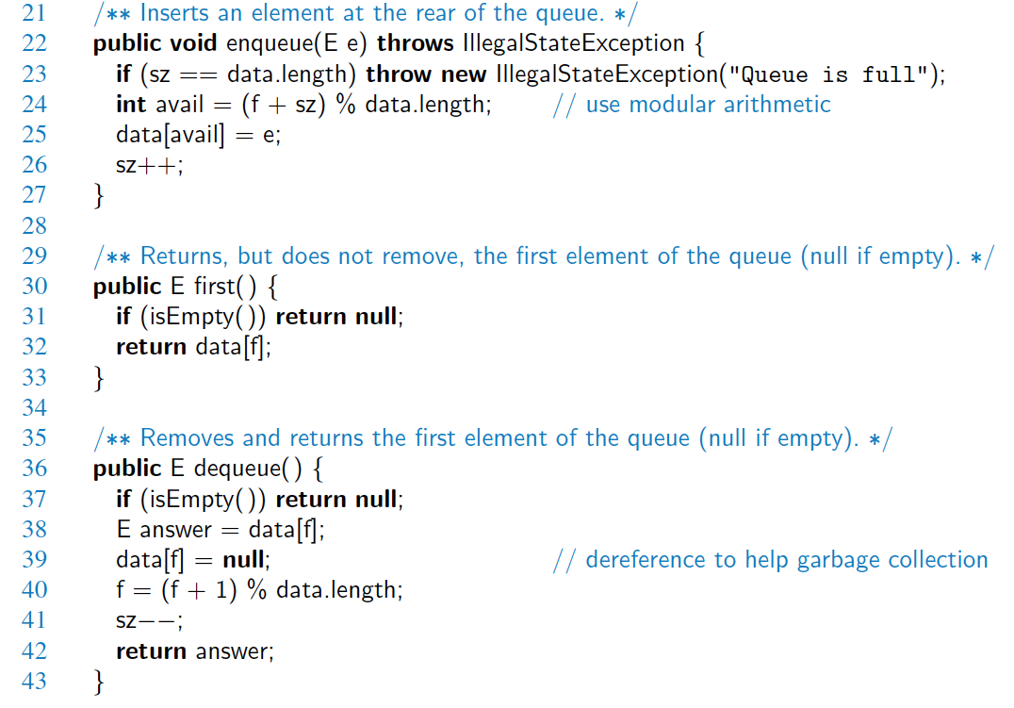
Array-based Implementation (2)
O(1)
O(1)
O(1)
© 2014 Goodrich, Tamassia, Goldwasser
Queues
14

Slide 15
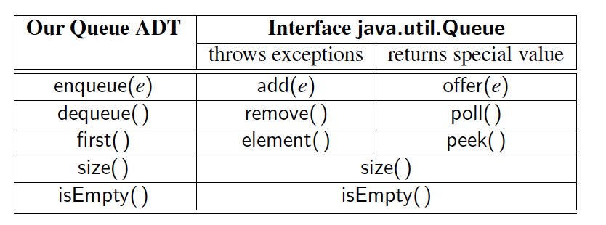
Comparison to java.util.Queue
Our Queue methods and corresponding methods of java.util.Queue:
© 2014 Goodrich, Tamassia, Goldwasser
Queues
15

Slide 16
Application: Round Robin Schedulers
We can implement a round robin scheduler using a queue Q by repeatedly performing the following steps:
e = Q.dequeue()
Service element e
Q.enqueue(e)
Queue
Dequeue
Enqueue
Shared Service
© 2014 Goodrich, Tamassia, Goldwasser
Queues
16
Notes:
What is a Round Robin scheduler???
A circular queue is an excellent abstraction for applications in which elements are cyclically arranged, such as for multiplayer, turn-based games, or round-robin scheduling of computing processes.
As the term is generally used, time slices are assigned to each process in equal portions and in circular order, handling all processes without priority

Slide 17
Linked List-based Queue
Let’s discuss it!
© 2014 Goodrich, Tamassia, Goldwasser
Queues
17
Notes:
LINKED QUEUE
each node stores a next reference, in addition to the element reference, a linked list uses more space per element than a properly sized array of references.
For a linked list, an insertion includes the instantiation and initialization of a new node, relinking an existing node to the new node, and incrementing the size counter. In practice, this makes the linked-list method more expensive than the array-based method.

Slide 18
Reminder: Singly Linked List
A singly linked list is a concrete data structure consisting of a sequence of nodes, starting from a head pointer
Each node stores
element
link to the next node
next
element
node
head
∅
A
B
C
D
Notes:
In a singly linked list, each node stores a reference to an object that is an element of the sequence, as well as a reference to the next node of the list
The tail of a list can be found by traversing the linked list— starting at the head and moving from one node to another by following each node’s next reference.

Slide 19
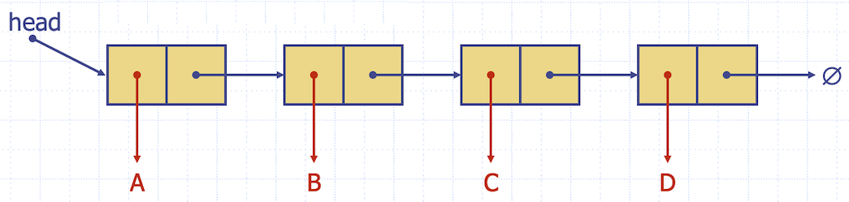
Linked List-based Queue
Enqueue: Adding the node at the end just before null->O(n)
Dequeue: Removing the node at the head –>O(1)
Size: size of the sll ->O(1)
IsEmpty: if head points to null or not O(1)
Notes:
LINKED QUEUE
each node stores a next reference, in addition to the element reference, a linked list uses more space per element than a properly sized array of references.
For a linked list, an insertion includes the instantiation and initialization of a new node, relinking an existing node to the new node, and incrementing the size counter. In practice, this makes the linked-list method more expensive than the array-based method.

Slide 20
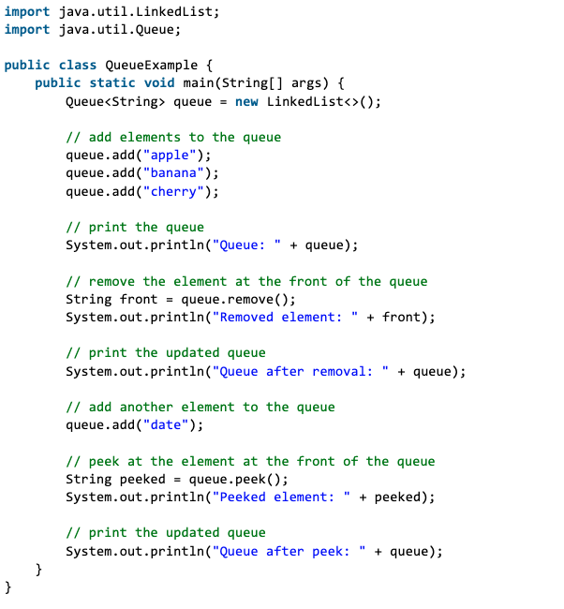
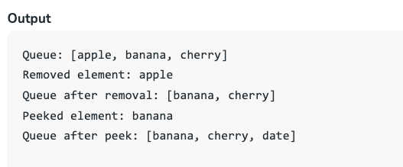
Java example
Notes:
Source: https://www.geeksforgeeks.org/queue-interface-java/

Slide 21
Presentation for use with the textbook Data Structures and Algorithms in Java, 6th edition, by M. T. Goodrich, R. Tamassia, and M. H. Goldwasser, Wiley, 2014
Double-Ended Queues (Deques)
© 2014 Goodrich, Tamassia, Goldwasser
Queues
21
Notes:
Queues
21
30.10.2023

Slide 22
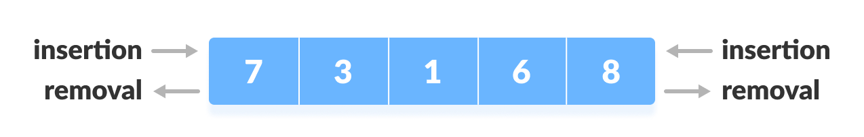
The Deque ADT
The Deque ADT stores arbitrary objects
More general than both the stack and the queue ADTs
Insertions and deletions at both the front and the back
Main queue operations:
addFirst(e): inserts an element at the front of the deque
addLast(e): inserts an element at the back of the deque
e removeFirst(): removes and returns the first element of the deque
e removeLast(): removes and returns the last element of the deque
Auxiliary queue operations:
e first(): returns the first element of the deque without removing it
e last(): returns the last element of the deque without removing it
int size(): returns the number of elements in the deque
bool isEmpty(): returns a boolean indicating whether the deque is empty
Boundary cases:
Attempting the execution of removeFirst, removeLast, first, or last on an empty deque returns null
© 2014 Goodrich, Tamassia, Goldwasser
Queues
22
Notes:
Queues
22
A double-ended queue, or deque is a queue-like data structure that supports insertion and deletion at both the front and the back of the queue.
30.10.2023

Slide 23
Example
© 2014 Goodrich, Tamassia, Goldwasser
Queues
23

Slide 24
Array-based Deque
Use an array of size N in a circular fashion
Two variables keep track of the front and size
f index of the front element
sz number of stored elements
When the queue has fewer than N elements, array location r = (f + sz) mod N is the first empty slot past the rear of the queue
When removing first element, array location updated as f = (f+1) mod N
When inserting at the front it is a mistake to assign f = (f-1) mod N because it results in -1 in Java
Instead, assign f = (f-1+N) mod N to assure for a positive value
© 2014 Goodrich, Tamassia, Goldwasser
Queues
24
Notes:
When removing the first element, the front index is advanced in circular fashion, with the assignment f = (f+1) % N. But when an element is inserted at the front, the first index must effectively be decremented in circular fashion and it is a mistake to assign f = (f−1) % N. The problem is that when f is 0, the goal should be to “decrement” it to the other end of the array, and thus to index N−1. However, a calculation such as −1 % 10 in Java results in the value −1. A standard way to decrement an index circularly is instead to assign f = (f−1+N) % N. Adding the additional term of N before the modulus is calculated assures that the result is a positive value.

Slide 25
Linked List-based Deque
Let’s discuss it!
© 2014 Goodrich, Tamassia, Goldwasser
Queues
25
Notes:
Because the deque requires insertion and removal at both ends, a doubly linked list is most appropriate for implementing all operations efficiently.

Slide 26
Reminder:Doubly Linked List
A doubly linked list can be traversed forward and backward
Nodes store:
element
link to the previous node
link to the next node
Special trailer and header nodes
prev
next
element
node
header
nodes/positions
trailer
elements
Notes:
To provide greater symmetry, we define a linked list in which each node keeps an explicit reference to the node before it and a reference to the node after it. Such a structure is known as a doubly linked list.

Slide 27
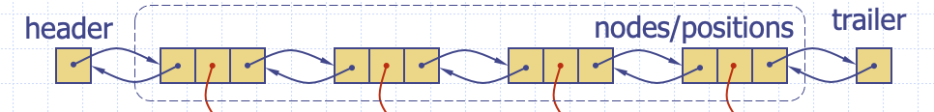
Linked List-based Deque
Main queue operations:
addFirst(e): inserts an element at the header
addLast(e): inserts an element at the trailer
e removeFirst(): removes and returns the element at the header
e removeLast(): removes and returns the element at the trailer
Auxiliary queue operations:
e first(): returns the element at the header without removing it
e last(): returns the element at the trailer without removing it
int size(): returns the number of elements in the deque
bool isEmpty(): returns a boolean indicating whether header shows null
O(1)
O(1)

