Slide 1
Stacks
Presentation for use with the textbook Data Structures and Algorithms in Java, 6th edition, by M. T. Goodrich, R. Tamassia, and M. H. Goldwasser, Wiley, 2014

Slide 2
Abstract Data Types (ADTs)
An abstract data type (ADT) is an abstraction of a data structure
An ADT specifies:
Data stored
Operations on the data
Error conditions associated with operations
Example: ADT modeling a simple stock trading system
The data stored are buy/sell orders
The operations supported are
order buy(stock, shares, price)
order sell(stock, shares, price)
void cancel(order)
Error conditions:
Buy/sell a nonexistent stock
Cancel a nonexistent order
Notes:
The notion of abstraction is to distill a complicated system down to its most fundamental parts.
Applying the abstraction paradigm to the design of data structures gives rise to abstract data types (ADTs).
An ADT is a mathematical model of a data structure that specifies the type of data stored, the operations supported on them, and the types of parameters of the operations.
An ADT specifies what each operation does, but not how it does it. In Java, an ADT can be expressed by an interface, which is simply a list of method declarations, where each method has an empty body.

Slide 3
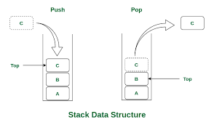
The Stack ADT
LIFO: last-in first-out
The Stack ADT stores arbitrary objects
Insertions and deletions follow the last-in first-out (LIFO) scheme
Main stack operations:
push(object): inserts an element
object pop(): removes and returns the last inserted element
Auxiliary stack operations:
object top(): returns the last inserted element without removing it
integer size(): returns the number of elements stored
boolean isEmpty(): indicates whether no elements are stored
Notes:
A stack is a collection of objects that are inserted and removed according to the last-in, first-out (LIFO) principle.
The name “stack” is derived from the metaphor of a stack of plates in a spring-loaded, cafeteria plate dispenser. You can think of it as a napkin dispenser.

Slide 4
Stack Interface in Java
Java interface corresponding to our Stack ADT
Assumes null is returned from top() and pop() when stack is empty
Different from the built-in Java class java.util.Stack
public interface Stack<E> {
int size();
boolean isEmpty();
E top();
void push(E element);
E pop(); }
Notes:
Because of the importance of the stack ADT, Java has included, since its original version, a concrete class named java.util.Stack that implements the LIFO semantics of a stack. However, Java’s Stack class remains only for historic reasons, and its interface is not consistent with most other data structures in the Java library. In fact, the current documentation for the Stack class recommends that it not be used, as LIFO functionality (and more) is provided by a more general data structure known as a double-ended queue

Slide 5
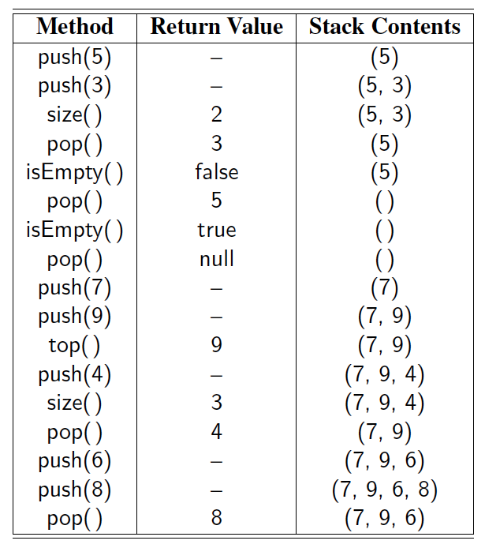
Example

Slide 6
Exceptions vs. Returning Null
Attempting the execution of an operation of an ADT may sometimes cause an error condition
Java supports a general abstraction for errors, called exception
An exception is said to be “thrown” by an operation that cannot be properly executed
In our Stack ADT, we do not use exceptions
Instead, we allow operations pop and top to be performed even if the stack is empty
For an empty stack, pop and top simply return null

Slide 7
Applications of Stacks
Direct applications
Page-visited history in a Web browser
Undo sequence in a text editor
Chain of method calls in the Java Virtual Machine
Indirect applications
Auxiliary data structure for algorithms
Component of other data structures
Notes:
Internet Web browsers store the addresses of recently visited sites on a stack. Each time a user visits a new site, that site’s address is “pushed” onto the stack of addresses. The browser then allows the user to “pop” back to previously visited sites using the “back” button.
Text editors usually provide an “undo” mechanism that cancels recent editing operations and reverts to former states of a document. This undo operation can be accomplished by keeping text changes in a stack.

Slide 8
Method Stack in the JVM
The Java Virtual Machine (JVM) keeps track of the chain of active methods with a stack
When a method is called, the JVM pushes on the stack a frame containing
Local variables and return value
Program counter, keeping track of the statement being executed
When a method ends, its frame is popped from the stack and control is passed to the method on top of the stack
Allows for recursion
main() { int i = 5; foo(i); }
foo(int j) { int k; k = j+1; bar(k); }
bar(int m) { … }
bar
PC = 1 m = 6
foo
PC = 3 j = 5
k = 6
main
PC = 2 i = 5

Slide 9
Array-based Stack
A simple way of implementing the Stack ADT using an array
We add elements from left to right
A variable keeps track of the index of the top element
Algorithm size()
return t + 1
Algorithm pop()
if isEmpty() then
return null
else
t ← t − 1
return S[t + 1]
…
S
0
1
2
t

Slide 10
Array-based Stack (cont.)
The array storing the stack elements may become full
A push operation will then throw a FullStackException
Limitation of the array-based implementation
Not intrinsic to the Stack ADT
Algorithm push(o)
if t = S.length − 1 then
throw FullStackException
else
t ← t + 1
S[t] ← o
…
S
0
1
2
t

Slide 11
Performance and Limitations
Performance
Let n be the number of elements in the stack
The space used is O(n)
Each operation runs in time O(1)
Limitations
The maximum size of the stack must be defined a priori and cannot be changed
Trying to push a new element into a full stack causes an implementation-specific exception
Notes:
If the application needs much less space than the reserved capacity, memory is wasted.
even with its simplicity and efficiency, the array-based stack implementation is not necessarily ideal.

Slide 12
Array-based Stack in Java
public class ArrayStack<E> implements Stack<E> {
// holds the stack elements private E[ ] S;
// index to top element private int top = -1;
// constructor public ArrayStack(int capacity) { S = (E[ ]) new Object[capacity]); }
public E pop() { if isEmpty() return null; E temp = S[top]; // facilitate garbage collection: S[top] = null; top = top – 1; return temp; }
… (other methods of Stack interface)
Notes:
Our reason for returning the cell to a null reference is to assist Java’s garbage collection mechanism, which searches memory for objects that are no longer actively referenced and reclaims their space for future use.

Slide 13
Example Use in Java
public class Tester {
// … other methods public intReverse(Integer a[]) { Stack<Integer> s; s = new ArrayStack<Integer>();
… (code to reverse array a) … }
public floatReverse(Float f[]) { Stack<Float> s; s = new ArrayStack<Float>();
… (code to reverse array f) … }

Slide 14
Parentheses Matching
Each “(”, “{”, or “[” must be paired with a matching “)”, “}”, or “]”
correct: ( )(( )){([( )])}
correct: ()( )(( )){([( )])}
incorrect: )(( )){([( )])}
incorrect: ({[ ])}
incorrect: (
Notes:
Each opening symbol must match its corresponding closing symbol. For example, a left bracket, “[,”must match a corresponding right bracket, “],”

Slide 15
Parenthesis Matching (Java)
public static boolean isMatched(String expression) {
final String opening = "({["; // opening delimiters
final String closing = ")}]"; // respective closing delimiters
Stack<Character> buffer = new LinkedStack<>( );
for (char c : expression.toCharArray( )) {
if (opening.indexOf(c) != −1) // this is a left delimiter
buffer.push(c);
else if (closing.indexOf(c) != −1) { // this is a right delimiter
if (buffer.isEmpty( )) // nothing to match with
return false;
if (closing.indexOf(c) != opening.indexOf(buffer.pop( )))
return false; // mismatched delimiter
}
}
return buffer.isEmpty( ); // were all opening delimiters matched?
}
Notes:
Method indexOf returns the index at which a given character is first found in a string (or −1 if the character is not found).

Slide 16
HTML Tag Matching
For fully-correct HTML, each <name> should pair with a matching </name>
<body>
<center>
<h1> The Little Boat </h1>
</center>
<p> The storm tossed the little
boat like a cheap sneaker in an
old washing machine. The three
drunken fishermen were used to
such treatment, of course, but
not the tree salesman, who even as
a stowaway now felt that he
had overpaid for the voyage. </p>
<ol>
<li> Will the salesman die? </li>
<li> What color is the boat? </li>
<li> And what about Naomi? </li>
</ol>
</body>
The Little Boat
The storm tossed the little boat
like a cheap sneaker in an old
washing machine. The three
drunken fishermen were used to
such treatment, of course, but not
the tree salesman, who even as
a stowaway now felt that he had
overpaid for the voyage.
1. Will the salesman die?
2. What color is the boat?
3. And what about Naomi?

Slide 17
HTML Tag Matching (Java)
public static boolean isHTMLMatched(String html) {
Stack<String> buffer = new LinkedStack<>( );
int j = html.indexOf('<'); // find first ’<’ character (if any)
while (j != −1) {
int k = html.indexOf('>', j+1); // find next ’>’ character
if (k == −1)
return false; // invalid tag
String tag = html.substring(j+1, k); // strip away < >
if (!tag.startsWith("/")) // this is an opening tag
buffer.push(tag);
else { // this is a closing tag
if (buffer.isEmpty( ))
return false; // no tag to match
if (!tag.substring(1).equals(buffer.pop( )))
return false; // mismatched tag
}
j = html.indexOf('<', k+1); // find next ’<’ character (if any)
}
return buffer.isEmpty( ); // were all opening tags matched?
}
Notes:
We make a left-to-right pass through the raw string, using index j to track our progress. The indexOf method of the String class, which optionally accepts a
starting index as a second parameter, locates the '<' and '>' characters that define the tags. Method substring, also of the String class, returns the substring starting
at a given index and optionally ending right before another given index. Opening tags are pushed onto the stack, and matched against closing tags as they are popped
from the stack

Slide 18
Evaluating Arithmetic Expressions
Slide by Matt Stallmann included with permission.
14 – 3 * 2 + 7 = (14 – (3 * 2) ) + 7
Operator precedence
* has precedence over +/–
Associativity
operators of the same precedence group
evaluated from left to right
Example: (x – y) + z rather than x – (y + z)
Idea: push each operator on the stack, but first pop and perform higher and equal precedence operations.

Slide 19
Algorithm for Evaluating Expressions
Slide by Matt Stallmann included with permission.
Two stacks:
opStk holds operators
valStk holds values
Use $ as special “end of input” token with lowest precedence
Algorithm doOp()
x ← valStk.pop();
y ← valStk.pop();
op ← opStk.pop();
valStk.push( y op x )
Algorithm repeatOps( refOp ):
while ( valStk.size() > 1 ∧
prec(refOp) ≤ prec(opStk.top())
doOp()
Algorithm EvalExp()
Input: a stream of tokens representing an arithmetic expression (with numbers)
Output: the value of the expression
while there’s another token z
if isNumber(z) then
valStk.push(z)
else
repeatOps(z);
opStk.push(z)
repeatOps($);
return valStk.top()

Slide 20
Algorithm on an Example Expression
Slide by Matt Stallmann included with permission.
Operator ≤ has lower precedence than +/–
14 ≤ 4 – 3 * 2 + 7
4
–
14
≤
3
*
$
$
4
–
7
$
14
≤
F
+
-2
+
5
+
14
≤
14
≤
2
2
3
*
3
*
6
4
–
4
–
4
–
-2
+
14
≤
14
≤
14
≤
14
≤

Slide 21
Computing Spans
Using a stack as an auxiliary data structure in an algorithm
Given an array X, the span S[i] of X[i] is the maximum number of consecutive elements X[j] immediately preceding X[i] and such that X[j] ≤ X[i]
Spans have applications to financial analysis
E.g., stock at 52-week high
X
6 | 3 | 4 | 5 | 2
1 | 1 | 2 | 3 | 1
S

Slide 22
Quadratic Algorithm
Algorithm spans1(X, n)
Input array X of n integers
Output array S of spans of X #
S ← new array of n integers n
for i ← 0 to n − 1 do n
s ← 1 n
while s ≤ i ∧ X[i − s] ≤ X[i] 1 + 2 + …+ (n − 1)
s ← s + 1 1 + 2 + …+ (n − 1)
S[i] ← s n
return S 1
Algorithm spans1 runs in O(n²) time

Slide 23
Computing Spans with a Stack
We keep in a stack the indices of the elements visible when “looking back”
We scan the array from left to right
Let i be the current index
We pop indices from the stack until we find index j such that X[i] < X[j]
We set S[i] ← i − j
We push x onto the stack
Notes:
What is x?

Slide 24
Linear Time Algorithm
Each index of the array
Is pushed into the stack exactly once
Is popped from the stack at most once
The statements in the while-loop are executed at most n times
Algorithm spans2 runs in O(n) time
Algorithm spans2(X, n) #
S ← new array of n integers n
A ← new empty stack 1
for i ← 0 to n − 1 do n
while (¬A.isEmpty() ∧
X[A.top()] ≤ X[i] ) do n
A.pop() n
if A.isEmpty() then n
S[i] ← i + 1 n
else
S[i] ← i − A.top() n
A.push(i) n
return S 1

Slide 25
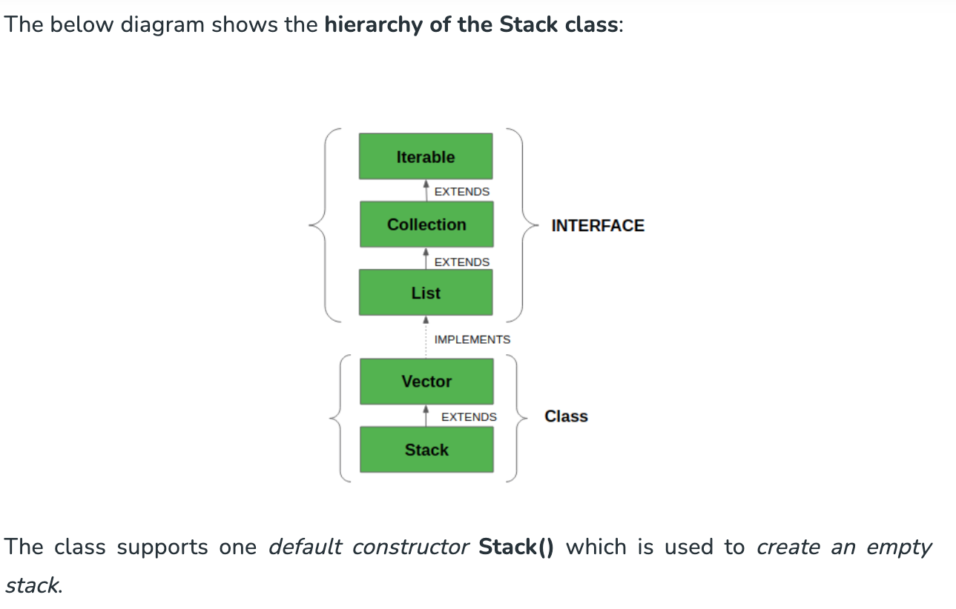
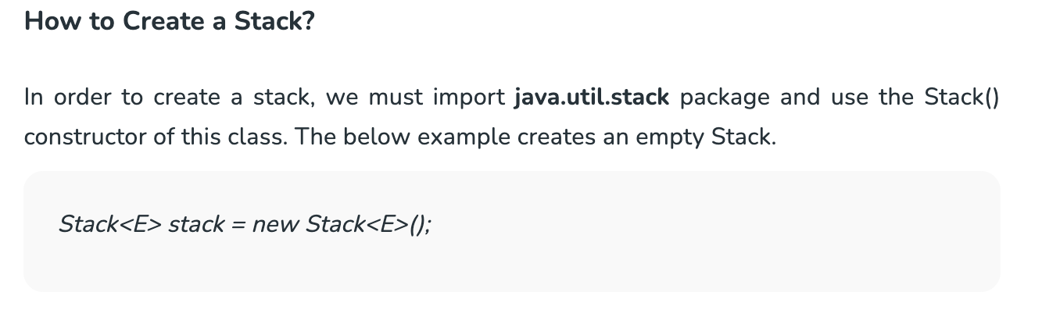
Stack Class in Java
Notes:
Resource: https://www.geeksforgeeks.org/stack-class-in-java/

Slide 26
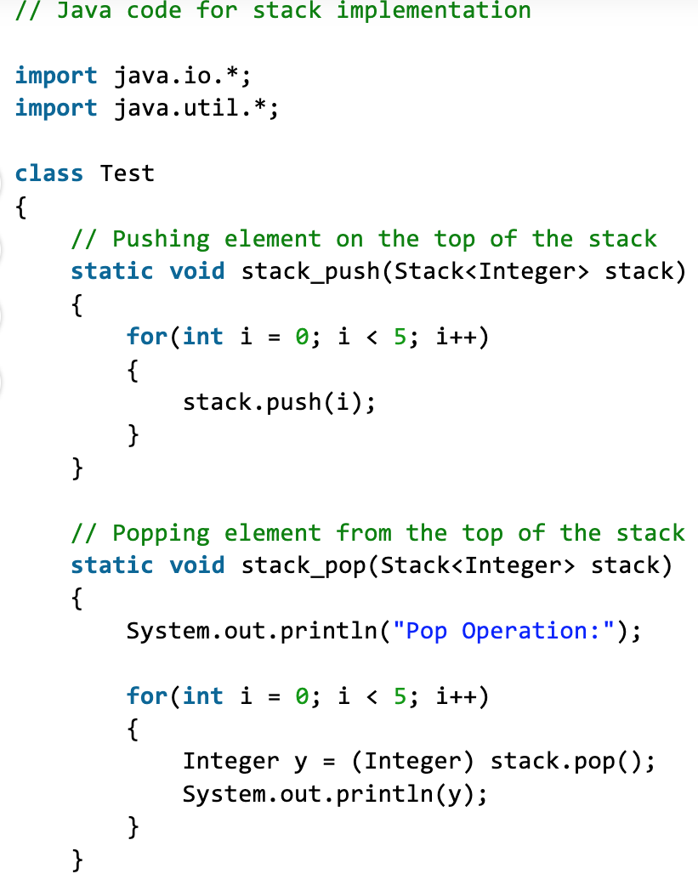
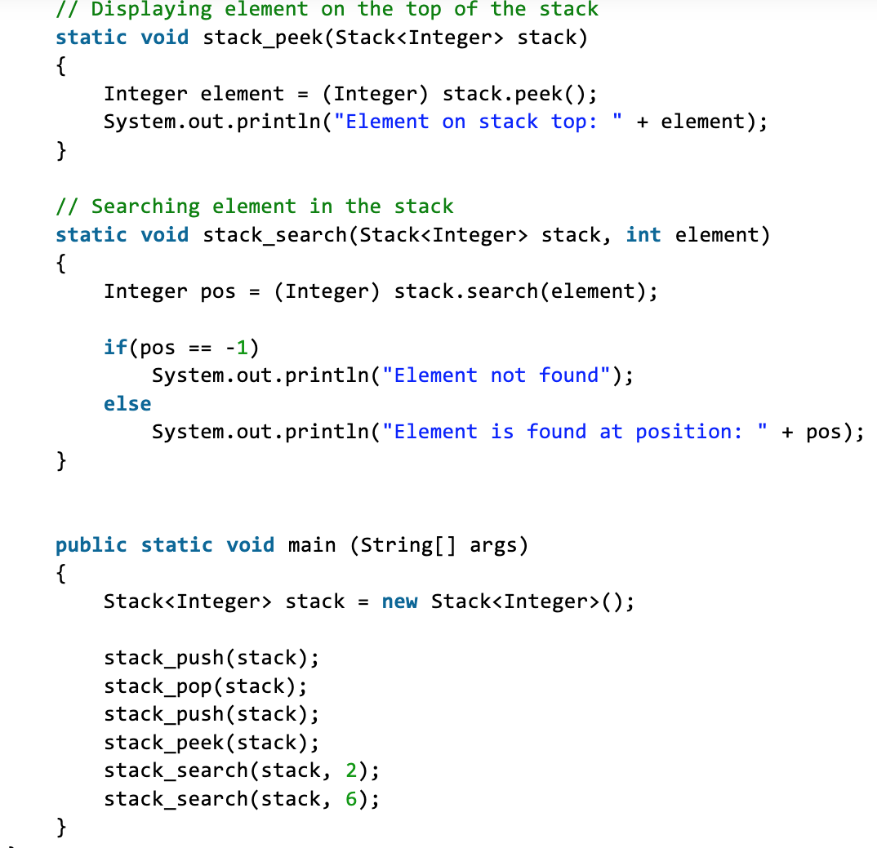
Stack in Java
Notes:
Resource: https://www.geeksforgeeks.org/stack-class-in-java/

