Slide 1
Priority Queues
Presentation for use with the textbook Data Structures and Algorithms in Java, 6th edition, by M. T. Goodrich, R. Tamassia, and M. H. Goldwasser, Wiley, 2014

Slide 2
Priority Queue ADT
A priority queue stores a collection of entries
Each entry is a pair (key, value)
Main methods of the Priority Queue ADT
insert(k, v) inserts an entry with key k and value v
removeMin() removes and returns the entry with smallest key, or null if the the priority queue is empty
Additional methods
min() returns, but does not remove, an entry with smallest key, or null if the the priority queue is empty
size(), isEmpty()
Applications:
Standby flyers
Auctions
Stock market
Notes:
suppose a certain flight is fully booked an hour prior to departure. Because of the possibility of cancellations, the airline maintains a queue of standby passengers hoping to get a seat. Although the priority of a standby passenger is influenced by the check-in time of that passenger, other considerations include the fare paid and frequent-flyer status. So it may be that an available seat is given to a passenger who has arrived later than another, if such a passenger is assigned a better priority by the airline agent.

Slide 3
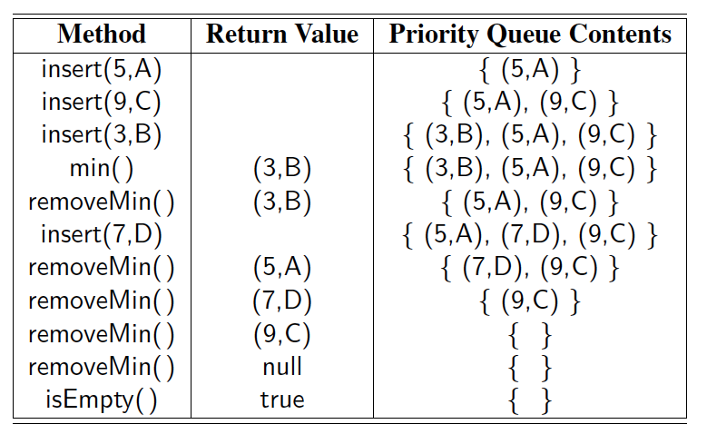
Example
A sequence of priority queue methods:

Slide 4
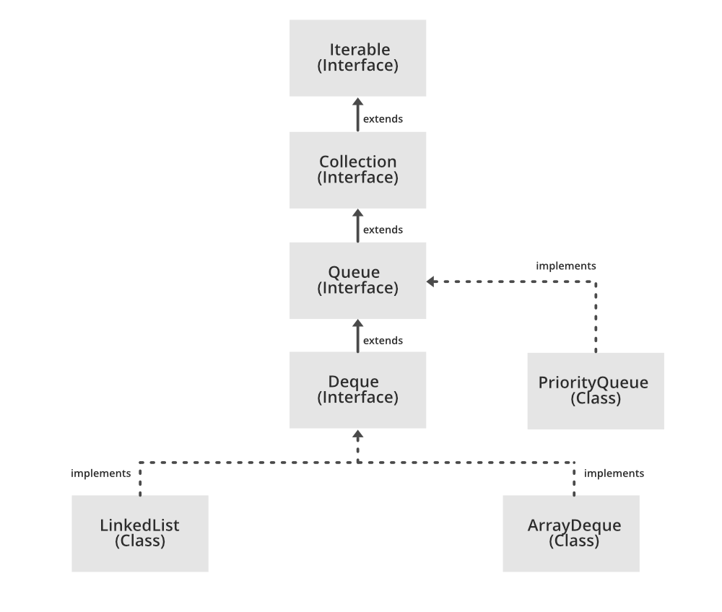
PQ In Java
A PriorityQueue is used when the objects are supposed to be processed based on the priority. It is known that a Queue follows the First-In-First-Out algorithm, but sometimes the elements of the queue are needed to be processed according to the priority, that’s when the PriorityQueue comes into play.
The elements of the priority queue are ordered according to the natural ordering, or by a Comparator provided at queue construction time, depending on which constructor is used.

Slide 5
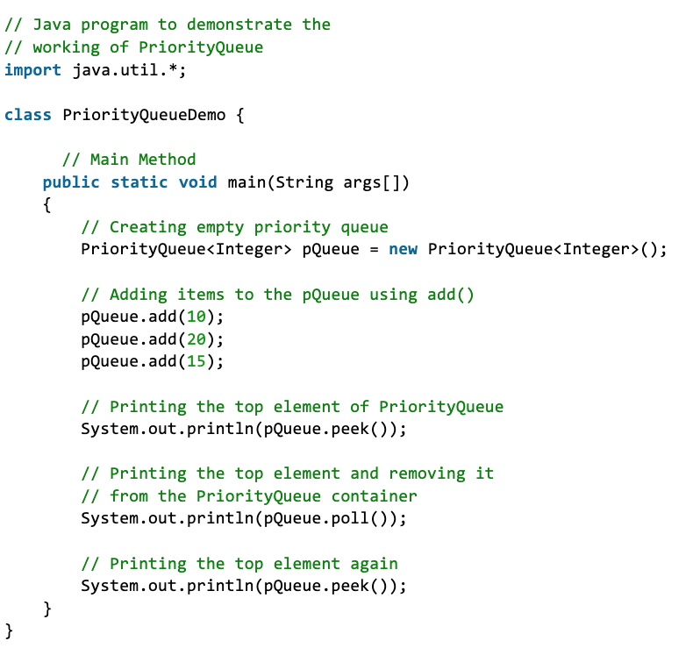
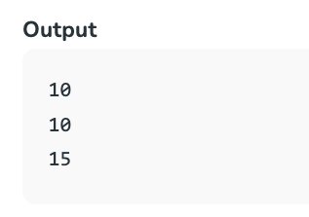
How to Use PQ In Java
PQ: 10 15 20

Slide 6
Total Order Relations
Keys in a priority queue can be arbitrary objects on which an order is defined
Two distinct entries in a priority queue can have the same key
Mathematical concept of total order relation ≤
Comparability property: either x ≤ y or y ≤ x
Antisymmetric property: x ≤ y and y ≤ x ⇒ x = y
Transitive property: x ≤ y and y ≤ z ⇒ x ≤ z
Notes:
In defining the priority queue ADT, we can allow any type of object to serve as a key, but we must be able to compare keys to each other in a meaningful way.

Slide 7
Entry ADT
An entry in a priority queue is simply a key-value pair
Priority queues store entries to allow for efficient insertion and removal based on keys
Methods:
getKey: returns the key for this entry
getValue: returns the value associated with this entry
As a Java interface:
/**
* Interface for a key-value
* pair entry
**/
public interface Entry<K,V> {
K getKey();
V getValue();
}

Slide 8
Comparator ADT
A comparator encapsulates the action of comparing two objects according to a given total order relation
A generic priority queue uses an auxiliary comparator
The comparator is external to the keys being compared
When the priority queue needs to compare two keys, it uses its comparator
Primary method of the Comparator ADT
compare(x, y): returns an integer i such that
i < 0 if x < y,
i = 0 if x = y
i > 0 if x > y
An error occurs if x and y cannot be compared.
Notes:
Although it is quite common for priorities to be expressed numerically, any Java object may be used as a key, as long as there exists means to compare any two instances x and y, in a way that defines a natural order of the keys.
For a general and reusable form of a priority queue, we allow a user to choose any key type and to send an appropriate comparator instance as a parameter to the priority queue constructor. The priority queue will use that comparator anytime it needs to compare two keys to each other.

Slide 9
Example Comparator
Lexicographic comparison of 2-D points:
/** Comparator for 2D points under the standard lexicographic order. */
public class Lexicographic implements Comparator {
int xa, ya, xb, yb;
public int compare(Object a, Object b) throws ClassCastException {
xa = ((Point2D) a).getX();
ya = ((Point2D) a).getY();
xb = ((Point2D) b).getX();
yb = ((Point2D) b).getY();
if (xa != xb)
return (xb - xa);
else
return (yb - ya);
}
}
Point objects:
/** Class representing a point in the plane with integer coordinates */
public class Point2D {
protected int xc, yc; // coordinates
public Point2D(int x, int y) {
xc = x;
yc = y;
}
public int getX() {
return xc;
}
public int getY() {
return yc;
}
}

Slide 10
Example Comparator

Slide 11
Sequence-based Priority Queue
Implementation with an unsorted list
Performance:
insert takes O(1) time since we can insert the item at the beginning or end of the sequence
removeMin and min take O(n) time since we have to traverse the entire sequence to find the smallest key
Implementation with a sorted list
Performance:
insert takes O(n) time since we have to find the place where to insert the item
removeMin and min take O(1) time, since the smallest key is at the beginning
4
5
2
3
1
1
2
3
4
5

Slide 12
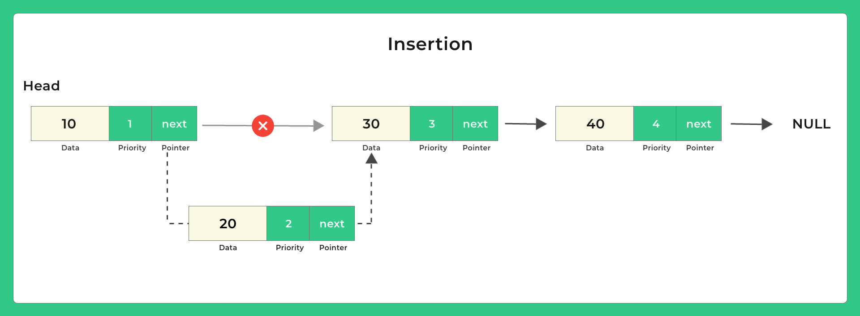
Linked List Implementation
Time Complexity of Insertion: O(n) where n is the size of Linked List.
Time Complexity of Remove: O(1).
Notes:
https://prepinsta.com/c-program/implementation-of-priority-queue-using-linked-list/

Slide 13
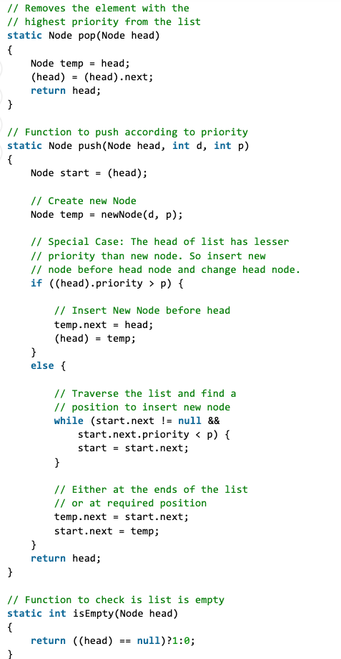
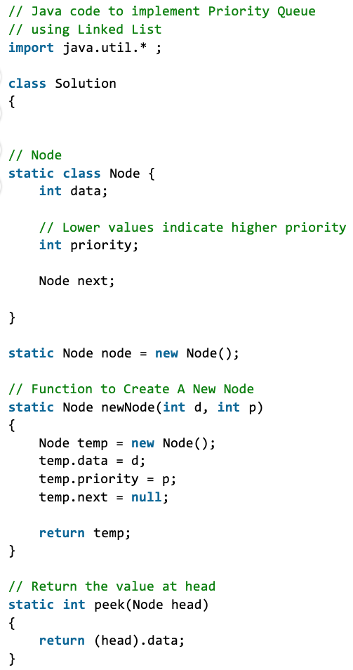
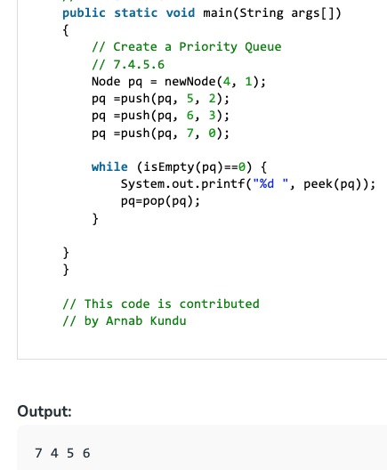
Linked List Implementation
Notes:
https://www.geeksforgeeks.org/priority-queue-using-linked-list/

Slide 14
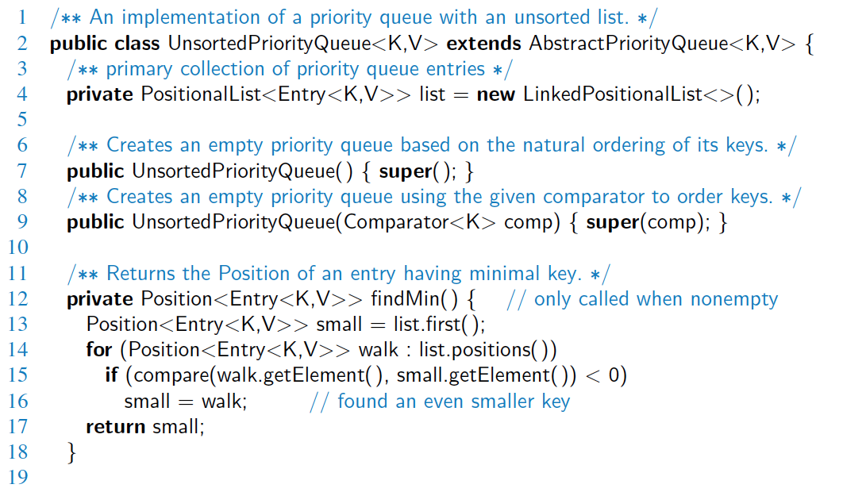
Unsorted List Implementation

Slide 15
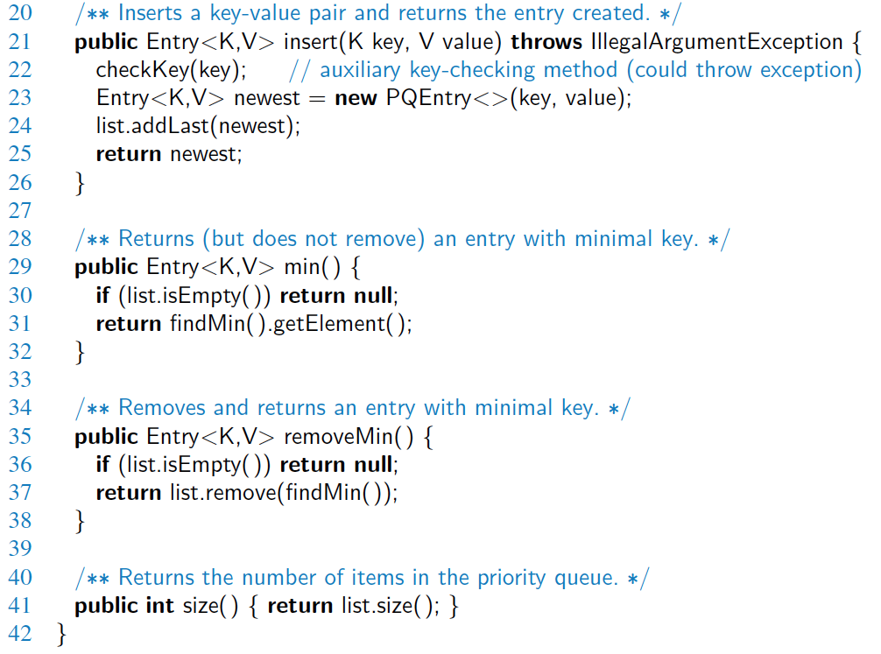
Unsorted List Implementation, 2

Slide 16
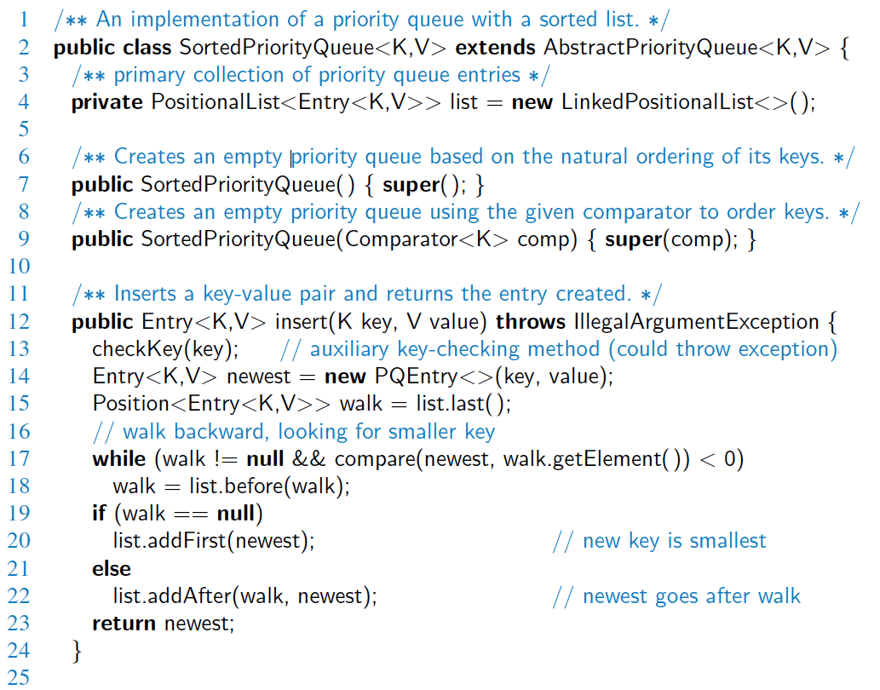
Sorted List Implementation

Slide 17
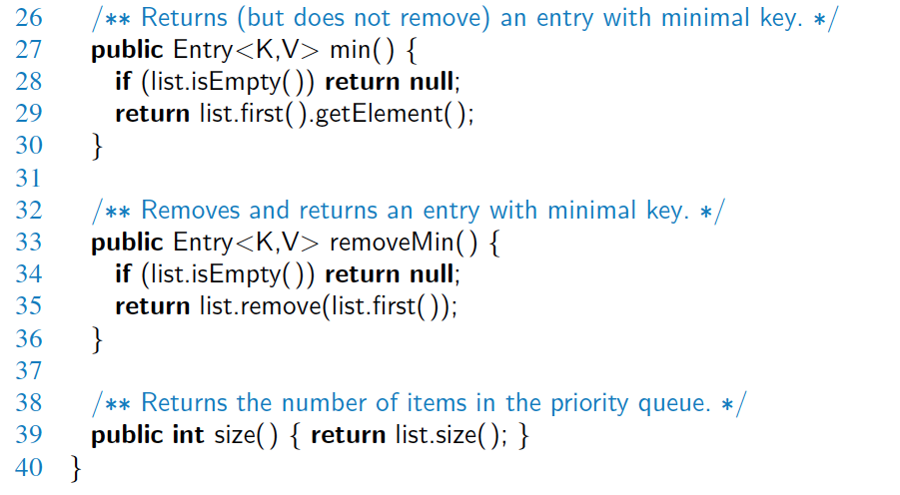
Sorted List Implementation, 2

Slide 18
Priority Queue Sorting
We can use a priority queue to sort a list of comparable elements
Insert the elements one by one with a series of insert operations
Remove the elements in sorted order with a series of removeMin operations
The running time of this sorting method depends on the priority queue implementation
Algorithm PQ-Sort(S, C)
Input list S, comparator C for the elements of S
Output list S sorted in increasing order according to C
P ← priority queue with comparator C
while ¬S.isEmpty ()
e ← S.remove(S.first ())
P.insert (e, ∅)
while ¬P.isEmpty()
e ← P.removeMin()
S.addLast(e)

Slide 19
Selection-Sort
Selection-sort is the variation of PQ-sort where the priority queue is implemented with an unsorted sequence
Running time of Selection-sort:
Inserting the elements into the priority queue with n insert operations takes O(n) time
Removing the elements in sorted order from the priority queue with n removeMin operations takes time proportional to n + n + …+ n
Selection-sort runs in O(n²) time

Slide 20
Selection-Sort Example
Sequence S Priority Queue P
Input: (7,4,8,2,5,3,9) ()
Phase 1
(a) (4,8,2,5,3,9) (7)
(b) (8,2,5,3,9) (7,4)
.. .. ..
(g) () (7,4,8,2,5,3,9)
Phase 2
(a) (2) (7,4,8,5,3,9)
(b) (2,3) (7,4,8,5,9)
(c) (2,3,4) (7,8,5,9)
(d) (2,3,4,5) (7,8,9)
(e) (2,3,4,5,7) (8,9)
(f) (2,3,4,5,7,8) (9)
(g) (2,3,4,5,7,8,9) ()

Slide 21
Insertion-Sort
Insertion-sort is the variation of PQ-sort where the priority queue is implemented with a sorted sequence
Running time of Insertion-sort:
Inserting the elements into the priority queue with n insert operations takes time proportional to
n + n + …+ n
Removing the elements in sorted order from the priority queue with a series of n removeMin operations takes O(n) time
Insertion-sort runs in O(n²) time

Slide 22
Insertion-Sort Example
Sequence S Priority queue P
Input: (7,4,8,2,5,3,9) ()
Phase 1
(a) (4,8,2,5,3,9) (7)
(b) (8,2,5,3,9) (4,7)
(c) (2,5,3,9) (4,7,8)
(d) (5,3,9) (2,4,7,8)
(e) (3,9) (2,4,5,7,8)
(f) (9) (2,3,4,5,7,8)
(g) () (2,3,4,5,7,8,9)
Phase 2
(a) (2) (3,4,5,7,8,9)
(b) (2,3) (4,5,7,8,9)
.. .. ..
(g) (2,3,4,5,7,8,9) ()

Slide 23
In-place Insertion-Sort
Instead of using an external data structure, we can implement selection-sort and insertion-sort in-place
A portion of the input sequence itself serves as the priority queue
For in-place insertion-sort
We keep sorted the initial portion of the sequence
We can use swaps instead of modifying the sequence
5
4
2
3
1
5
4
2
3
1
4
5
2
3
1
2
4
5
3
1
2
3
4
5
1
1
2
3
4
5
1
2
3
4
5

